Slide 1



Open Data Science and AI
Dr. Rahul Ramachandran
Manager | Inter-Agency Implementation and Advanced Concepts Team (IMPACT)
Senior Research Scientist | Earth Science Branch (ST11)
Marshall Space Flight Center/NASA
Huntsville, Alabama 35812, USA

Slide 2
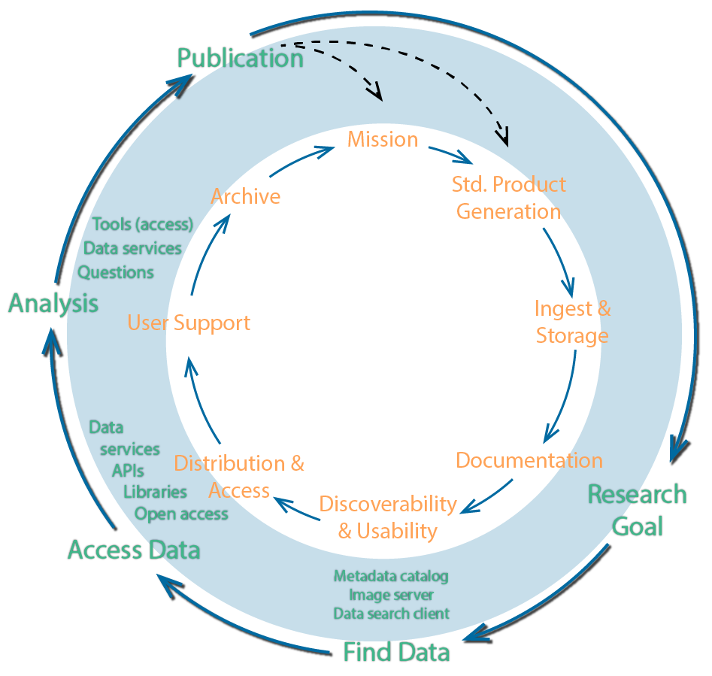

Role of AI in the Knowledge Life Cycle
Potential Applications/Implications:
Improved data discovery capabilities
Knowledge discovery
  Automated data/Infomation curation and semantic aggregation
Analysis (Knowledge Extraction)
Enable new means of extracting new information and knowledge from data

Slide 3
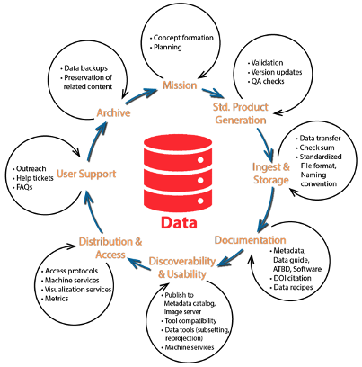
Role of AI in the Data Life Cycle
Potential Applications:
Automate and improve data quality checks
Optimize compute costs
Augment metadata and document generation
Optimize storage strategies for improved access while reducing costs
Automated user desk support
Implications:
Data storage structures optimized for ML
Cataloging ML models, code, training data
Improve overall efficiency, quality of data and metadata while reducing cost of data production

Slide 4
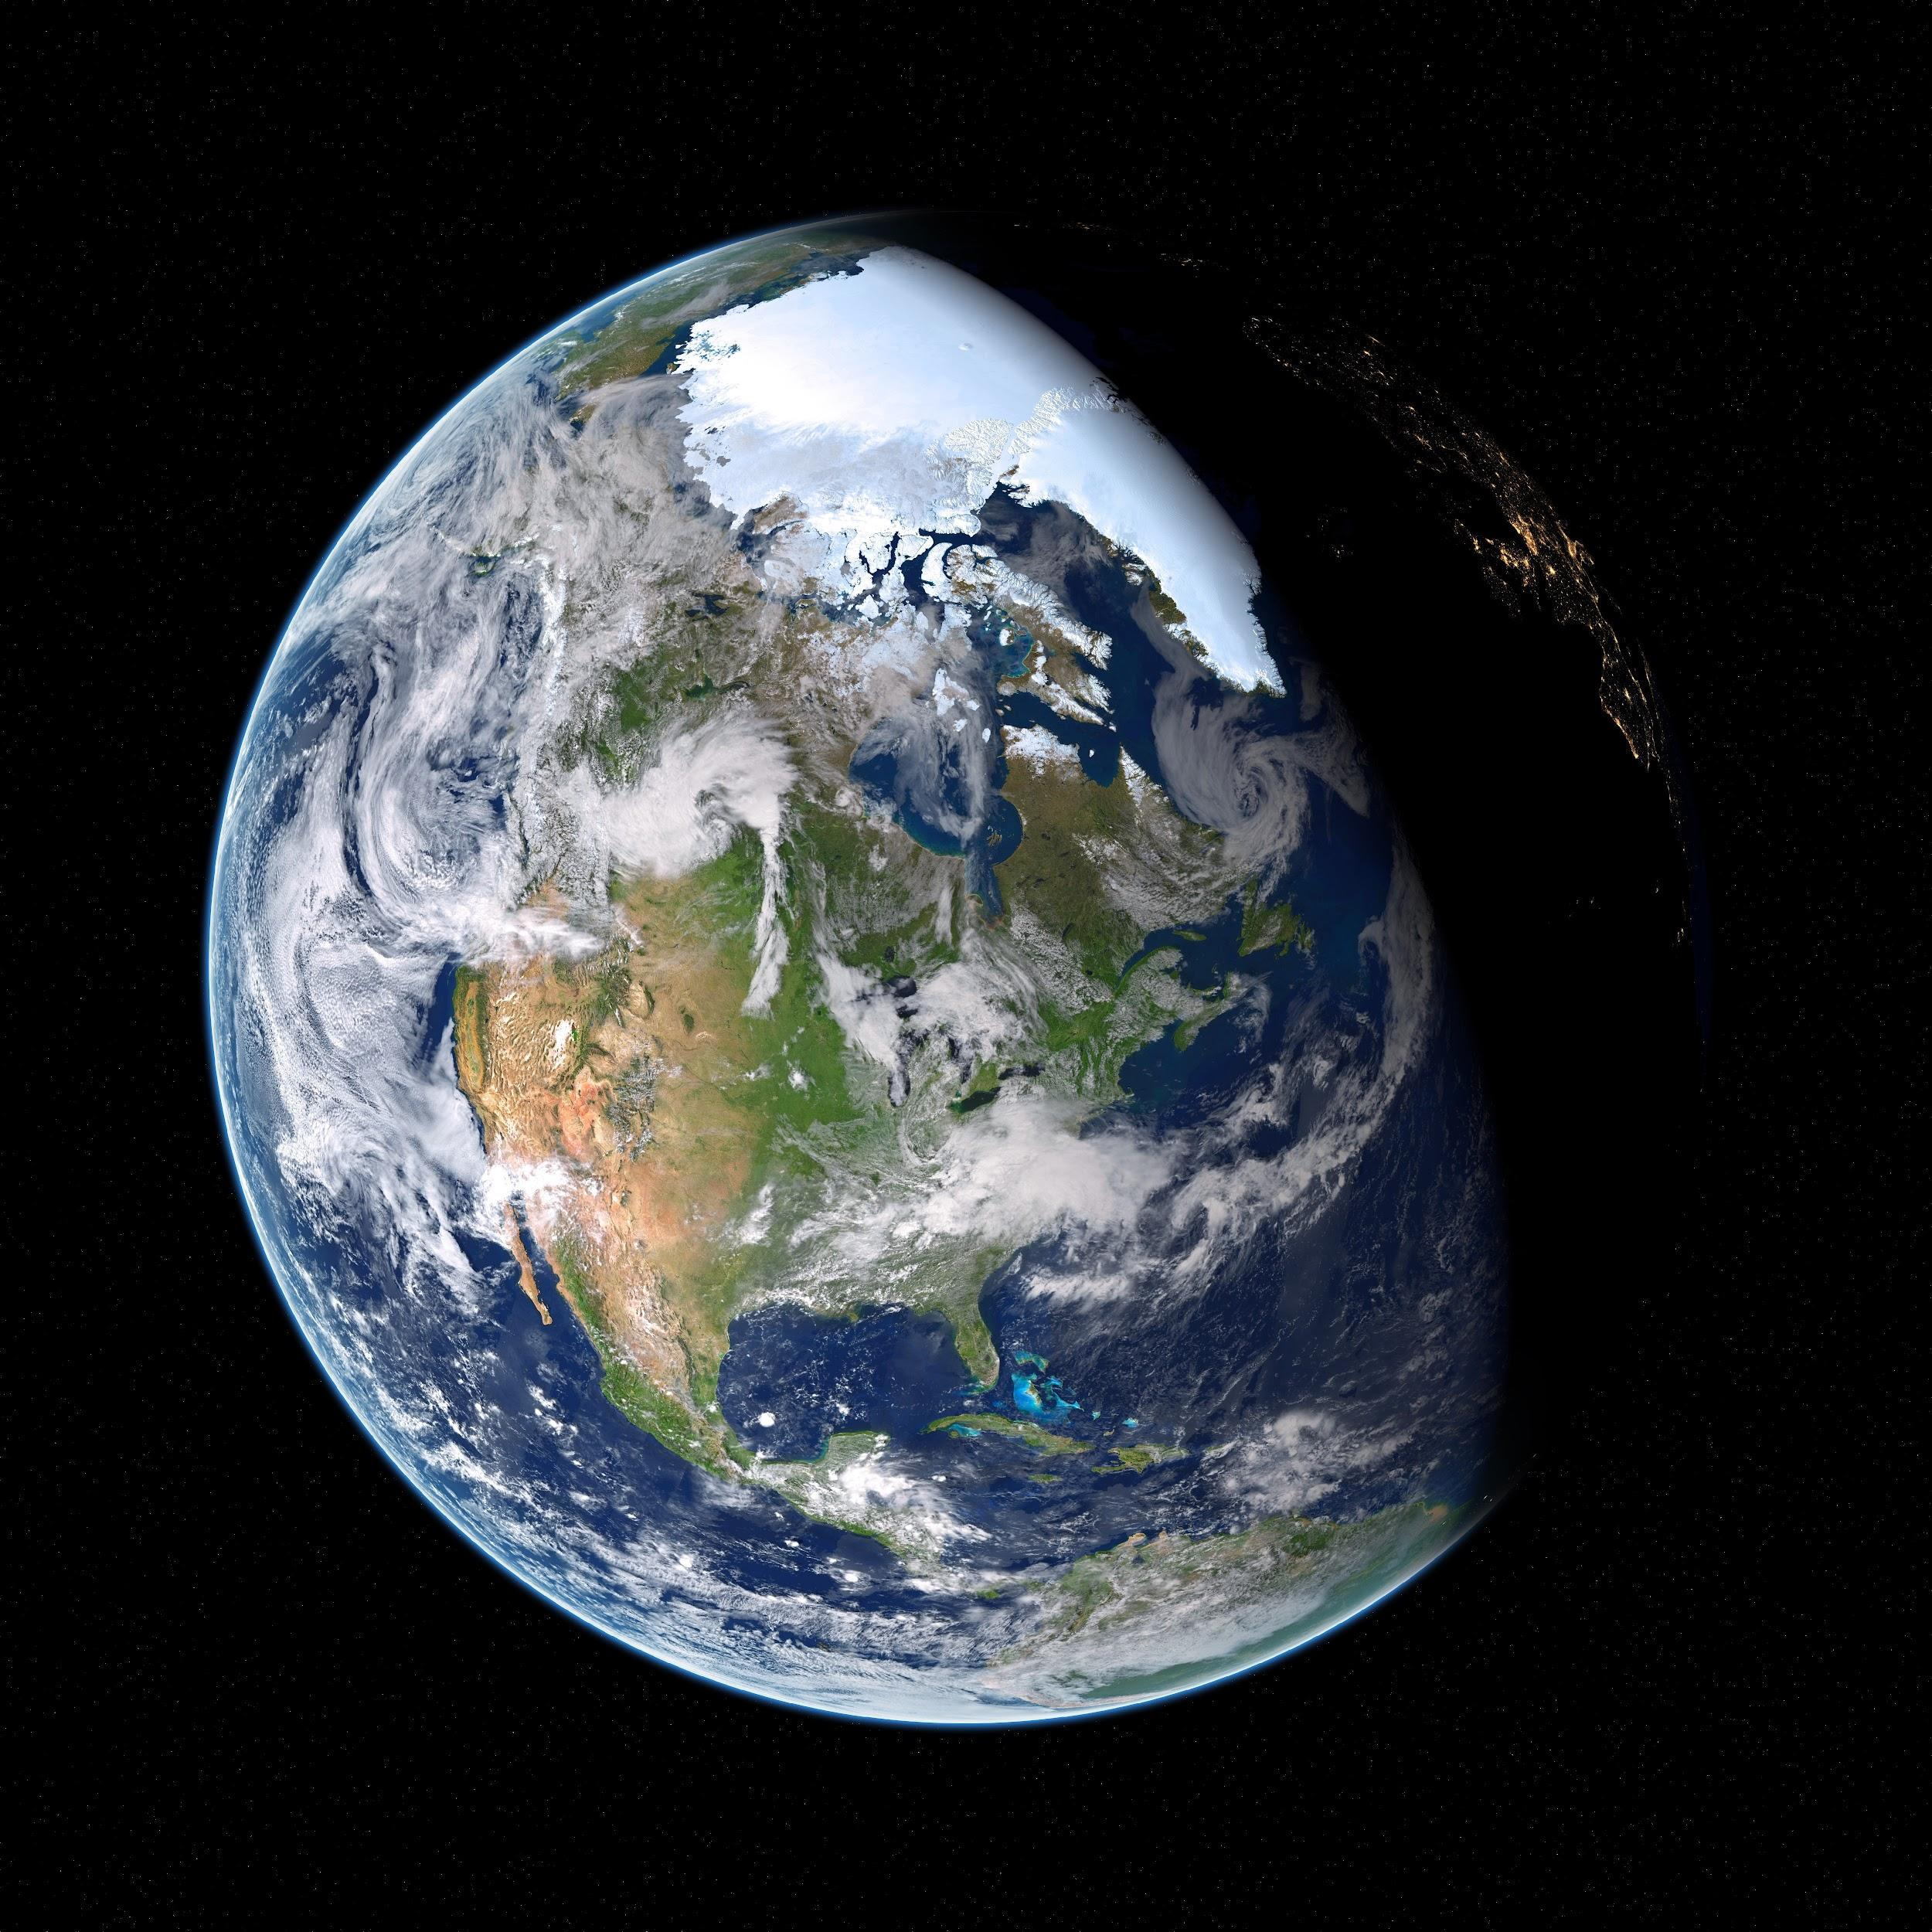
Open Science Definition(s)
Open science definitions
Open science is the idea that scientific knowledge of all kinds be openly shared as early as it is practical in the discovery process (Narrow)
Open science can be defined as any activity that covers anything about the future of knowledge creation and dissemination (Broad)
“open science as a collaborative culture enabled by technology that empowers the open sharing of data, information, and knowledge within the scientific community and the wider public to accelerate scientific research and understanding”
- Ramachandran, R., Bugbee, K., & Murphy, K. J. (Accepted 2021). Moving from Open Data to Open Science. Earth and Space Science, Wiley Publication (https://agupubs.onlinelibrary.wiley.com/doi/10.1029/2020EA001562)
https://www.pexels.com/photo/astronomy-cosmic-cosmos-dark-355935/

Slide 5
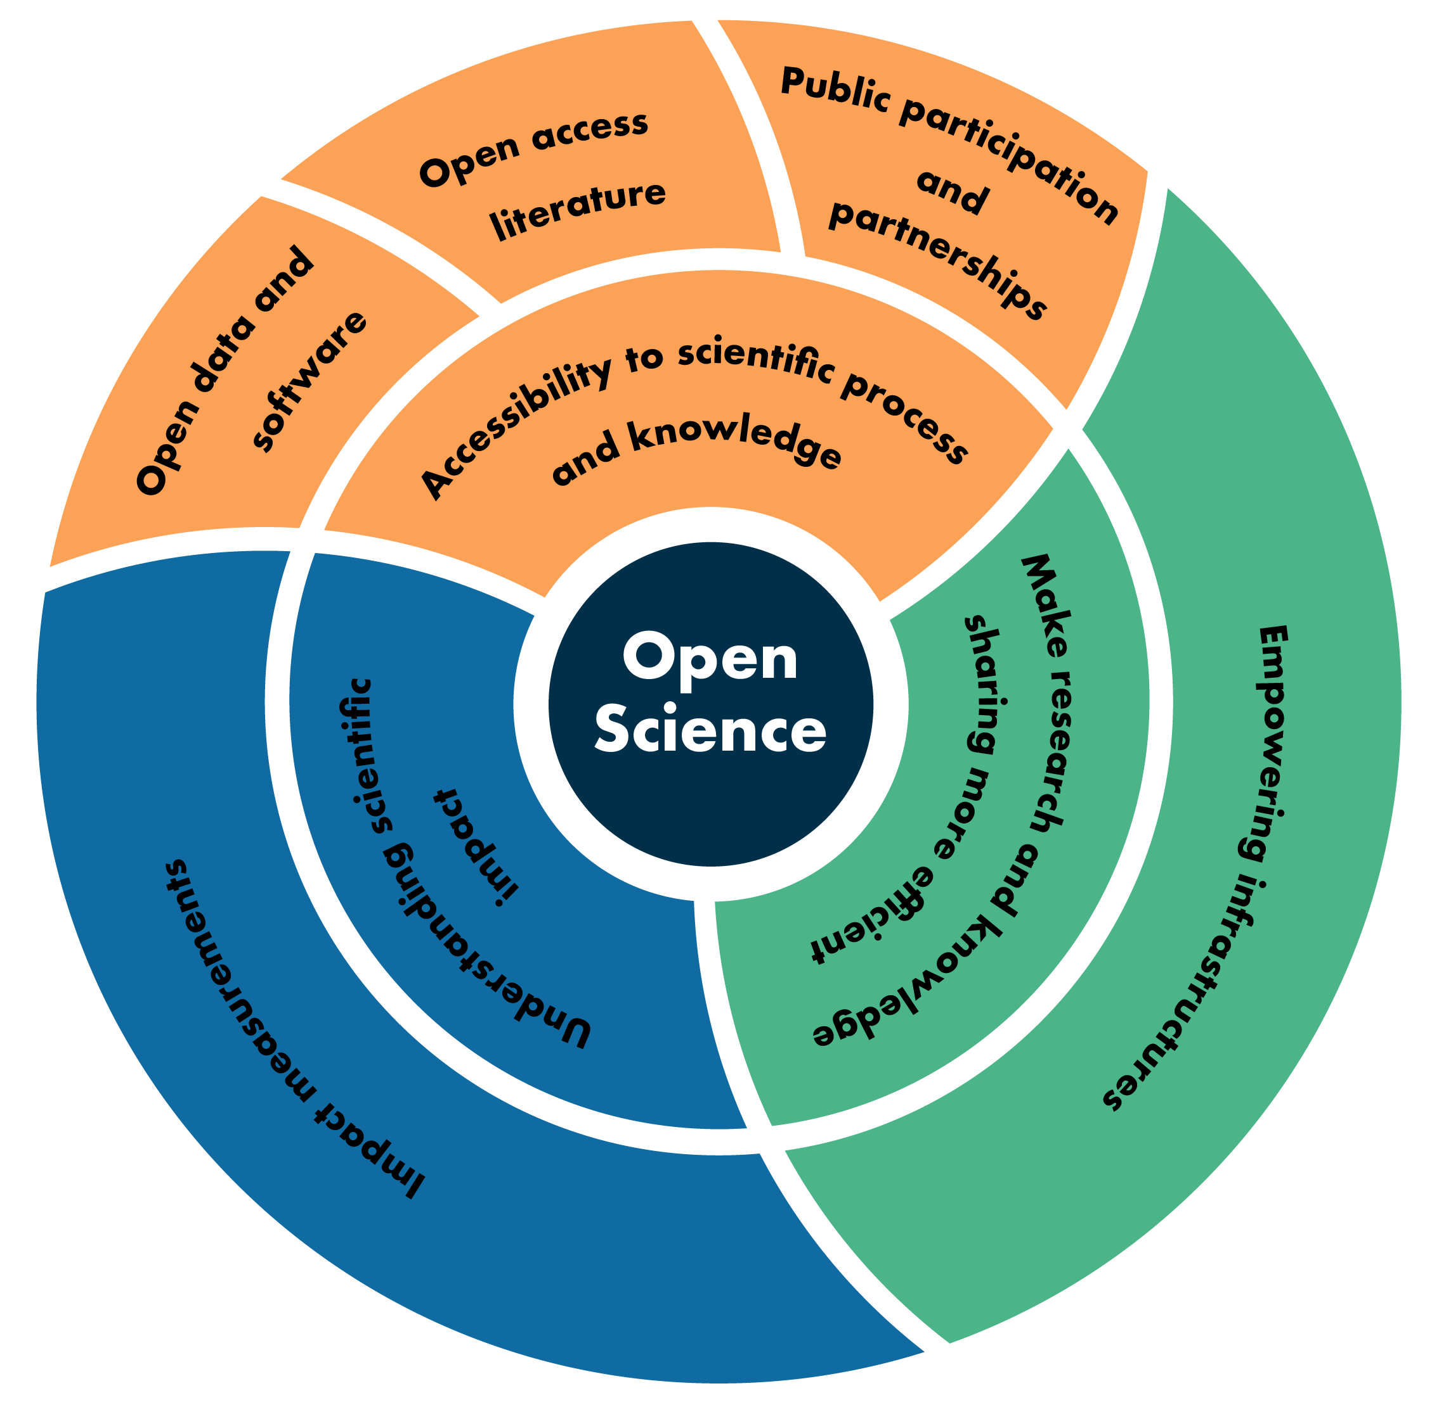
Open Science Areas
Accessibility to Science
Science as a way of thinking
  Participation of non-scientists and amateurs in research
  Enabling broader comprehension of research results
Science as a body of knowledge
  Open data, open source software and open access literature (Gold/Green)
Efficient research processes and knowledge dissemination
  Cyberinfrastructure to support science
  Free a researcher from the constraints of limited local resources
  Abstract away the data management, wrangling and scaling complexity
  Collaborations
  Facilitate the management and sharing of research objects, support actionable research
Understanding Scientific Impact

Slide 6
Focus
Accessibility to Science
Science as a way of thinking
  Participation of non-scientists and amateurs in research
  Enabling broader comprehension of research results
Science as a body of knowledge
  Open data, open source software and open access literature (Gold/Green)
Efficient research processes and knowledge dissemination
  Cyberinfrastructure to support science
  Free a researcher from the constraints of limited local resources
  Abstract away the data management, wrangling and scaling complexity
  Collaborations
  Facilitate the management and sharing of research objects, support actionable research
Understanding Scientific Impact
Open Participation
Accessibility Reproducibility

Slide 7
Open Participation
Creation and Sharing training datasets
  Ex: https://mlhub.earth/data/nasa_tropical_storm_competition
Model Development
  Community Challenge
    FDL Challenge, SpaceML
  Competitions - Open platforms allow this
    https://competitions.codalab.org/competitions/30440
    https://www.drivendata.org/competitions/72/predict-wind-speeds/
Evaluation - Open platforms usually allow objective evaluation
  https://competitions.codalab.org/
  http://bbochallenge.com/
  https://competitions.codalab.org/

Slide 8
ML/AI Application - Team Sport
Data Engineers
ML
Engineers
Subject
Matter
Experts

Slide 9
Idealized ML Process
FORMULATE PROBLEM
CURATE DATA
FEATURE ENGINEERING
PREPARATORY PHASE
ALGORITHM
SELECTION
MODEL TRAINING
REFINE
MODEL
MODEL BUILDING & TRAINING
MODEL DEPLOYMENT
& TESTING
MODEL DEPLOYMENT
INFERENCE
*attributions: Dr. Manil Maskey, Iksha Gurung and M. Ramasubramanian
Notes:
Roles:
Subject Matter Experts
Curation potential sources of data especially ‘labelled’ data
Landscape analysis for the application (background research)
Validation Strategy
Data Engineering
Feature engineering - creating ‘labelled’ data sets
Optimizing primary data for AI/ML libraries
Shareable Research Artifacts:
Feature engineering code
Mechanism for sharing: Github
Training Data
Mechanism for sharing: community accepted approaches do not exist though
RadiantEarth ML Hub is a start, AWS OpenData Programs
Datasets available through pytorch datasets and tensorflow datasets. (eg: TorchGeo from microsoft (https://github.com/microsoft/torchgeo))
Individual responsible for hosting and need to register the data

Slide 10
PREPARATORY PHASE
ROLES
Subject Matter Expert (SME)
Curation potential sources of data especially ‘labelled’ data
Landscape analysis
Validation Strategy
Data Engineer
Feature engineering - creating ‘labelled’ data sets
Optimizing primary data for AI/ML libraries
ML PROCESS ARTIFACTS
Feature engineering code (Github)
Training Data (community accepted approaches do not exist)
  RadiantEarth ML Hub, AWS OpenData Programs
  Datasets available through pytorch datasets and tensorflow
FORMULATE PROBLEM
CURATE DATA
FEATURE ENGINEERING
PREPARATORY PHASE
PROCESS KNOWLEDGE
Curation criteria (authoritative data such as HURDAT, NHC best track)
Data transformation rationale
Data munging rationale
Data Labeling process and tools
[Notebooks, Github (Repos, Wiki pages)]
Notes:
Roles:
Subject Matter Experts
Curation potential sources of data especially ‘labelled’ data
Landscape analysis for the application (background research)
Validation Strategy
Data Engineering
Feature engineering - creating ‘labelled’ data sets
Optimizing primary data for AI/ML libraries
Shareable Research Artifacts:
Feature engineering code
Mechanism for sharing: Github
Training Data
Mechanism for sharing: community accepted approaches do not exist though
RadiantEarth ML Hub is a start, AWS OpenData Programs
Datasets available through pytorch datasets and tensorflow datasets. (eg: TorchGeo from microsoft (https://github.com/microsoft/torchgeo))
Individual responsible for hosting and need to register the data

Slide 11
MODEL BUILDING &
TRAINING
ROLES
ML Engineer
Algorithm and Library assessment for the problem being solved
ML Model Development
SME
Validation & Assessment
ML PROCESS ARTIFACTS
ML Models
  Model Zoos such as Huggingface
ALGORITHM
SELECTION
MODEL TRAINING
REFINE
MODEL
MODEL BUILDING & TRAINING
PROCESS KNOWLEDGE
Choice of ML Library
Choice of Algorithm
Validation Assessment
Benchmark comparisons (bias / variance checks)
Model retraining
  Capture iterations in GitHub Repos
  Model training metrics accessible [wandb (example) and comet.ai.]
Capture final model design [conference/papers]
Notes:
Roles:
Subject Matter Experts
Curation potential sources of data especially ‘labelled’ data
Landscape analysis for the application (background research)
Validation Strategy
Data Engineering
Feature engineering - creating ‘labelled’ data sets
Optimizing primary data for AI/ML libraries
Shareable Research Artifacts:
Feature engineering code
Mechanism for sharing: Github
Training Data
Mechanism for sharing: community accepted approaches do not exist though
RadiantEarth ML Hub is a start, AWS OpenData Programs
Datasets available through pytorch datasets and tensorflow datasets. (eg: TorchGeo from microsoft (https://github.com/microsoft/torchgeo))
Individual responsible for hosting and need to register the data

Slide 12
MODEL DEPLOYMENT
& TESTING
ROLES
SME
Periodic validation of results
ML Engineer
Model versioning and deployment
Back-testing
  Testing model changes on historical data
Run current production model to baseline performance
Run new models, competing for production
Now-testing
  Testing of production model on latest data
  Model drift - check if model may be faltering?
ML PROCESS ARTIFACTS
Repeatable deployment pipeline
  [Dropping the model in the known location]
Periodic Performance Evaluation Metrics/Approach
  [Model Zoos, GitHub, Docker Images]
MODEL DEPLOYMENT
& TESTING
MODEL DEPLOYMENT
INFERENCE
PROCESS KNOWLEDGE
Evaluation and assessment in real world operation?
Deployment strategy, tools (docker, CDK, CLI , etc.)
[GitHub Wiki/Pages/Issues or Paper]
Notes:
Roles:
Subject Matter Experts
Curation potential sources of data especially ‘labelled’ data
Landscape analysis for the application (background research)
Validation Strategy
Data Engineering
Feature engineering - creating ‘labelled’ data sets
Optimizing primary data for AI/ML libraries
Shareable Research Artifacts:
Feature engineering code
Mechanism for sharing: Github
Training Data
Mechanism for sharing: community accepted approaches do not exist though
RadiantEarth ML Hub is a start, AWS OpenData Programs
Datasets available through pytorch datasets and tensorflow datasets. (eg: TorchGeo from microsoft (https://github.com/microsoft/torchgeo))
Individual responsible for hosting and need to register the data

Slide 13
Key Takeaway
Sprawl of information - both process artifacts and knowledge stored in adhoc and not in a systematic manner
Ensure to turn implicit knowledge into explicit knowledge
Opportunity to reshape AI science applications using Open Science principles
Seeking approaches to open participation
  Build on foundational work coming out of citizen science projects to label data and include more participation [you can decide to include or not]
Ensuring that both research artifacts and processes are captured in a systematic manner for reproducibility and reuse
  Developing some community guidelines for
    Capturing both research artifacts and implicit knowledge
    Allow community comment and review

