Slide 1
Deductive agents
Madalina Croitoru
University of Montpellier

Slide 2

Based on “An Introduction to MultiAgent Systems” by Michael Wooldridge, John Wiley & Sons, 2002. http://www.csc.liv.ac.uk/˜mjw/pubs/imas/

Slide 3
Agent Architectures
An agent is a computer system capable of flexible autonomous action…
Issues one needs to address in order to build agent-based systems…
Three types of agent architecture:
symbolic/logical
reactive
hybrid

Slide 4
Agent Architectures
Originally (1956-1985), pretty much all agents designed within AI were symbolic reasoning agents
Problems with symbolic reasoning led to a reaction against this — the so-called reactive agents movement, 1985–present
From 1990-present, a number of alternatives proposed: hybrid architectures, which attempt to combine the best of reasoning and reactive architectures

Slide 5
Symbolic Reasoning Agents
The classical approach to building agents is to view them as a particular type of knowledge-based system
This paradigm is known as symbolic AI
We define a deliberative agent or agent architecture to be one that:
contains an explicitly represented, symbolic model of the world
makes decisions (for example about what actions to perform) via symbolic reasoning

Slide 6
Symbolic Reasoning Agents
Two key (yet unsolved) problems to be solved:
The transduction problem: that of translating the real world into an accurate, adequate symbolic description, in time for that description to be useful…vision, speech understanding, learning
The representation/reasoning problem: how to symbolically represent information about complex real-world entities and processes, and how to get agents to reason with this information in time for the results to be useful…knowledge representation, automated reasoning, automatic planning

Slide 7
Deductive Reasoning Agents
How can an agent decide what to do using theorem proving?
Basic idea is to use logic to encode a theory stating the best action to perform in any given situation
Let:
ρ be this theory (typically a set of rules)
Δ be a logical database that describes the current state of the world
Ac be the set of actions the agent can perform
Δ |_{ρ}φ mean that φ can be proved from Δ using ρ

Slide 8
Deductive Reasoning Agents
/* try to find an action explicitly prescribed */
for each a ∈ Ac do
if Δ |_{ρ} Do(a) then
return a
end-if
end-for
/* try to find an action not excluded */
for each a ∈ Ac do
if Δ |_{ρ} ¬Do(a) then
return a
end-if
end-for
return null /* no action found */

Slide 9
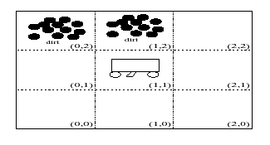
Deductive Reasoning Agents
An example: The Vacuum World
Goal is for the robot to clear up all dirt

Slide 10
Deductive Reasoning Agents
Use 3 domain predicates to solve problem:
In(x, y) agent is at (x, y)
Dirt(x, y) there is dirt at (x, y)
Facing(d) the agent is facing direction d
Possible actions:
Ac = {turn, forward, suck}
P.S. turn means “turn right”

Slide 11
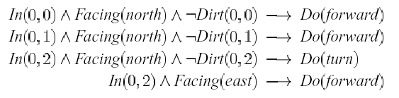
Deductive Reasoning Agents
Rules ρ for determining what to do:
…and so on!
Using these rules (+ other obvious ones), starting at (0, 0) the robot will clear up dirt

Slide 12
Deductive Reasoning Agents
Problems:
How to convert video camera input to Dirt(0, 1)?
Decision making assumes a static environment: calculative rationality
Even where we use propositional logic, decision making in the worst case means solving co-NP-complete problems (PS: co-NP-complete = bad news!)
Typical solutions:
weaken the logic
use symbolic, non-logical representations
shift the emphasis of reasoning from run time to design time

Slide 13
Exercise for this week
Choose one scenario from last week homework
Try to implement it using a symbolic approach using the imperative programming language of your choice
What problems do you see combining imperative programming and deductive agents?
(Optional) Try and implement the same scenario using Prolog. Is this solution easier than the imperative programming one?

