Slide 1


T5 Final_Project
MICROSOFT MALWARE PREDICTION
By Noha Abdulwahab Zamaan– Nov 16, 2021

Slide 2
Presentation Outline:
1. Define problem
2. Discover the data
6. Results &Conclusion
3. Cleansing & EDA
5. Modeling
4. Deal with features

Slide 3
Define Problem
Industries of malware and hacking are very powerful and growth
large global companies like Microsoft work hard to defense their customer from any attack.
Microsoft provides its dataset on Kaggle to challenge the data scientist to apply various machine learning models to predict malware before occurring.

Slide 4
Discover The Data
Big Data
8921482 rows ------>
10000. rows
82 columns , 10 null
01
Supervise Model
It contains the target ‘HasDetections’
02
The dataset
Classification Data
The target values 1 or 0
03

Slide 5



Cleansing & EDA
01
Divide features
Categorical and numerical features
plot histogram for numerical features
04
02
Full null values
Numerical features: replace -> ‘median’
Categorical features: replace -> ‘0’
03
Covert categorical features
Use ‘get dummy’ function to make all features numerical
Heatmap
Create two ‘heatmap’ to make sure no null in the dataset

Slide 6
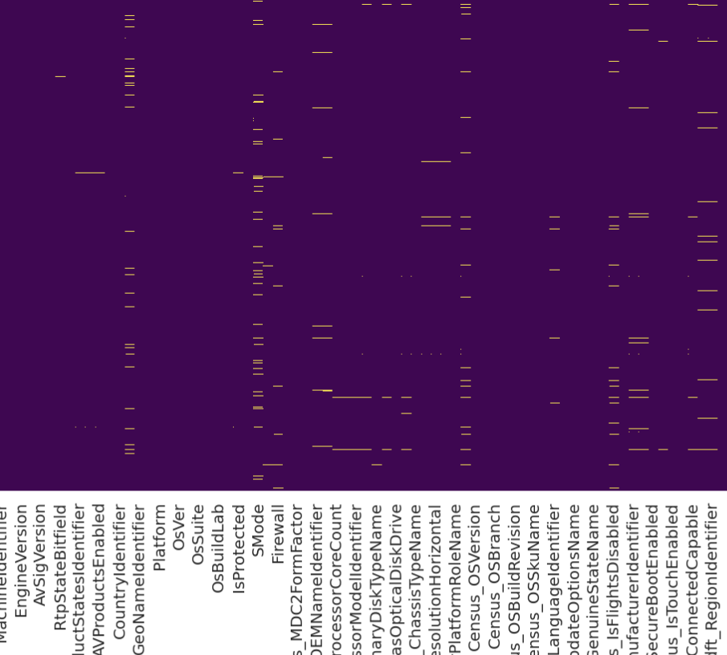

Cleansing the Data
Data before
Data After
Contains a lot of nulls .
Clear means no null value

Slide 7
Dealing With Features
ExtraTreesClassifier() Model
‘.feature_importances_’
Feature_importances_
1
Feature_selection
‘SelectKBest()’
Best_features
2
RandomForestRegressor
‘.feature_importances_’
Random_Forest
3
Decomposition
PCA(n_components=6)
Principal Component Analysis
4

Slide 8
Modeling
1- Logistic
Regression
Feature_importances_ = 54%
SelectKBest = 59.6%
Random_Forest = 56.2%
2- Kneighbors
Classifier
SelectKBest = 58.1%
Random_Forest = 57.8%
3- Random Forest Classifier
SelectKBest = 59.6%
Random_Forest = 60.5%
PCA = 54%
4-Neural_Network
SelectKBest = 58.1%

Slide 9
Modeling
Random Forest
Test score: 0.60.
SelectKBest
Test score: 0.596
SelectKBest
Test score: 0.592
1- Random Forest Classifier
2- Logistic Regression
SelectKBest
Test score: 0.581
4- Neural Network
3- Kneighbors Classifier

Slide 10
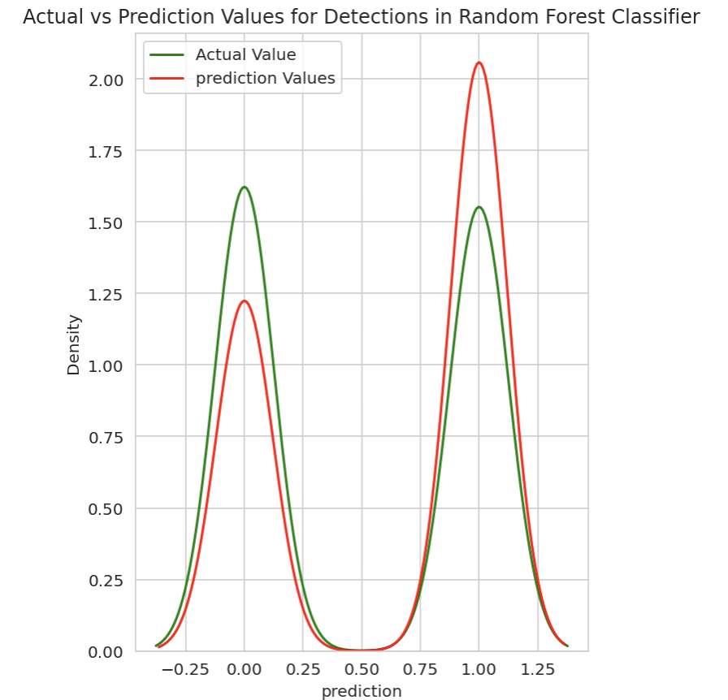
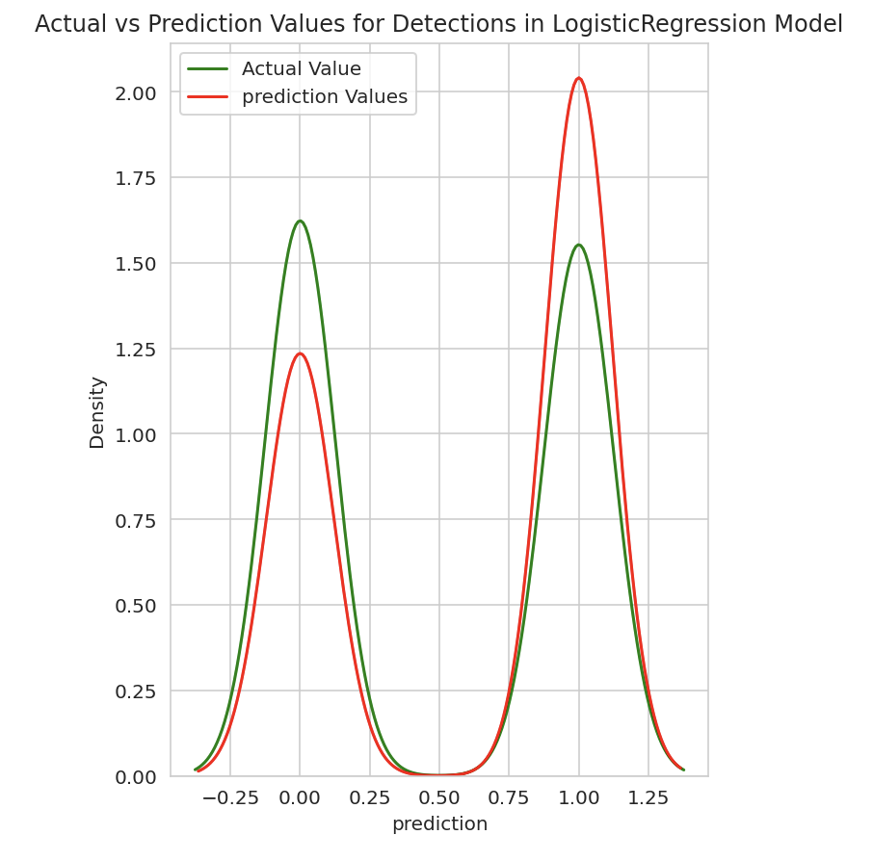
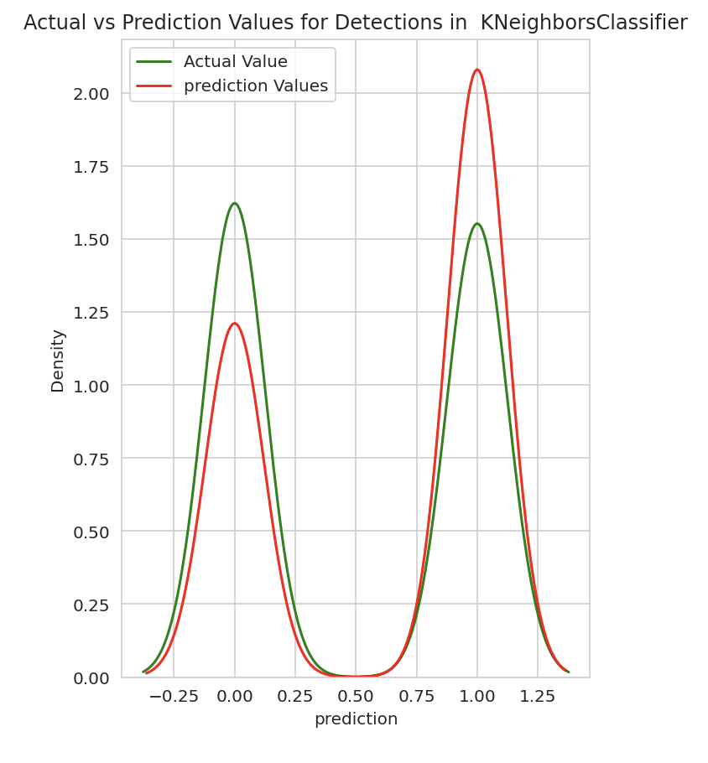
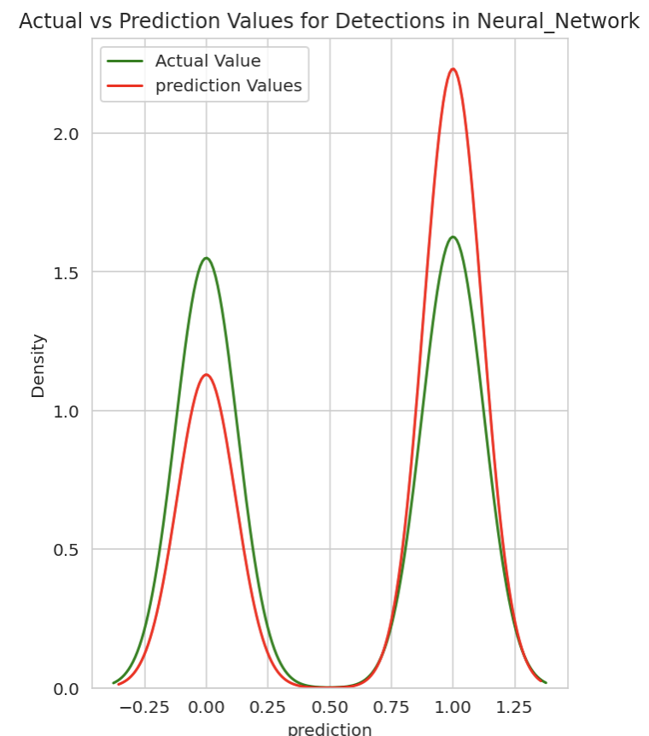
Modeling
Random Forest Classifier
Logistic
Regression
Kneighbors
Classifier
Neural Network

Slide 11

Results and Conclusion
Prediction
Some problems are still hard to predict their solution for them even though they have features.
04
Features
03
Still, the score isn’t good. Maybe it needs other features that have more correlation with the target.
Features
TheFeature_selection with ‘SelectKBest()’ function can be the best method to do a filtering on huge features.
02
ML Model
Random Forest was the best model performance with Scaling and GridSearch methods
01

Slide 12
THANK YOU
Welcome You To Any Question.

Slide 13
Refrences:
https://medium.com/@erikgreenj/k-neighbors-classifier-with-gridsearchcv-basics-3c445ddeb657
http://powerpoint.sage-fox.com/hacker-stealing-data-ppt-3/
https://towardsdatascience.com/random-forest-ca80e56224c1
https://medium.com/@amrianto.saragih/4-methods-to-boost-the-accuracy-of-a-neural-network-model-bb694e650a69
https://towardsdatascience.com/pca-using-python-scikit-learn-e653f8989e60
https://towardsdatascience.com/machine-learning-step-by-step-6fbde95c455a

