Slide 1
Linux Fundamentals
What you need to know

Slide 2
Key Topics:
Linux Overview
Why should I care ?
Shell
GUI vs Shell
Commands
Before I use section
Fun exercise
How to get Linux ?

Slide 3
What is Linux?
Notes:
Legitimate question.

Slide 4
Linux is:
An open source kernel (Based on UNIX) created by Linus Torvalds and was released in 1991.
Free, *reliable*, fast and easy to use are just some words commonly associated with the Linux kernel.
IMPORTANT : “Linux” is the kernel itself, not the operating system as a whole.

Slide 5
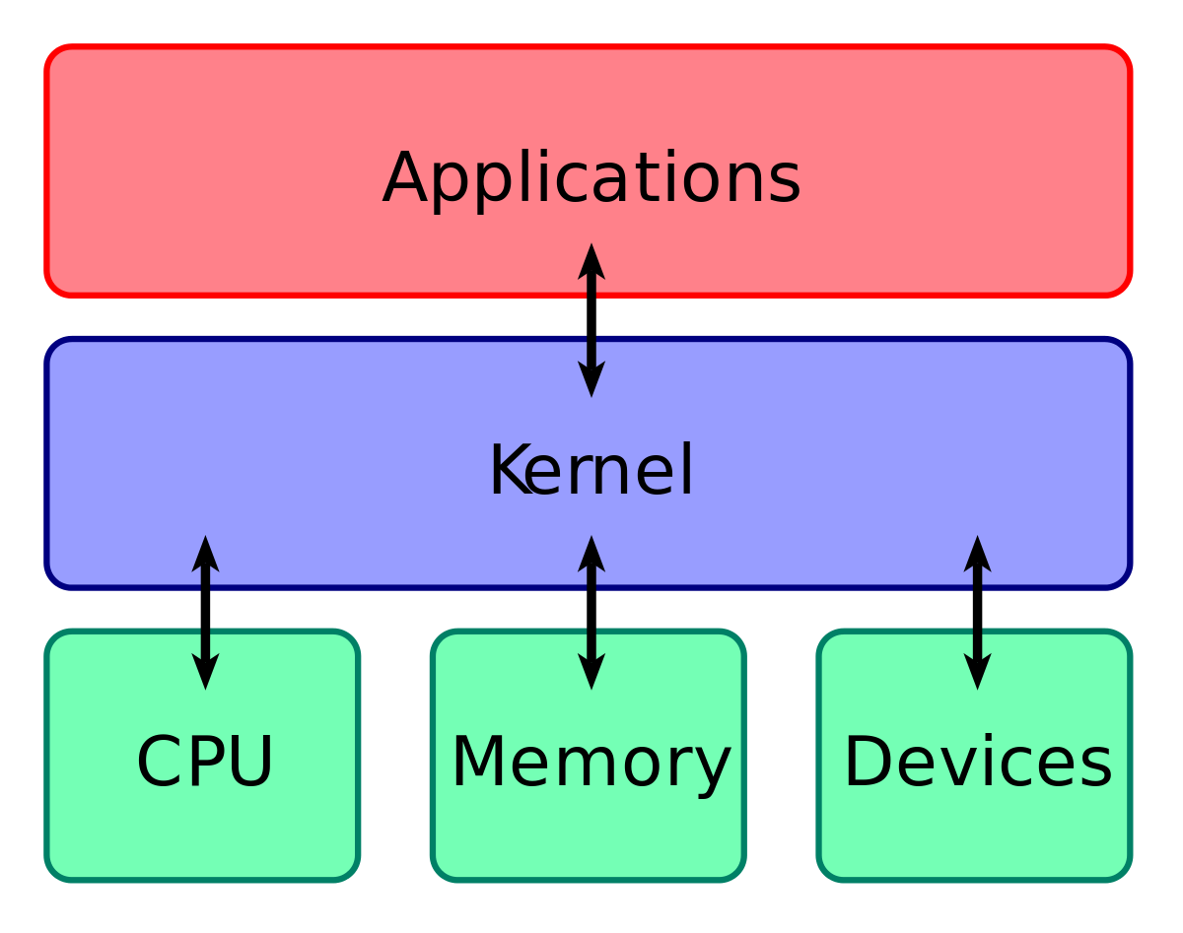
Notes:
https://en.wikipedia.org/wiki/Kernel_(operating_system)

Slide 6
Why should I care?
It’s used everywhere!
It’s free.
Examples:
Servers
Mainframes
Computers
Embedded Systems
Notes:
Q: What are embedded systems? used in cars where guis etc arent needed and the same function is needed RELIABLY
A: Phones Tablets PDA’s (Android made with subsidiary of Linux)

Slide 7
What OS’s use Linux?
Lots…
Arch Linux, CentOS, Debian, Raspbian, Fedora, Ubuntu and OpenSuse.
Since all of these distro’s use the Linux kernel…
Everything you learn here today is applicable to any of these.

Slide 8
Shell
What is a shell?
In simple terms, It’s a programmers way of directly interacting with the operating system.
The shell takes commands from us (the user) and passes them to the operating system to perform
Notes:
Q:How can you interact? A: Commands
Q: Can’t I just use GUI? A: You can but you won’t get very far.

Slide 9
GUI vs Shell
Notes:
Talking point.
Gui easier to learn but can only take you so far, CLI lets us go that extra mile.
Gui is "safe" and has rules in place; but safe is boring and rules are restricting.
CLI is faster since we only use keyboard while GUI it's both keyboard and mouse.
Hacking is done from CLI, change my mind....
You can make shortcuts through GUI but if done with CLI not only can you create shortcuts but you can make some pretty sick scripts for almost anything.

Slide 10
Commands
man [command]
ls [options] [file]
cd [directory]
touch [filename.filetype]
cat [filename]
vim/nano/gedit(subl) [filename]
mkdir/rm("dir"(-r)) [directoryName]
cp [source(file/directory)] [destination(directory)]
echo [string]
which [executeableName]
chmod [oct|oct|oct] [file/directory]
chown [userName] [file/directory]
sudo apt
https://explainshell.com/

Slide 11
Before you use:
Linux won’t fight you when you try to break it -> sudo rm -rf /*
Some distros come bare boned and allow the user to build the distro to their liking
Linux comes pre packed with all your programming needs, the Yoda for the aspiring programmer
The terminal makes you look like you’re in a movie scene hacking the pentagon
^ it doesn’t really but I still pretend
Notes:
linux can be broken easily and wont fight you as you essentially kill it
arch is the most mini version and requirs you to build from ground up
comes with c compiler, asm compiler and linker and python

Slide 12


Slide 13
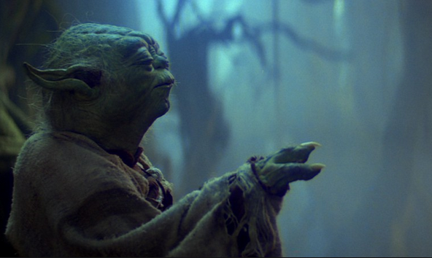
Exercise time !!
Connor made this fun exercise, it still doesn’t make up for using an extra n for his name.
Log into Linux on a computer and get ready to use the force of the terminal.

Slide 14
New to Linux exercise:
This exercise will be a nice time to use them new commands you’ve just learned
We are going to make a new directory called ‘LinuxTalk’, make a file inside that directory called ‘firstfile.txt, add text to the file and print the files contents to our screen. All from within the terminal !
Higher difficulty exercise to follow !

Slide 15
More eventful exercise
Sign into Redbrick:
ssh ‘yourUserName’@redbrick.dcu.ie
cp /home/committe/mulreac/talks/file.txt ~/file.txt

Slide 16
How do I get/use Linux ?
Download your desired distro.
You now have options:
Join the dark side and nuke your HDD and let Linux run wild.
Use a VM on your existing OS
Dual boot, use your pre-installed OS and linux side by side
We will be running an event shortly covering all of the above.

Slide 17
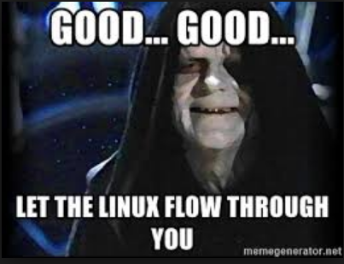
Thank You !
Your Linux powers have doubled (hopefully)

Slide 18
Commands
man [command]
ls [options] [file]
cd [directory]
touch [filename.filetype]
cat [filename]
vim/nano/gedit(subl) [filename]
mkdir
rmdir [directoryName]
cp [source(file/directory)] [destination(directory)]
echo [string]
which [executeableName]
chmod [oct|oct|oct] [file/directory]
chown [userName] [file/directory]
sudo apt
https://explainshell.com/

Slide 19
InstallFest
Welcome to the Redbrick (or deadbrick for the halloween spirit) Helpdesk talk/Installfest
At the end of this everyone will have a working install of Ubuntu 18.04 on their machine whether it be a VM or a dual boot

Slide 20
Straight to the point
Firstly we need to ensure secure boot is turned off in your BIOS
Turn your laptop off
Continuously press F2, F10 OR F12 as your machine turns on and you will be brought to the BIOS screen
Navigate to system configuration and from there ensure that secure boot is disabled.
Secure boot will prevent us booting from our USB so its essential it is disabled.
Example on next slide.

Slide 21
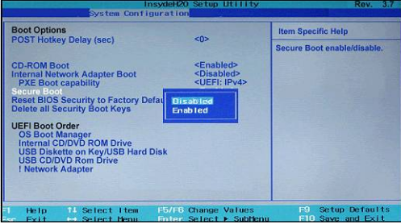

Slide 22
Disable Fast Start-up
Next we will disable fast start-up
Search for and open “Power Options” in the start menu
On the right hand side, select “Additional Power Settings”
Select “Choose what the power buttons do”
Select “Change settings that are currently unavailable”
Under shutdown settings, ensure “Fast Startup is not ticked”

Slide 23
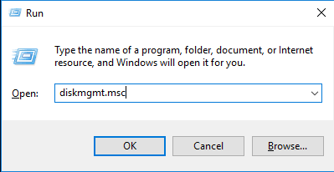
Partitioning
Next we need to allocate HDD space to install our Distro onto
Press Win (windows logo on your keyboard) and r (Win + r)
A run dialog will be opened into which you will type (without the quotes) “diskmgmt.msc” and press enter

Slide 24
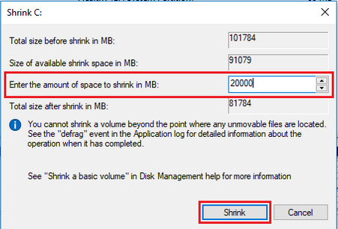
Partition continued
Right-click on your “(C:)” partition and select “Shrink Volume”
We will allocate 30gb to our new install as this allows for freedom to install programmes if needs be

Slide 25
Booting from our USB
The next step requires patience
Determine what key you need to press to change the boot order of your machine on start up. (usually F2, F10 OR F12)(Google search should be fruitful).
Once you have determined this, power off your machine and insert the USB
Power the machine back on and continously press the needed key. When the options appear select USB. We will be walking around to help with this step.

Slide 26
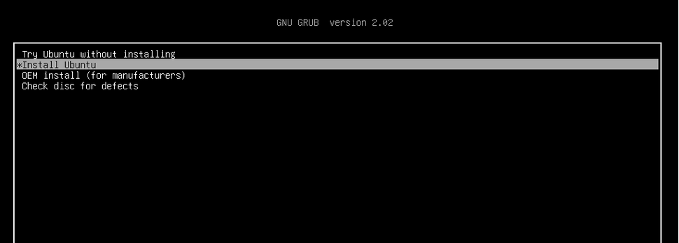
The install
Once the boot order will has been selected you will be greeted with the below screen. Wait !! Let others catch up if needs be.

Slide 27
Easy Sailing
Obviously we want to install Ubuntu on our system, so select the install Ubuntu option.

Slide 28
Continued
After selecting install, choose your language preference and time zone.
Select your keyboard layout also.
Wait at the “Preparing to install Ubuntu” screen.

Slide 29
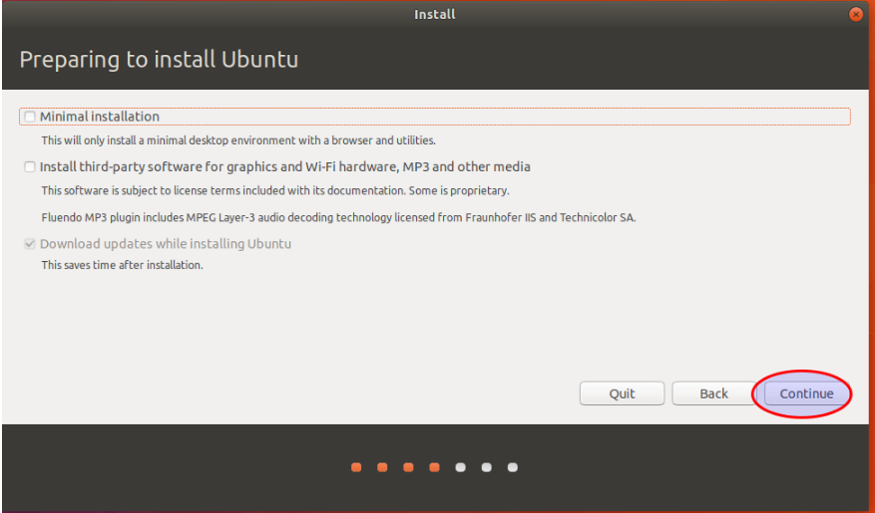

Slide 30
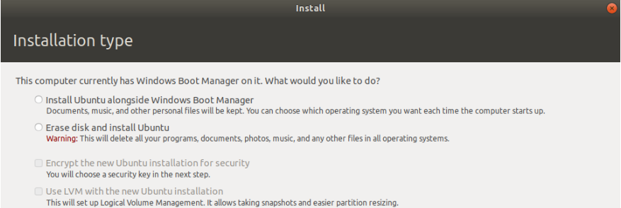
Installing
Select “Install third-party…”
After you have selected this wait on the following screen.

Slide 31
Select “Install alongside Windows Bootloader”
You will then be asked onto what partition you wish to install, wait here and we will go around and make sure Ubuntu installs in the correct place. If you continue(without us) be extremely careful as you could overwrite your entire Windows install

Slide 32
Install- Nearing end
From here on in follow on screen instructions, we will be walking around to help but your install is practically complete.

