Slide 1
Smart Home Automation Using Bangla Voice Command
CSE 4000: Project/Thesis
Supervised by:
Dr. M.M.A. Hashem
Professor, Dept. of CSE, KUET.
Khulna University of Engineering and Technology
Presented By:
Nohel Kumar Nath (1607013)
Pranto Sarker (1607024)

Slide 2
Outlines
Introduction
Objective
Literature Review
Methodology
Hardware implementation
Circuit Design
Result and Analysis
Conclusion and Future Work
References

Slide 3
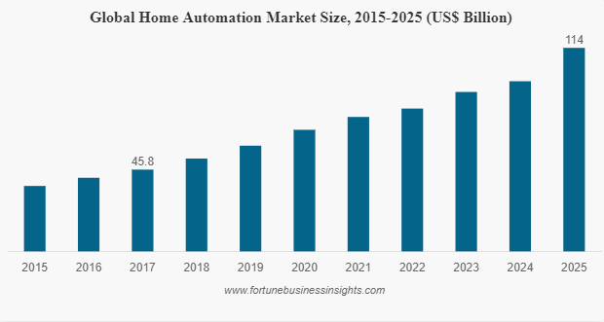
Introduction
The Global Home Automation market size and opportunities.
Bangla Speech Recognition contribution in Home Automation System
Bangla voice-controlled home automation system.

Slide 4
Objectives
To develop a Home automation in local Voice Command.
User control from one place.
Remote control of home functions.

Slide 5
Related Works
Ahmed et al. [1] proposed convolutional neural network (CNN) architectures to recognize Bangla short speech commands.
Sharmin et al. [2] proposed Bengali speech recognition system which is the process of Bengali spoken digit classification.
Chowdhury & Sultana [3] proposed ZigBee based home automation system.
Rafi and Farhan [4] proposed home Automation Using Raspberry Pi.

Slide 6


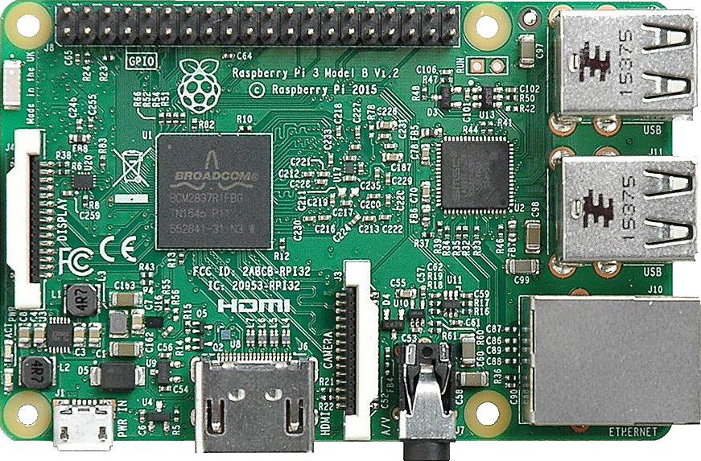

Methodology
Main components of the method are :
Preparing Bangla Voice Dataset
Build a Bangla Voice Command Recognition Model
Build a Realtime Voice input Recognition System
Hardware (Raspberry Pi) Implementation

Slide 7
Methodology Cont.
Diagram:
Fig 1: Proposed model
Begin
Dataset
Train
Test
Compute MFCC
CNN model
Performance Evaluation
End

Slide 8
Methodology Cont.
Dataset
Dataset has been created for home automation.
Total 2853 audio files was recorded with microphone.
The dataset contains total 10 command.
Sampling rate of 44080 Hz and bit rate of 320 kbps.

Slide 9
Methodology Cont.
Mel Frequency Cepstral Coefficient
Mel-frequency cepstral coefficients (MFCCs) are coefficients that collectively make up an MFC. They are derived from a type of cepstral representation of the audio clip.
After getting the voice data, we extracted the features by using Mel-frequency Cepstral Coefficients. By MFCC we will find the coefficients and the data were carefully labelled as 0,1,2,3, 4.. and etc. MFCC features were extracted from the audio files using the "librosa” module of python.

Slide 10
Methodology Cont.
Mel Frequency Cepstral Coefficient
Working on MFCC for feature extraction.
Splitting audio signal into short timestamps.
Power spectrum has been calculated.
Mel-filter bank is applied .
Finally, the Discrete Cosine Transform were used.
Data were carefully labelled as 0,1,2,3, 4..

Slide 11
Methodology Cont.
Convolutional Neural Network
A convolutional neural network (CNN) contains one or more convolutional layers, pooling or fully connected, and uses a variation of multilayer perceptions discussed above.
Convolutional layers use a convolution operation to the input passing the result to the next layer.
This operation allows the network to be deeper with much fewer parameters.
Convolutional neural networks show outstanding results in speech applications.

Slide 12
Methodology Cont.
Convolutional Neural Network
CNN for feature learning and classification.
Proposed CNN model has:
3 Convolution layers
3 Batch Normalization layers
3 max pooling layers
1 flatten layer
2 dense layers and
1 dropout layer

Slide 13
Methodology Cont.
The first convolutional layer consists of with a filter size of 16 and a pool size of (3,3) and a relu activation function.
The 2nd convolutional layer consists of with a filter size of 32 and a pool size of (3,3) and a relu activation function.
The 3rd convolutional layer consists of with a filter size of 64 and a pool size of (2,2) and a relu activation function.
The output was sent to max-pooling layer with a pool size of (2,2)
Then a droput layer with 30% dropout rate is used.
And we used another dense layer with softmax activation and 10 nodes for classification.

Slide 14
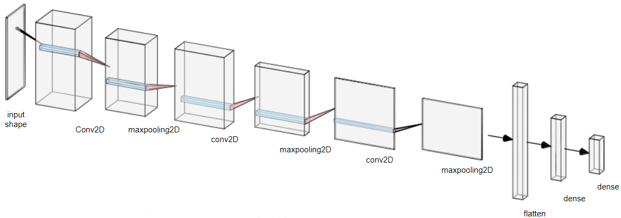
Methodology Cont.
Appling Convolutional Neural Network
Fig 2: Architecture of the proposed approach using CNN

Slide 15
Methodology Cont.
Parameters | Status
Batch Size | 32
Learning Rate | .0001
Activation Function | Relu , Softmax
Epoch | 48
Optimizer | Adam
Trainable Params | 145290

Slide 16
Hardware Implementation
To implement our model we used Raspberry Pi.
Can use Python programing.
Can be easily connected with internet for home automation.
Can also be used for further extension.
Fig 3: Raspberry Pi 3 Model B

Slide 17
Hardware Implementation
To implement our model to Raspberry Pi
Installing an OS for raspberry pi.
Connect with the internet.
Create a virtual environment to run python.
Load the python model to Raspberry Pi.
Control the desired home appliance.

Slide 18
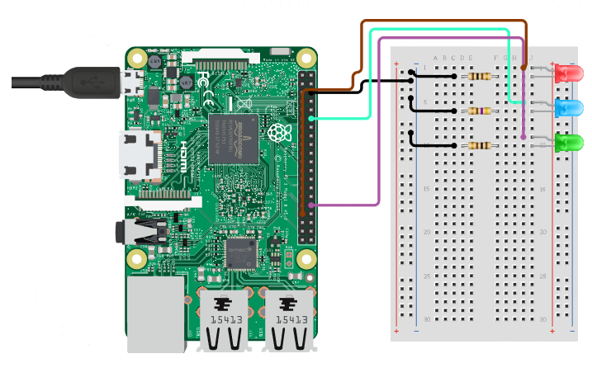
Circuit Design
Sound card and microphone connected for input voice command.
Out of 40-pin extended GPIO
GPIO pin 12 (appliance 1)
GPIO pin 13 (appliance 2)
GPIO pin 18 (appliance 3)
Fig 4: Circuit Implementation

Slide 19
Result and Analysis
Trained over 2853 Bangla audio voice command.
80% of dataset are training dataset and 20% was used for test dataset.
Table 2: the accuracy of our dataset
Model | Number Of Epoch | Accuracy | Loss | Number Of Parameters
CNN | 48 | 96.5% | 13.3% | 145,290

Slide 20
Result and Analysis Cont.
Experimented on the proposed dataset
The best result found having
3 CNN layer.
16-32-64 filter sequence.
Softmax activation function and sparse categorical cross-entropy.

Slide 21
Result and Analysis Cont.
Experimented on the proposed dataset:
Table 3: Results of precision, recall and f1-score found for different sizes of datasets
Data Size | Accuracy | Precision | Recall | F1-score
250 | 38.30% | 38.00% | 38.00% | 38.00%
953 | 90.10% | 90.00% | 90.00% | 90.00%
2853 | 96.50% | 96.00% | 96.00% | 96.00%

Slide 22
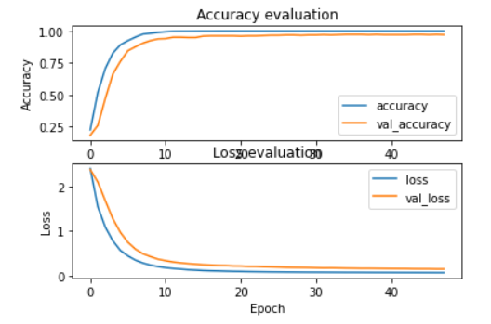
Result and Analysis Cont.
Model trained very well.
Showed the properties in the testing phase.
Accuracy-Epoch and Loss-Epoch graphs totally flat after 48 epoch.
Fig 5: Graph of Accuracy evaluation
and Loss evaluation

Slide 23
Result and Analysis Cont.
In Real-Time above 80% of success rate has been reached.
Works better in a normal environment.

Slide 24
Result and Analysis Cont.
Table 4: Real-Time Accuracy of the Model
Command | Total Number of Command | Accurate | Error
এক নাম্বার বাতি নিভাও | 10 | 8 | 2
এক নাম্বার বাতি জ্বালানো হোক | 10 | 6 | 4
দুই নাম্বার বাতি নিভাও | 10 | 9 | 1
এক নাম্বার পাখা বন্ধ করো | 10 | 8 | 2
এক নাম্বার পাখা চালাও | 10 | 9 | 1
দরজা খোলো | 10 | 9 | 1
দুই নাম্বার পাখা চালাও | 10 | 8 | 2
দরজা বন্ধ করো | 10 | 9 | 1
দুই নাম্বার বাতি জ্বালাও | 10 | 7 | 3
দুই নাম্বার পাখা বন্ধ করো | 10 | 7 | 3

Slide 25
Conclusion
Using Raspberry pi over wi-fi, home appliances like light, fan, door etc can be controlled.
Command over voice to the module that turn on or off the appliance.
The proposed system obtained a test accuracy of 96%.

Slide 26
Future Work
Extension of integrating give user full control over the appliances.
Remote control implementation.
Implementation of automation in factories and manufacturing plants.

Slide 27
References
[1] S. Ahmed Sumon, J. Chowdhury, S. Debnath, N. Mohammed and S. Momen, "Bangla Short Speech Commands Recognition Using Convolutional Neural Networks," 2018 International Conference on Bangla Speech and Language Processing (ICBSLP), 2018, pp. 1-6, doi: 10.1109/ICBSLP.2018.8554395.
[2] Riffat Sharmin, Shantanu Kumar Rahut, Mohammad Rezwanul Huq, “Bengali Spoken Digit Classification: A Deep Learning Approach Using Convolutional Neural Network,” Procedia Computer Science, Volume 171, 2020, Pages 1381-1388, ISSN 1877-0509.
[3] Mohammed Arif Hasan Chowdhury, Jeenat Sultana. Bangla Voice Recognition Based Home Automation for Elderly and Disabled Patient (https://www.academia.edu/37475623/IRJET_Bangla_Voice_Recognition_Based_Home _Automation_for_Elderly_and_Disabled_Patient).
[4] Ar Rafi, Farhan. (2018). Application of Android and Raspberry Pi for Home Automation.

Slide 28
THANK YOU

