Slide 1

Predicting Autism Spectrum Disorder Using ML
Department of Computer Science & Engineering
Guide:
Dr. Subba Rao
Associate Professor
Presented By:
D. Harshitha – 23RH1A05K5
G. Sushmitha – 23RH1A05N0
G. Thapana – 23RH1A05N9

Slide 2
INTRODUCTION
ASD: Lifelong neurodevelopmental disorder affecting social interaction, communication, and behavior.
Prevalence: Affects millions globally; early diagnosis leads to better support and outcomes.
Machine Learning Motivation: Allows data-driven, scalable, and potentially more accurate detection using existing datasets.

Slide 3
EXSISTING SYSTEM
Traditional diagnosis via clinical interviews, behavioral observations, and standardized questionnaires.
Drawbacks:
Time-consuming and subjective
Dependent on clinician expertise
Limited scalability and accessibility
May miss subtle cases or lead to late diagnosis

Slide 4
PROPOSED SYSTEM
Approach: Use machine learning to analyze behavioral and demographic data for ASD prediction.
Workflow:
Data collection → Preprocessing → Feature Selection → Model Training → Prediction
Goals:
Increase speed and accuracy of screening
Offer scalable support for clinicians

Slide 5
FEATURES ADDED
🔹 Accepts questionnaire inputs (M-CHAT/ AQ test ) and demographic details.
🔹 It uses TensorFlow-based ML models for ASD risk prediction.
🔹 Supports multilingual translation
English
Hindi
Telugu
🔹 Provides AI voice assistant using gTTS to read out risk results in chosen selected language.
🔹Integrated Analytics Module:
Pie charts for symptom distribution.
Bar/line charts for model accuracy, recall, and AUC metrics.
🔹 Tracks and displays Most Evaluated / searched Assessments for each user.

Slide 6
TECHNOLOGIES USED
🔹 Machine Learning Frameworks: TensorFlow, Scikit-learn, XGBoost
🔹 Programming Languages: Python
🔹 APIs: Google Translate API, gTTS (Text-to-Speech)
🔹 Visualization Tools: Matplotlib, Seaborn, Chart.js
🔹 Database: MongoDB / MySQL (for storing user data, test results)
🔹 Frontend (optional): React / HTML / CSS for dashboard
🔹 Environment: Jupyter Notebook / VS Code

Slide 7
ADVANTAGES OF PROPOSED SYSTEM
Faster and more scalable screening.
Reduces subjectivity; consistent predictions.
Can identify patterns missed by clinicians.
Assists healthcare professionals, not replaces them.
Potential for integration into telemedicine platforms.
Ethical design considers privacy and fairness.

Slide 8
MODULES USED
1. User Authentication Module
Handles login/signup and session management for users/clinicians.
2. Data Collection Module
Collects questionnaire data and demographic information.
3. Multilingual Translation Module
Translates prediction and insights into English, Hindi, or Telugu.
4. ML Prediction Module
Processes data and predicts ASD risk using trained TensorFlow model.
5. Analytics Module
Displays visual reports like symptom distribution and accuracy charts.
6. User History Module
Tracks previous predictions and “most evaluated” users.

Slide 9
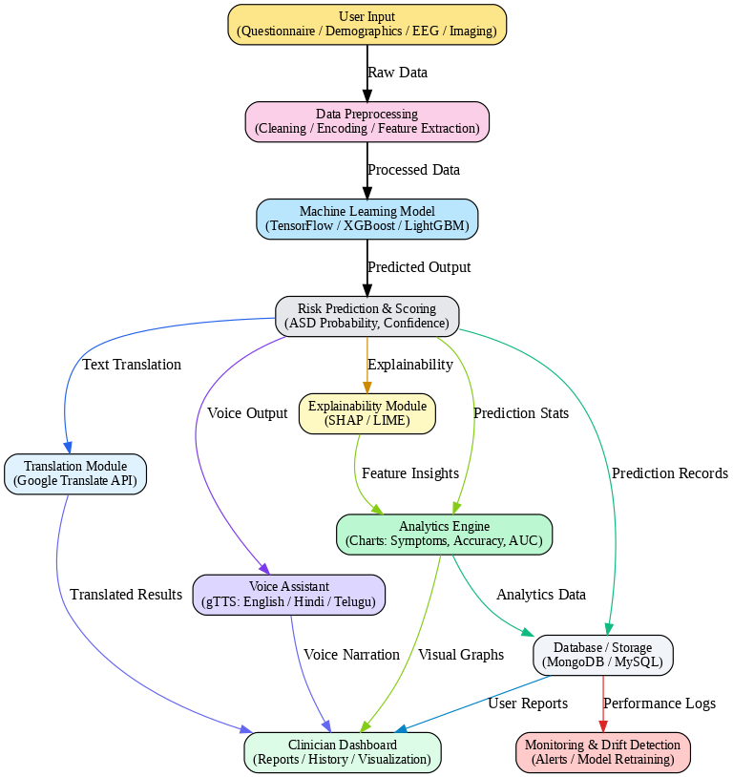
SYSTEM ARCHITECTURE

Slide 10
IMPLEMENTATION
Developed using Python, TensorFlow, and Scikit-learn.
Built user interface with HTML, CSS, and JS (optional).
Integrated Google Translate API for multilingual support.
Implemented gTTS for AI voice narration.
Created data visualization dashboards for model accuracy and symptom analysis.
Stored all user data and prediction results in a MongoDB/MySQL database.

Slide 11
TESTING AND VALIDATION
Functional testing: Checked module connectivity and correct output for inputs.
Model evaluation: Accuracy, Recall, Precision, and ROC-AUC scores computed.
User testing: Ensured usability of multilingual and voice features.
Non-functional testing: Verified performance, reliability, and data privacy.

Slide 12
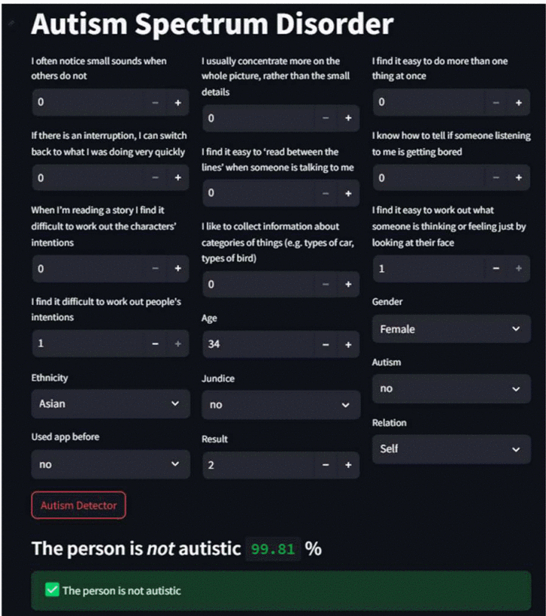
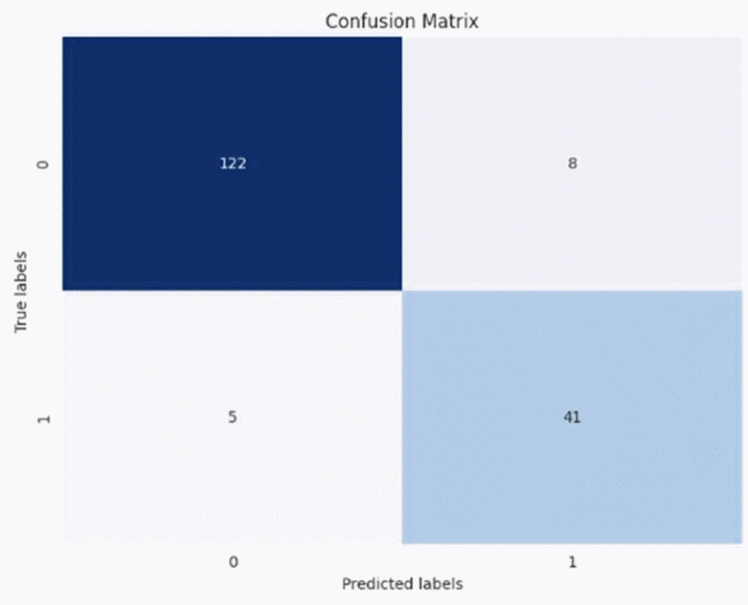
OUTPUT SCREENS

Slide 13
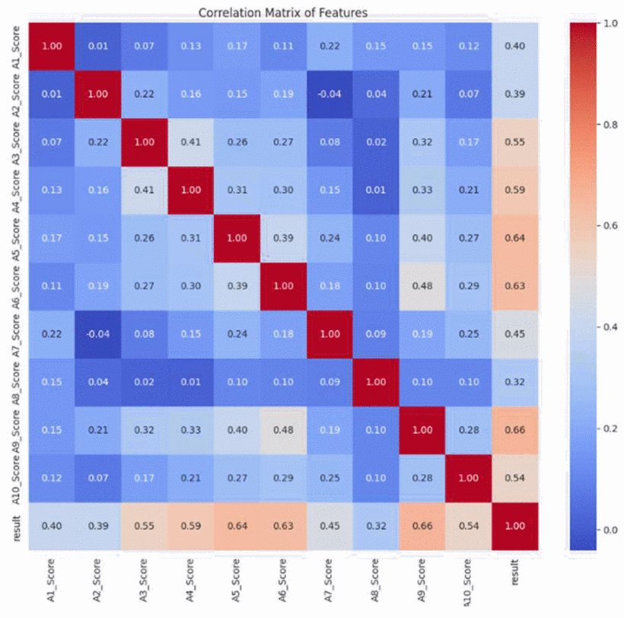

Slide 14
CONCLUSION
The proposed ASD Prediction System successfully demonstrates how Machine Learning and Artificial Intelligence can be applied to support early screening of Autism Spectrum Disorder. By combining behavioral questionnaires, automated risk prediction, multilingual support, and AI-based voice assistance, the system makes ASD assessment faster, more accessible, and user-friendly. Through integrated analytics and explainability modules, it provides clinicians with deeper insights into key behavioral indicators, enhancing the accuracy and reliability of early diagnosis.

Slide 15
REFERENCES
[1] S. S. Dash, S. Pati, B. K. Sahu, and S. S. Rath, “Autism Spectrum Disorder Prediction Using Machine Learning,” 2024 3rd International Conference on Artificial Intelligence and Signal Processing (AISP), IEEE, pp. 1–6, 2024. Available: https://ieeexplore.ieee.org/document/10533493
[2] S. N. Dhameliya, S. H. Chaudhary, and K. R. Rathod, “Autism Spectrum Disorder Prediction Using Machine Learning,” 2024 8th International Conference on Computing, Communication, Control and Automation (ICCUBEA), IEEE, pp. 1–8, 2024. Available: https://ieeexplore.ieee.org/document/10677807
[3] S. A. Hussain, S. A. Khan, and A. S. Hussain, “Analysis and Detection of Autism Spectrum Disorder Using Machine Learning,” Procedia Computer Science, vol. 167, pp. 234–240, 2020. Available: https://www.sciencedirect.com/science/article/pii/S1877050920308656
[4] M. J. Kosmicki, J. P. Sochat, S. Duda, et al., “Machine Learning Prediction of Autism Spectrum Disorder,” JAMA Network Open, vol. 7, no. 3, pp. e232394, 2024. Available: https://jamanetwork.com/journals/jamanetworkopen/fullarticle/2822394
[5] I. M. Umi, “Autism Prediction Using Machine Learning – GitHub,” [Online]. Available: https://github.com/imumi17/Autism-Prediction-Using-Machine-Learning

Slide 16


