Slide 1
Simplified analytical model
Decide on a Team Leader
The entire team needs to support and trust the team leader in solving the problem.
All team members must work together (no individual work).
The team leader can choose the presenter.

Slide 2
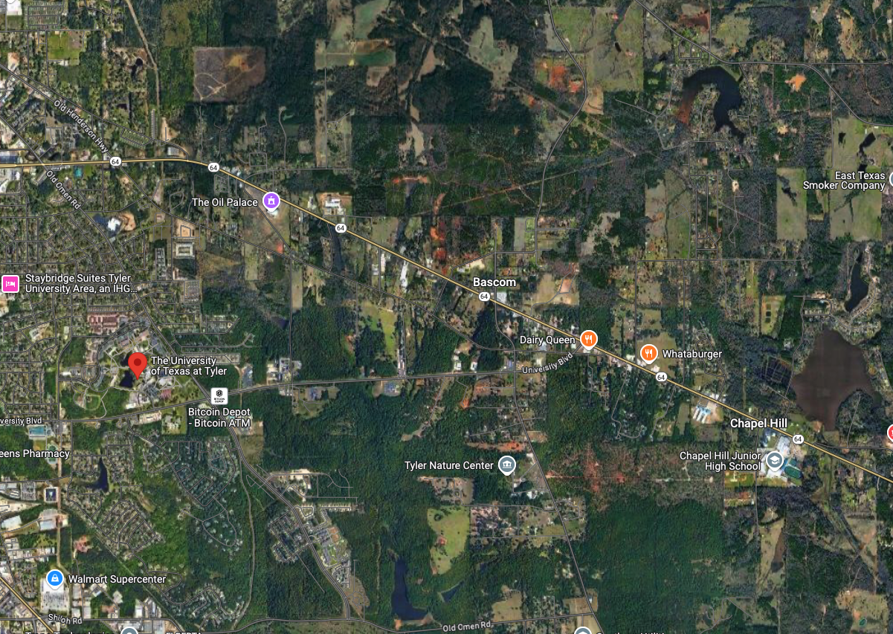
Simplified analytical model
48.6 acres

Slide 3
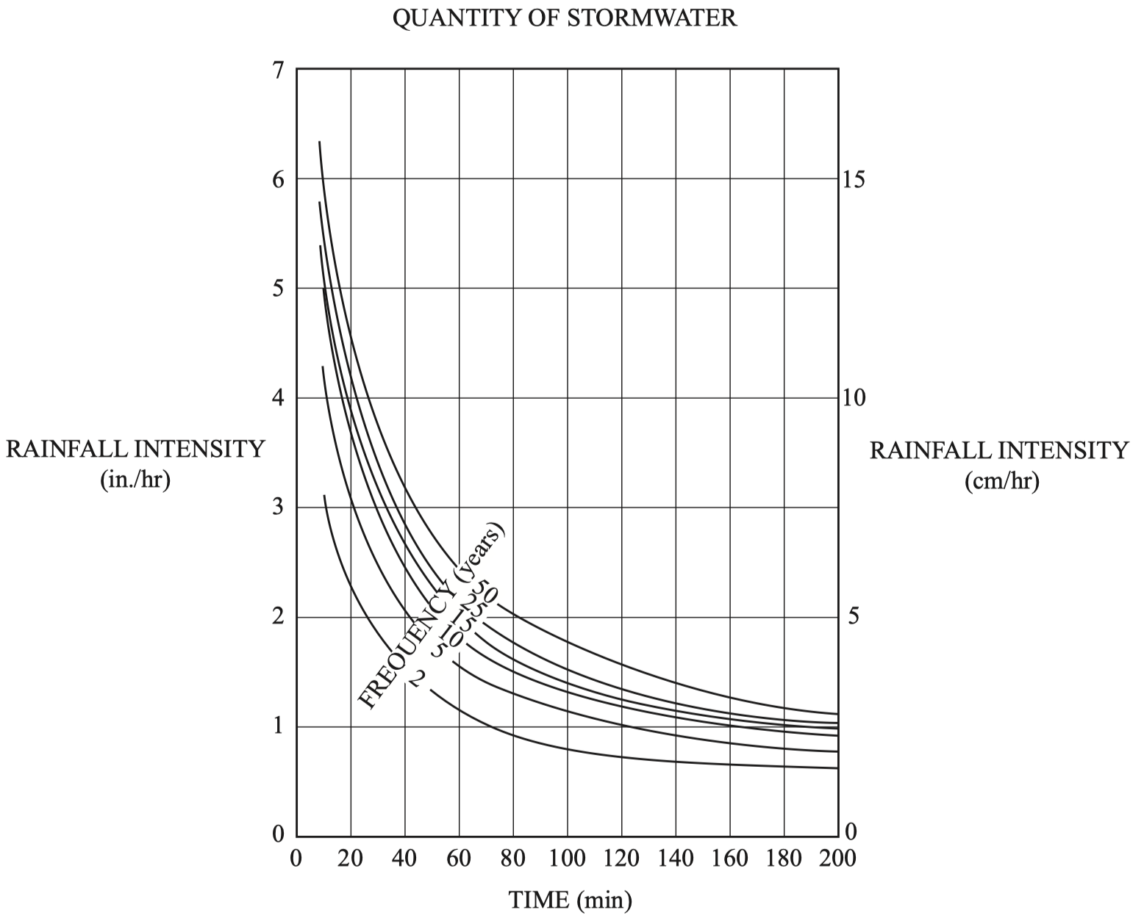
Date | Duration (min) | Frequency (years) | Q (cfs)
07/01/1675 | 60 | 2 | 19.3
06/21/1676 | 70 | 25 | 29.2
08/04/1677 | 40 | 2 | 24.1
06/09/1678 | 100 | 50 | 28.7
06/21/1679 | 120 | 10 | 19.8
08/05/1680 | 20 | 5 | 50.3
07/15/1681 | 150 | 50 | 21.9

