Slide 1

DRISHTI-Bn: A Parameter-Efficient Multimodal Vision-Language Framework for Simultaneous Flood Damage Classification and Bengali Caption Generation
Presented By-
Jahid Hasan (ID- 0242310005341038)
Supervisor: Md. Fahad Hossain (Senior Lecturer)
Department of Software Engineering, Daffodil International University

Slide 2
Outlines
Research Gaps and Problem Statement
Methodology
References
Publications
Objectives and Contribution
Research Scope and Literature Review

Slide 3
Problem Statement
~94.42 million Bangladeshis face severe flood risk — 57.5% of the national population
During disasters, thousands of social media images arrive faster than human teams can assess
Manual image review is slow, error-prone, and fails under high-volume crisis conditions
Existing AI models are unimodal — they classify damage but cannot generate descriptive text
All current systems are English-centric; no system produces native Bengali disaster summaries
Large vision-language models require billions of parameters — undeployable in local emergency centers with limited GPU resources
No multimodal, Bengali-capable, hardware-efficient AI system exists for flood disaster response in Bangladesh

Slide 4
Objectives
Curate a domain-specific Bengali flood corpus by filtering CrisisMMD (3,755 samples) and generating verified Bengali annotations
Design DRISHTI-Bn: a joint vision-language architecture uniting ViT-Base/16 (visual encoder) with BanglaBERT (autoregressive decoder)
Implement LoRA (Rank=8) inside attention layers of both encoders to enable training within a single 16GB GPU
Optimize a multi-task loss: L_total = λ_cls · L_cls + λ_cap · L_cap for simultaneous classification and Bengali caption generation

Slide 5
Research Gap
Gap 1: Unimodal Systems Only
  CNN/ViT models classify damage but cannot generate descriptive text — no generative output exists
Gap 2: English-Centric Bias
  All existing VLMs are trained on English corpora; zero Bengali multimodal disaster system exists
Gap 3: No Bengali Annotated Disaster Dataset
  No multimodal flood dataset with Bengali captions is publicly available
Gap 4: Prohibitive Computational Cost
  Full fine-tuning of VLMs requires 80GB+ VRAM — impossible for regional emergency centers
DRISHTI-Bn addresses ALL four gaps simultaneously

Slide 6
Literature Review
Model / System | Performance | Key Limitation
CNN Era (ResNet50, ResNet101, VGG16) | 66.85-79.55% Acc | No global context; no text generation
Vision Transformer - ViT Baseline | 81.82% Acc | Unimodal; no language decoder
CrisisViT (Domain-specific ViT) | 83.07% Acc | English-only; no Bengali support
Multilingual VLMs (CLIP, BLIP) | High (English) | English-centric; needs 80GB+ GPU
BanglaBERT (NLP only) | Superior Bengali NLU | Text-only; not disaster-specific
DRISHTI-Bn [PROPOSED] | Ongoing (To be evaluated) | Addresses above limitations (Multimodal + Bengali + LoRA)

Slide 7
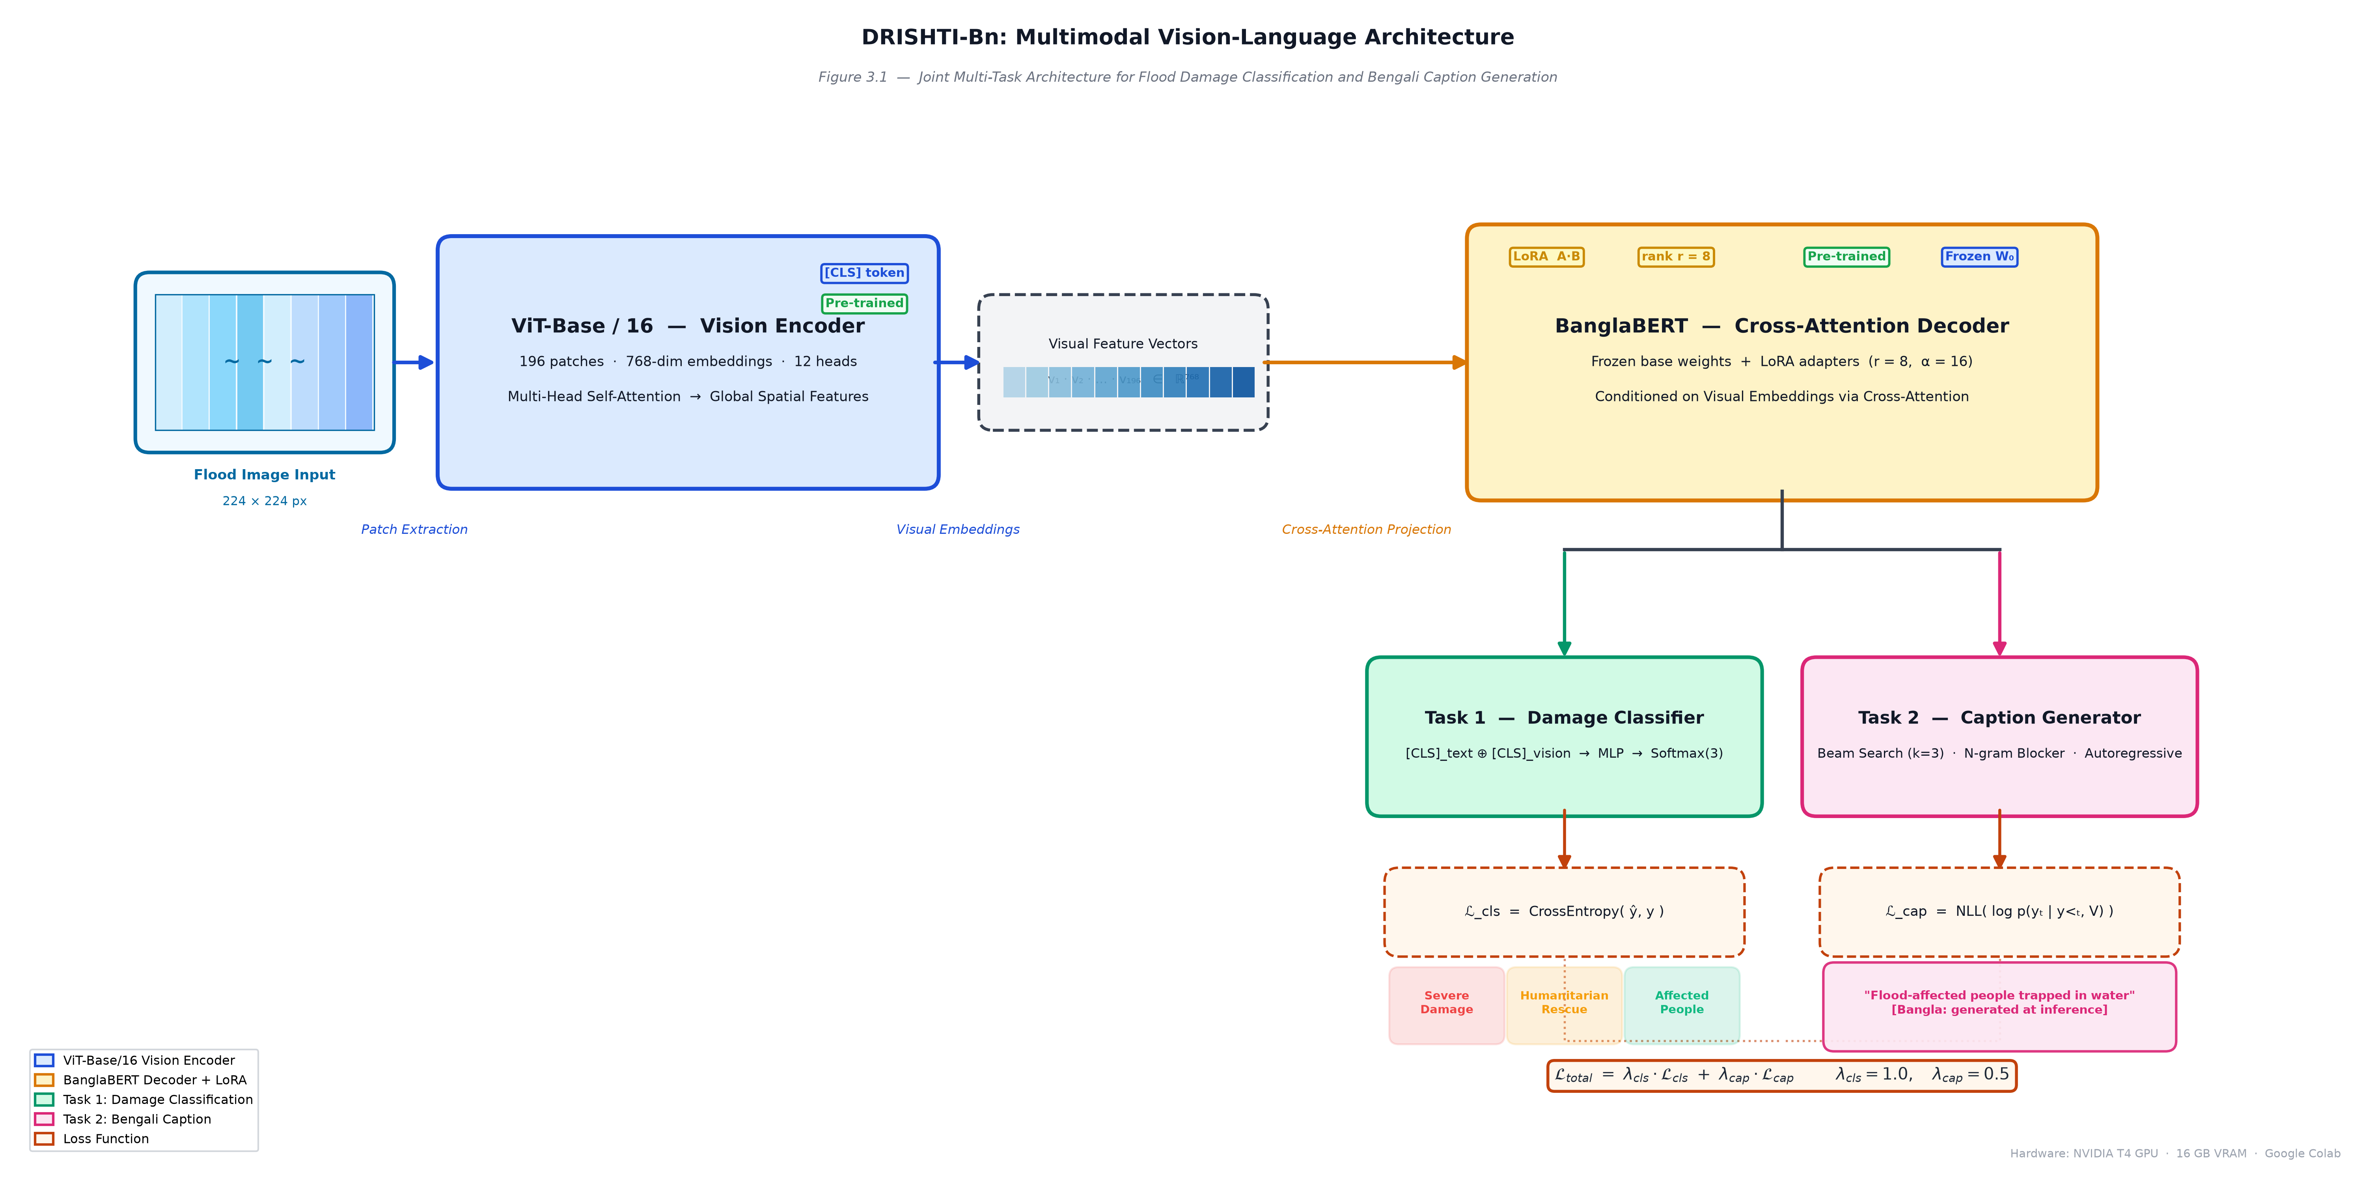
Methodology
ViT-Base/16 → Patch Embeddings → Cross-Attention → BanglaBERT Decoder → [Classification + Bengali Caption] | Optimized with LoRA (r=8)

Slide 8
References
[1] Alam et al. (2021). CrisisMMD: Multimodal Twitter Datasets from Natural Disasters. ICWSM.
[2] Dosovitskiy et al. (2020). An Image is Worth 16x16 Words: Transformers for Image Recognition. ICLR.
[3] Hu et al. (2021). LoRA: Low-Rank Adaptation of Large Language Models. ICLR 2022.
[4] Bhattacharjee et al. (2022). BanglaBERT: Language Model Pretraining and Benchmarks. ACL Findings.
[5] Long et al. (2023). CrisisViT: A Robust Vision Transformer for Crisis Image Classification. EMNLP.
[6] He et al. (2016). Deep Residual Learning for Image Recognition. CVPR.
[7] Li & Liang (2021). Prefix-Tuning: Optimizing Continuous Prompts for Generation. ACL.

Slide 9
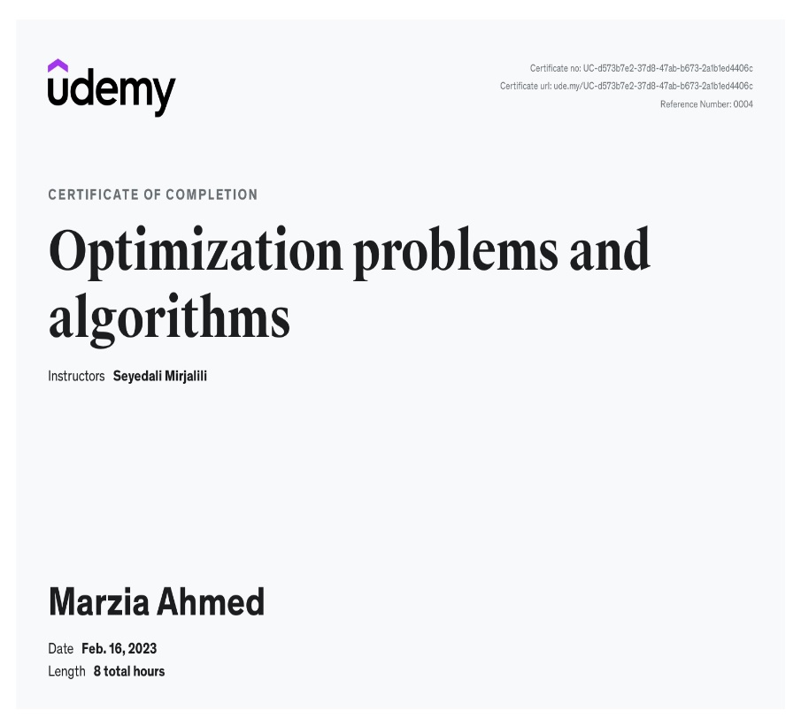
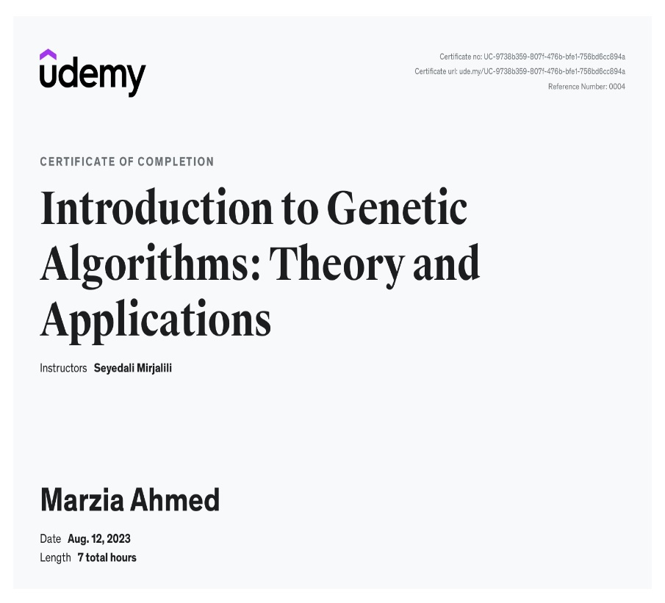
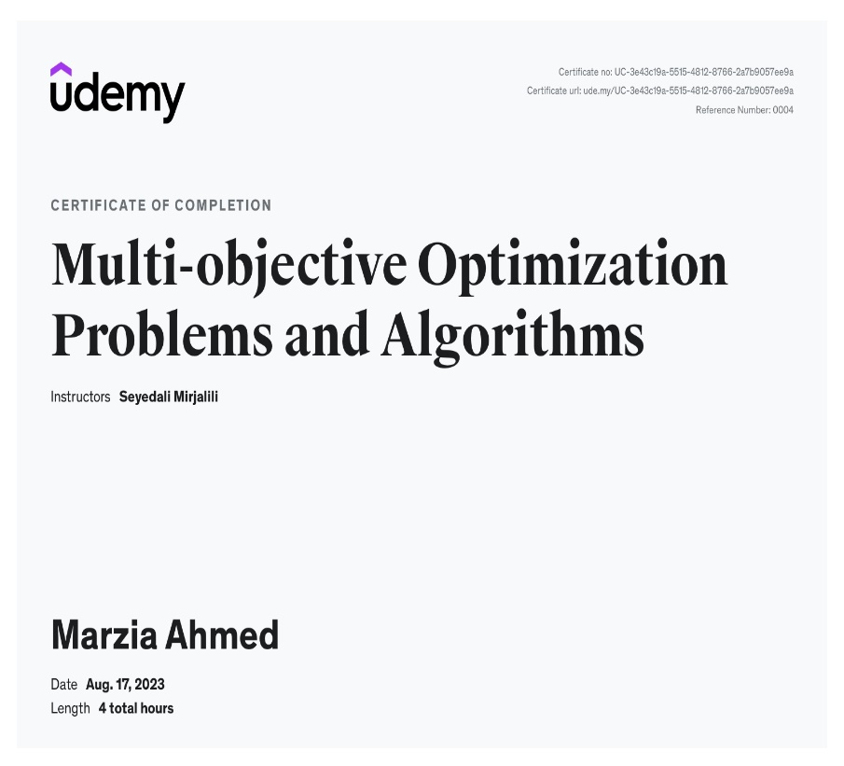
List of Certification

Slide 10
THANK YOU

Slide 11

Question ???

