Slide 1

AI-Assisted Early Risk Detection of Depression and Anxiety in University Students During Job Search Using Social, Behavioral, and Self-Report Signals
Presented By-
Nohzat Tabsassum (ID- 0242310005341109)
Supervisor: Dr. Imran Mahmud (Department Head)
Department of Software Engineering, Daffodil International University

Slide 2
Outlines
Research Gaps and Problem Statement
Methodology
References
Publications
Objectives and Contribution
Research Scope and Literature Review

Slide 3
Problem Statement
Students face severe psychological strain during the school-to-work transition. Labour market uncertainty creates distress comparable to actual unemployment.
Standard screening tools (PHQ-9, GAD-7) are used in isolation. They ignore behavioral and social signals — missing many at-risk students.
Most AI/ML models use single-modality data (e.g., social media only), are opaque, lack explainability, and are not reproducible.
Severe class imbalance in existing datasets causes high-risk minority groups to be systematically under-detected.

Slide 4
Objectives
O1: Construct an integrated feature space combining PHQ-9, GAD-7, MSPSS with quantified job-search behavioral indicators.
O2: Develop and compare supervised ML baselines (LR, SVM, RF, XGBoost) for joint depression-anxiety risk classification.
O3: Apply SHAP explainability to generate interpretable feature-level explanations for non-clinical decision support.
O4: Operationalize behavioral variables (search intensity, planfulness, rejection load) with consistent measurement definitions.
O5: Implement a TRIPOD-aligned evaluation workflow using stratified CV and macro-F1 with class-imbalance-aware analysis.

Slide 5
Research Gap
Gap 1: Models rely on single-modality data — social media OR clinical records. Perceived social support (MSPSS) is omitted.
Gap 2: No joint depression-anxiety pipeline for student job-search context exists.
Gap 3: Deep learning models are opaque — no SHAP or interpretability for practitioners.
Gap 4: Behavioral signals (search intensity, planfulness) are inconsistently defined.
Gap 5: TRIPOD & PROBAST violations are widespread — reproducibility is lacking.
Gap 6: Class imbalance causes high-risk minority groups to be under-detected.

Slide 6
Literature Review
Model / System | Performance | Key Limitation
CNN Era (ResNet50, ResNet101, VGG16) | 66.85-79.55% Acc | No global context; no text generation
Vision Transformer - ViT Baseline | 81.82% Acc | Unimodal; no language decoder
CrisisViT (Domain-specific ViT) | 83.07% Acc | English-only; no Bengali support
Multilingual VLMs (CLIP, BLIP) | High (English) | English-centric; needs 80GB+ GPU

Slide 7
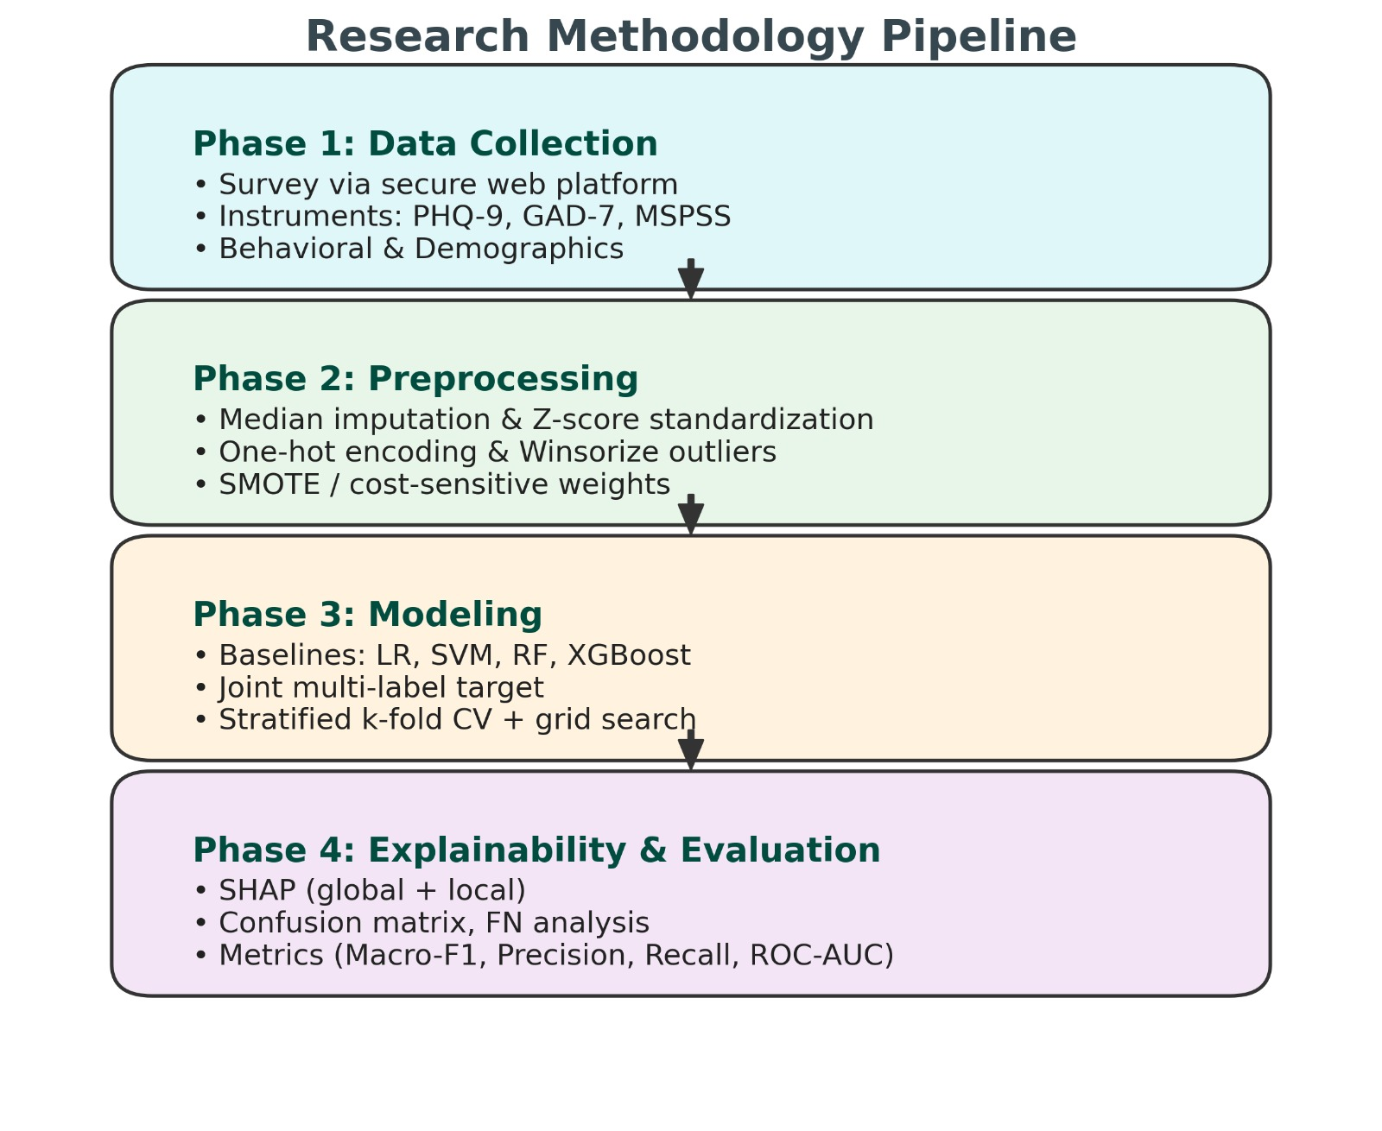
Methodology

Slide 8
References
[1] Kroenke et al. (2001). The PHQ-9. J General Internal Medicine, 16(9), 606-613.
[2] Spitzer et al. (2006). GAD-7 brief measure. Archives of Internal Medicine, 166, 1092-1097.
[3] Zimet et al. (1988). Multidimensional Scale of Perceived Social Support. J Personality Assessment.
[4] Paul & Moser (2009). Unemployment impairs mental health: Meta-analyses. J Vocational Behavior.
[5] Collins et al. (2015). Transparent Reporting of prediction models (TRIPOD). BMJ, 350, g7594.
[6] Ramos-Lima et al. (2020). Predicting depression using ML — systematic review. Psychiatry Research.
[7] Lundberg & Lee (2017). A unified approach to interpreting model predictions (SHAP). NeurIPS.
[8] Wolff et al. (2019). PROBAST: Tool to assess prediction model risk of bias. Annals Internal Med.

Slide 9
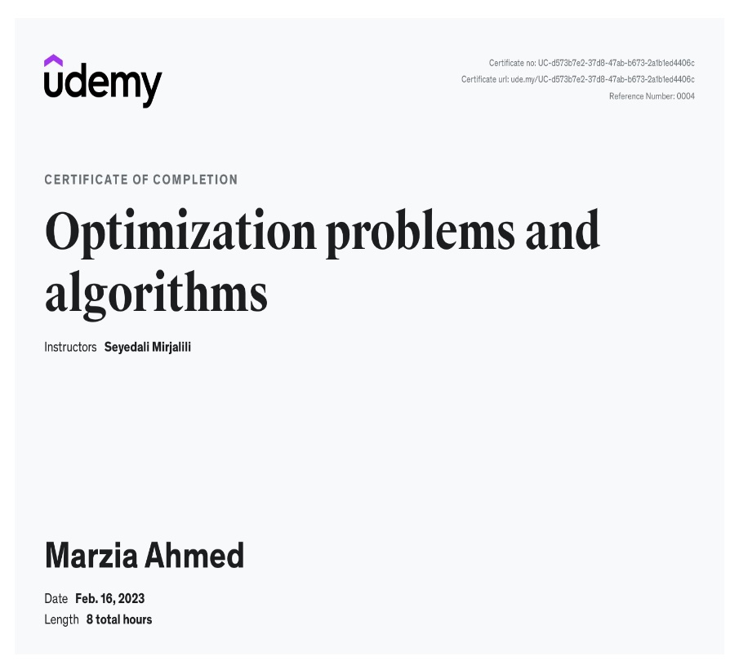

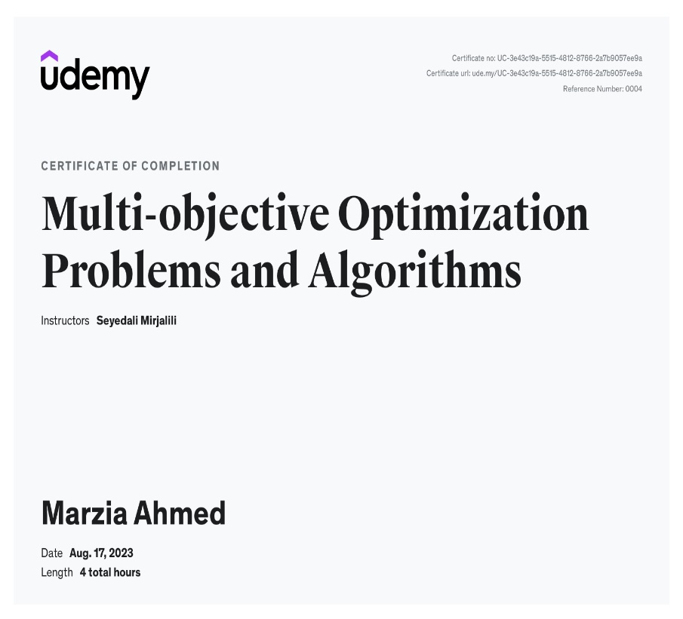
List of Certification

Slide 10
THANK YOU

Slide 11

Question ???

