Slide 1
E-Commerce Project
Course: 420-411-VA
Team Name: Shop Fresh
By Enrique Garcia

Slide 2
Outline Slide
• Project Description
• Feature Showcase
• Team Responsibilities
• Challenges
• Learning Outcomes
• Demo

Slide 3
Project Description
My project is a Grocery Store Website called ShopFresh built using PHP, MySQL, and the MVC architecture.
The platform allows users to browse, search, and add/remove grocery products from their cart before purchasing the products.
Administrators can manage users and view logs.

Slide 4
Next up all the features required in the Project Requirements

Slide 5
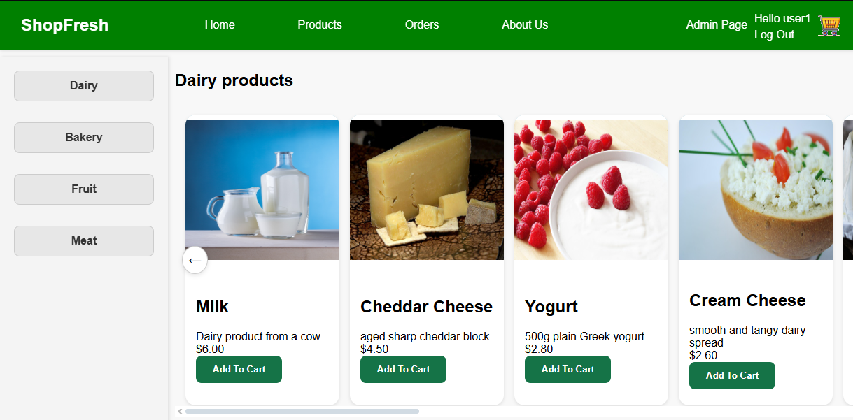
A Listing web page with at least 4 attributes
Here we see the name of the product, a brief description, its price and an image

Slide 6
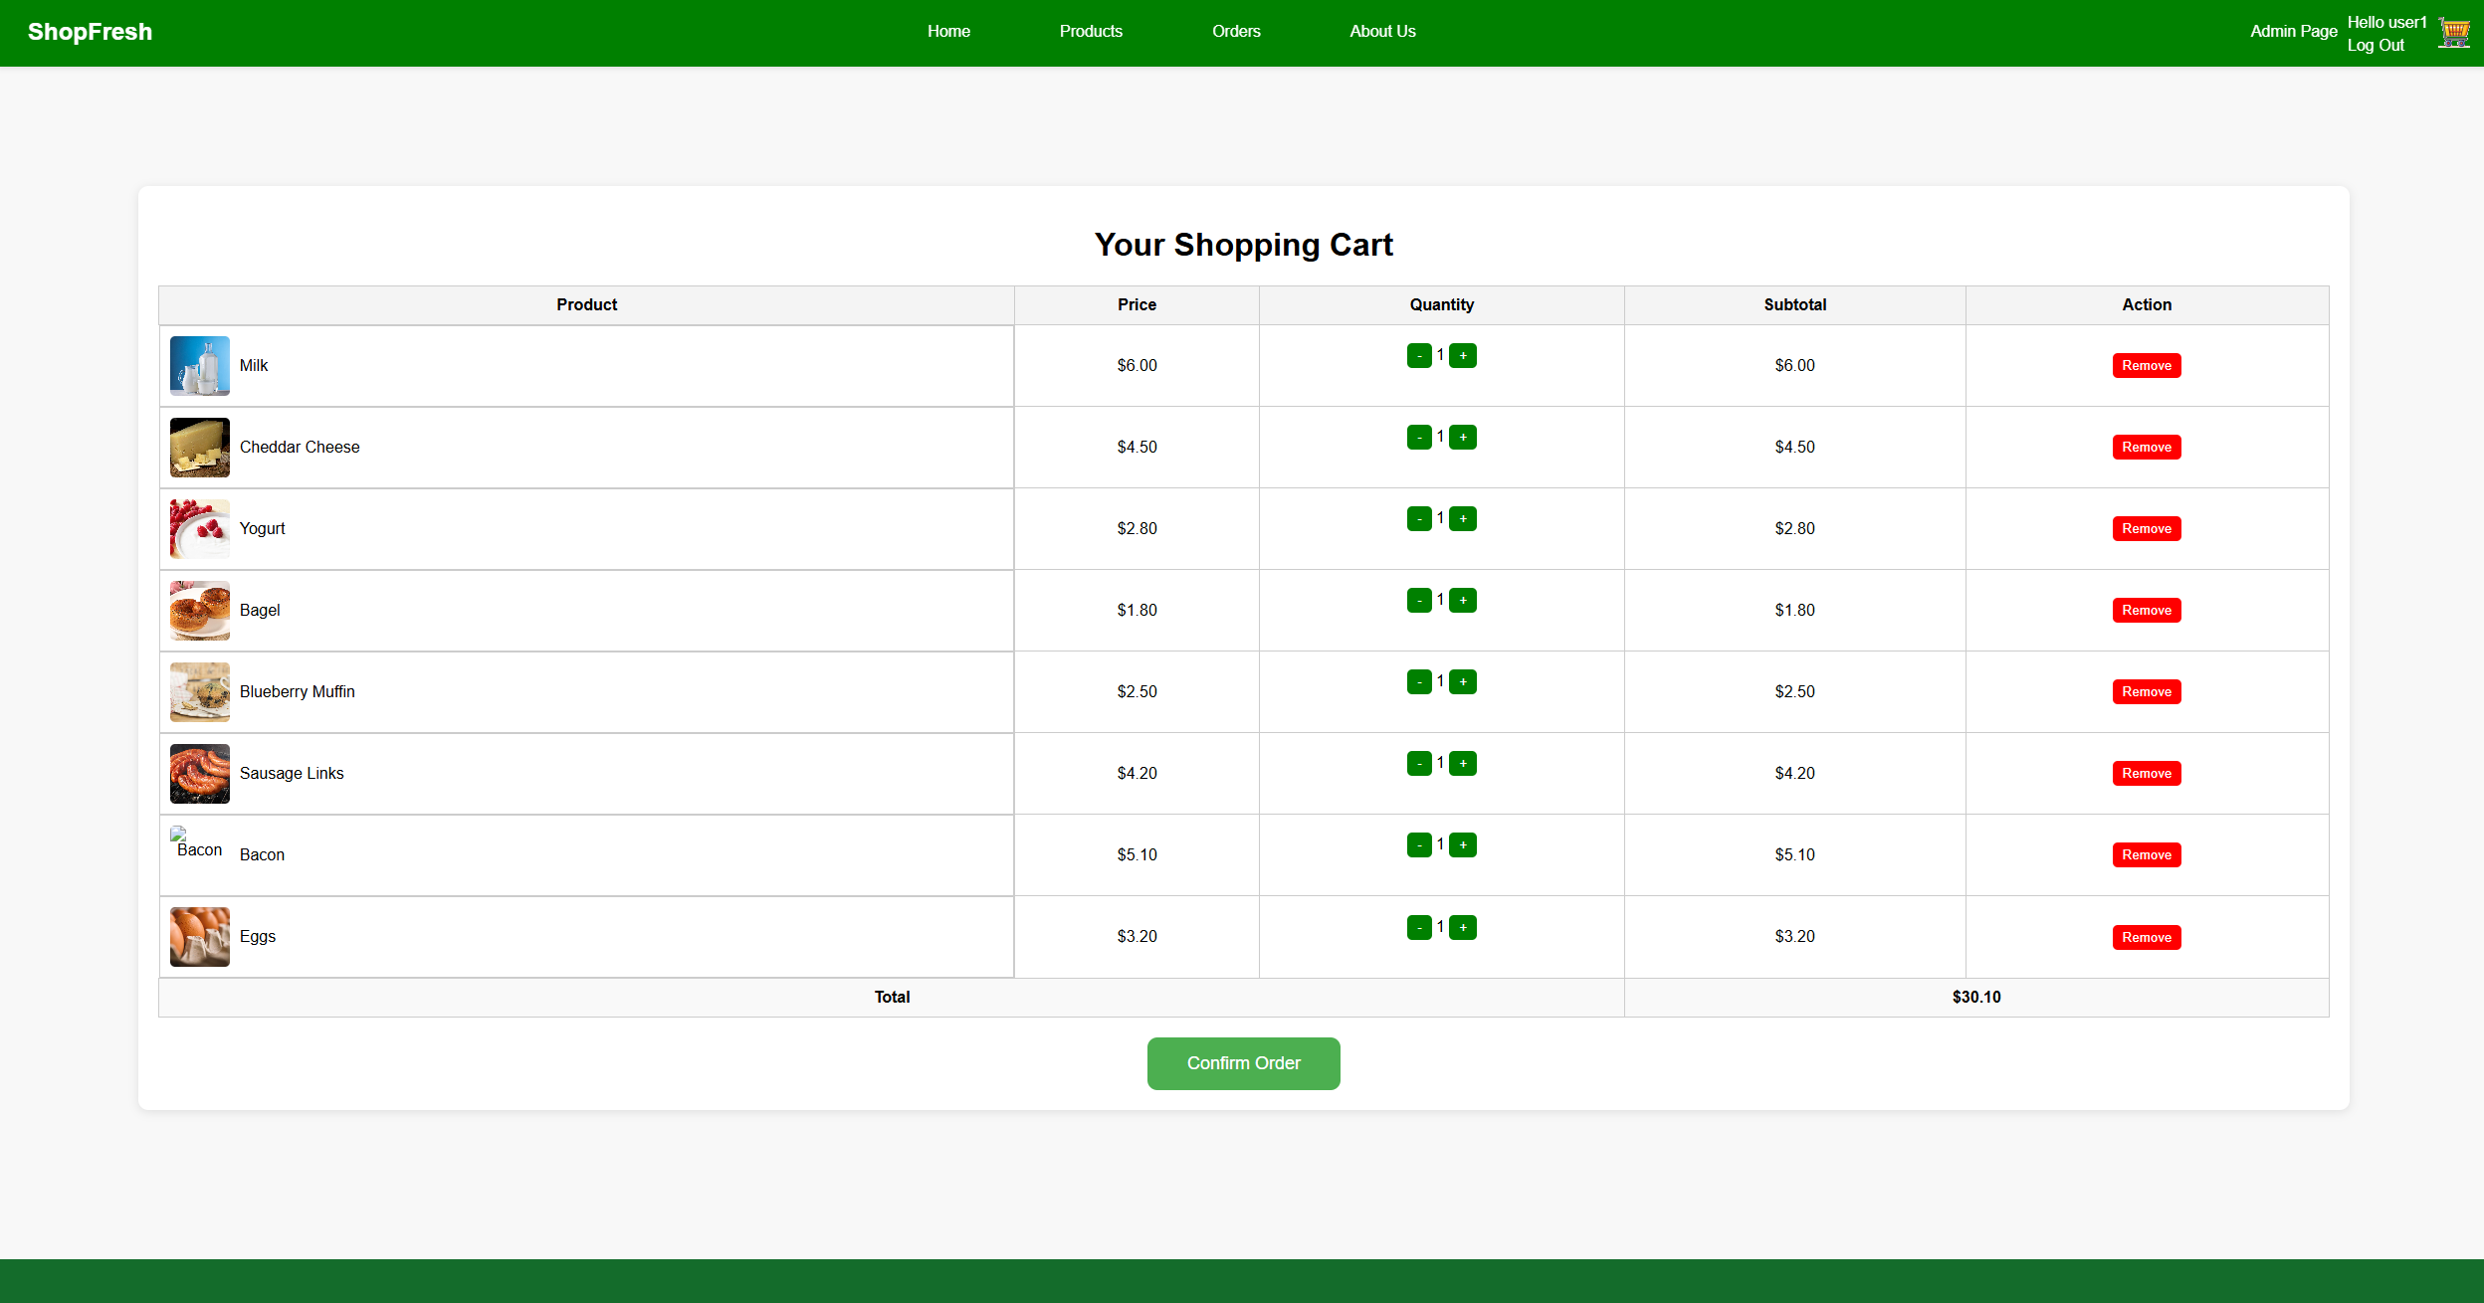
An editing web page to edit data on the webpage
Users can increase or decrease the quantity of each product
The Remove button deletes the item from their cart
The confirm Order creates an order using all items currently in the cart

Slide 7
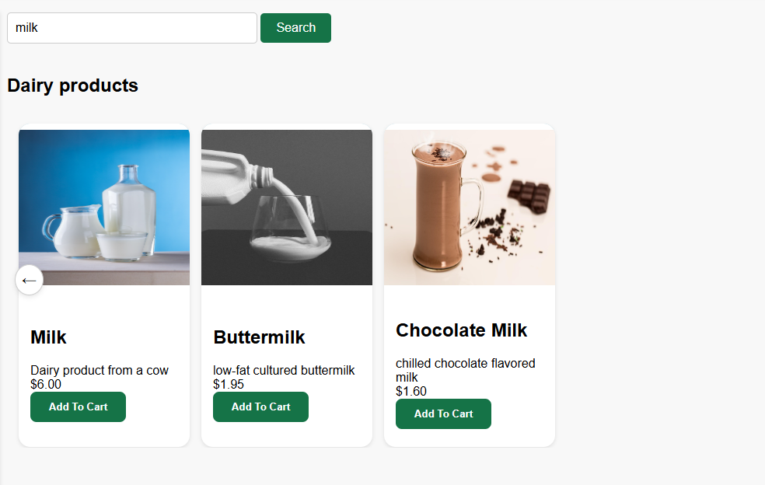
Search functionality allows the filtering of data.

Slide 8
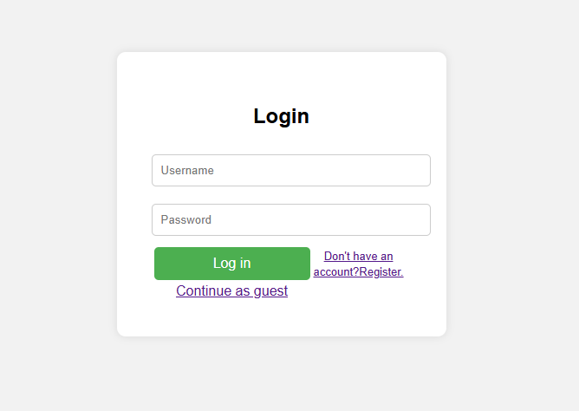
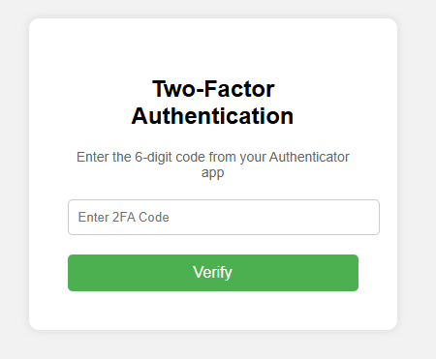
A login web page allowing access to secured web pages that cannot be accessed otherwise
Once the user logs in they get access to the cart and the ability to add items to the cart had they tried to before loging in they would be taken to this page

Slide 9

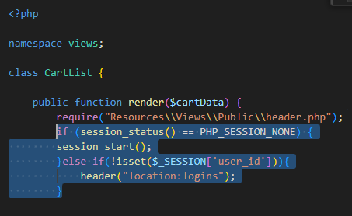
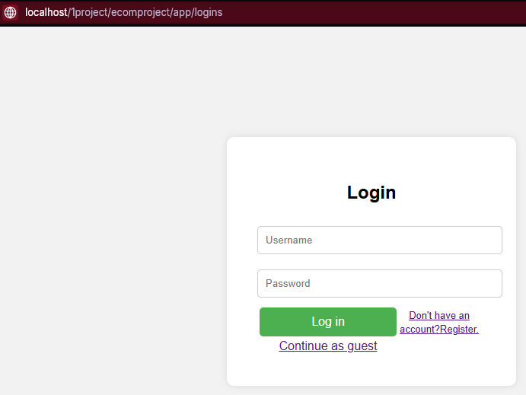
At least one authentication check
If a user tries accessing the cart page when not logged in they are automatically taken to the login page

Slide 10

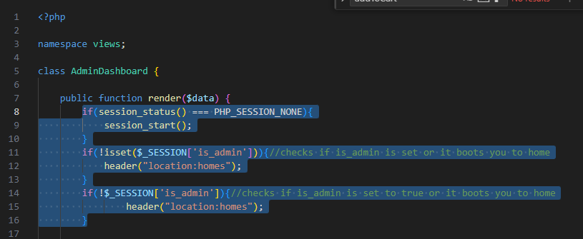
At least one authorization check
If your account is considered admin then a admin page button will appear to the left of the Log Out button

Slide 11
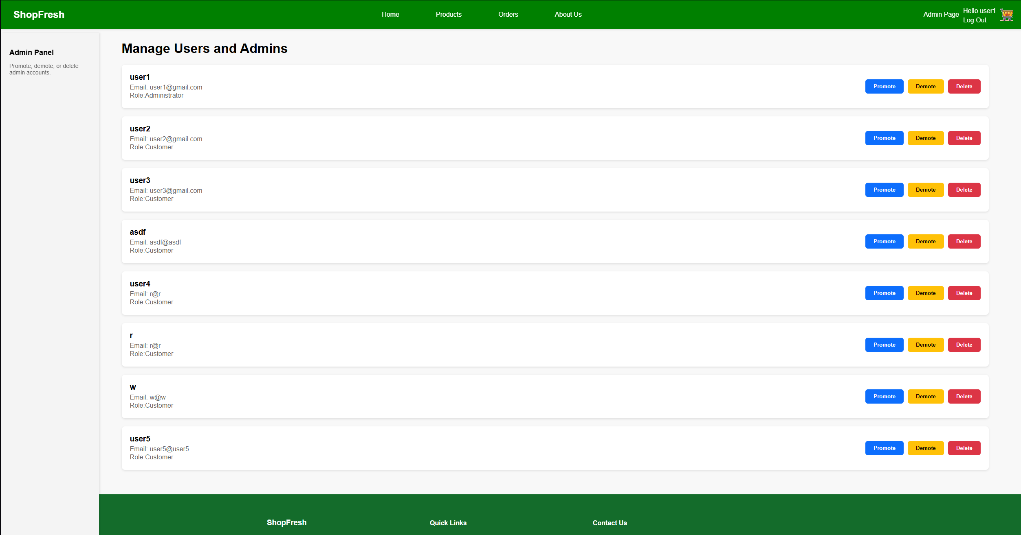
When you click the Admin Page button it takes you to this page**
Where admins can create new admins or demote admins back down to users or delete users all together

Slide 12
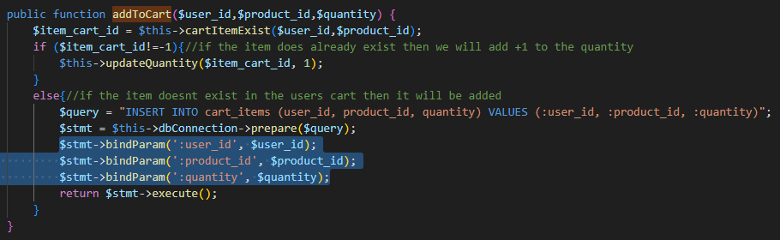
SQL Injection prevention for all queries
Here is an example of how I am binding params in order to prevent SQL injection

Slide 13
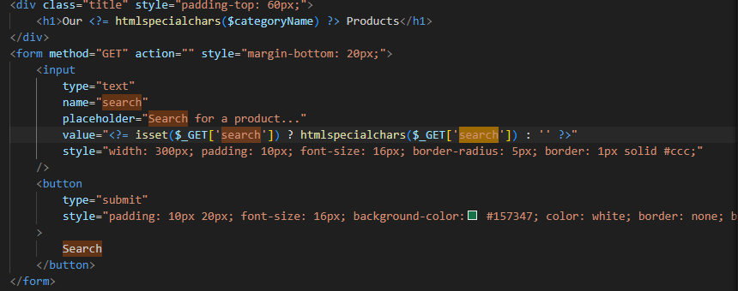
User inputs and URLs sanitization for all user inputs and URLs **
I make sure to use htmlspecialchars() whenever I get a input from the user

Slide 14
Internationalization and localization **

Slide 15
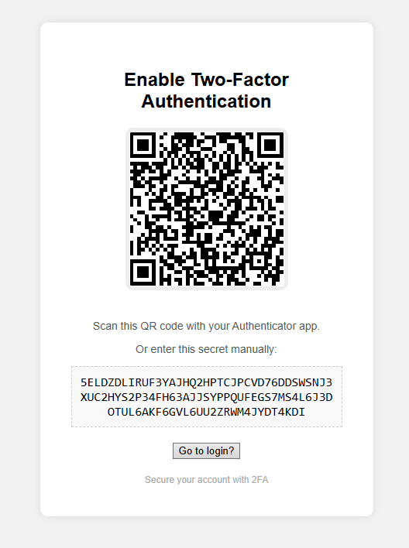
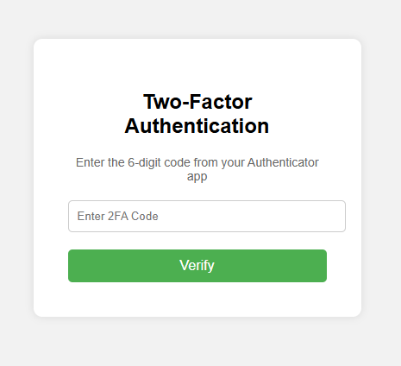
Two-Factor Authentication
When trying to log in after inputing password and username you are taken to this page
After inputing data to register yourself and the username is unique then you are taken to this page

Slide 16
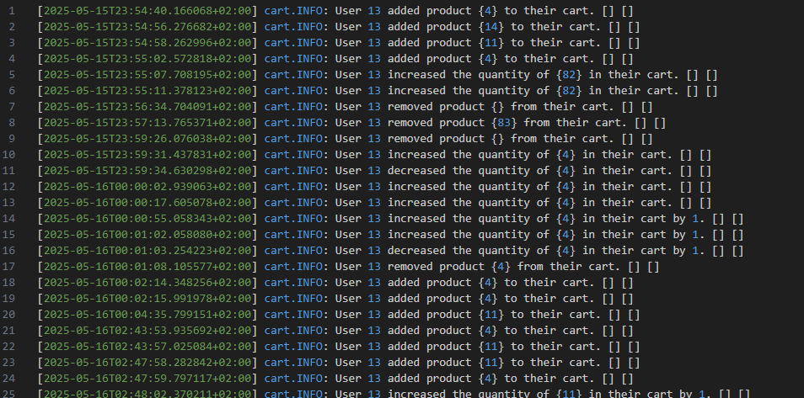
Logging

Slide 17
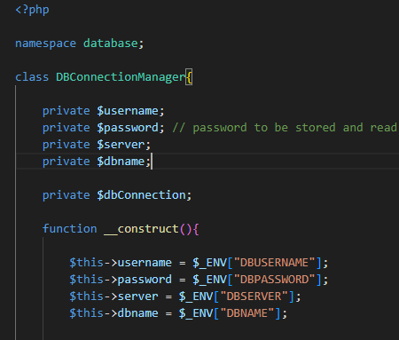
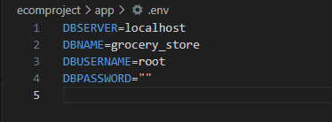
Storage of database credentials in environment variables

Slide 18
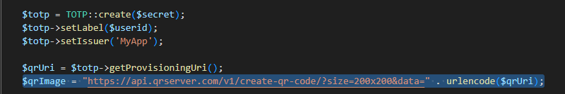
Access to a third party API
I use an API when calling the qr code maker for the 2fa

Slide 19
URL Rewrite of canonical URLs

Slide 20
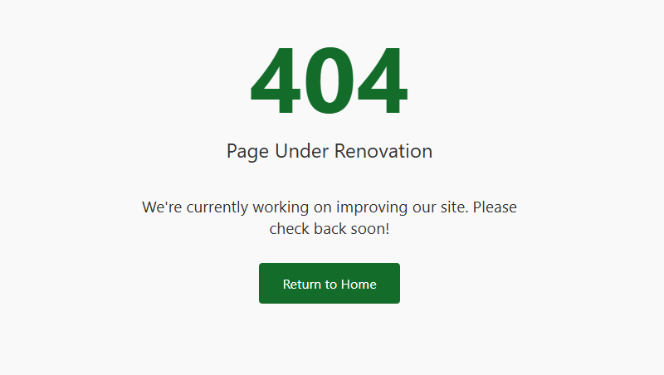

Custom Error document and favicon
Here is what the user sees when a 404 error is thrown
Here is the favicon

Slide 21
Gherkin

Slide 22
Team Members Responsibilities
Enrique Garcia did every mistake
Honorable mentions
w3Schools
StackOverflow
Php wiki

Slide 23
Challenges
Struggled with time management, which led to rushing parts of the project near the deadline.
Faced issues with URL rewriting using .htaccess, especially getting query strings to display cleanly and trigger correctly.
Had trouble organizing file paths and relative/absolute directory references, which broke some includes early on.
Integration of Monolog logging was initially confusing, especially deciding where to log events (model vs. controller).

Slide 24
Learning Outcomes
Gained hands-on experience with MVC architecture and organizing code into Models, Views, and Controllers.
Learned how to use URL rewriting with .htaccess for cleaner and more user-friendly URLs.
Improved skills in PHP class-based development, especially around routing, autoloading, and modular structure.
Understood how to structure SQL queries and use PDO securely to interact with a MySQL database.
Learned how to design a user-friendly interface and how small UI decisions impact the shopping experience.

Slide 25
Link to the github
https://github.com/Noice04/ecomproject
Dont worry its public

