Slide 1
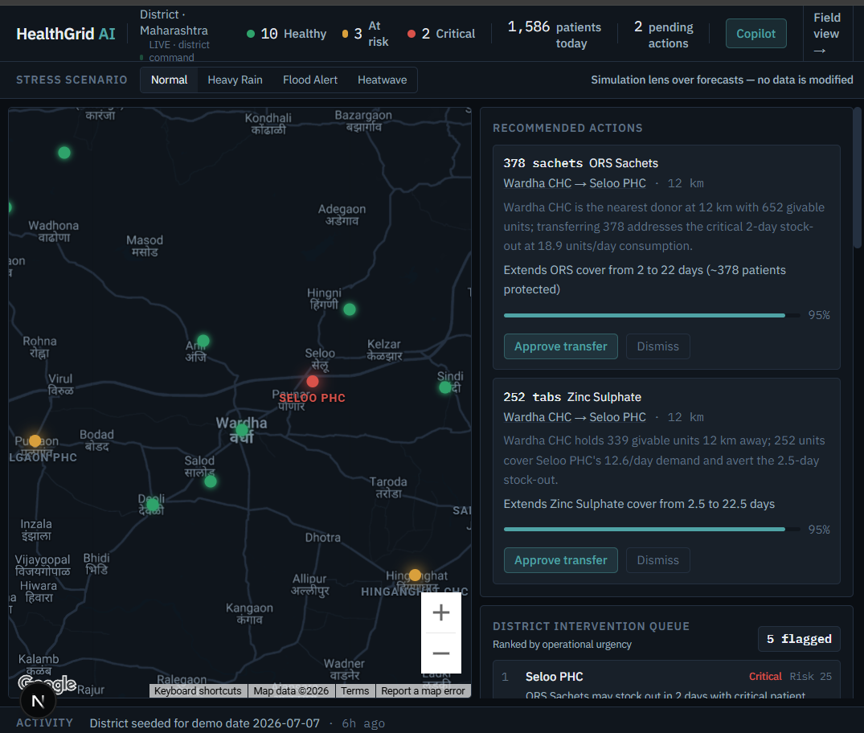
HealthGrid AI
An AI command center for district public healthcare.
HMIS records what happened. HealthGrid decides what to do next.
CODE FOR COMMUNITIES — SMART HEALTH
Saatvik Das · Nishant Rajpathak

Slide 2

THE PROBLEM
India's primary healthcare runs blind between monthly reports
25K+
~30
PHCs on paper
Days of delay
Medicines, beds, and staff tracked in paper registers — no real-time visibility
Before facility data reaches the district through monthly HMIS reporting
0
Early warnings
Stock-outs and staffing gaps are discovered only after patients are turned away

Slide 3

THE INSIGHT
HMIS records what happened. HealthGrid decides what to do next.
Existing systems
HealthGrid AI
Monthly reporting
Live facility status
Historical records
Real-time risk score
Drug logistics records
Early stock-out warnings
Manual escalation
AI-prioritized intervention queue
Static dashboards
Forecast → recommend → approve workflow
No rip-and-replace: HealthGrid ingests the records districts already keep and fills the real-time gap between reports from the frontline itself.

Slide 4
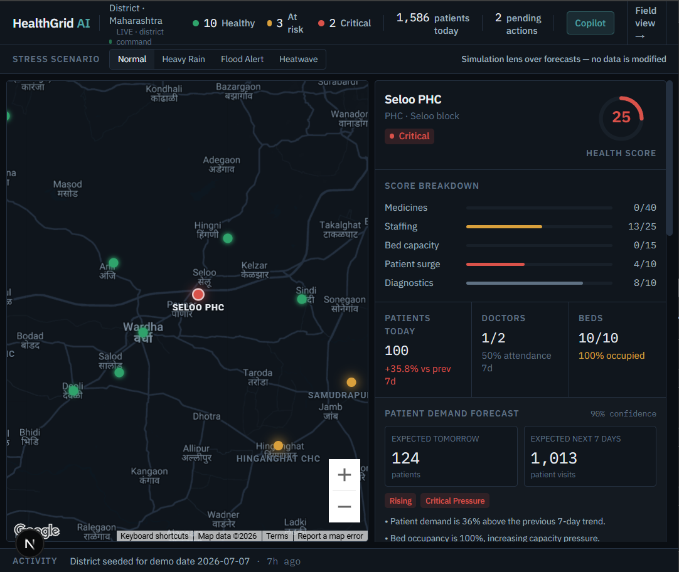
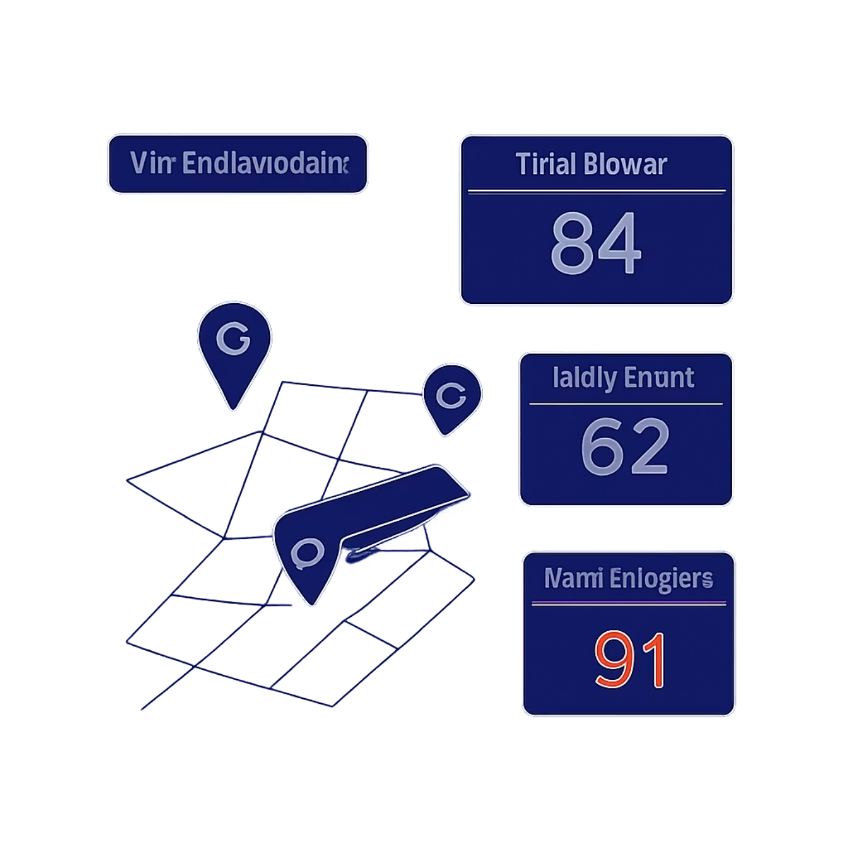
THE PRODUCT
Real Time District Command Center
Live Digital Twin
15 facilities scored 0–100 on medicines, staffing, beds, surge, and diagnostics — all at once.
AI That Explains & Acts
Root-cause analysis and guarded transfer plans — approved in one click with full audit trail.
Realtime, No Refresh
Every field update re-scores the entire district in seconds via Firestore sync.
Smart Redistribution
Recommends safe transfers of medicines/resources between nearby centres

Slide 5
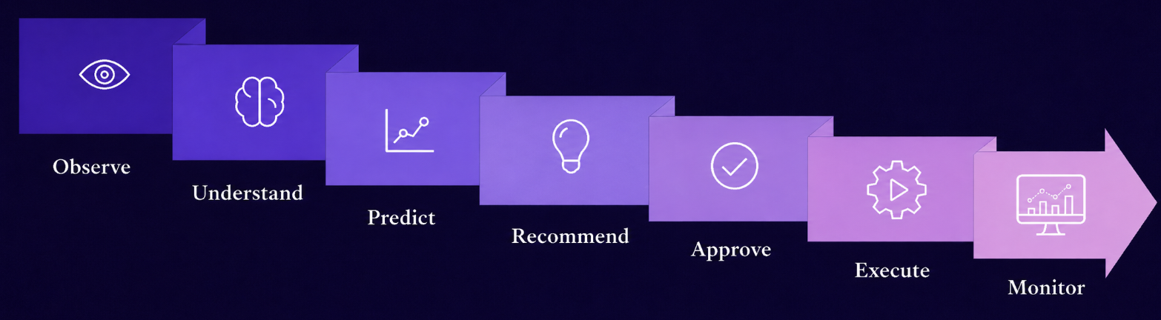
AI ARCHITECTURE
Deterministic engines decide the numbers. Gemini does what LLMs are actually good at.
Deterministic & Tested
Gemini, Where It Excels
Risk scoring : 5 weighted components, 0–100
Burn-rate stock-out forecasts per medicine
Transfer guardrails: donor keeps 14+ days, max 40%
88 unit tests · reproducible seed & simulations
Server side validation before any recommendation is approved
Grounded root-cause explanations — every claim cites data
Structured transfer proposals, validated server-side
Copilot with function calling over live engines
Hindi / Marathi / English speech → structured updates

Slide 6
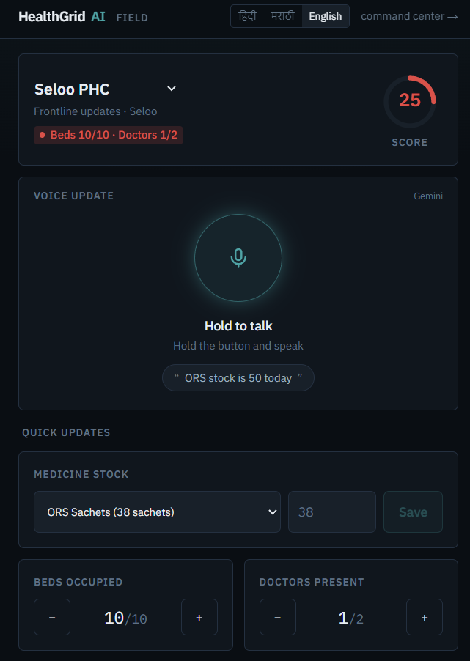
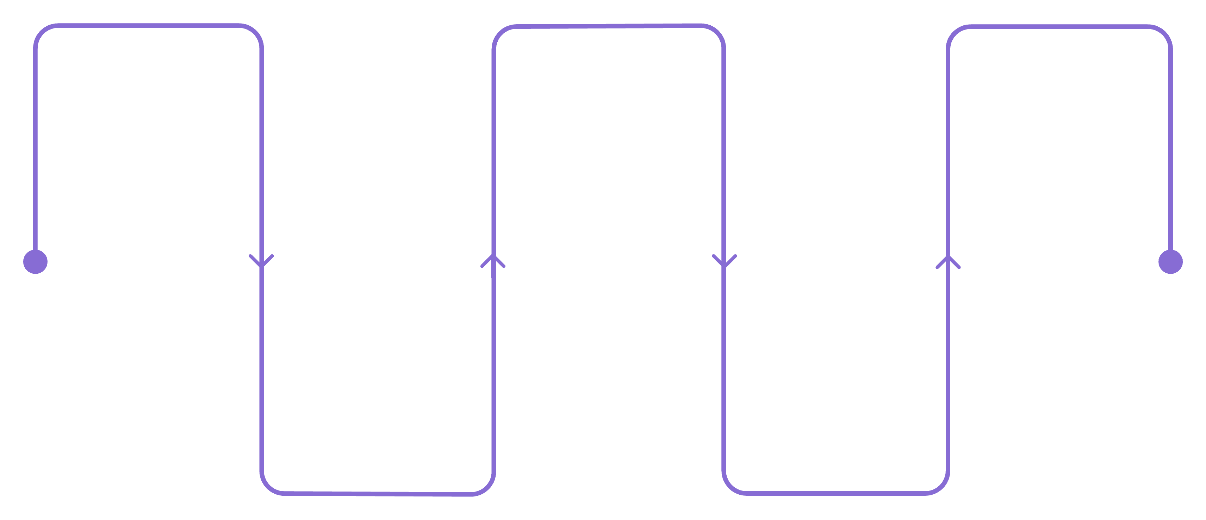
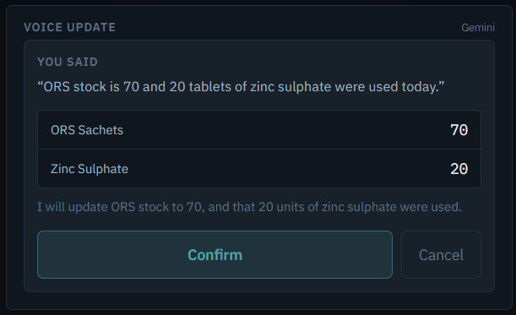
THE FRONTLINE
A health worker speaks. The district reacts in seconds.
Worker speaks in local language
Worker confirms the update
Facility score changes
Gemini parses medicine, quantity,
facility, intent
"आज ओआरएस का स्टॉक 50 बचा है"
Firestore updates live status
Language-first: Multilingual. हिंदी · मराठी · English, etc → whole UI localizes
Smart parsing: Handles mixed speech, maps medicine names to inventory IDs
Human in the loop: Nothing is written without on-screen confirmation
Zero friction: No forms. No paperwork. No English required.

Slide 7
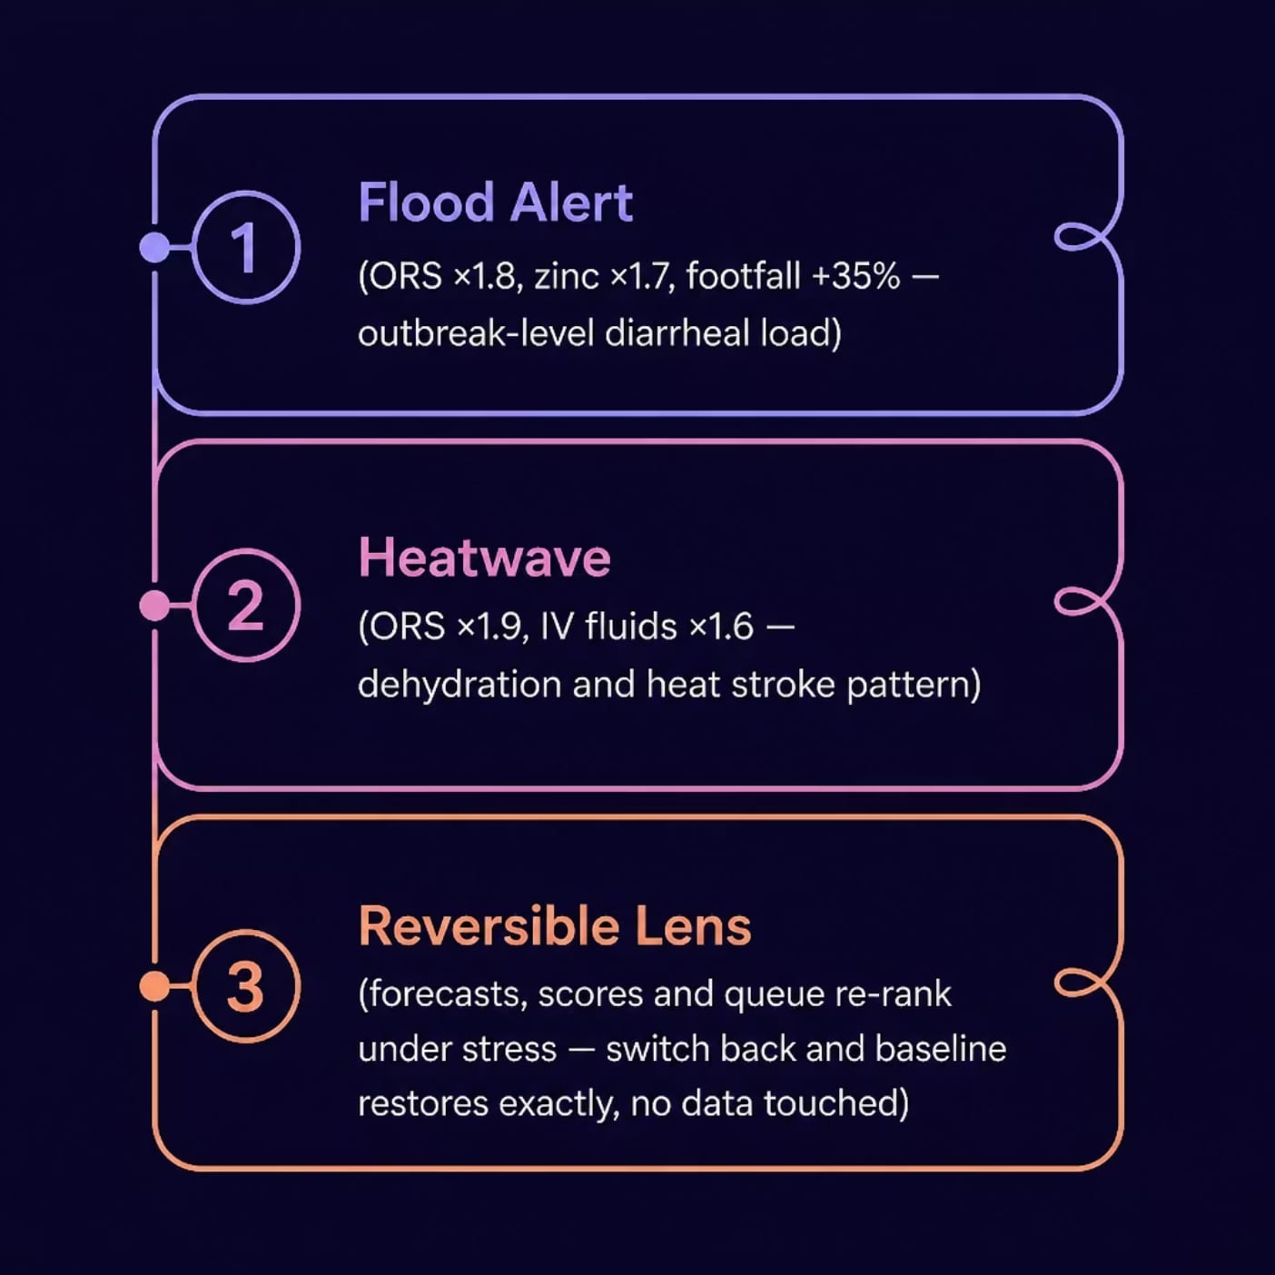

NEW FEATURE
Weather & Disaster Stress Mode
Proactive, not reactive
When a weather event is detected, HealthGrid automatically re-ranks facility scores and medicine forecasts based on WHO first-line response patterns.
Flood Alert: ORS ×1.8 · zinc ×1.7 · footfall +35%
Heatwave: ORS ×1.9 · IV fluids ×1.6
Reversible: Switch back — baseline restores exactly. No data touched.
Multipliers follow WHO first-line response patterns — built to be replaced by live IMD weather signals.

Slide 8
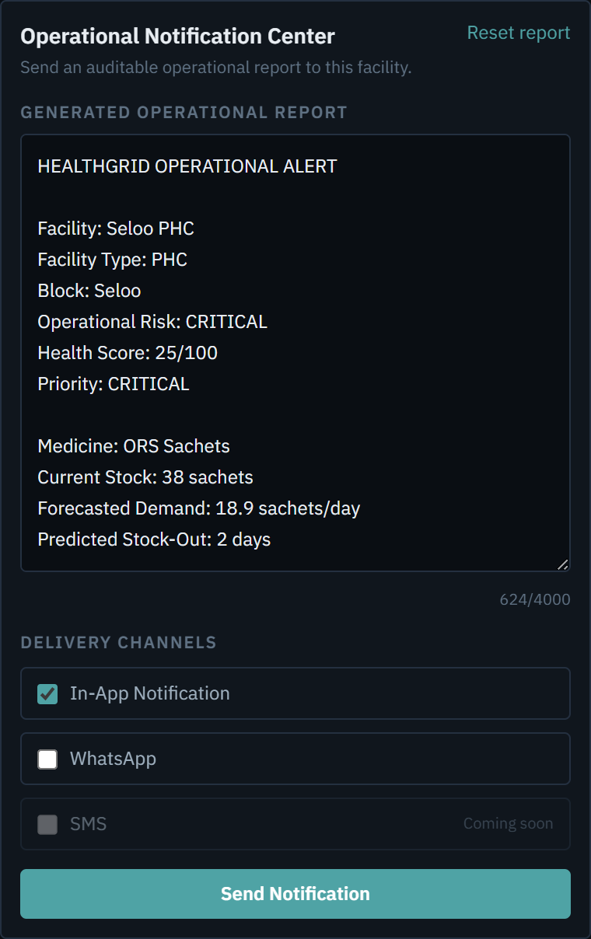
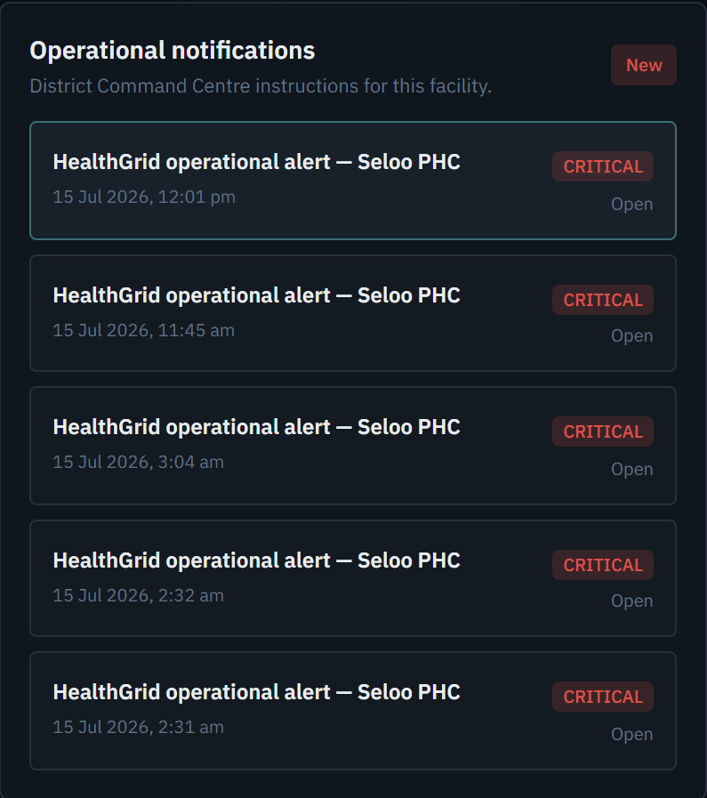
NEW FEATURE
Operational Notification Center
From decision to acknowledgement
The command centre turns a facility's live risk picture into an auditable operational report — and pushes it to the frontline in one click.
Two channels: in-app inbox + WhatsApp Cloud API — tracked per channel
Closed loop: read & acknowledge stream back to the district live
Auditable: every alert is a Firestore document with delivery history
WhatsApp failure never blocks in-app delivery — the frontline always gets the message.

Slide 9
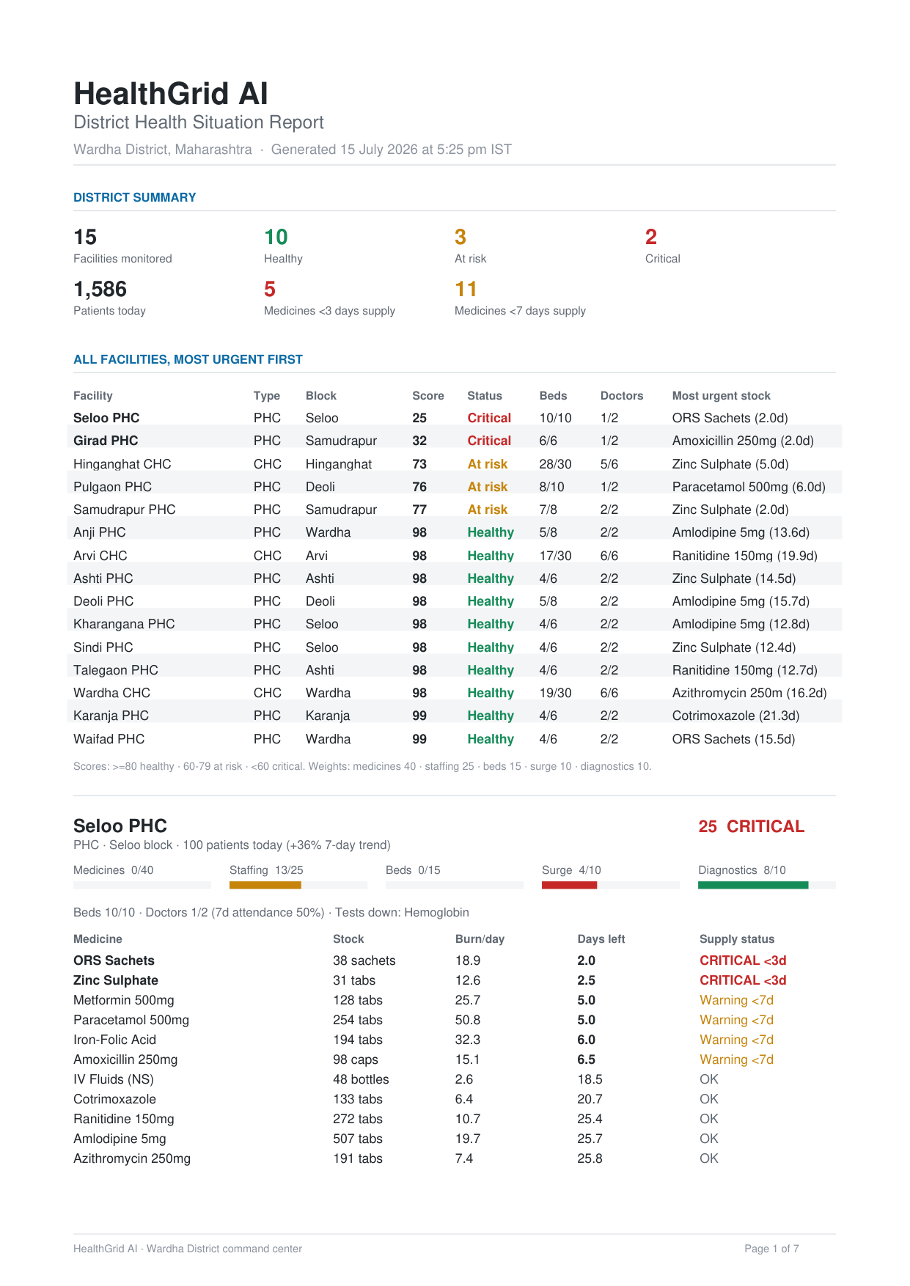
NEW FEATURE
One-Click District Report
The whole district, on paper
One button in the command centre exports a full PDF situation report — district summary, all 15 facilities triaged most-urgent first, and per-facility stock-out forecasts.
Same engines: it can never disagree with the map
Meeting-ready: printable, shareable, boardroom-friendly
Always current: generated on demand from live state
From live map to signed-off paperwork — the last mile of the decision loop.

Slide 10

MEASURED IMPACT
One month, one district, existing stock only.
0
Stock-out days
Down from 54 projected facility-medicine stock-out days over the next 30 days
31
Guarded transfers
Between facilities — each validated against guardrail rules
5,157
Units redistributed
Of existing district stock — no new purchases required
₹0
New medicine spent
All demand met through smarter redistribution of current inventory
Counterfactual simulation over seeded 90-day history + 30-day projection, using the exact engines and guardrails in the product. Reproducible: npx tsx scripts/impact-sim.ts

Slide 11
TECHNOLOGY
Gemini is the interface. Deterministic engines are the authority.
Gemini API
Cloud Firestore
Structured outputs · function calling · audio understanding · multilingual · TTS
Realtime listeners power the live map — no polling, no refresh
Google Maps Platform
Firebase
District digital twin on real Wardha cartography, custom dark style
Admin SDK transactions, security rules · deployed on Google Cloud Run
Next.js 16 · TypeScript · 88 unit tests · quota-aware Gemini model rotation

Slide 12
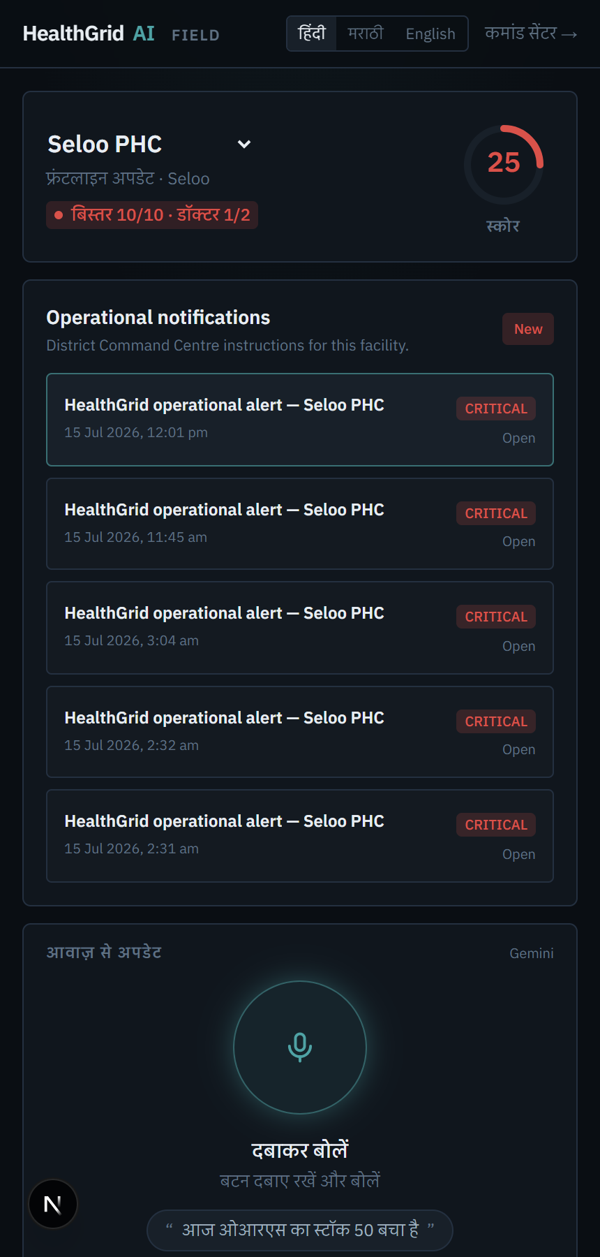
ROADMAP
Built for What Comes Next
Same engines, new reach
Every item extends the deterministic engine pipeline that already runs — new signals and new surfaces, no rearchitecture.
Offline-first: store-and-forward updates + SMS channel
Field View 2.0: worker-tested redesign of the frontline app
Regional languages: each state rollout ships its own languages
Readiness scores: new ops & facility metrics from new data
Sequenced by pilot feedback: connectivity first, then languages, then richer scores.

Slide 13
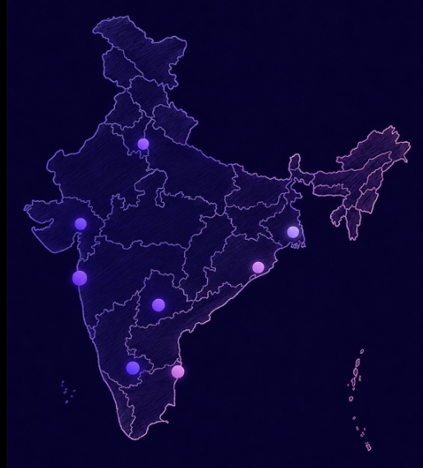

Pilot-ready for one district. Scalable to 800+ districts.
Prove — one district
Pilot 10–20 PHCs/CHCs — this hackathon's prize is the pilot
No hardware, no new data entry — runs on records districts already keep
Two KPIs: stock-out days prevented · alert-to-action time
Fund — through NHM
District evidence → state NHM Program Implementation Plan budget line
The District Health Society review already consumes our PDF report
Runs in low thousands ₹/month per district — inside existing IT budgets
Scale — on existing rails
HMIS/DVDMS integration — our schema mirrors their entities
District → 36 districts of Maharashtra → 800+ nationally
Scaling is configuration, not code: medicines, languages, geography
We sell evidence, not software — the pilot's own numbers make the case to the state.

Slide 14
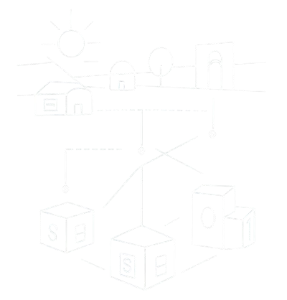
From a health worker's voice to a district's decision — in seconds.
One district today. 800 in India.
The decision layer India's HMIS data has been waiting for.
Nishant Rajpathak
Saatvik Das
Co-Builder
Co-Builder
HealthGrid AI
github.com/nishantr14/healthgrid

