Slide 1

Numerical Programming TTF 6

Slide 2
Interpolation
Interpolation is a method for estimating unknown values within the range of known data points. It "fills in" gaps by predicting values based on nearby points, commonly using linear interpolation (straight lines between points) or polynomial/spline interpolation (smooth curves through points).

Slide 3
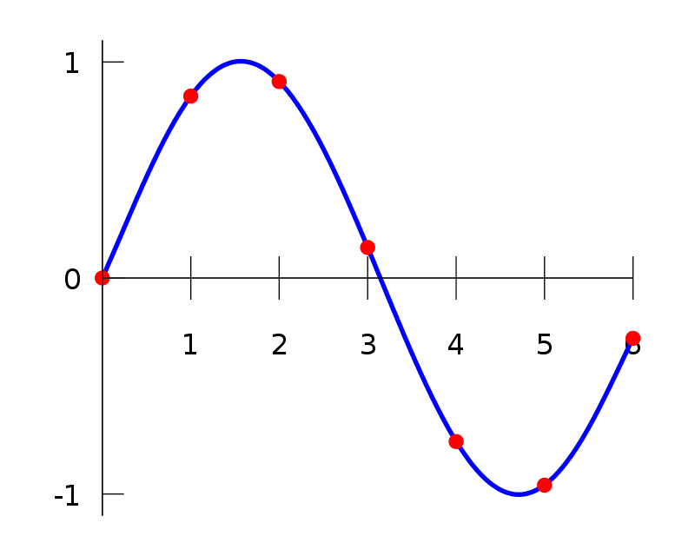
Example of interpolation

Slide 4
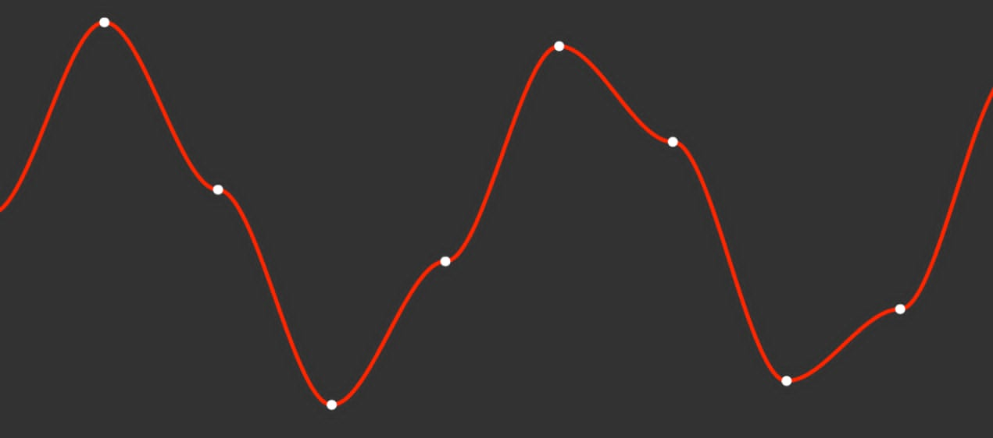
Example of interpolation

Slide 5
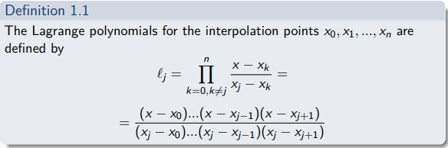
Lagrange formula

Slide 6
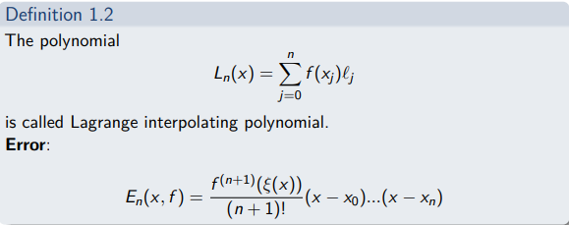
Lagrange formula

Slide 7


Slide 8
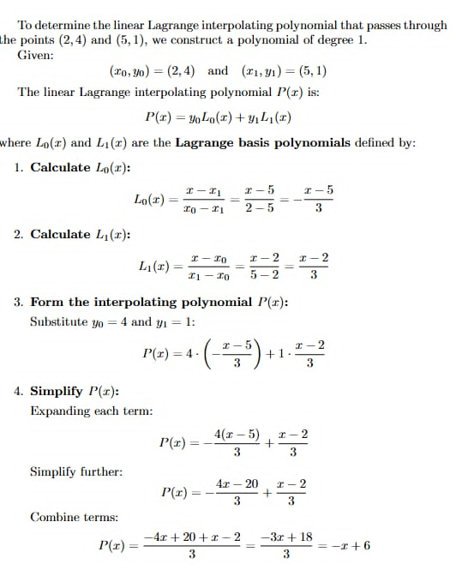

Slide 9
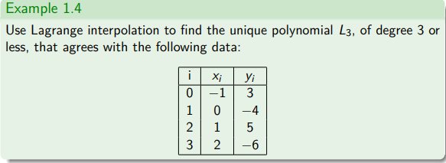

Slide 10
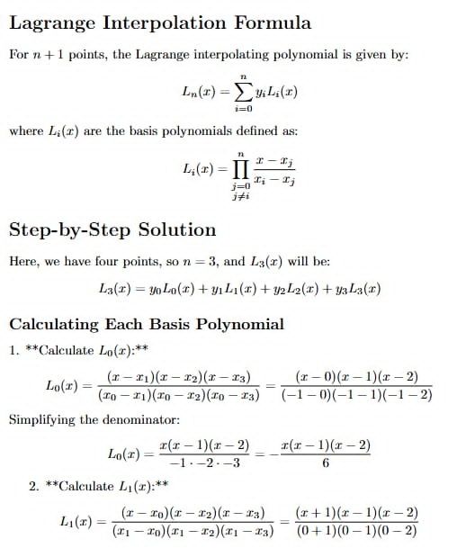

Slide 11
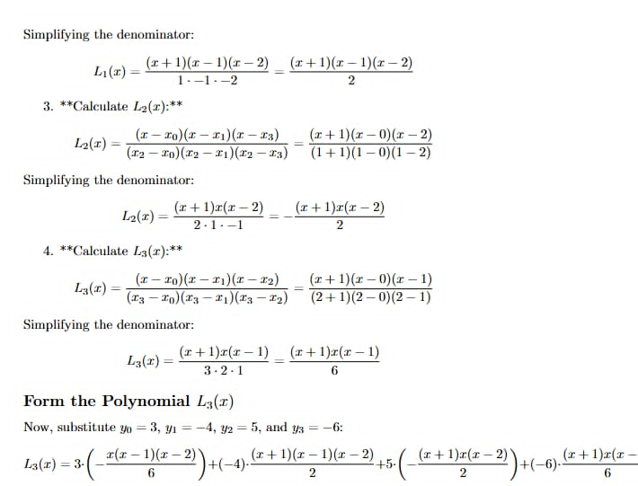

Slide 12
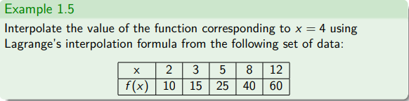

Slide 13
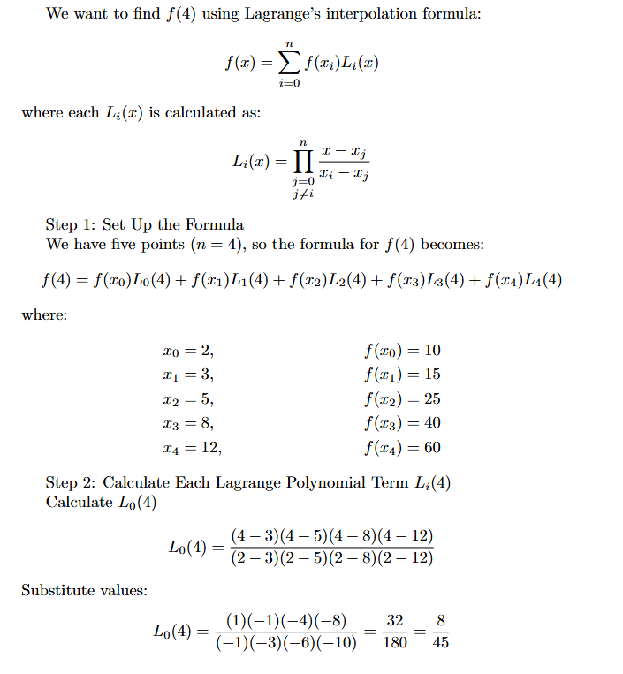

Slide 14
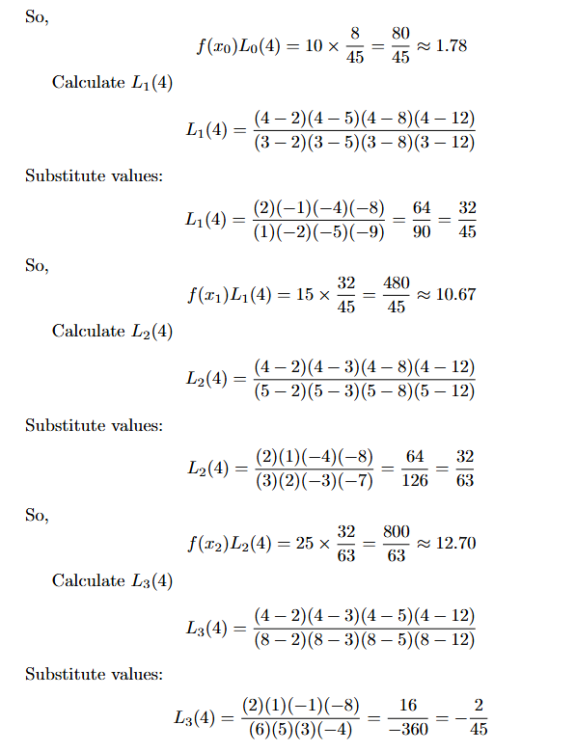
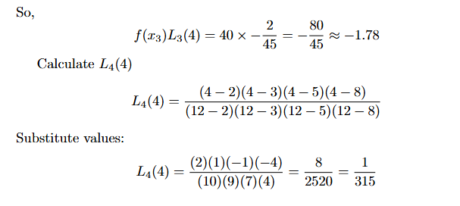

Slide 15
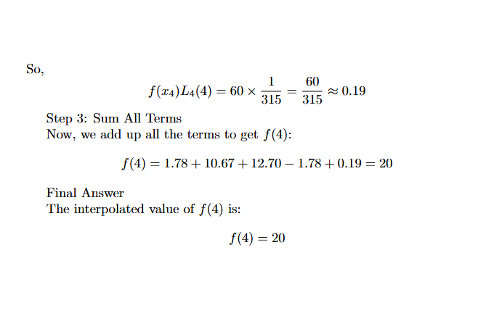

Slide 16
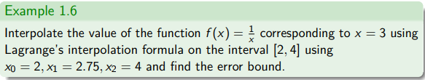

Slide 17
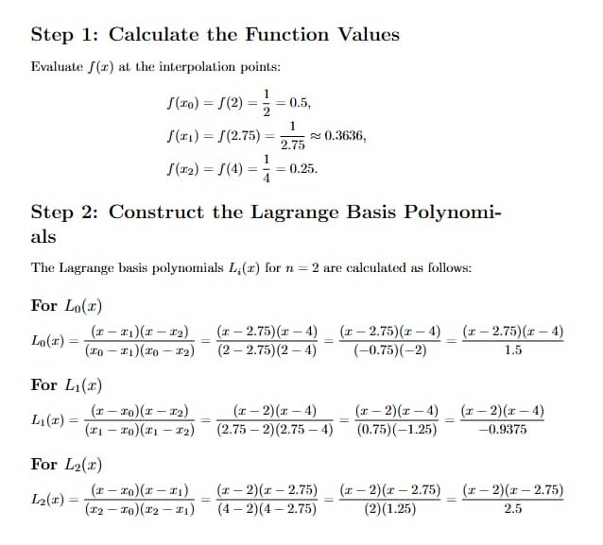

Slide 18
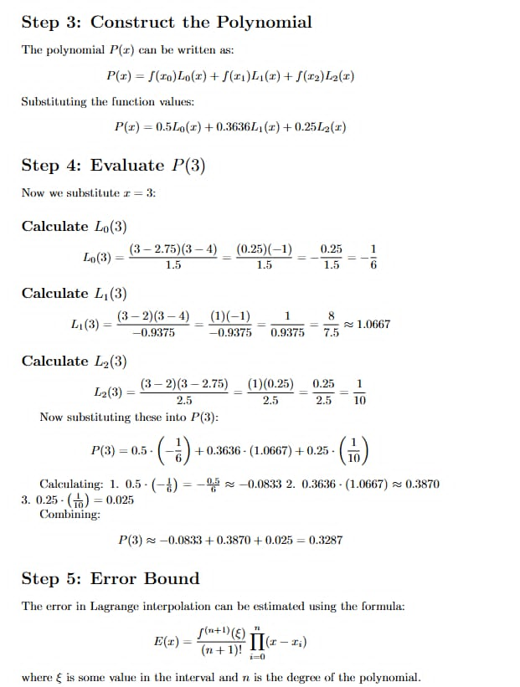

Slide 19
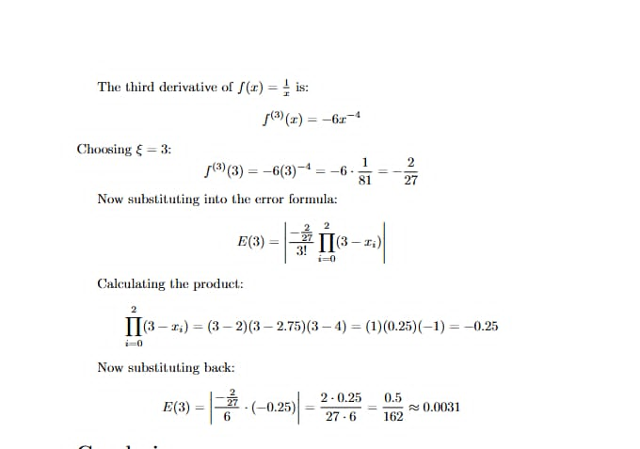

Slide 20
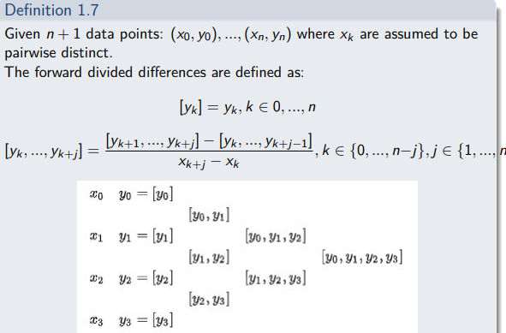

Slide 21
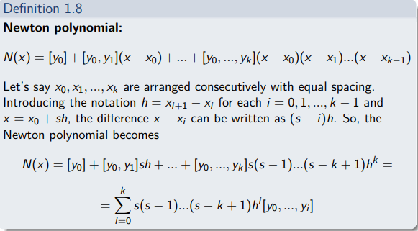
Newton’s formula

Slide 22
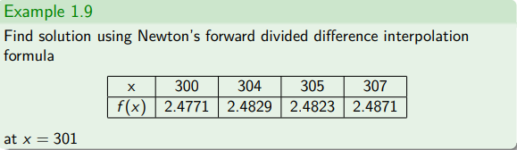

Slide 23
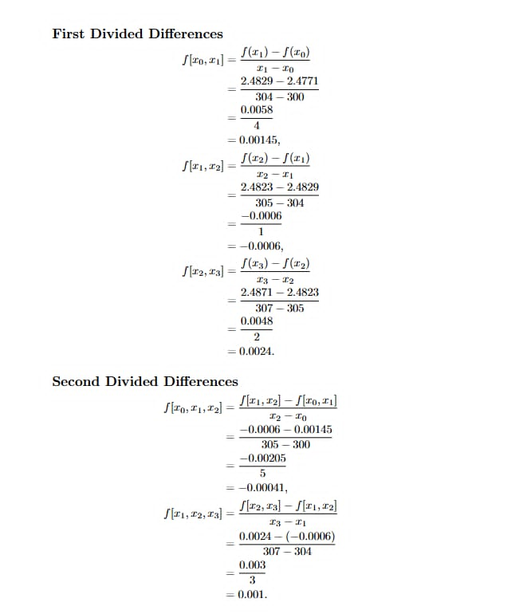

Slide 24
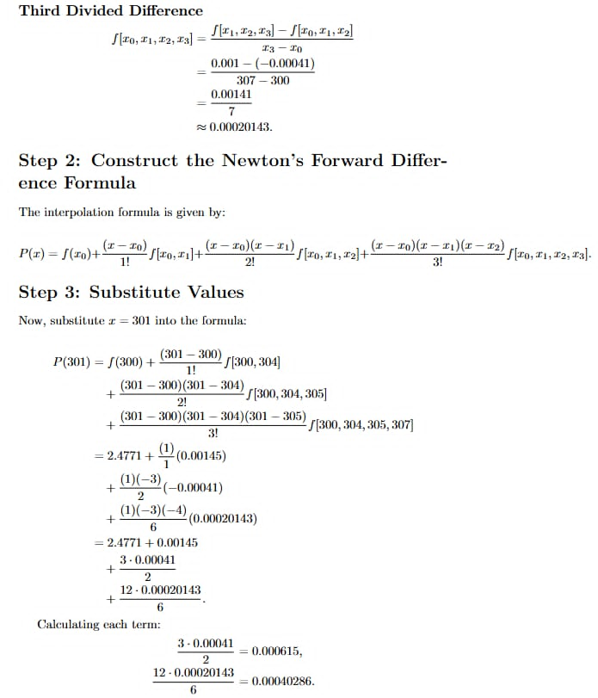

Slide 26
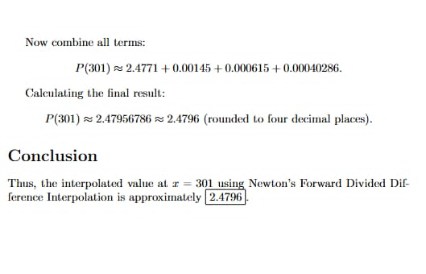

Slide 27
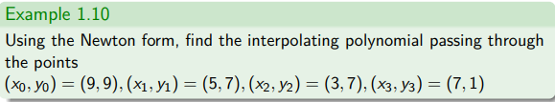

Slide 28
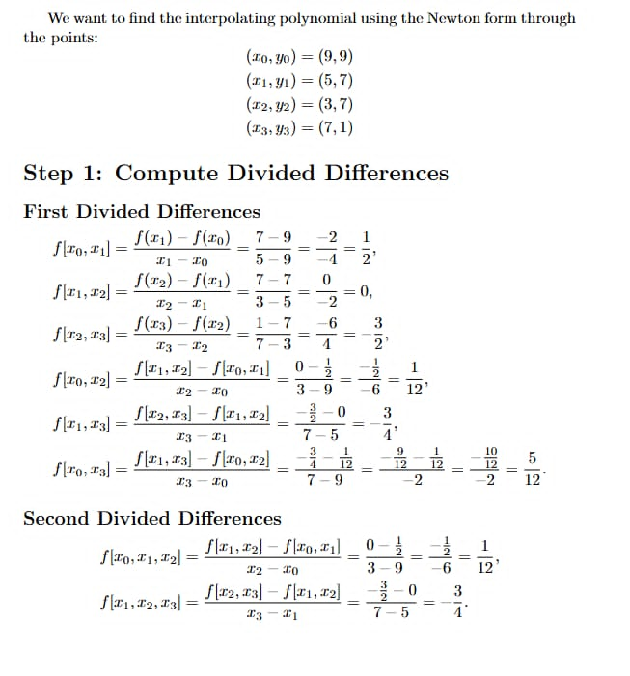

Slide 29
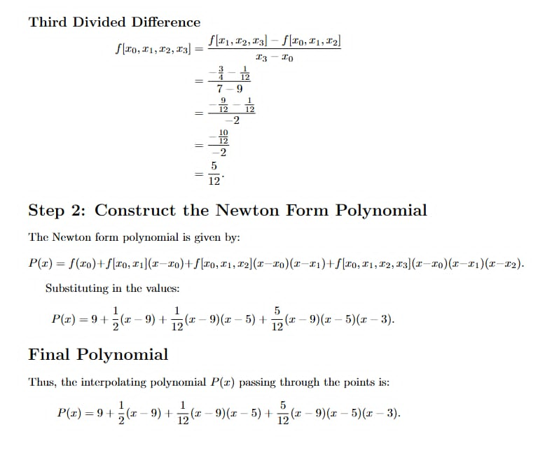

Slide 30


Slide 31
Runge’s phenomenon
Runge's phenomenon is a problem of oscillation at the edges of an interval that occurs when using polynomial interpolation with polynomials of high degree over a set of equispaced interpolation points.

Slide 32
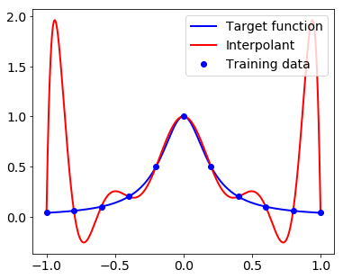
Runge’s phenomenon

Slide 33
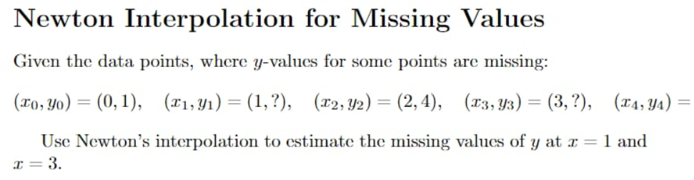
and Lagrange
|
v
(4, 7)
Also use Lagrange’s interpolation

