Slide 1

Numerical Programming TTF 7

Slide 2
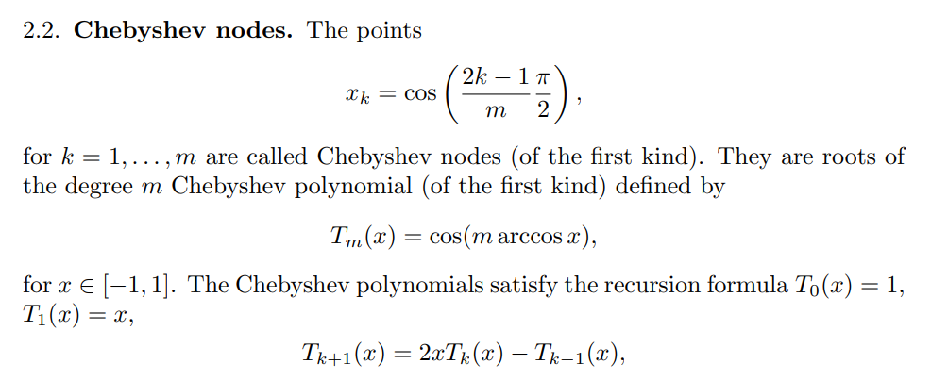
Chebyshev nodes

Slide 3
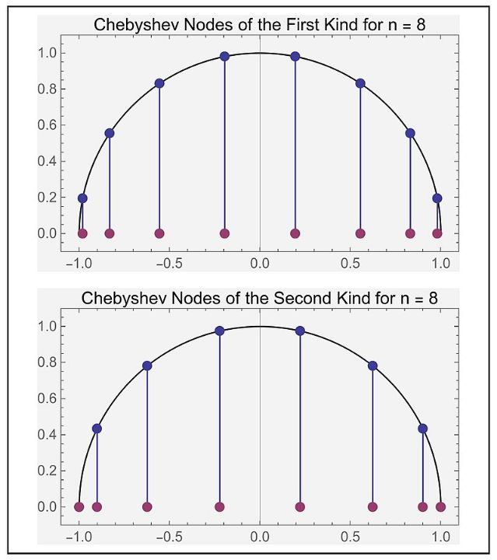

Slide 4
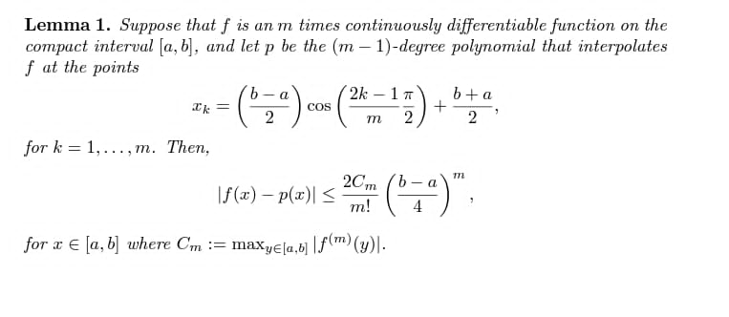

Slide 5
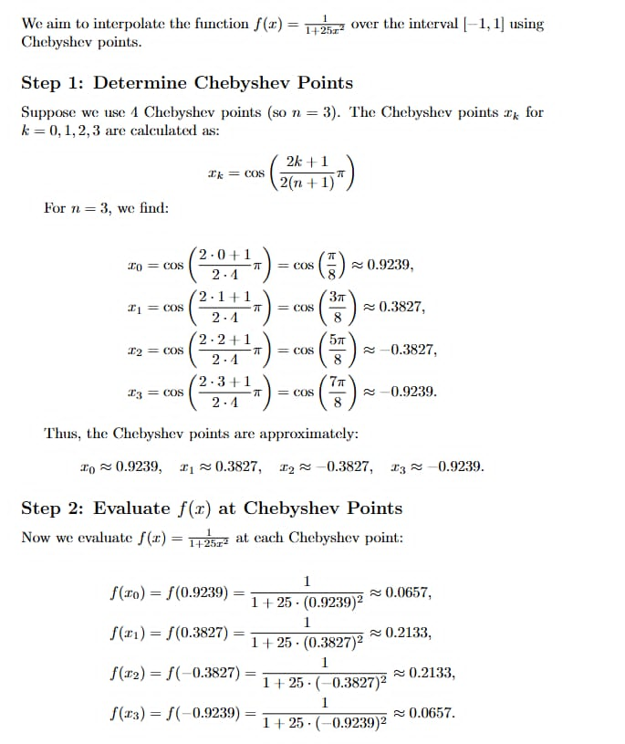

Slide 6
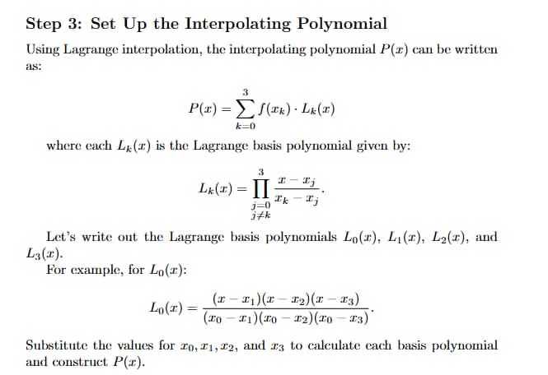

Slide 7
Piecewise interpolation
Instead of constructing a single global polynomial that goes through all the points, one can construct local polynomials that are then connected together. Suppose the interpolating function is y=g(x), and there are n+1 points to interpolate. We construct the function g(x) out of n local linear polynomials.

Slide 8
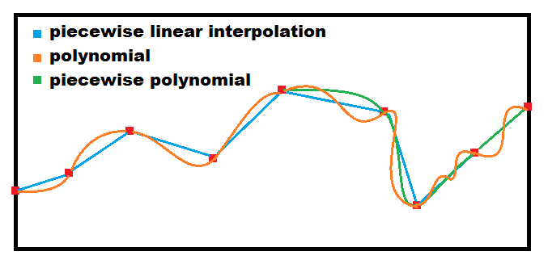

Slide 9


Slide 10
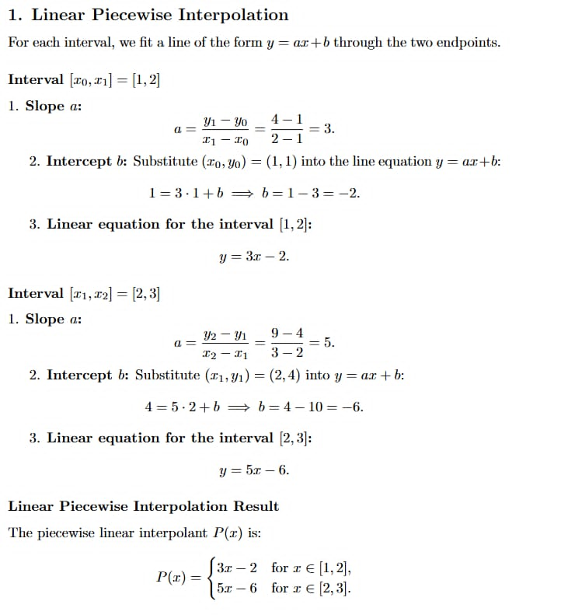

Slide 11
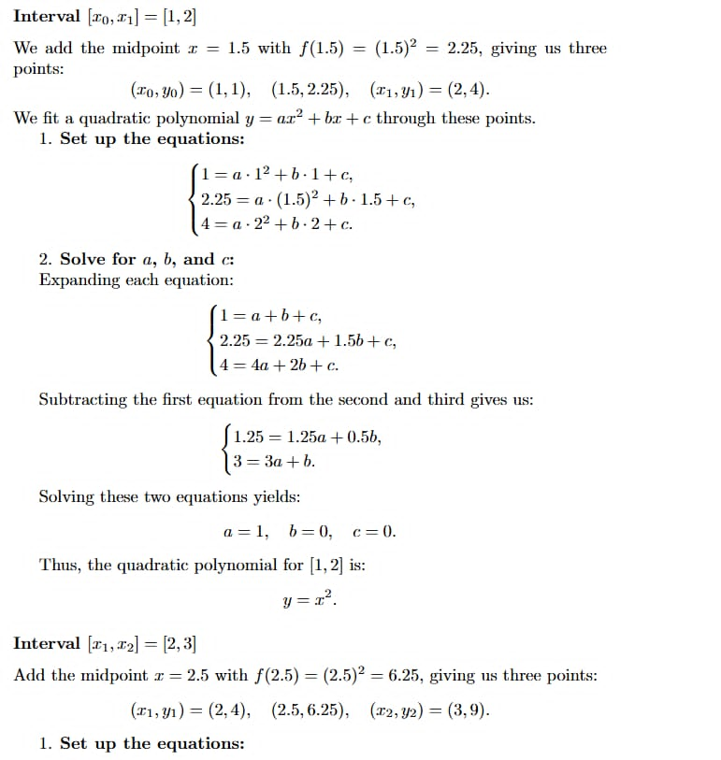

Slide 12

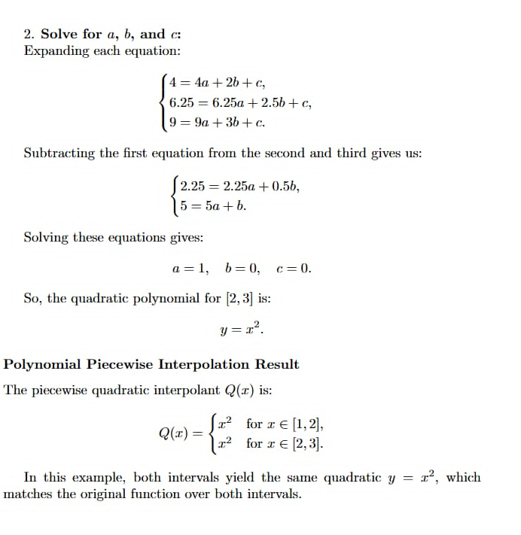

Slide 13
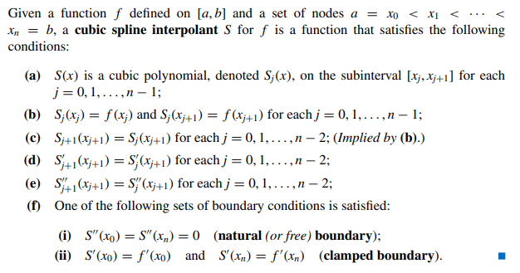
Cubic splines

Slide 14
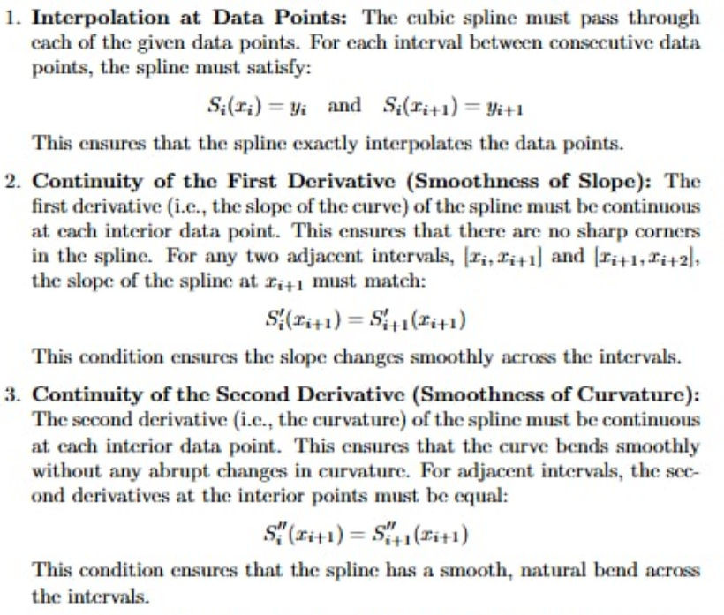
Cubic splines

Slide 15
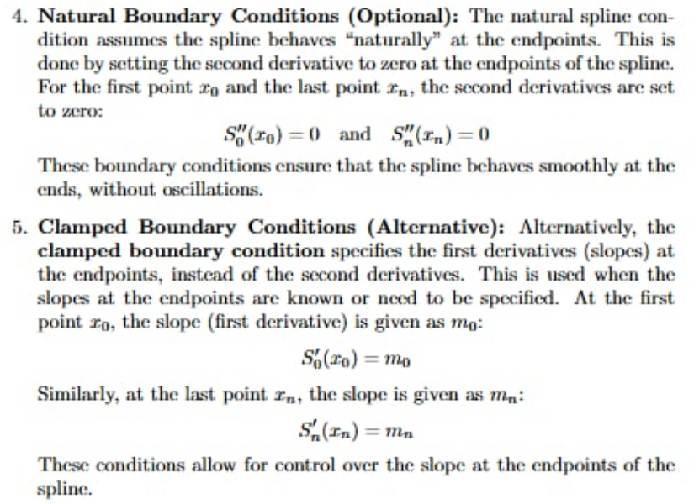
Cubic splines

Slide 17

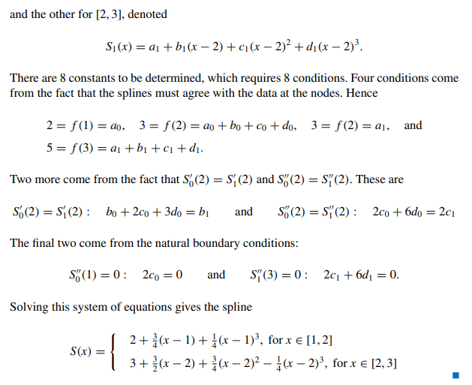

Slide 18
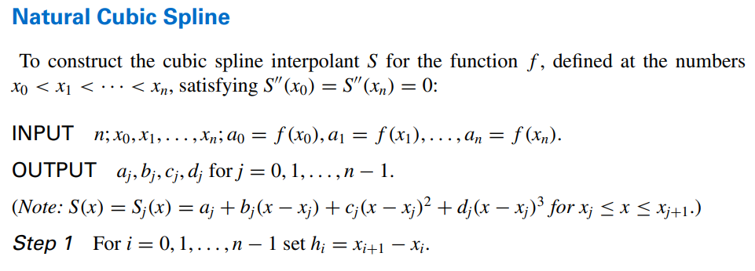

Slide 19
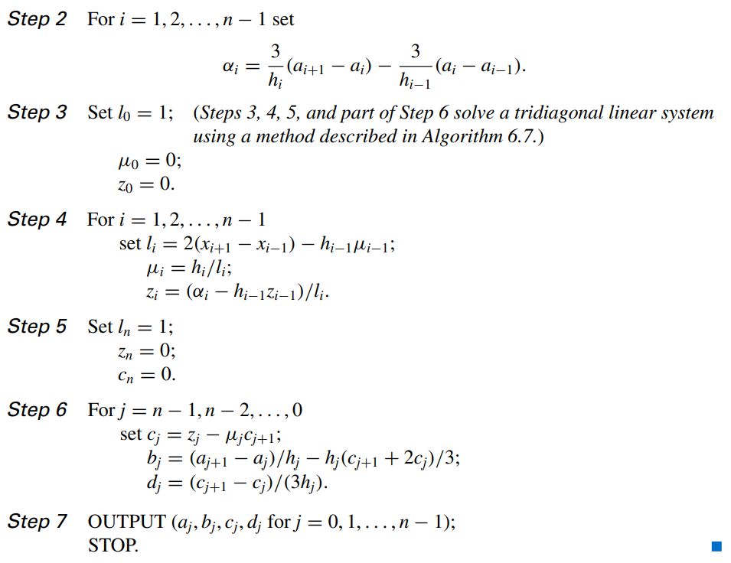

Slide 20
