Slide 1

Numerical Programming TTF 8

Slide 2
Hermite interpolation
Hermite interpolation is a method of polynomial interpolation, which generalizes Lagrange interpolation. Hermite interpolation computes a polynomial of degree less than n such that the polynomial and its first few derivatives have the same values at m (fewer than n) given points as the given function and its first few derivatives at those points.

Slide 3
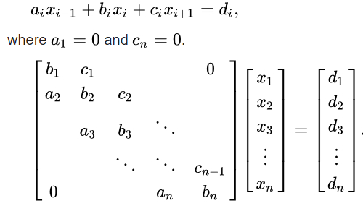
Thomas’ algorithm
Thomas algorithm is a simplified form of Gaussian elimination that can be used to solve tridiagonal systems of equations. A tridiagonal system for n unknowns may be written as

Slide 4
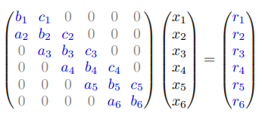
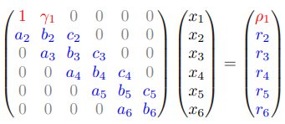
Thomas’ algorithm

Slide 5
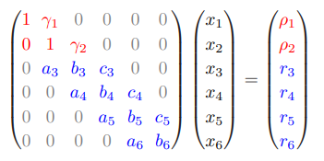
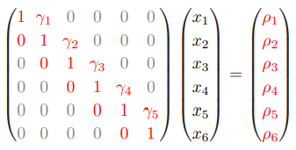
Thomas’ algorithm

Slide 6
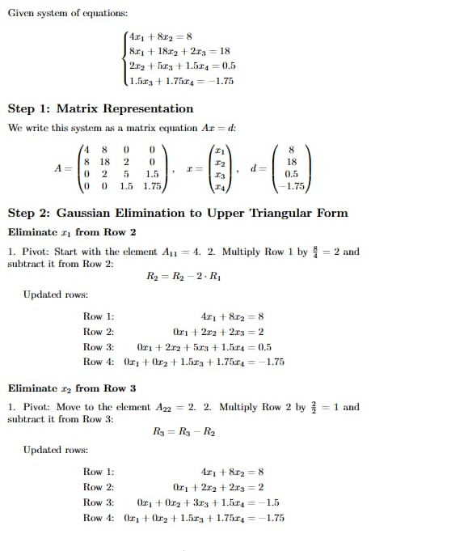
Thomas’ algorithm

Slide 7
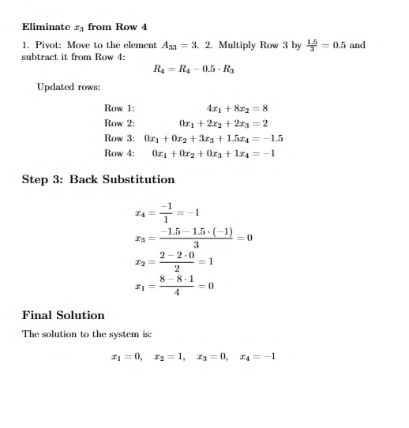
Thomas’ algorithm

Slide 8
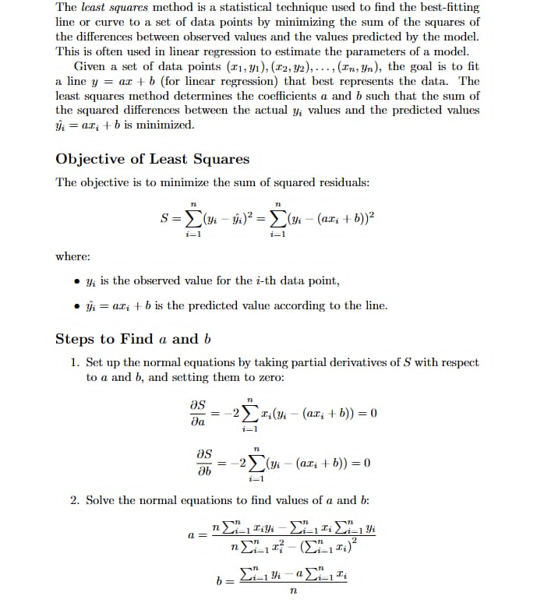
Least squares

Slide 9
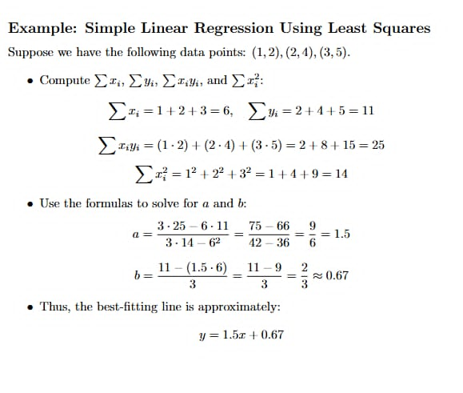
Least squares

Slide 10
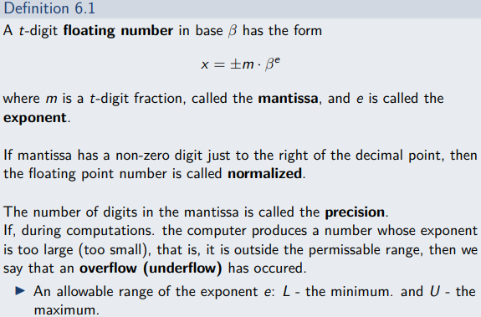
Floating point arithmetic

Slide 11
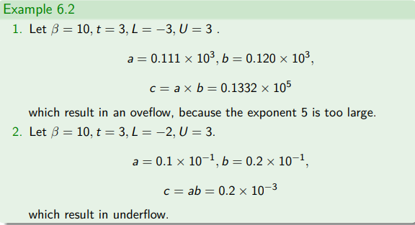
Floating point arithmetic

Slide 12
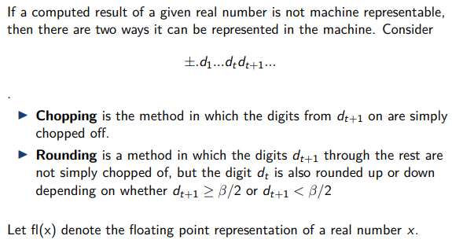
Floating point arithmetic

Slide 13
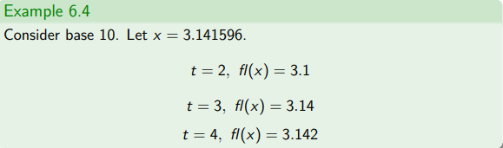
Floating point arithmetic

Slide 14
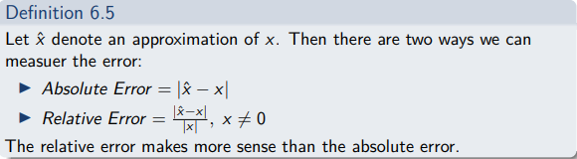
Floating point arithmetic

Slide 15
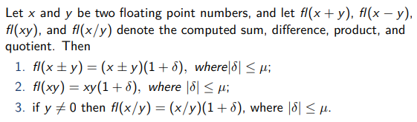
Floating point arithmetic

Slide 16
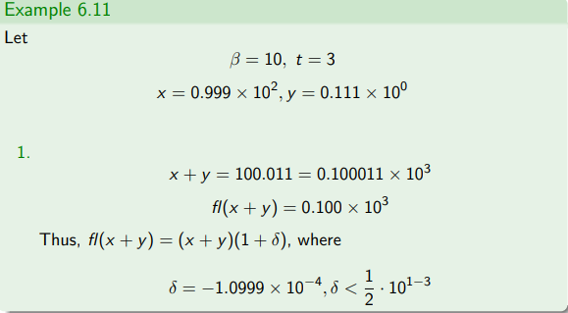
Floating point arithmetic

Slide 17
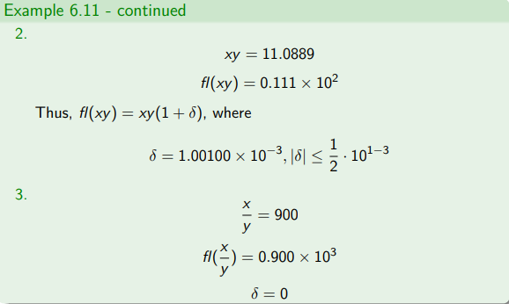
Floating point arithmetic

Slide 18
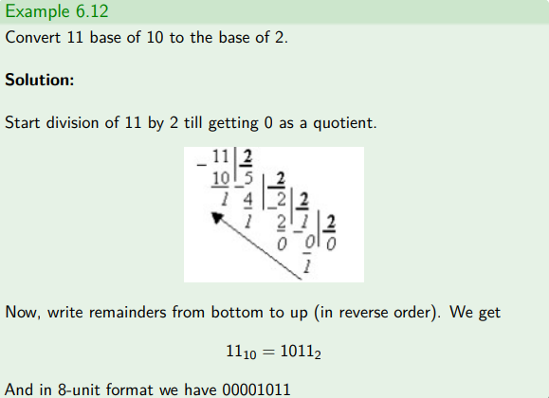
Floating point arithmetic

Slide 19
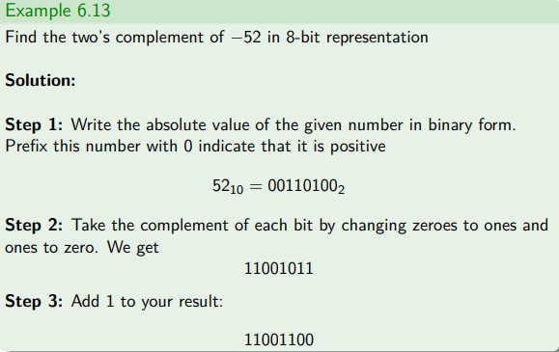
Floating point arithmetic

Slide 20
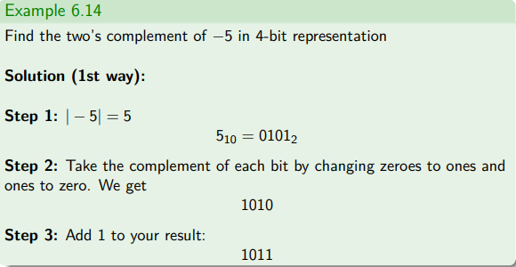
Floating point arithmetic

Slide 21
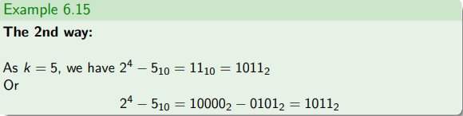
Floating point arithmetic

Slide 22
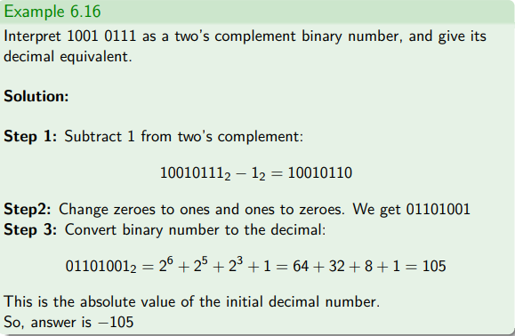
Floating point arithmetic

Slide 23
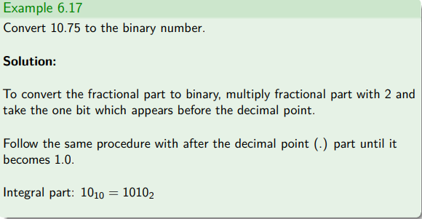
Floating point arithmetic

Slide 24
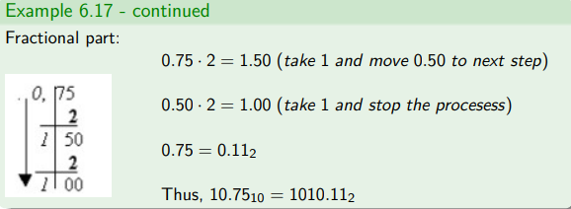
Floating point arithmetic

Slide 25
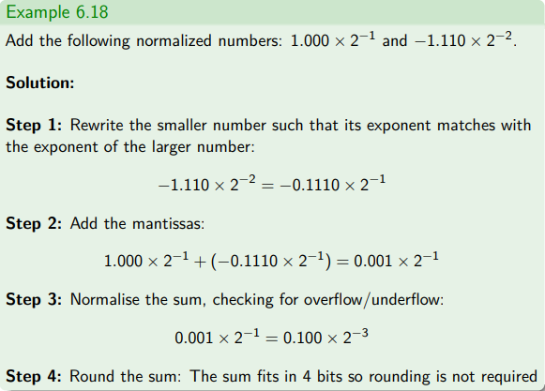
Floating point arithmetic

Slide 26
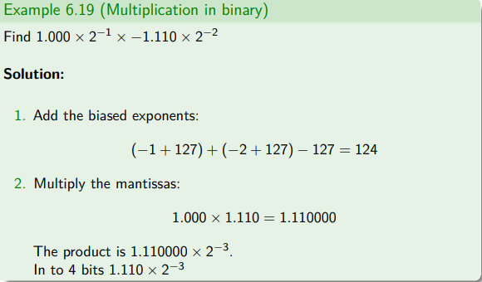
Floating point arithmetic

Slide 27
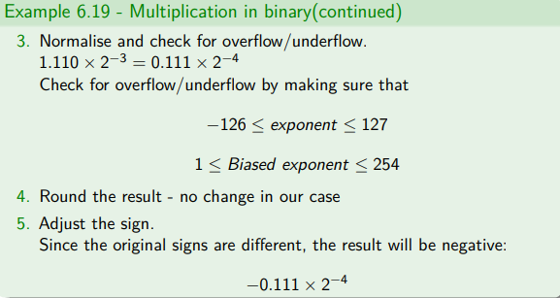
Floating point arithmetic

Slide 28
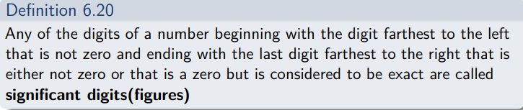
Floating point arithmetic

Slide 29
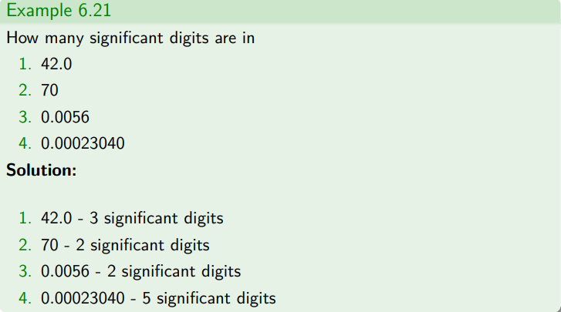
Floating point arithmetic

Slide 30

