Slide 1

Numerical Programming TTF 2

Slide 2

Matrices
A rectangular array/table of numbers, symbols, or expressions.
Can be viewed as a list of vectors
n x m matrix has n rows and m columns

Slide 3
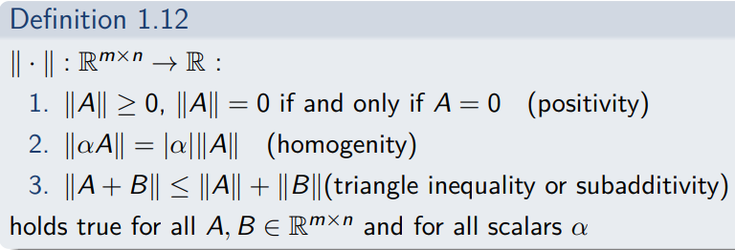
Matrix norms
Similar to vector norms
Has to satisfy these conditions

Slide 4
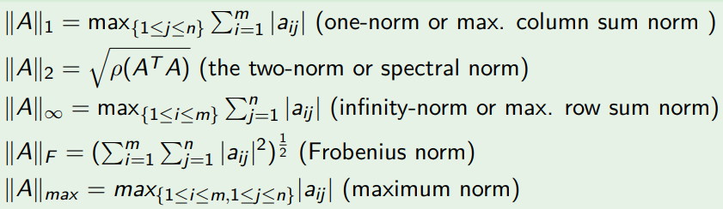
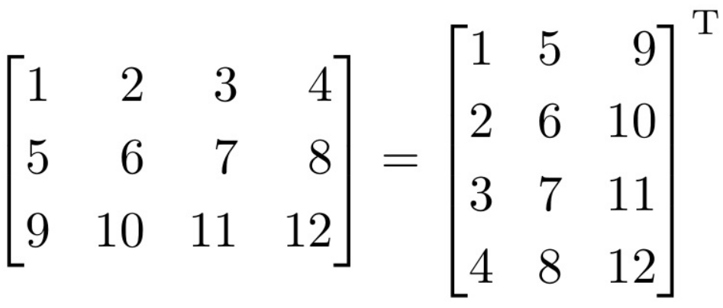
Examples of matrix norms

Slide 5
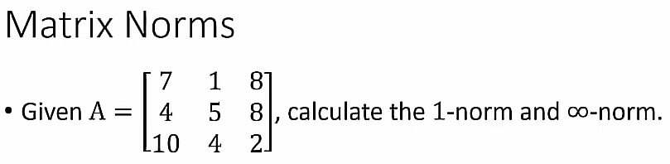
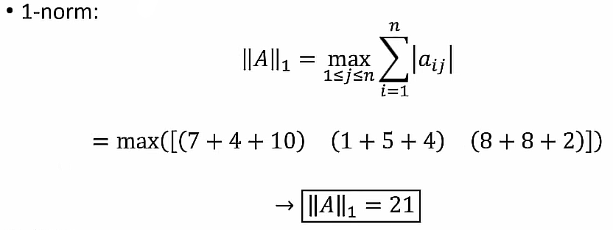
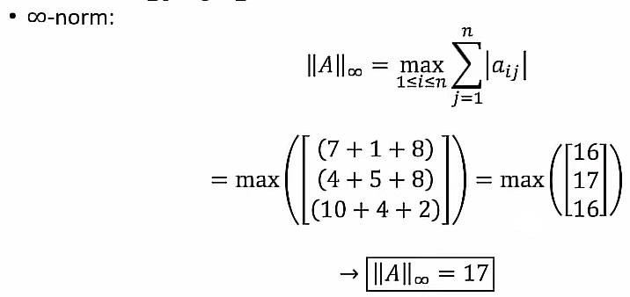

Slide 6
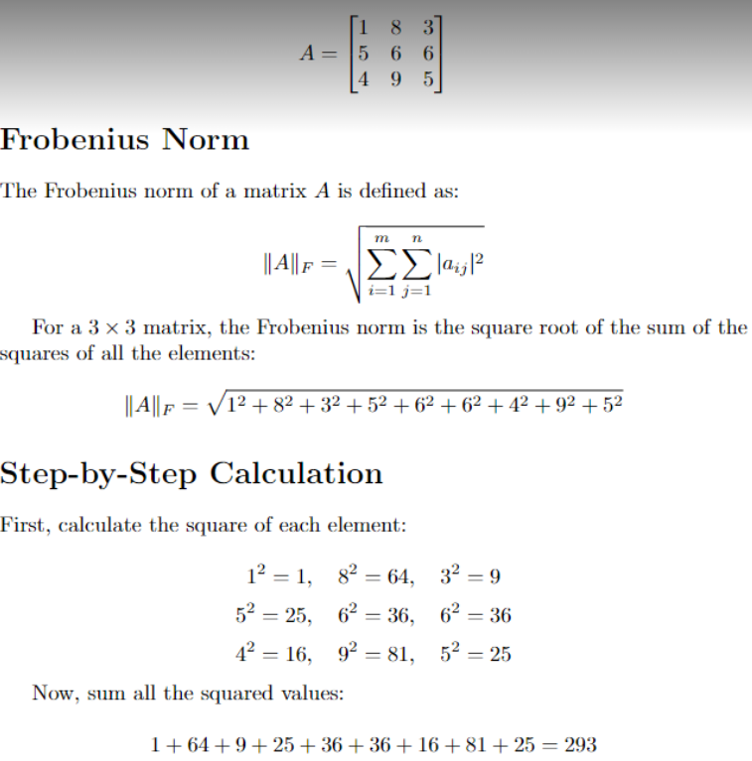
Frobenius norm

Slide 7
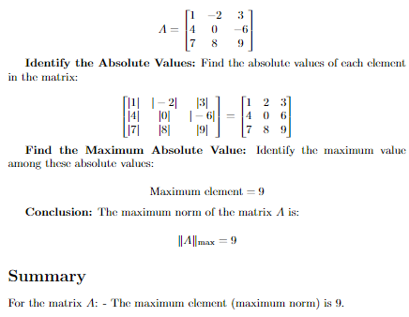
Max norm

Slide 8
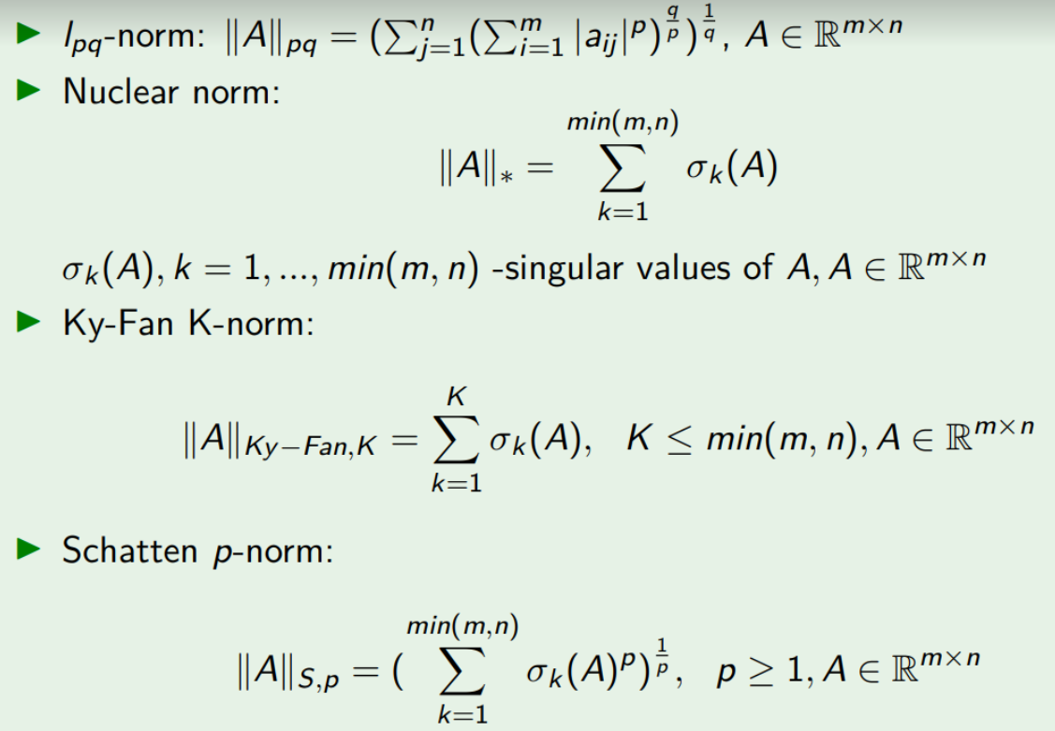

Slide 9
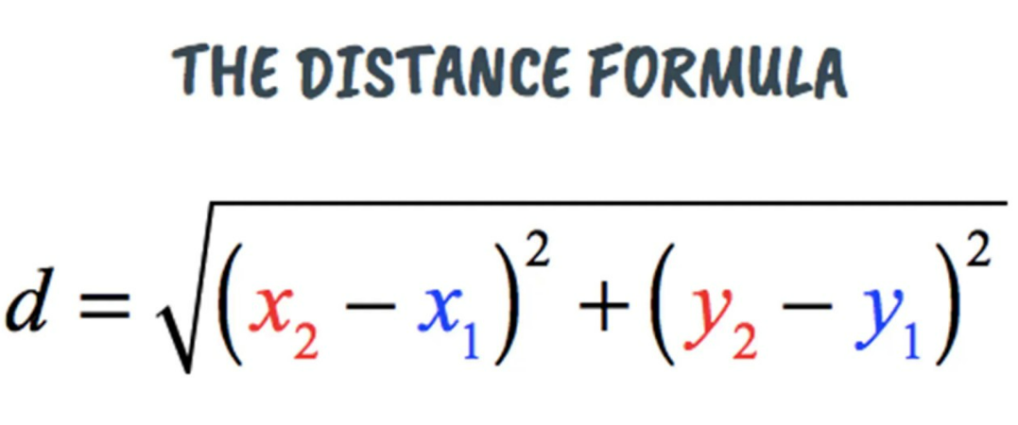
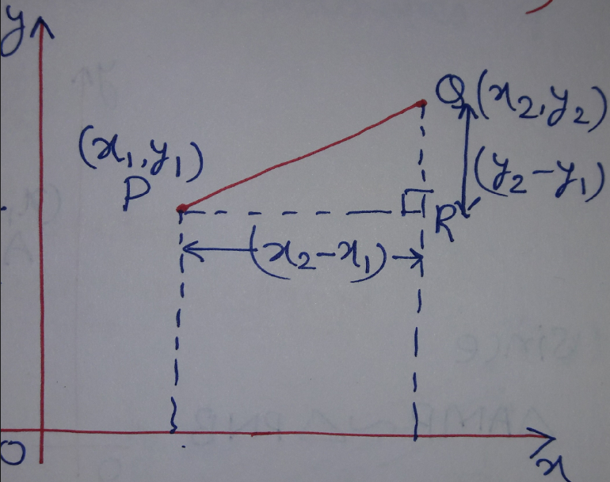
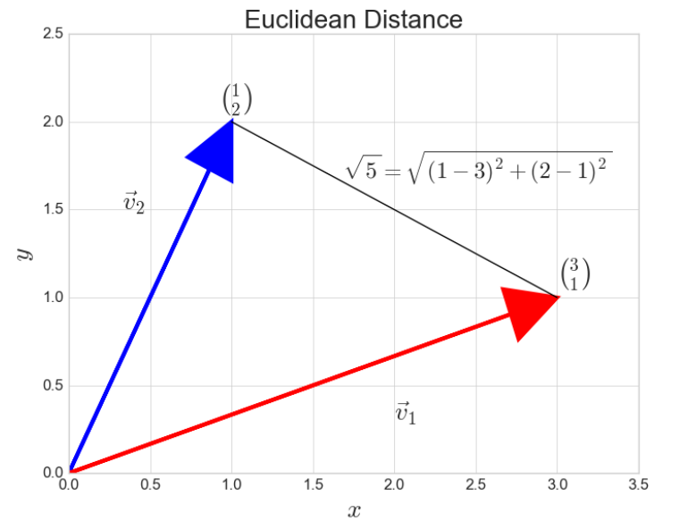

Slide 10
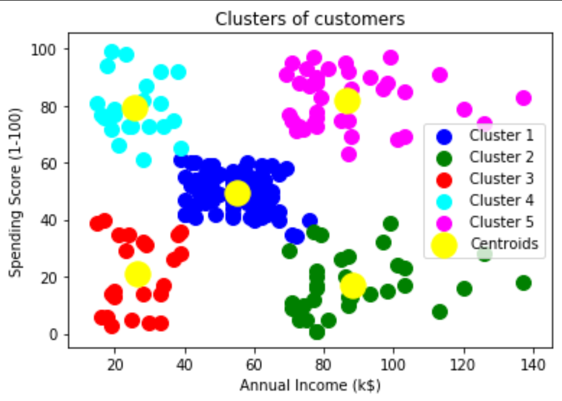
K-means clustering
Goal: group similar data and create K groups

Slide 11
K-means clustering: approach
Input: m vectors, e. g. v1, v2, v3, … vm where vi = (e1, e2, e3, … en)
Steps:
1) select k random vectors
2) for each vector vi, assign it to the closets k-vector (Partition)
3) for all vectors assigned to a k-vector, calculate the average and put it as the new k-vector (Update)
4) repeat 2) and 3) until changes are relatively small
Ouptut: k vectors, e. g. b1, b2, … bk where ai = (e1, e2, e3, … en)

Slide 12
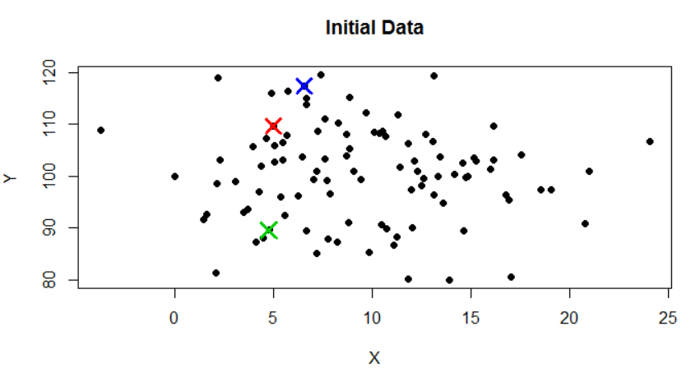
First step - Initial data

Slide 13
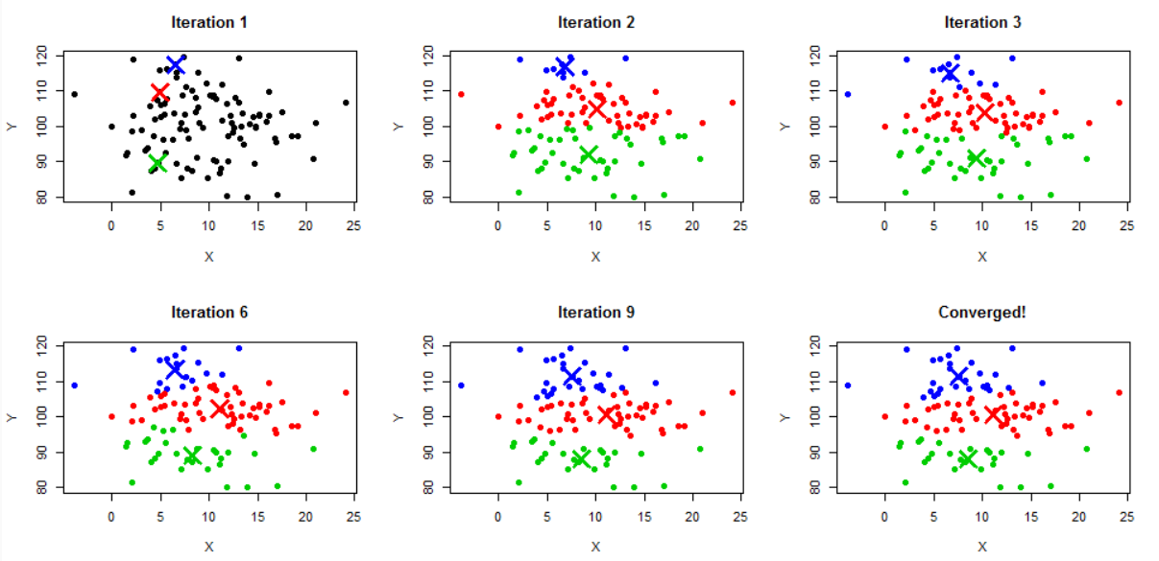
Visualization

Slide 14
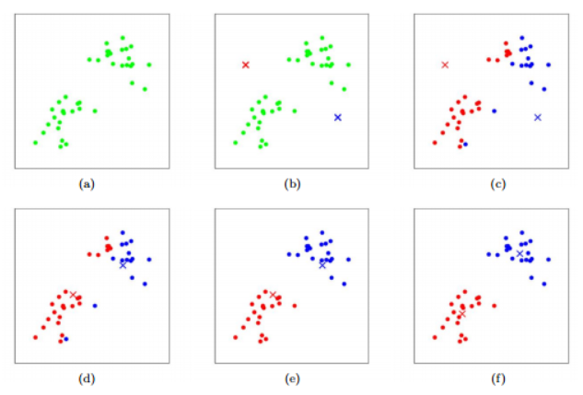
Step by step:

Slide 15
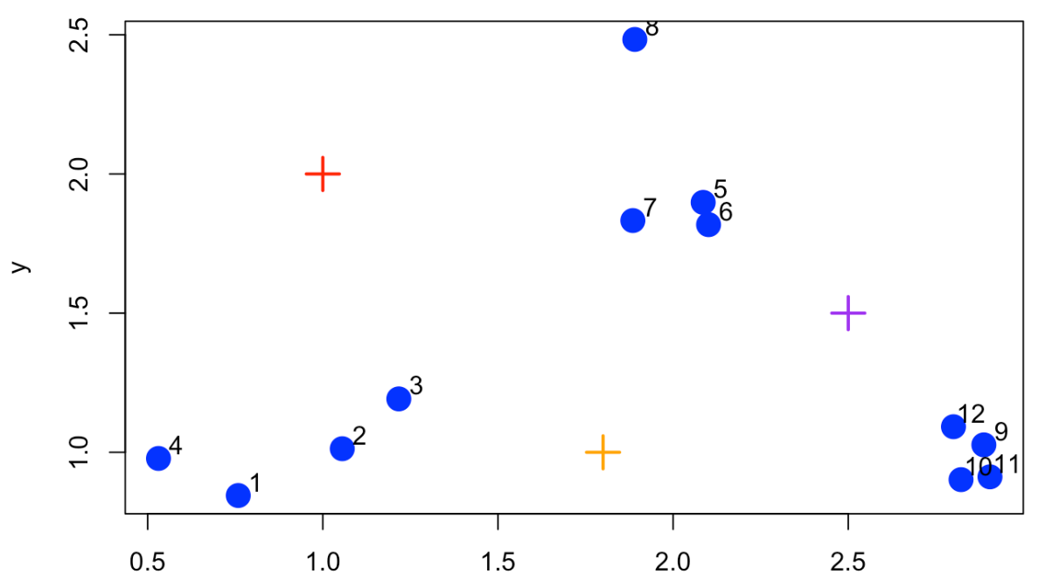
K-means clustering: example

Slide 16
Exercise
The user should input a matrix (3x3), then generate ten additional matrices. The task is to calculate the distances between the input matrix and the generated matrices using several norms (such as Frobenius, First, and Infinity norms). The goal is to determine which matrix is the closest and which is the farthest from the input matrix. After conducting the calculations, a conclusion based on the results from the different norms will be written in the comments of the code

