Slide 1

Numerical Programming TTF 3

Slide 2
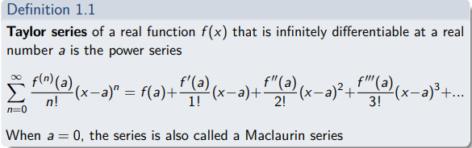

Slide 3
Taylor series
A Taylor series can be used to describe any function ƒ (x) that is a smooth function (or, in mathematical terms, "infinitely differentiable.") The function ƒ can be either real or complex. The Taylor series is then used to describe what the function looks like in the neighborhood of some number a.
"a" is a number on the x axis where f(a) is infinitely differentiable
"x" is any number on the x axis
"n" is natural numbers

Slide 4
Taylor series
Find the maclaurin series of the function f(x)=e^x

Slide 5
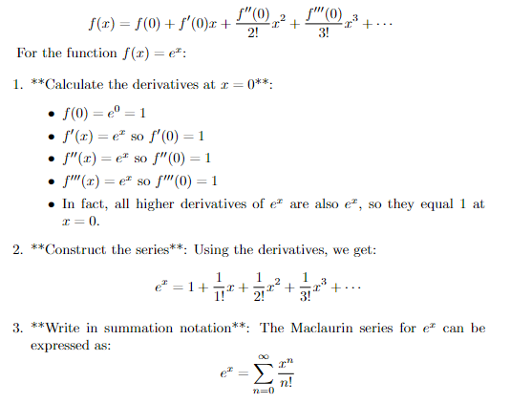

Slide 6
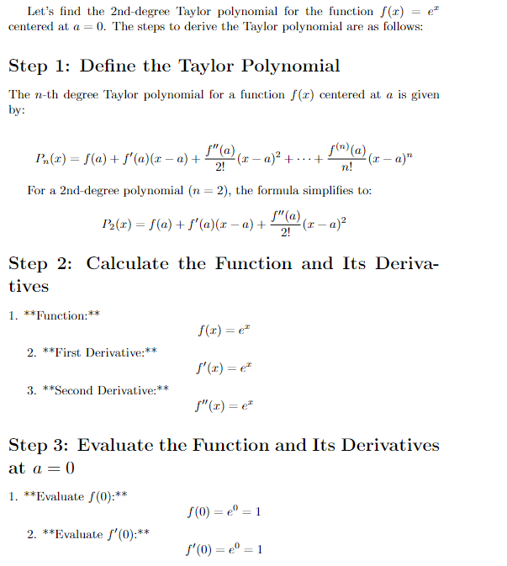

Slide 7
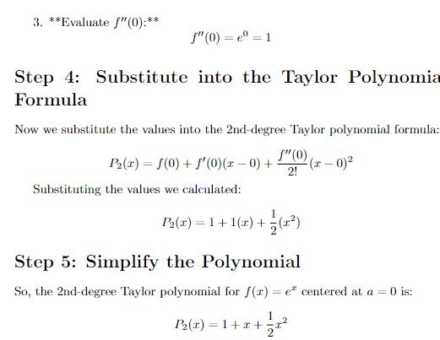

Slide 8
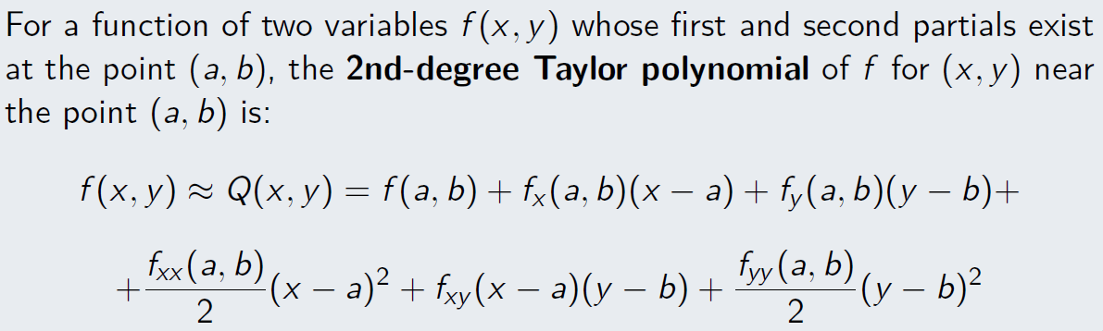

Slide 9
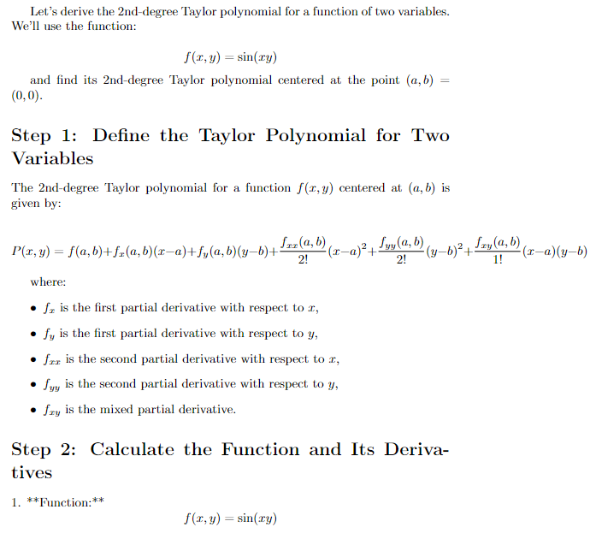

Slide 10
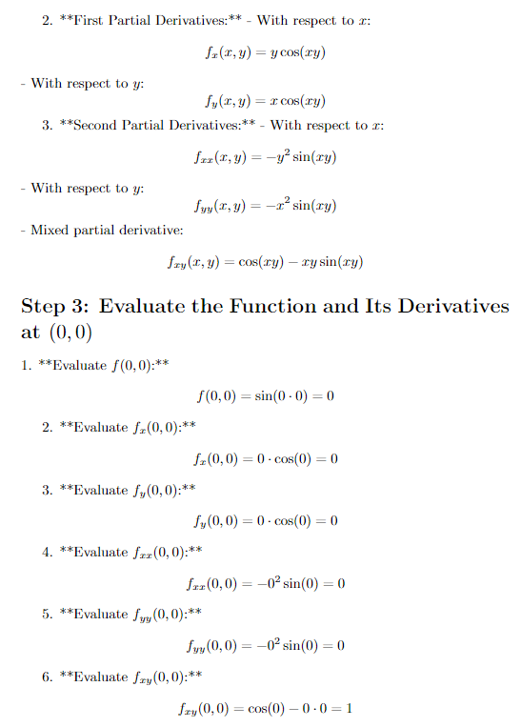

Slide 11
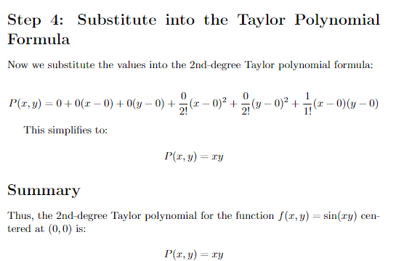

Slide 12
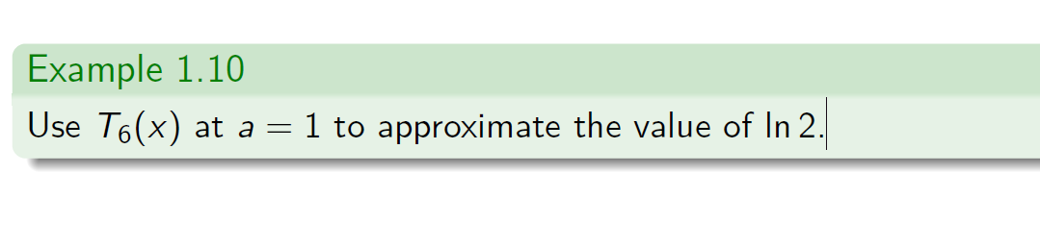

Slide 13
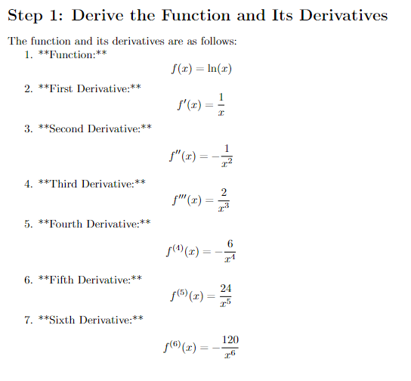

Slide 14
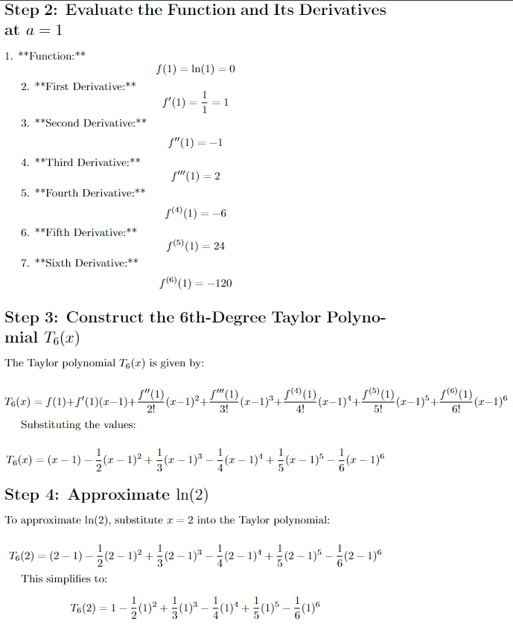

Slide 15
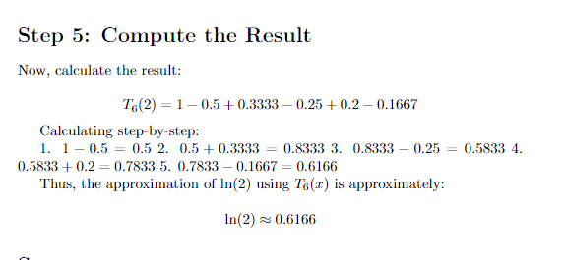

Slide 16
Finite differences
finite-difference methods (FDM) are a class of numerical techniques for solving differential equations by approximating derivatives with finite differences

Slide 17
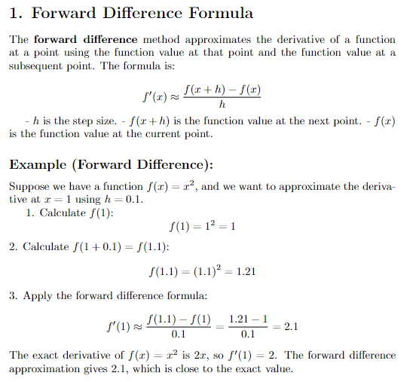

Slide 18
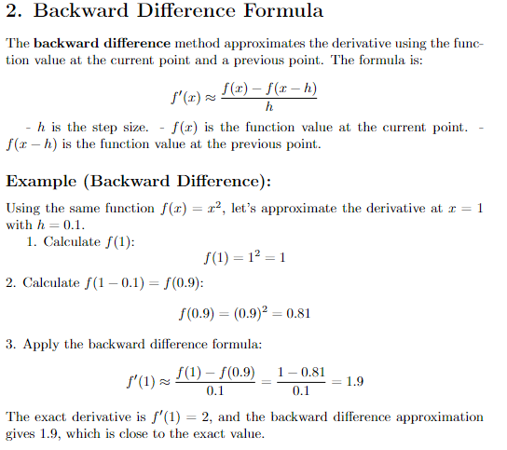

Slide 19
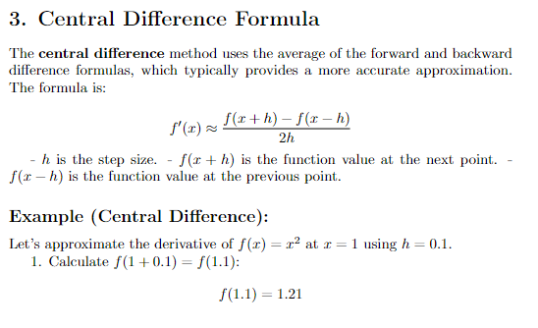

Slide 20
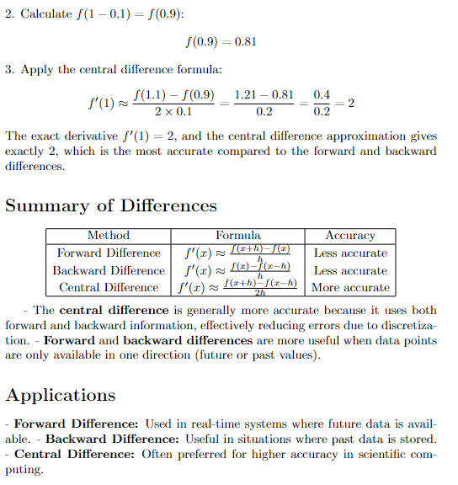

Slide 21
