Slide 1
Numerical Programming TTF 4

Slide 2
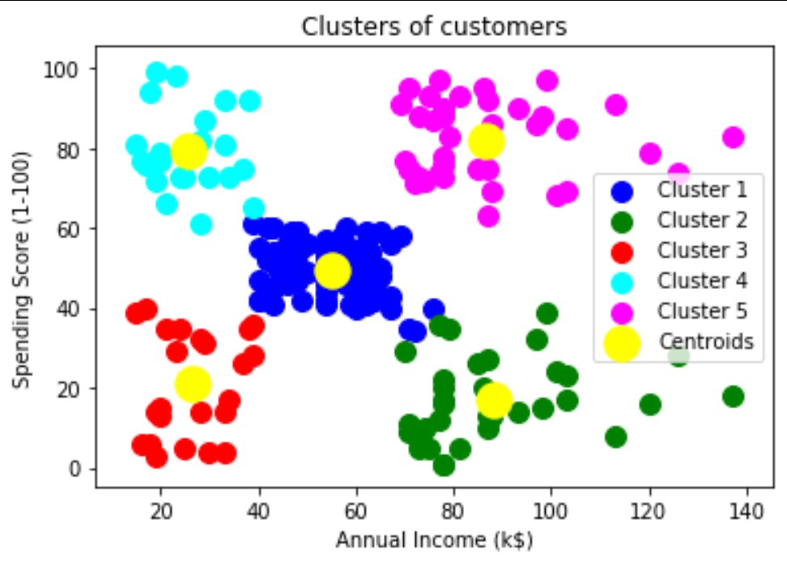
K-means clustering
Goal: group similar data and create K groups

Slide 3
Steps:
1
Input: m vectors, e. g. v1, v2, v3, … vm where vi = (e1, e2, e3, … en), k
Steps:
1) select k random vectors to initialize as centroids
2) for each vector vi, assign it to the closets k-vector (Partition)
3) for all vectors assigned to a k-vector, calculate the average and put it as the new k-vector (Update)
4) repeat 2) and 3) until changes are relatively small
Ouptut: k vectors, e. g. b1, b2, … bk where ai = (e1, e2, e3, … en)
2
3
4

Slide 4
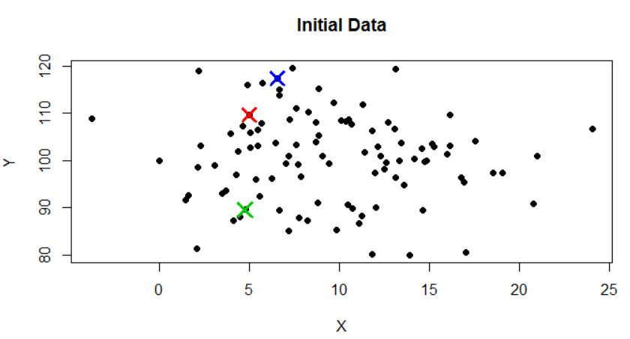
First step - Initial data

Slide 5
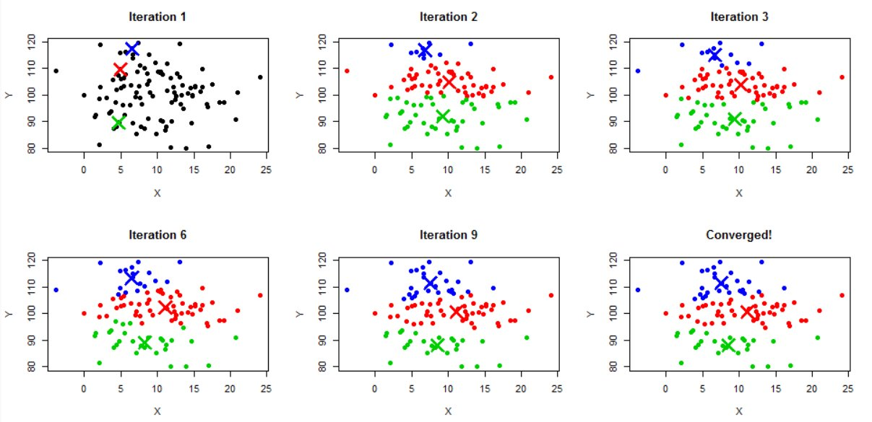
Visualization

Slide 6
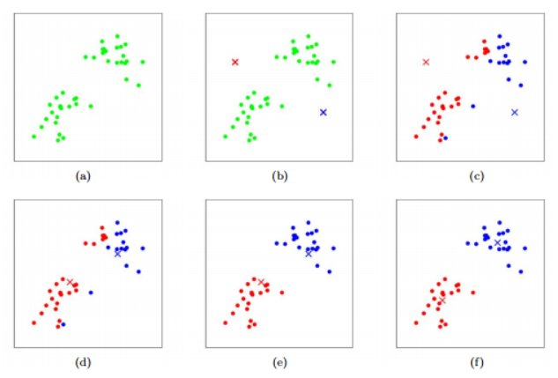

Slide 7
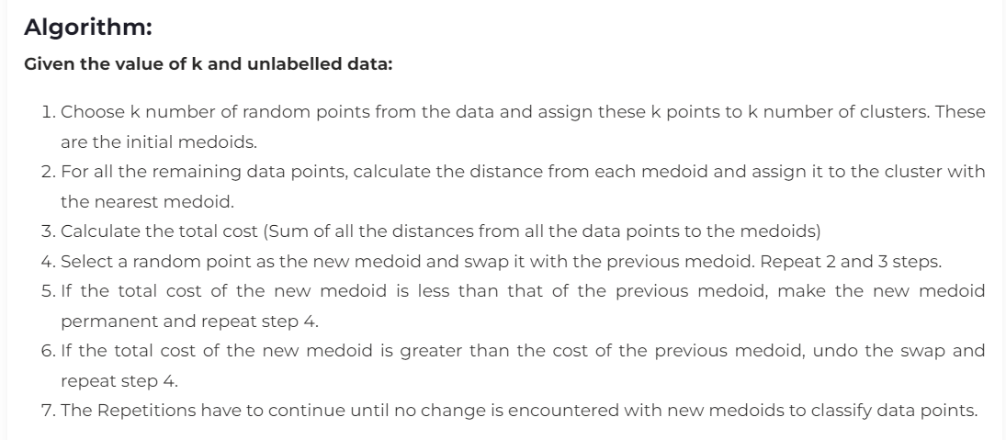
K-medoids
Medoid: A Medoid is a point in the cluster from which the sum of distances to other data points is minimal.

Slide 8
K-means vs K-medoids
The problem with the K-Means algorithm is that the algorithm needs to handle outlier data. An outlier is a point different from the rest of the points. All the outlier data points show up in a different cluster and will attract other clusters to merge with it. Outlier data increases the mean of a cluster by up to 10 units. Hence, K-Means clustering is highly affected by outlier data.
Advantages of using K-Medoids:
Deals with noise and outlier data effectively
Easily implementable and simple to understand
Faster compared to other partitioning algorithms
Disadvantages:
Not suitable for Clustering arbitrarily shaped groups of data points.
As the initial medoids are chosen randomly, the results might vary based on the choice in different runs.
K-medoid is more flexible
First of all, you can use k-medoids with any similarity measure.
Secondly, the medoid as used by k-medoids is roughly comparable to the median (in fact, there also is k-medians, which is like K-means but for Manhattan distance). If you look up literature on the median, you will see plenty of explanations and examples why the median is more robust to outliers than the arithmetic mean.
k-medoids is much more expensive
That's the main drawback. Usually, PAM takes much longer to run than k-means. As it involves computing all pairwise distances, it is O(n^2*k*i); whereas k-means runs in O(n*k*i) where usually, k times the number of iterations is k*i << n

Slide 9
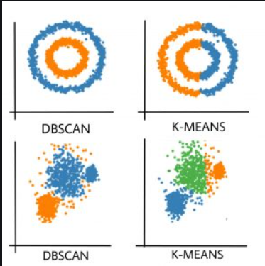
DBSCAN Clustering
Clusters are dense regions in the data space, separated by regions of the lower density of points. The DBSCAN algorithm is based on this intuitive notion of “clusters” and “noise”. The key idea is that for each point of a cluster, the neighborhood of a given radius has to contain at least a minimum number of points.
Partitioning methods (K-means, PAM clustering) and hierarchical clustering work for finding spherical-shaped clusters or convex clusters. In other words, they are suitable only for compact and well-separated clusters. Moreover, they are also severely affected by the presence of noise and outliers in the data.
Real-life data may contain irregularities, like:
Clusters can be of arbitrary shape such as those shown in the figure below.
Data may contain noise.

Slide 10
Required parameters
eps: It defines the neighborhood around a data point i.e. if the distance between two points is lower or equal to ‘eps’ then they are considered neighbors. If the eps value is chosen too small then a large part of the data will be considered as an outlier. If it is chosen very large then the clusters will merge and the majority of the data points will be in the same clusters. One way to find the eps value is based on the k-distance graph.
MinPts: Minimum number of neighbors (data points) within eps radius. The larger the dataset, the larger value of MinPts must be chosen. As a general rule, the minimum MinPts can be derived from the number of dimensions D in the dataset as, MinPts >= D+1. The minimum value of MinPts must be chosen at least 3.

Slide 11
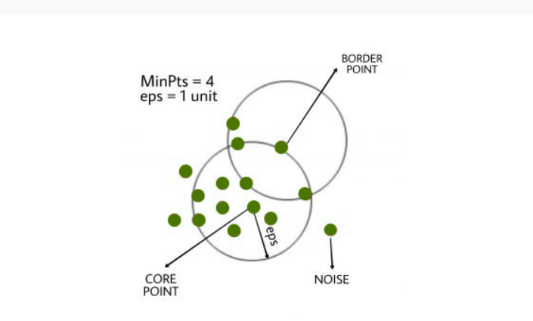

Slide 12
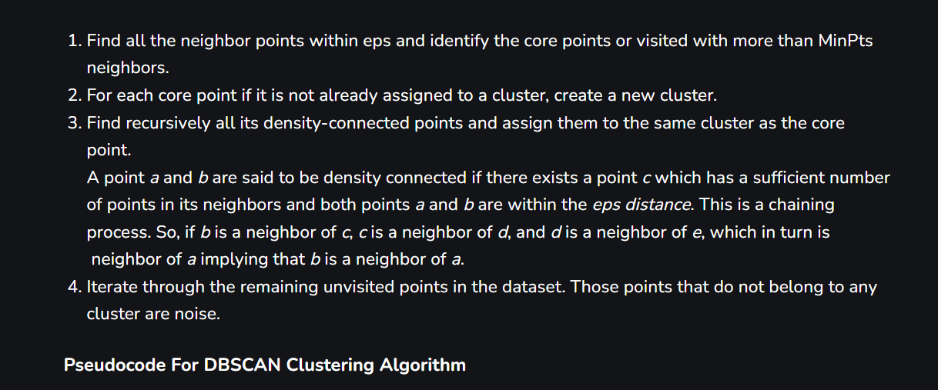
DBSCAN Clustering algorithm

Slide 13
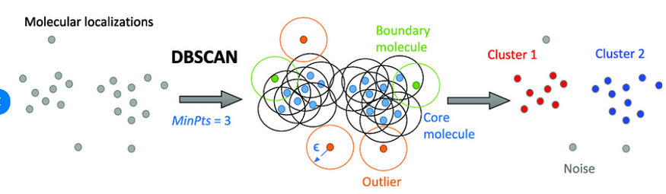
video

Slide 14
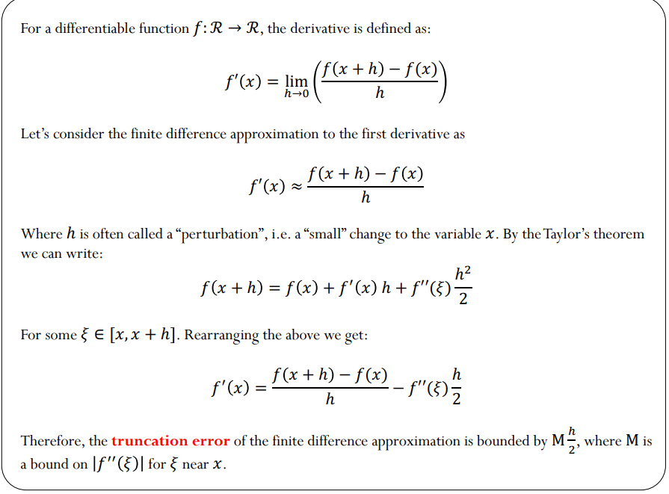

Slide 15
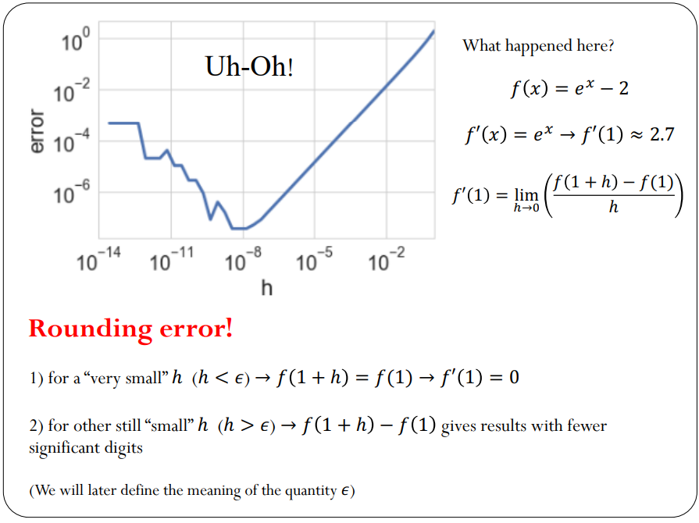

Slide 16
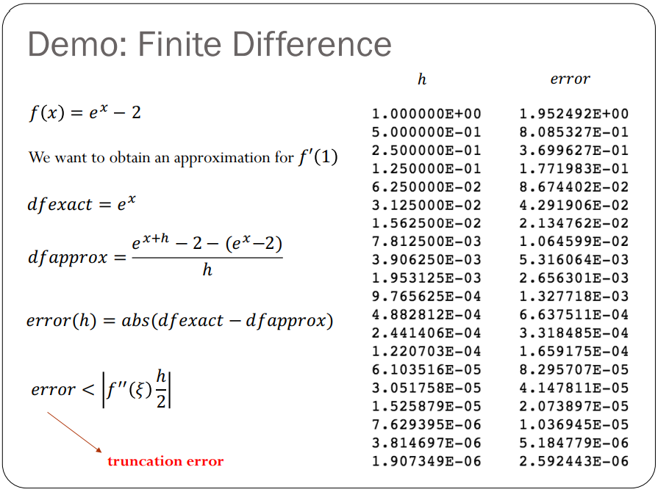

Slide 17
