Slide 1
Numerical Programing
Prof.: Ramaz Botchorishvili TA:Tsotne Mikadze SA:Giorgi kochiashvili; Nino Sharvashidze

Slide 2
Points
TTf 24% Activity 10% CP 24%
Quizzes 12%
Final Exam 30%

Slide 3
Introduction to Python
PyCharm or VS code install : pip pip install pip
Libraries Matplotlib
NumPy CV2

Slide 4
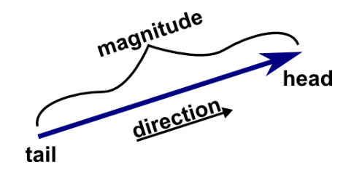
Vector
vector is an ordered collection of numbers, often used to represent a point in space or a direction and magnitude. Vectors are fundamental in areas like linear algebra, geometry, and calculus

Slide 5
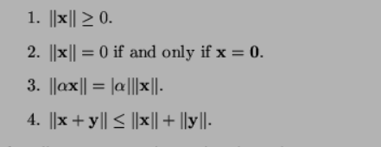
Vector Norm
The norm of a vector (also called the magnitude or length of a vector) is a measure of the vector's size

Slide 6
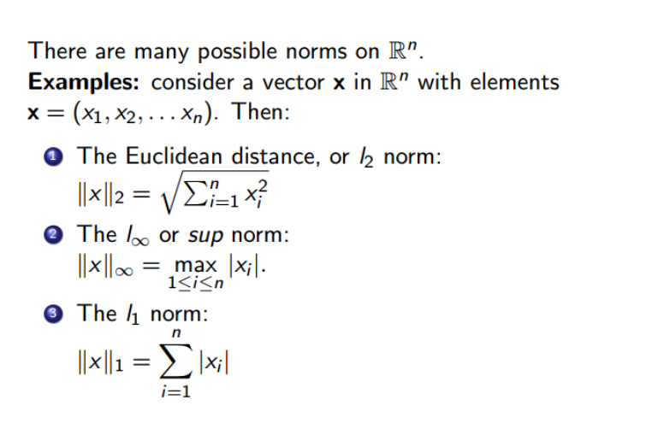

Slide 7
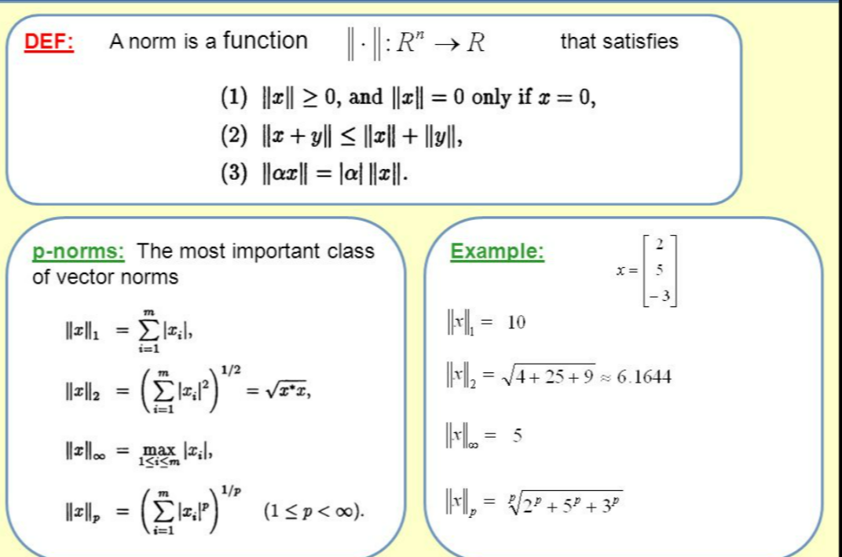

Slide 8
The user should input a vector. If the vector is valid for norm calculation, the program will proceed to calculate the norms. If the vector is invalid, the program should return the message:
Demonstrate the properties of norms through appropriate examples.
Once the vector is validated, the program will calculate the following norms:
1 L norm (Manhattan norm):
1 L norm is ...
2 L norm (Euclidean norm):
2 L norm is ...
Infinity norm:
Infinity norm is ...
P norm (generalized Lp norm):
P norm is ...

