Slide 1
Predicting Potential Customers for Banks using Machine Learning Algorithms
By:-
Abhinav Nair(19BPS1007)
Sparsh Raj(19BPS1028)
Hande Atharrava Devendra(19BPS1086)

Slide 2
Abstract
This project dives into the banking system taking into consideration the problem of revenue decline in banks due to no long term investments by customers.
The main idea behind taking up the study is to understand their existing customers – their transaction patterns, product holdings, demographics, past trend, and other attributes and behaviour with the bank to devise an effective strategy.
It is to determine that if the bank can devise any strategy to tap potential around its existing customer base, and if it can scale up business quickly in a more cost-effective manner as there is no acquisition cost. These customers are already banking with them they need attention, service, and hand-holding.
The solution proposed is through binary classification of the available data which predicts whether the customer is a potential long term investor or not.

Slide 3
Introduction
Customers are the most important factor for a business. Some customers can help the business to generate more profit compared to the others. A loyalty-prone customer intends to stay with the supplier who can provide the quality products. On the other hand, a deal-prone customer will always look for a better offer from a competitor. Customers can be classified as profitable and unprofitable.
In this project, The Problem statement is that the customers of a bank are not investing enough for long term deposits. We aim to perform Exploratory Data Analysis and Binary Classification on the Banking Dataset.
In this project, we are going to do an Exploratory Data Analysis and Binary Classification on Banking Dataset.
The Scenario is that the customers of a bank are not investing enough for long term deposits.
So we will do EDA on the dataset and will identify the existing customers that have higher chance to subscribe for long term deposits. So that the Banks can focus on them in particular.
So we will do all the Data Pre-processing steps and then move to EDA. Further after this we will train ML models with our data and check the model performance and move on to the Prediction finally.

Slide 4
Reviewing the Dataset
Exploratory data analysis is cross-classified in two different ways where each method is either graphical or non-graphical. And then, each method is either univariate, bivariate or multivariate.
UNIVARIATE ANALYSIS:The objective of univariate analysis is to derive the data, define and summarize it, and analyze the pattern present in it. In a dataset, it explores each variable separately. It is possible for two kinds of variables- Categorical and Numerical.
BIVARIATE ANALYSIS:Bivariate statistical analyses are data analysis procedures using two variables (e.g. self-efficacy and academic performance). Bivariate analyses can be descriptive (e.g. a scatterplot), but the goal is typically to compare or examine the relationship between two variables

Slide 5
Project Description
Our Project is based on Exploratory Data Analysis and Binary Classification on Banking Dataset. So, it consists of several modules as follows:-
Importing banking dataset
Exploratory Data analysis
Pre processing of the dataset
Graphical Visualisation of the dataset
Building multiple machine learning/deep learning models
Implementing the machine/deep learning models
Evaluating the built models
Prediction of potential banking customers

Slide 6
Dataset Description
Feature | Feature_Type | Description
age | numeric | age of a person
job | Categorical,nominal | type of job ('admin.','blue-collar','entrepreneur','housemaid','management','retired','self-employed','services','student','technician','unemployed','unknown')
marital | categorical,nominal | marital status ('divorced','married','single','unknown'; note: 'divorced' means divorced or widowed)
education | categorical,nominal | ('basic.4y','basic.6y','basic.9y','high.school','illiterate','professional.course','university.degree','unknown')
default | categorical,nominal | has credit in default? ('no','yes','unknown')
housing | categorical,nominal | has housing loan? ('no','yes','unknown')
loan | categorical,nominal | has personal loan? ('no','yes','unknown')
contact | categorical,nominal | contact communication type ('cellular','telephone')
month | categorical,ordinal | last contact month of year ('jan', 'feb', 'mar', …, 'nov', 'dec')
dayofweek | categorical,ordinal | last contact day of the week ('mon','tue','wed','thu','fri')
duration | numeric | last contact duration, in seconds . Important note: this attribute highly affects the output target (e.g., if duration=0 then y='no')
campaign | numeric | number of contacts performed during this campaign and for this client (includes last contact)
pdays | numeric | number of days that passed by after the client was last contacted from a previous campaign (999 means client was not previously contacted)
previous | numeric | number of contacts performed before this campaign and for this client
poutcome | categorical,nominal | outcome of the previous marketing campaign ('failure','nonexistent','success')

Slide 7
Data Pre-Processing
Data preprocessing is the process of transforming raw data into a useful, understandable format.
Real-world or raw data usually has inconsistent formatting, human errors, and can also be incomplete.
Data preprocessing resolves such issues and makes datasets more complete and efficient to perform data analysis.
One of the main steps in data preprocessing is handling missing data. Missing data means absence of observations in columns that can be caused while procuring the data, lack of information, incomplete results etc.

Slide 8
Exploratory Data Analysis
Exploratory Data Analysis refers to the critical process of performing initial investigations on data so as to discover patterns,to spot anomalies,to test hypothesis and to check assumptions with the help of summary statistics and graphical representations.
In Our Project, mostly we gonna do:-
Univariate Analysis of Categorical Variables
Univariate Analysis of Numerical Columns
Bivariate Analysis of Categorical Columns

Slide 9
ML Algorithms
A random forest algorithm consists of many decision trees. The (random forest) algorithm establishes the outcome based on the predictions of the decision trees. It predicts by taking the average or mean of the output from various trees. Increasing the number of trees increases the precision of the outcome.
LSTM Model is also one of the candidates for our test as it is a type of neural network capable of learning dependent data that is going to be present in the long term plan of our project and this is made possible by the models unique combination of layers that interact with each other.
Computing systems inspired by the biological neural networks that make up animal brains are known as artificial neural networks (ANNs), or more simply, neural nets.Artificial neurons, which are a set of interconnected units or nodes that loosely resemble the neurons in a biological brain, are the foundation of an ANN.
LSTM Model is also one of the candidates for our test as it is a type of neural network capable of learning dependent data that is going to be present in the long term plan of our project and this is made possible by the models unique combination of layers that interact with each other.
SVM is a model used to find a plane of N dimension space that classifies all the data points on it and it is used for both classification as well for the purposes of regression. The Regression Plane size is dependent on the dimensionality of the data.

Slide 10
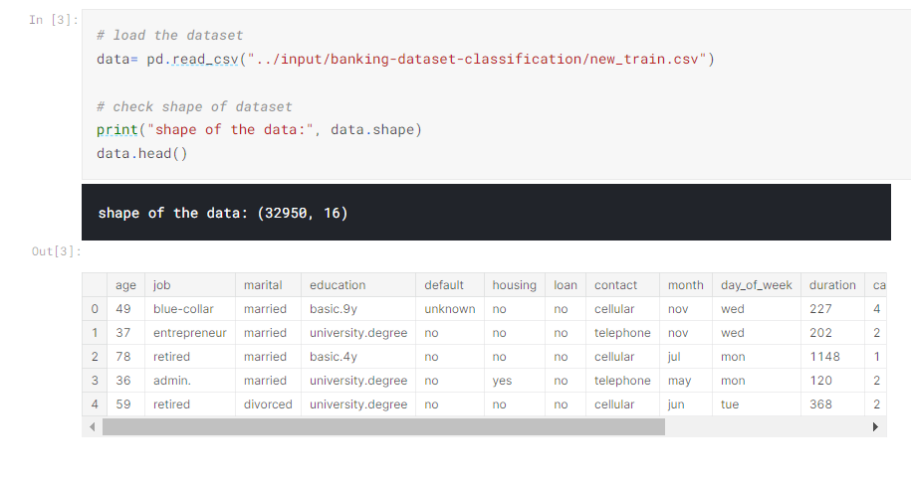
Loading Dataset

Slide 11
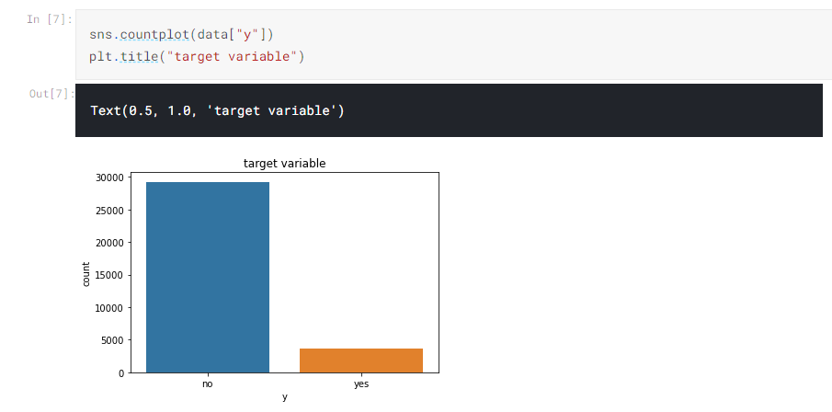
Target variable

Slide 12
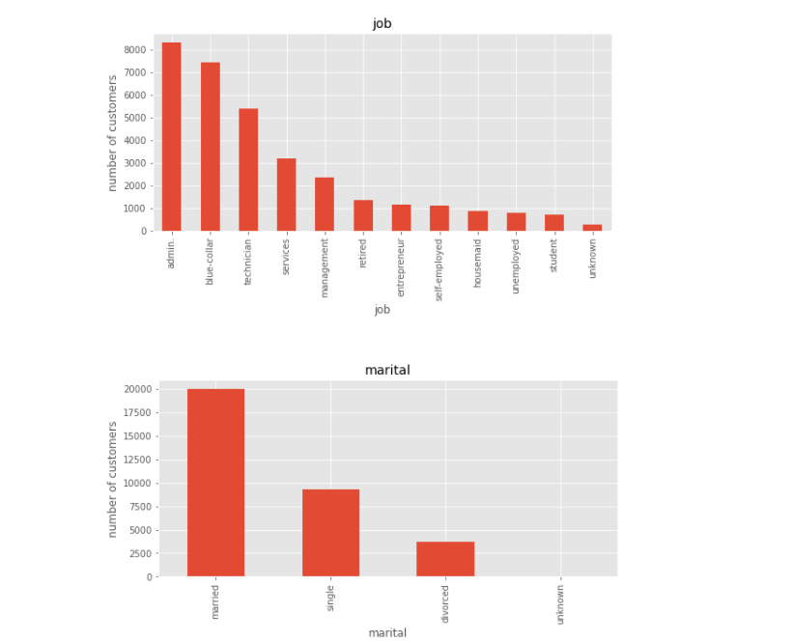
Univariate analysis of Categorical Var

Slide 13
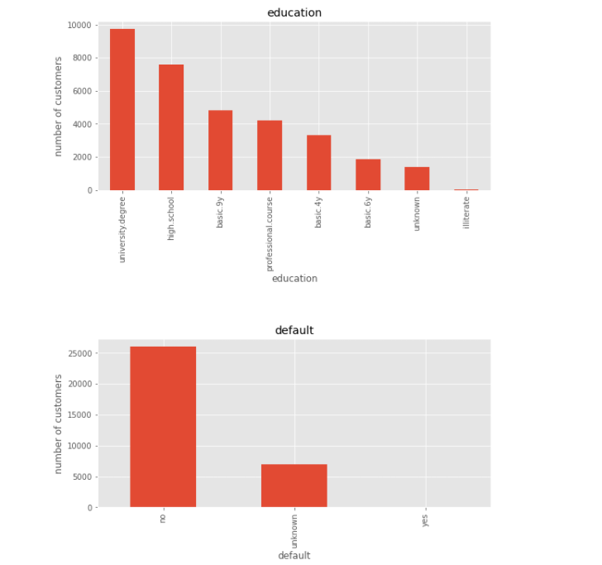

Slide 14
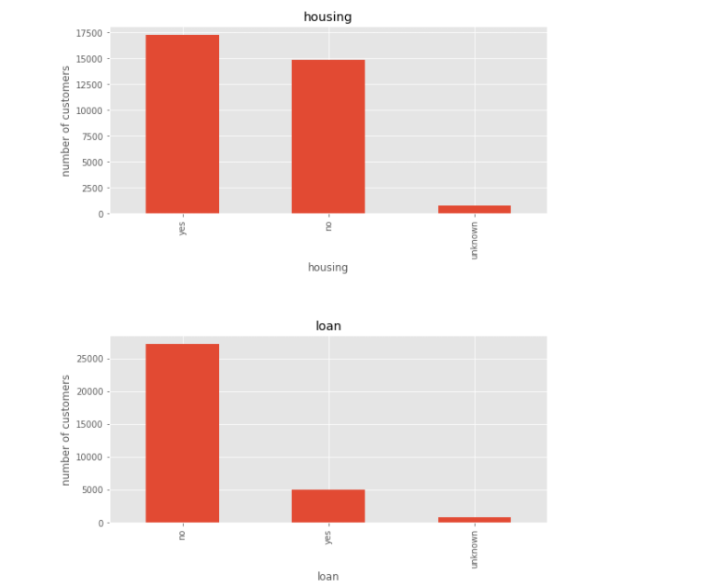

Slide 15
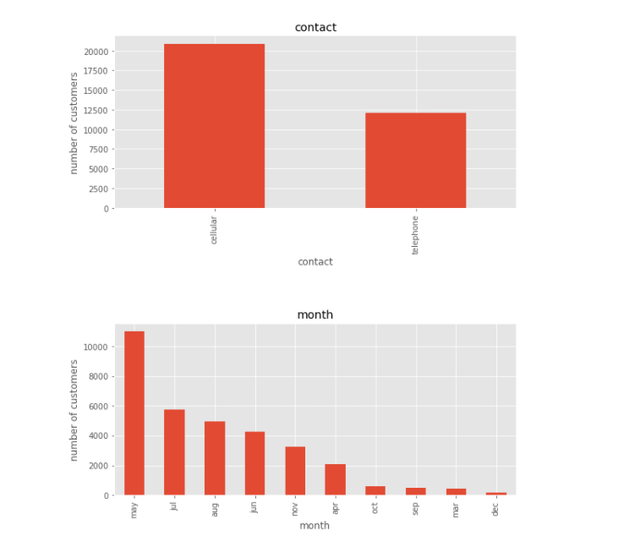

Slide 16
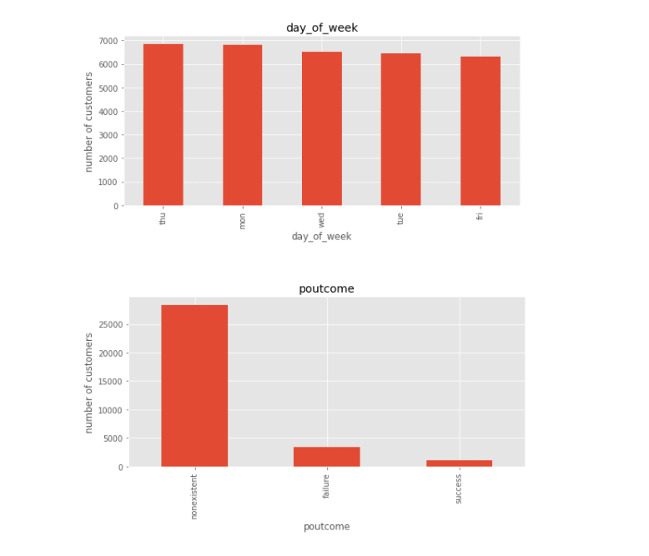

Slide 17
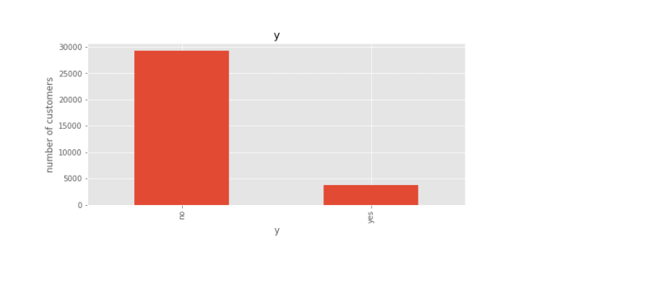

Slide 18
Observations:
The top three professions that our customers belong to are - administration, blue-collar jobs and technicians.
A huge number of the customers are married.
Majority of the customers do not have a credit in default
Many of our past customers have applied for a housing loan but very few have applied for personal loans.
Cell-phones seem to be the most favoured method of reaching out to customers.
Many customers have been contacted in the month of May.
The plot for the target variable shows heavy imbalance in the target variable.

Slide 19
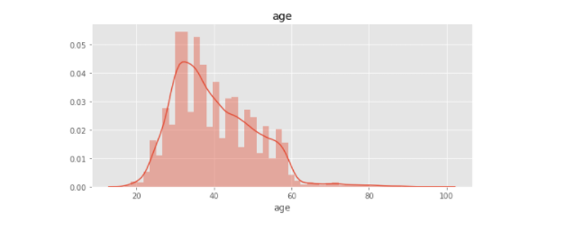
Univariate analysis of Numerical columns

Slide 20
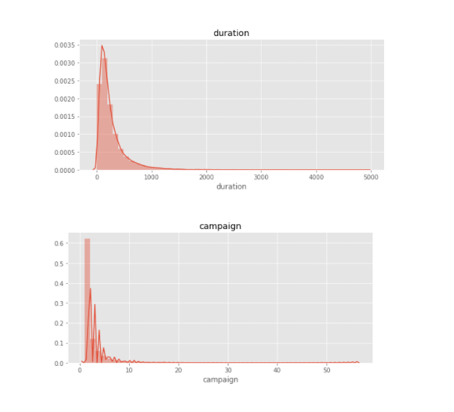

Slide 21
Observation :
As we can see from the histogram, the features age, duration and campaign are heavily skewed and this is due to the presence of outliers as seen in the boxplot for these features.
Looking at the plot for pdays, we can infer that majority of the customers were being contacted for the first time because as per the feature description for pdays the value 999 indicates that the customer had not been contacted previously.

Slide 22
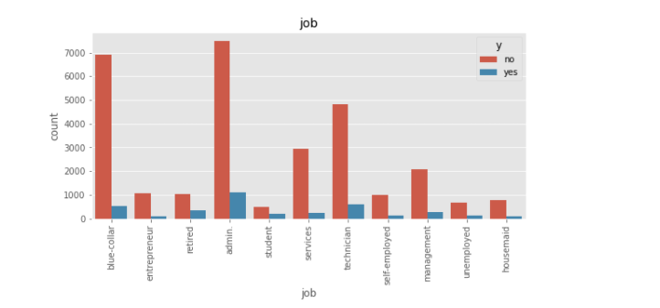
Bivariate Analysis of Categorical Columns

Slide 23
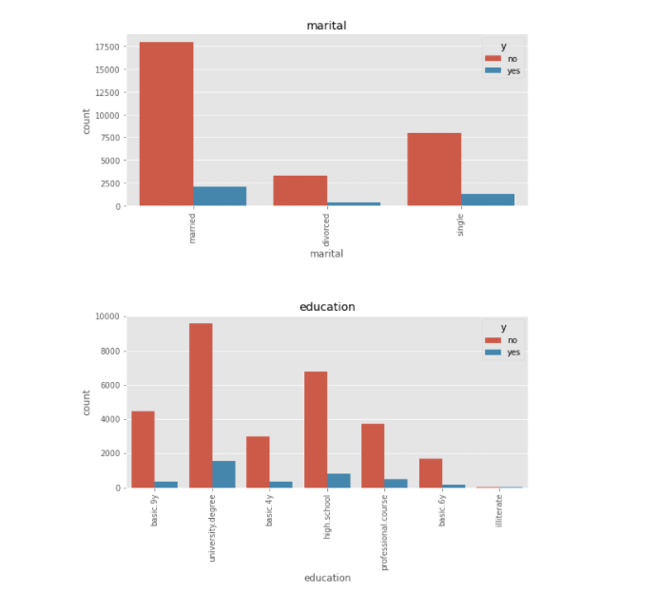

Slide 24
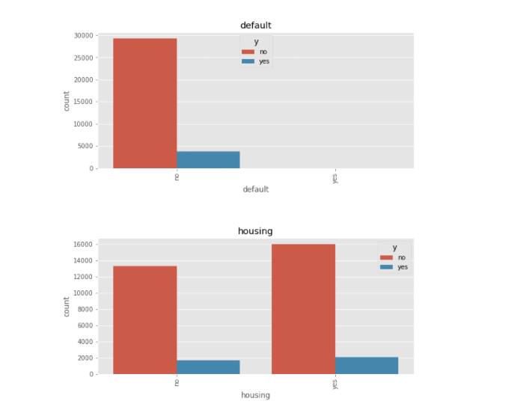

Slide 25
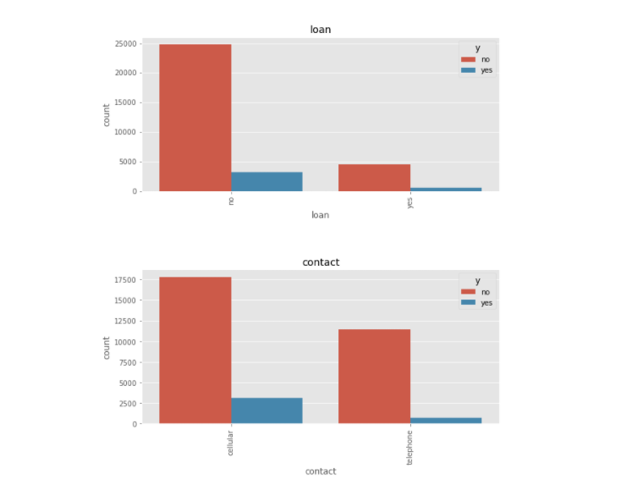

Slide 26
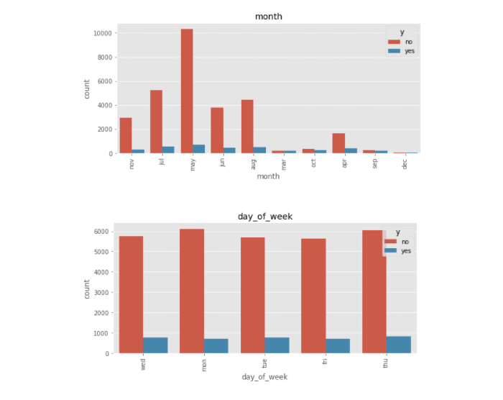

Slide 27
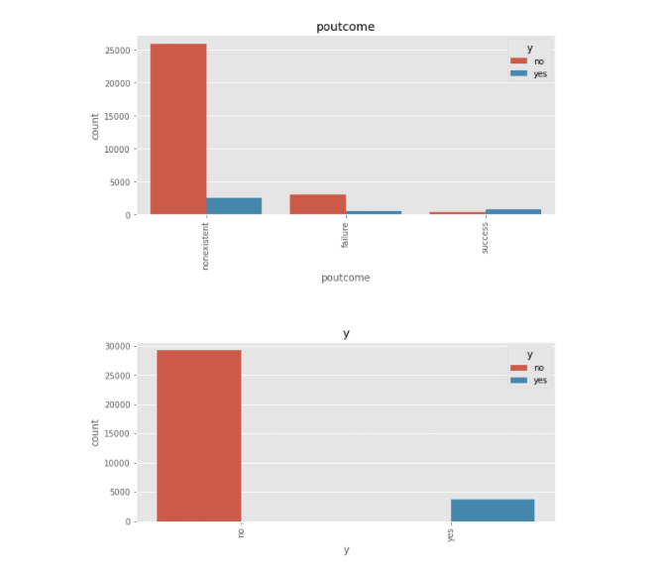

Slide 28
Observation:
Customers having administrative jobs form the majority amongst those who have subscirbed to the term deposit.
They are married
They hold a university degree
They do not hold a credit in default
Housing loan doesn't seem a priority to check for since an equal number of customers who have and have not subscribed to it seem to have subscribed to the term deposit.
Cell-phones should be the preferred mode of contact for contacting customers.

Slide 29
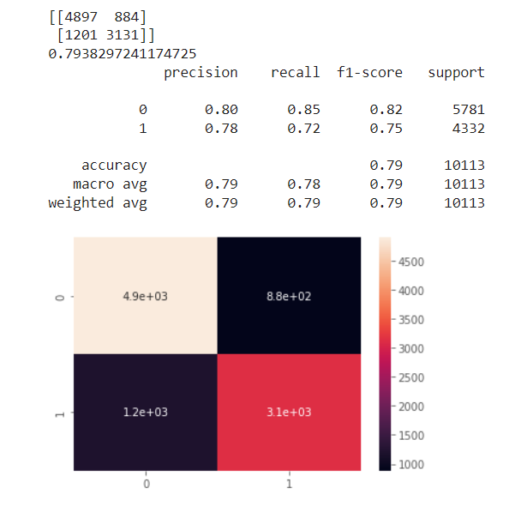
Model Analysis:
Logistic Regression:

Slide 30
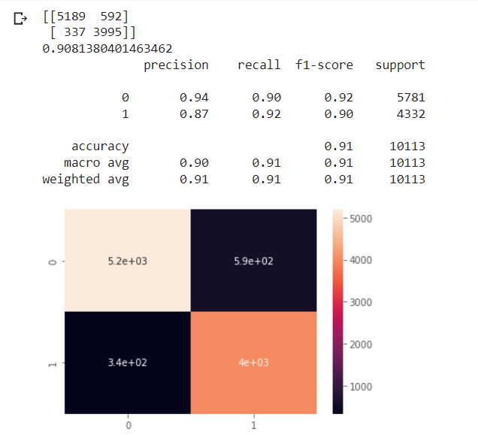
Model Analysis:
Random Forest Search:

Slide 31
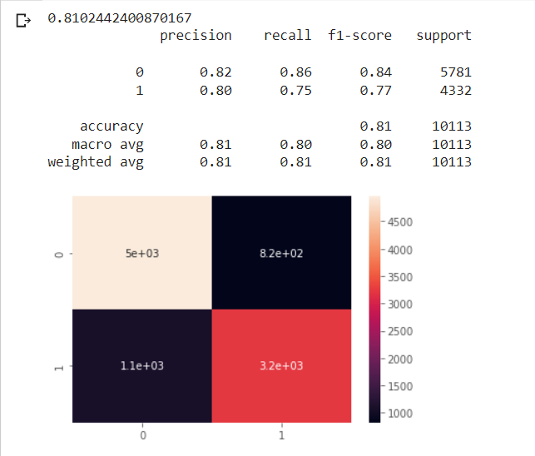
Model Analysis:
Artificial Neural Network:

Slide 32
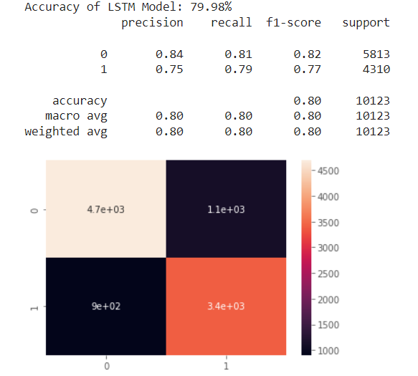
Model Analysis:
LSTM:

Slide 33
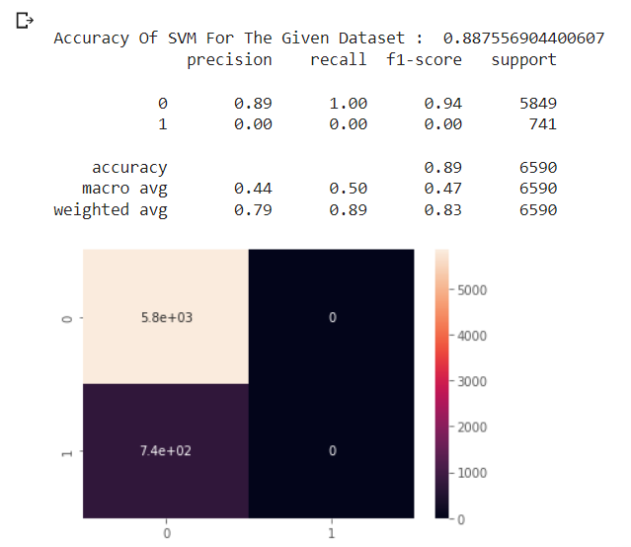
Model Analysis:
SVM:

Slide 34
Model Analysis:
Logistic Regression:79% accuracy
Random Forest Search:91% accuracy
Artificial Neural Network:81% accuracy
LSTM Model:79% accuracy
SVM Model:88% accuracy
So we can see from the previous slides that random forest model fares much better than logistic regression and artificial neural network , the reason lies in the fundamental working of these models, logistic regression is quite simple and straightforward in its approach while artificial neural network need a ton of computation power to approach perfect solution and as such random forest fares much better for our scenario, although ANN can be better for organizations. LSTM Model was less performance efficient however SVM Model also showed much better accuracy similar to Random Forest, the reason can be related to the SMOTE we used to handle class imbalance leading to a better performance from SVM.

Slide 35
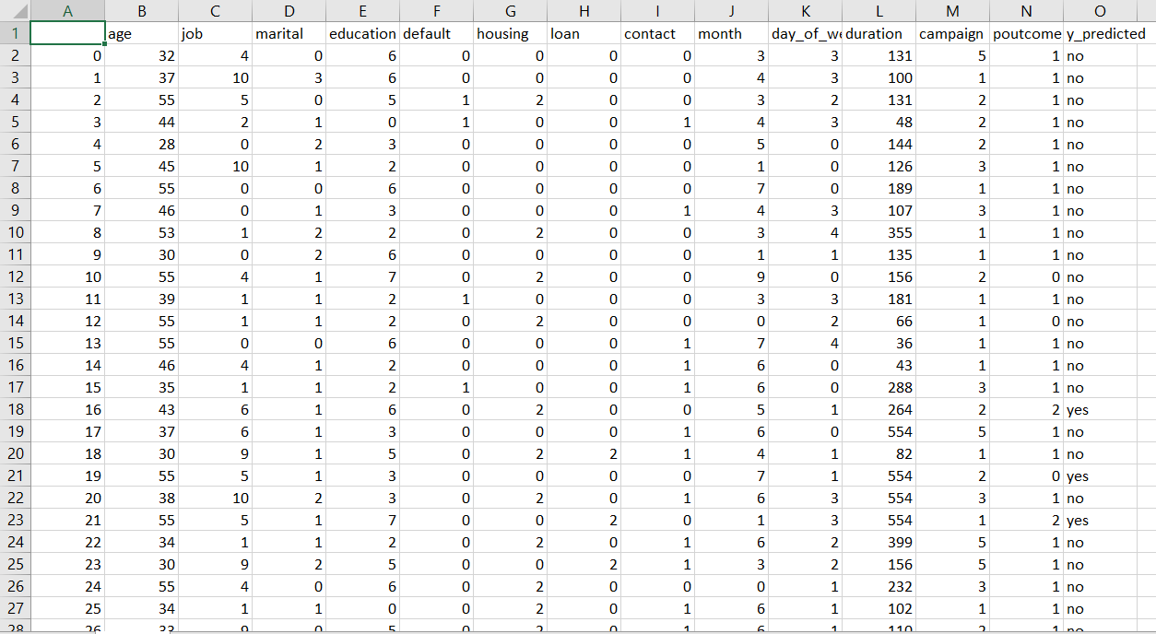
Final Output

Slide 36
Conclusion
The purpose of our project was to predict whether a customer would register a long-time deposit or not provide customer data.
There were a wide range of categories and other numerical variables that capture a variety of customer information and bank-customer relationships.
We first did an EDA and found that there are no empty data values, and the data is not equal, where "no" is a majority class. After a consistent analysis we found that the day_of_the week is not very helpful when it comes to predicting target fluctuations. But on the other hand, some numerical features often predict the best-intentioned variable.
After pre-processing the basic data, we encoded the categorical data with Label Encoding Method.
After that we trained our data using five models: Logistic Regression, Random Forest, ANN, LSTM and SVM.
After using all the models, we realized that the model that provided the best performance was the Random Forest and the AUC test was 0.904 which was somewhat similar or better to the results the researchers found in the related research papers.
The reason could be attested to the fact the dataset required heavy classification along with regression techniques which are provided by random forest and SVM better and their accuracies do support these facts.

Slide 37
Tools Used
Python as the programming language
Juypter Notebooks/Google Colab as an IDE
Libraries:
GGPLOT
Matplolib
Scikit
Keras
Imblearn
Pandas
Numpy
Seaborn

Slide 38
LITERATURE SURVEY
Sr.No | Title | Year Of Publication | Methodologies Used | Literature Survey
1) | A Machine Learning Approach to Identify Potential Customer Based on Purchase Behavior | 2019 International Conference on Robotics,Electrical and Signal Processing Techniques (ICREST) | Statistical analysis EDA Classification Algorithms | Classification Algorithms of Machine Learning was used to identify Potential Customers for a retail superstore.
2) | POTENTIAL CUSTOMER DETECTION-BASED ON PURCHASE BEHAVIOUR | 2020 INTERNATIONAL JOURNAL OF RESEARCH IN ELECTRONICS AND COMPUTER ENGINEERING A UNIT OF I2OR | Data analysis Preprocessing SVM (Support Vector Machine) | This research paper focuses on finding potential customer ans aims to improve the customer satisfaction trough machine learning algorithm.
3) | Identifying New Customers Using Machine Learning | 2017 | Data Gathering Data Preprocessing Model Building -Clustering Based Classifier -PU-learning | we found that the best clustering based classifier achieved an F1 estimator criteria of 1.1 while the best PU-learning classifier achieved an F1 estimator criteria of 3.51. This means that the PU-learning approach was substantially better at the given task of predicting new customers.
4) | A Machine Learning Framework for Predicting Purchase by online customers based on Dynamic Pricing | 2014 Conference Organized by Missouri University of Science and Technology | Data Collection Pre-Processing Attribute Selection Predictive Modeling - Logistic regression - K-means clustring | Clustering ,data mining and machine learning models used to predict purchase by online customers

