Slide 1
Test
1. The Water Jar Puzzle and its drawbacks
2. The need for another test case
3. The Road to Bucharest problem
4. Extending the test case to stress heuristic engines
5. Adversary search tests missing

Slide 2
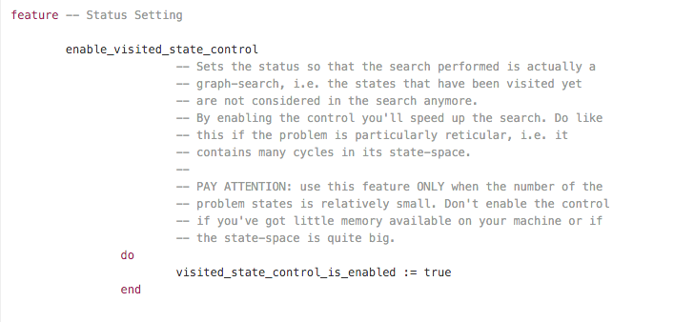

Slide 3
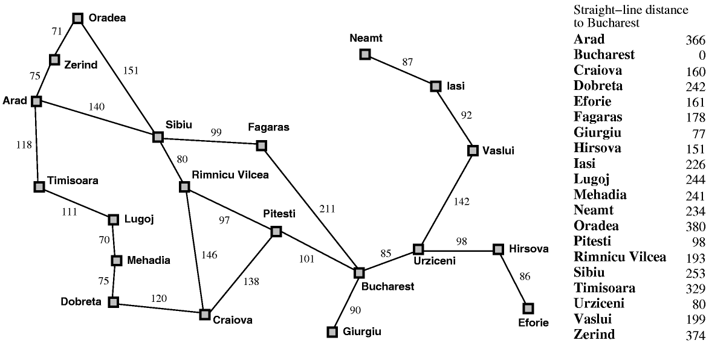

Slide 4
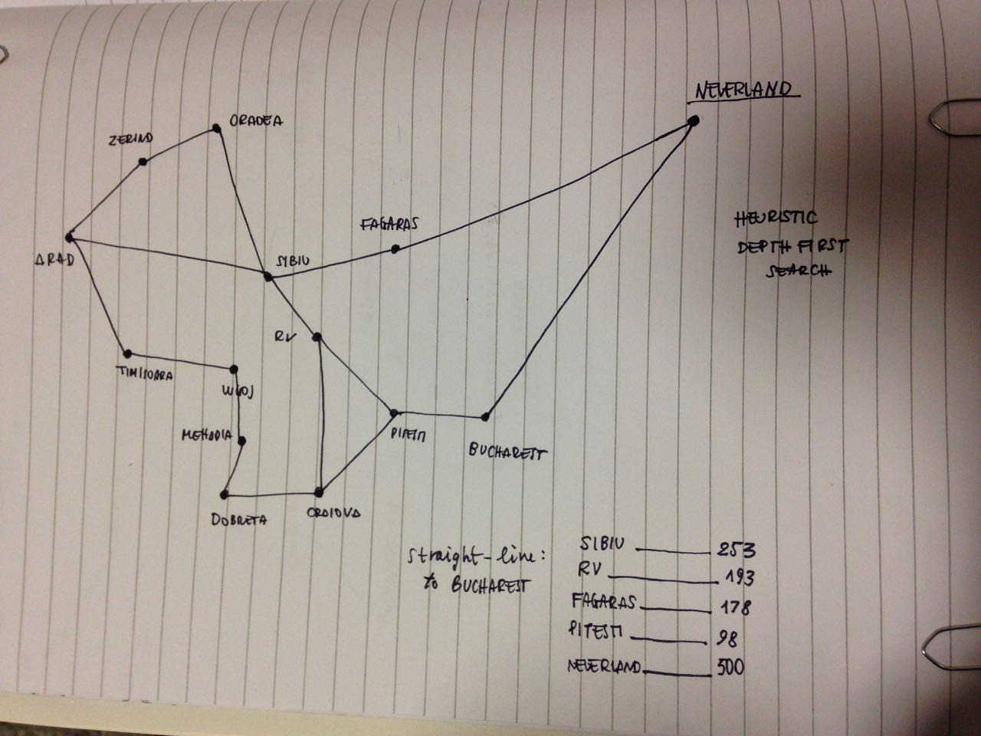
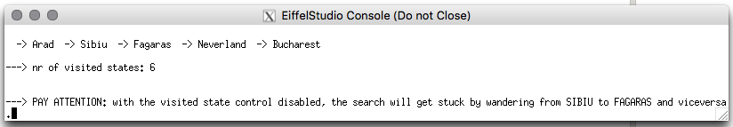

Slide 5
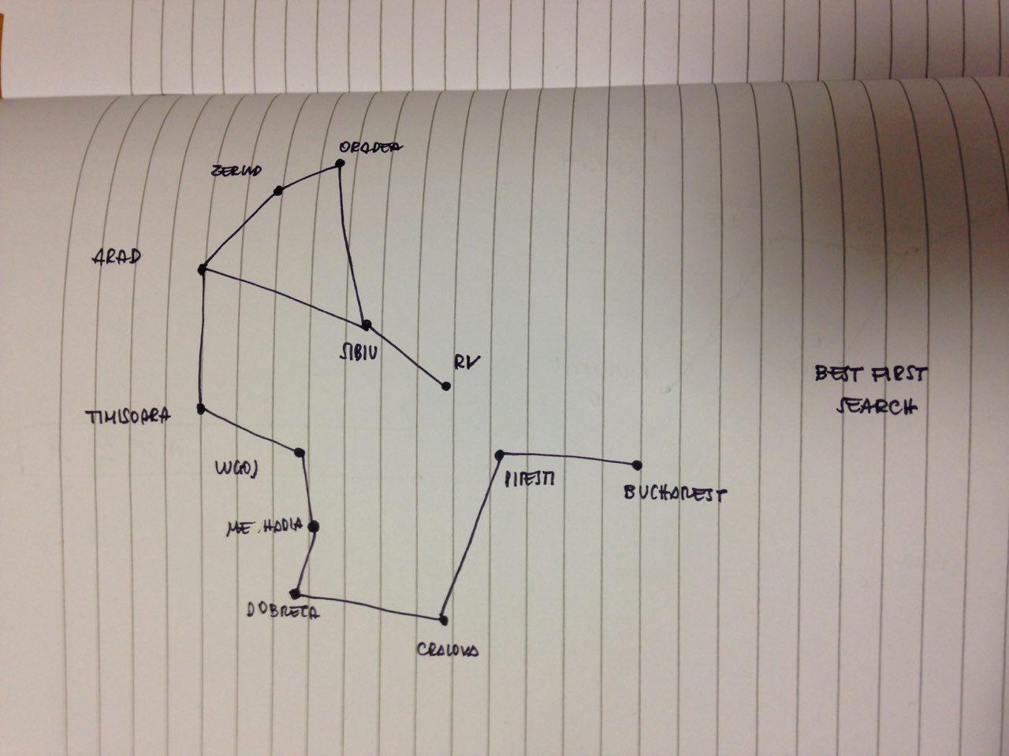
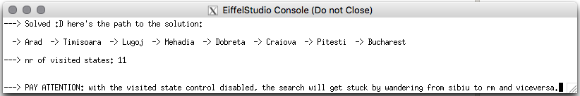

Slide 7
Solitaire Heuristic Function
1. Solitaire Mancala: a non-solvable problem
2. Fail to apply the most common approach
3. A customized approach: Life Expectancy

Slide 8
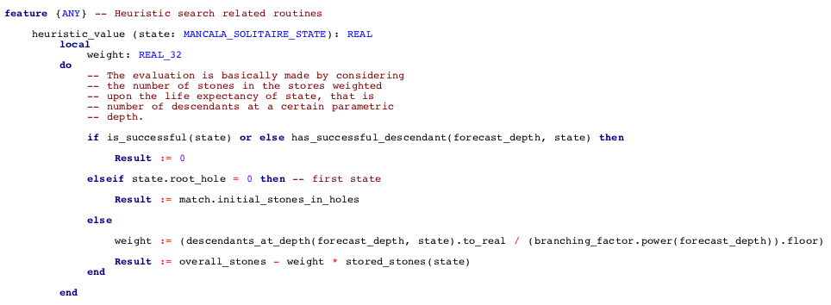

Slide 9
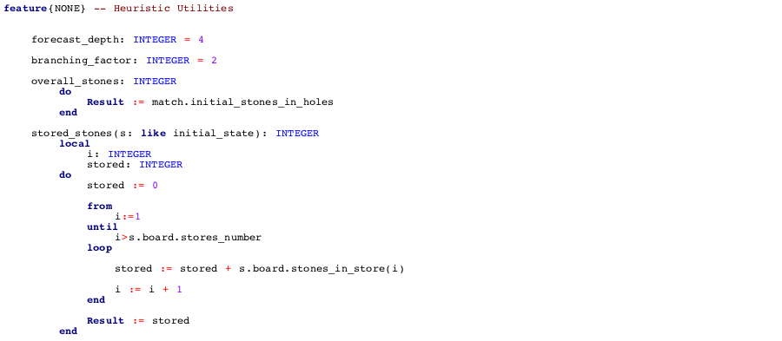

Slide 10
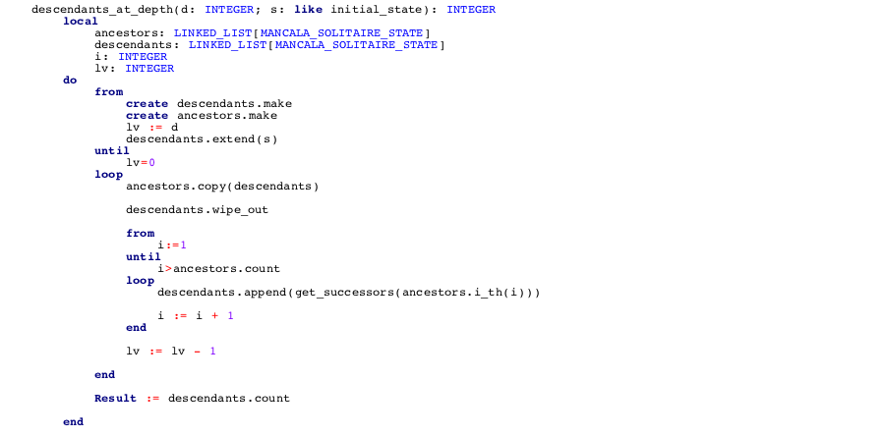

Slide 11
