Slide 1
Test
1. The Water Jar Puzzle and its drawbacks
2. The need for another test case
3. The Road to Bucharest problem
4. Extending the test case to stress heuristic engines
5. Adversary search tests missing

Slide 2
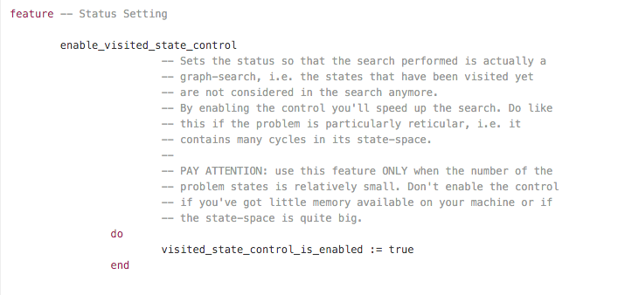

Slide 3
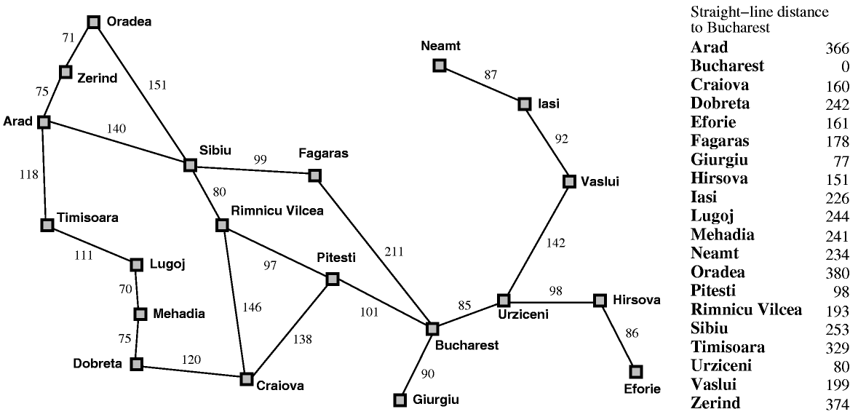

Slide 4
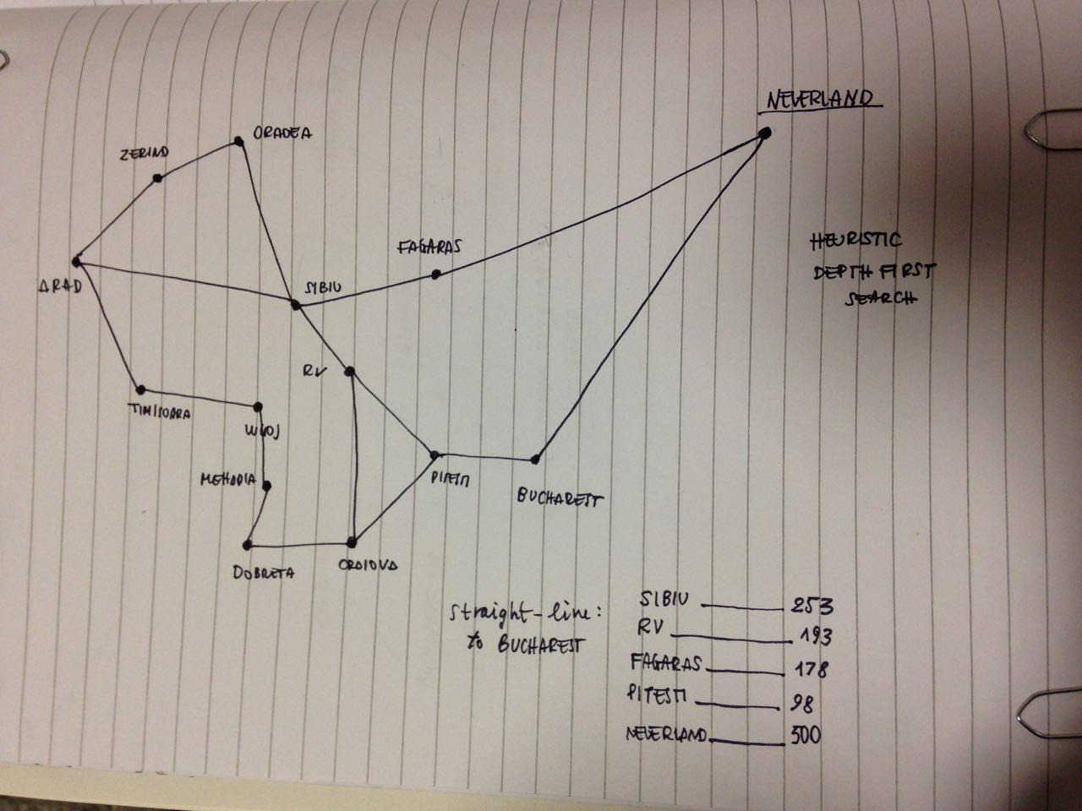
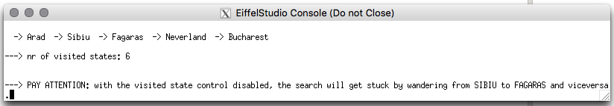

Slide 5
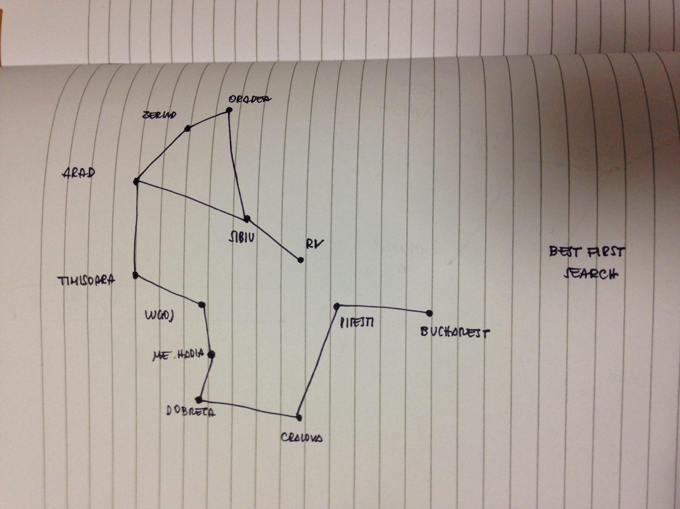
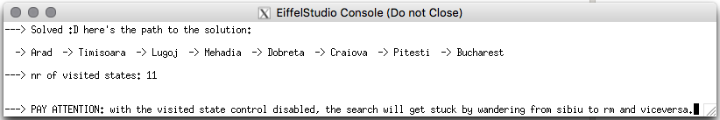

Slide 7
Designing the Model
1. Two models into one
2. The board shared class
3. Integrating the AI library
4. Keeping the game and the AI engine separated
5. Interfacing with the view

Slide 8
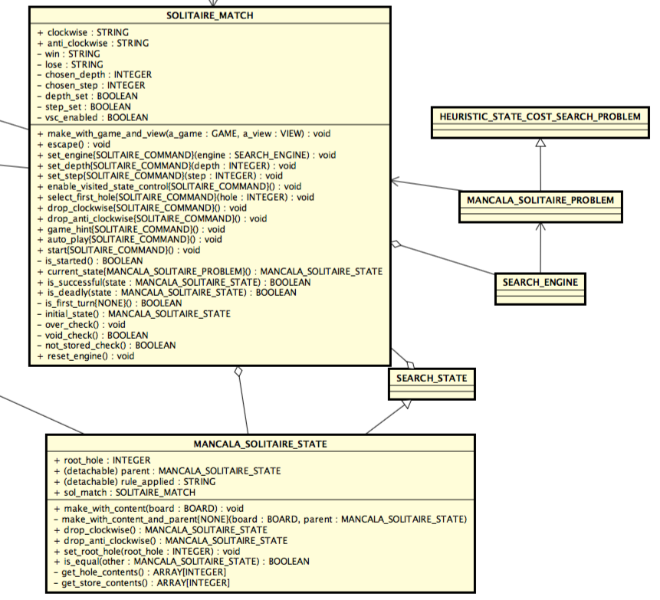

Slide 9
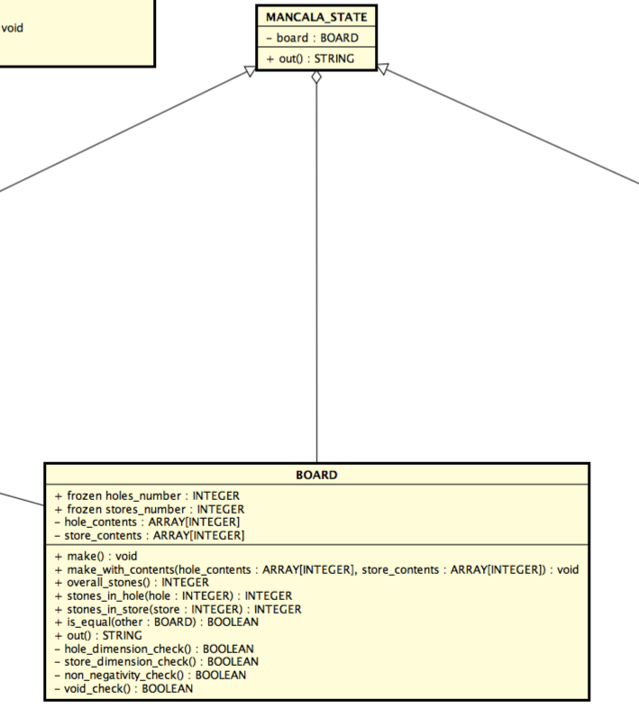

Slide 10
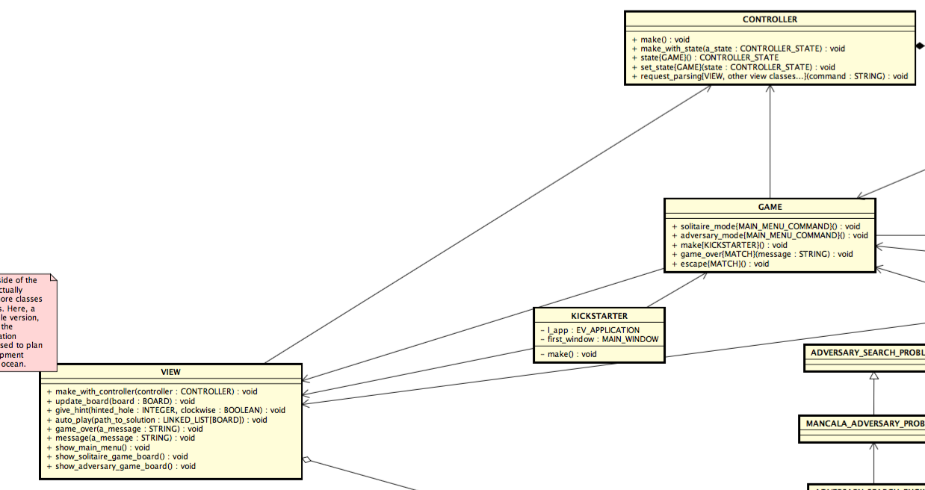

Slide 12
Solitaire Heuristic Function
1. Solitaire Mancala: an unsolvable problem
2. Fail to apply the most common approach
3. A customized approach: Life Expectancy

Slide 13
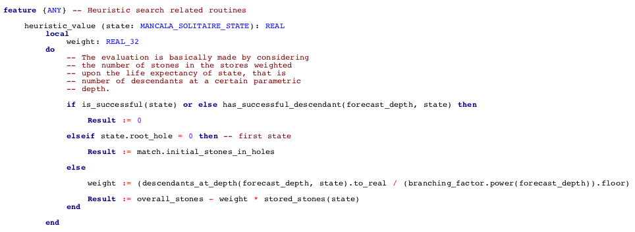

Slide 14
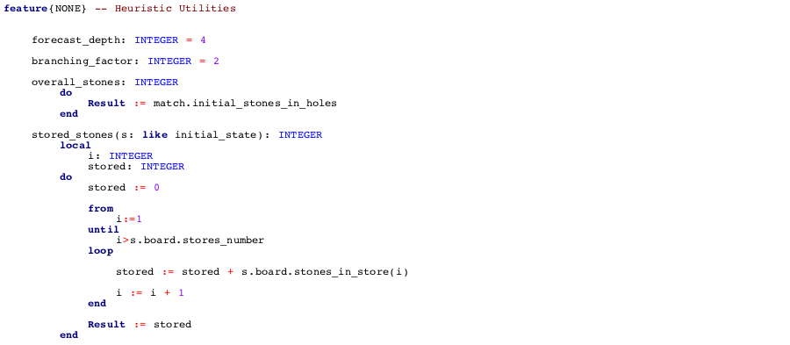

Slide 15
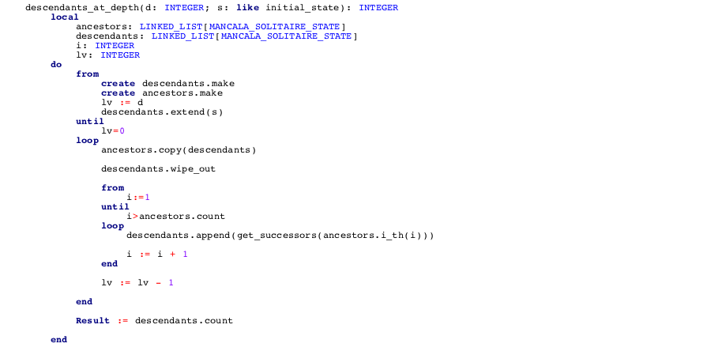

Slide 16
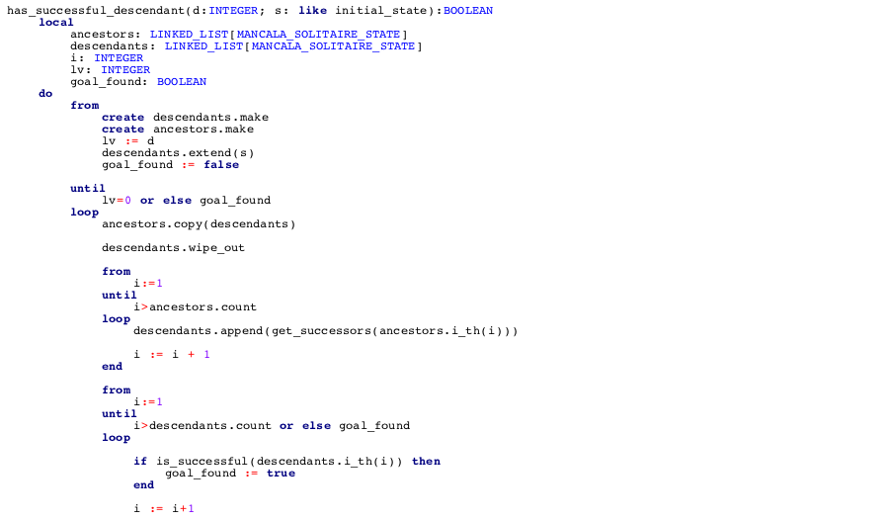
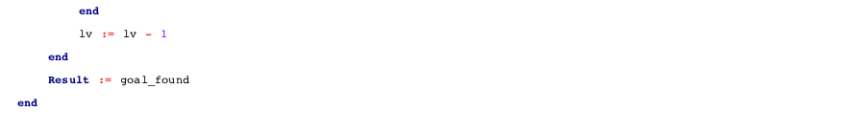

Slide 18
Bug Competition: Inspecting other teams' code

