Slide 1
Closed List
What is it?
Why?
Example of implementation in BDFS
Example with water jar and simpler problem
Importance of remove from visited states the ones with greater depth when decreasing the depth

Slide 2
Closed List
What is it?
A control which allow to not generate any state that was visited before.
Why?
no wasting time by expanding states that have already been encountered before on some other path.
moreover it makes an algorithm like BDFS complete, it means that if the solution is in the defined bound it will be found sooner or later
Price
Requires every state that was visited to be kept in memory, resulting in a possibly hight consumption of memory.
Notes:
1. Which means

Slide 3
Closed List - implementation
For instance, in the Bounded Depth First Search algorithm this was implemented using a list obj to store the already visited states and then:
before adding any child of a state to the frontier check if it was already visited or if it isn't already in the frontier
If the max depth was reached remove the states with greater depth from the visited once because could be a shorter path to that state
The feature may be enabled or disabled

Slide 4
Closed List – decreasing depth
Max depth: 3
Initial state: a
Goal state: f
a
b
c
d
e
f

Slide 5
Closed List – decreasing depth
Max depth: 3
Initial state: a
Goal state: f
a
b
c
d
e
f

Slide 6
Closed List – decreasing depth
Max depth: 3
Initial state: a
Goal state: f
a
b
c
d
e
f

Slide 7
Closed List – example with BDFS
Water Jar Puzzle:
Closed list disabled: unsolvable, the algorithm get stuck between one or more states
Closed list enabled: find the solution with max depth 16 in a few milliseconds, visiting 34 states
Road to Bucharest (max depth set to 20):
Closed list disabled: path length 19, visited states 88. The algorithm get stuck between two cities until the max depth is reached
Closed list enabled: path length 7, visited states 10

Slide 8
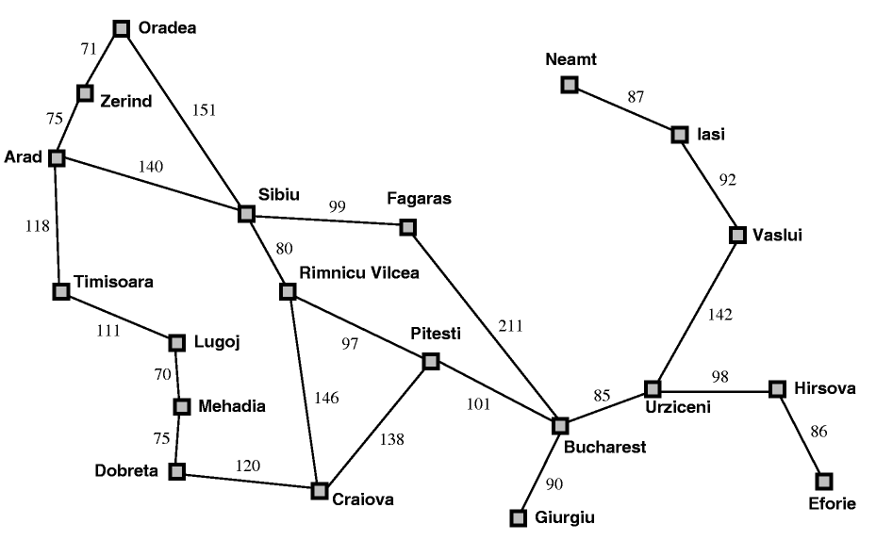
Closed List – road to Bucharest
All the children are in the visited states list or in the frontier already
Get stuck until max depth

