Slide 1
Test
1. The Water Jar Puzzle and its drawbacks
2. The need for another test case
3. The Road to Bucharest problem
4. Extending the test case to stress heuristic engines
5. Adversary search tests missing

Slide 2
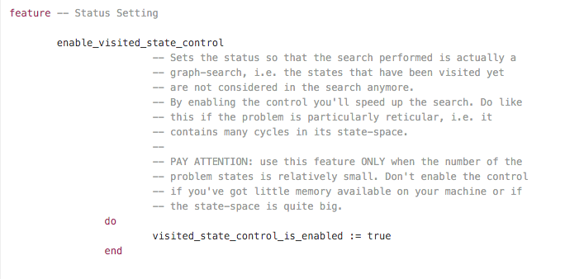

Slide 3
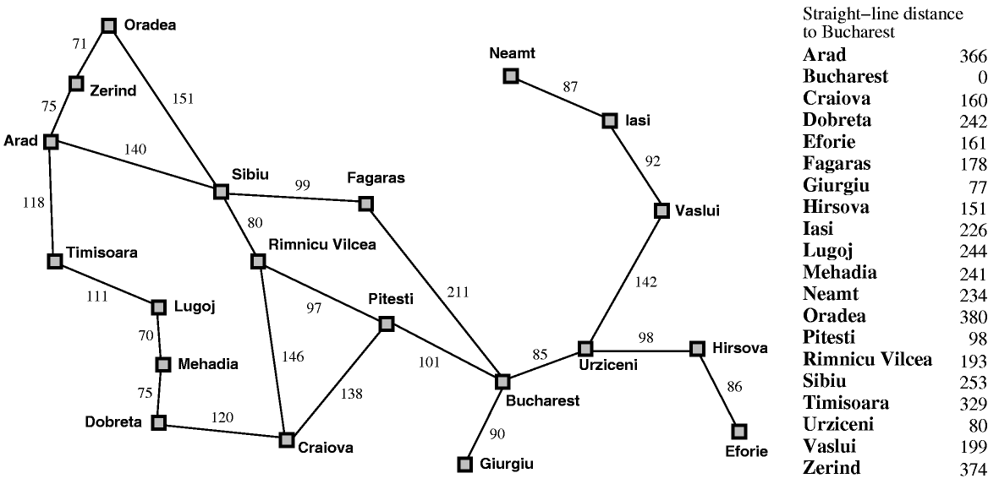

Slide 4
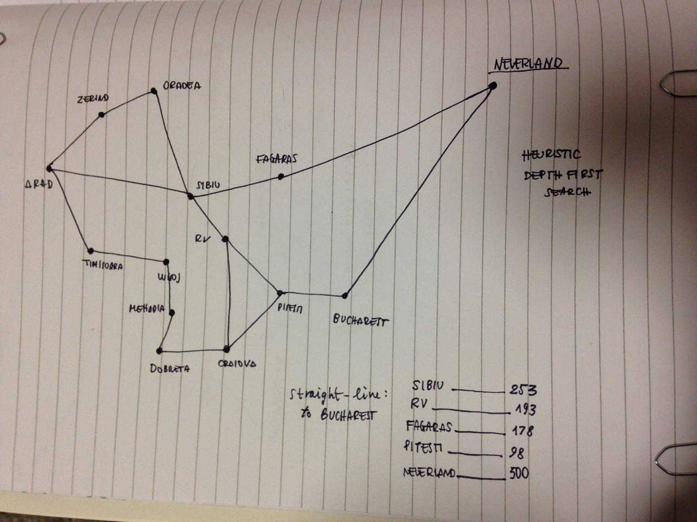
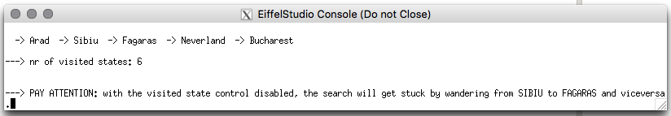

Slide 5
