Slide 1
Dose 2015
Group 7

Slide 2
Members
Team Milan 4
Team Rio Cuarto 7
Fabrizio Frasca
Luca Massaron
Calin Liviu Razvan
Alberto Fontana
Demian Romero
Romina Miranda

Slide 3
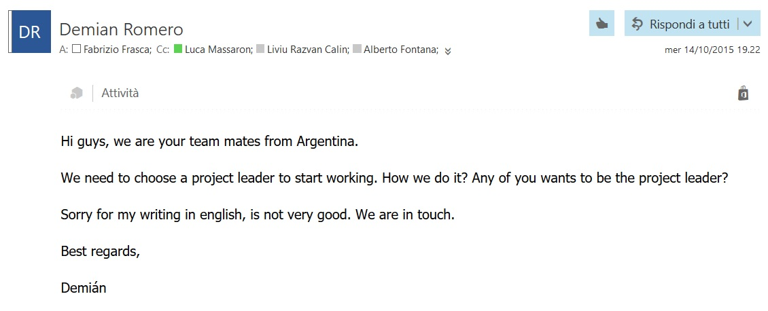
First Contact
0. Presentation
Skill checking
Project leader
Tasks assignment
Communication methods

Slide 4
1. Skill Checking
 | Milan | Argentina
English | All good | Only one speak not so fluently
Education | 3 from Polimi, 1 from Polito | 4th year of university (last)
Eiffel | No knowledge | Lessons with Nazareno
Git | 2 Ok, 1 basic knowledge, 1 never used | All good
AI Background | 2 following AI course | Followed course of AI

Slide 5
2. Project Leader
Volunteers
Lessons Schedule
Work
Language Skills
Technical Skills
Possibly in Milan

Slide 6
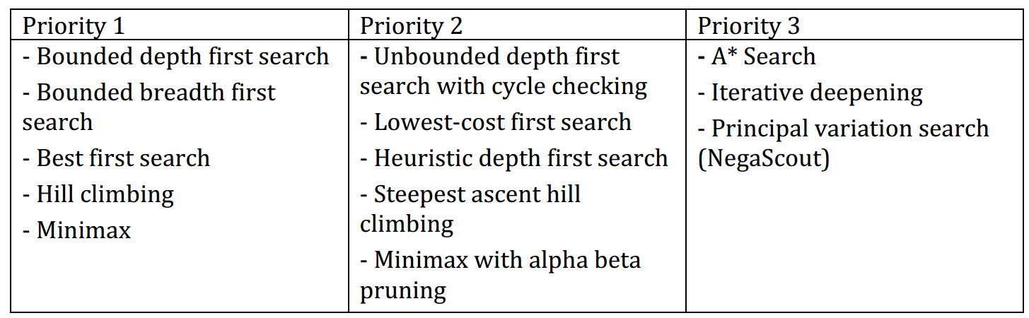
3. Task Assignment
13 Algorithms
2 algorithms each + 1 TBD (Negascout)
10 Single Agent Search + 3 Adversary Search

Slide 7
4. Communication Methods
Mailing List for official matter (documentation, instructions, meeting hour etc.)
Telegram group for instant messaging
Skype for periodic meetings and group working

Slide 9
Eiffel
Pros
Cons
Contract Design
Basic-like (well readable)
Object composed only by features
Better visibility management
Multiple Inheritance
Only one type of cycle
Basic-like (too much writing)
No polymorphism
Bad Exception Handling
Awful IDE
No Return in features

Slide 10
Eiffel Configuration File .ecf
<?xml version="1.0" encoding="ISO-8859-1"?>
<system xmlns="http://www.eiffel.com/developers/xml/configuration-1-14-0" xmlns:xsi="http://www.w3.org/2001/XMLSchema-instance" xsi:schemaLocation="http://www.eiffel.com/developers/xml/configuration-1-14-0 http://www.eiffel.com/developers/xml/configuration-1-14-0.xsd" name="eiffel-ai-search" uuid="C7C425FB-CC6A-4F1D-A3D3-7765C54B8A0C" library_target="eiffel-ai-search">
<target name="eiffel-ai-search">
<root all_classes="true"/>
<option warning="true" is_attached_by_default="false" void_safety="none">
<assertions precondition="true" postcondition="true" check="true" invariant="true" loop="true" supplier_precondition="true"/>
</option>
<setting name="console_application" value="true"/>
<library name="base" location="$ISE_LIBRARY\library\base\base.ecf"/>
<library name="testing" location="$ISE_LIBRARY\library\testing\testing.ecf"/>
<cluster name="eiffel-ai-search" location=".\">
<file_rule>
<exclude>/EIFGENs$</exclude>
<exclude>/CVS$</exclude>
<exclude>/.svn$</exclude>
</file_rule>
<cluster name="single-agent-search" location=".\single_agent_search\"/>
<cluster name="single-agent-search-engines" location=".\single_agent_search\single_agent_search_engines\"/>
<cluster name="single-agent-search-examples" location=".\single_agent_search_examples\"/>
<cluster name="adversary-search" location=".\adversary_search\"/>
<cluster name="adversary-search-engines" location=".\adversary_search\adversary_search_engines\"/>
<cluster name="adversary-search-examples" location=".\adversary_search_examples\"/>
</cluster>
</target>
</system>

Slide 12
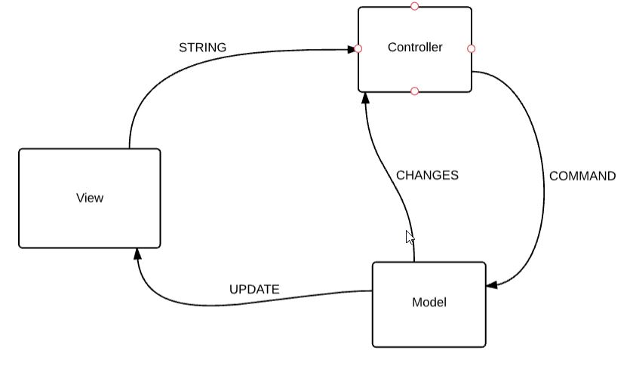
MVC Pattern
Simple Application
Easy job division
Already used
Common approach

Slide 13
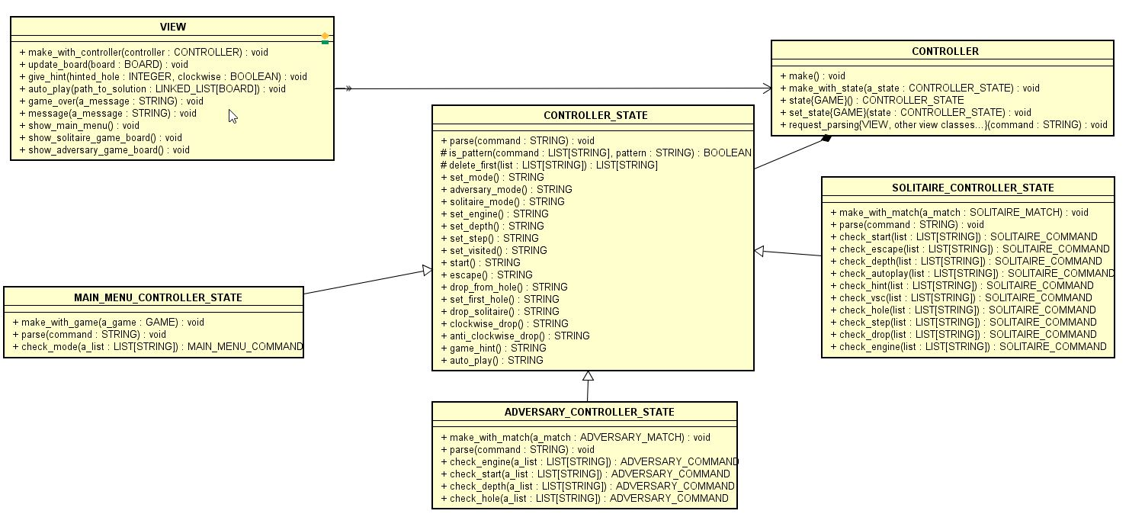
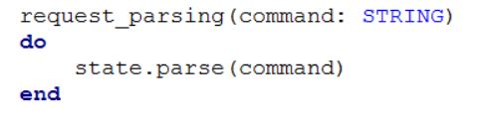
View - Controller
The State Pattern is used to filter different set of commands: Main Menu, Solitaire and Adversary

Slide 14
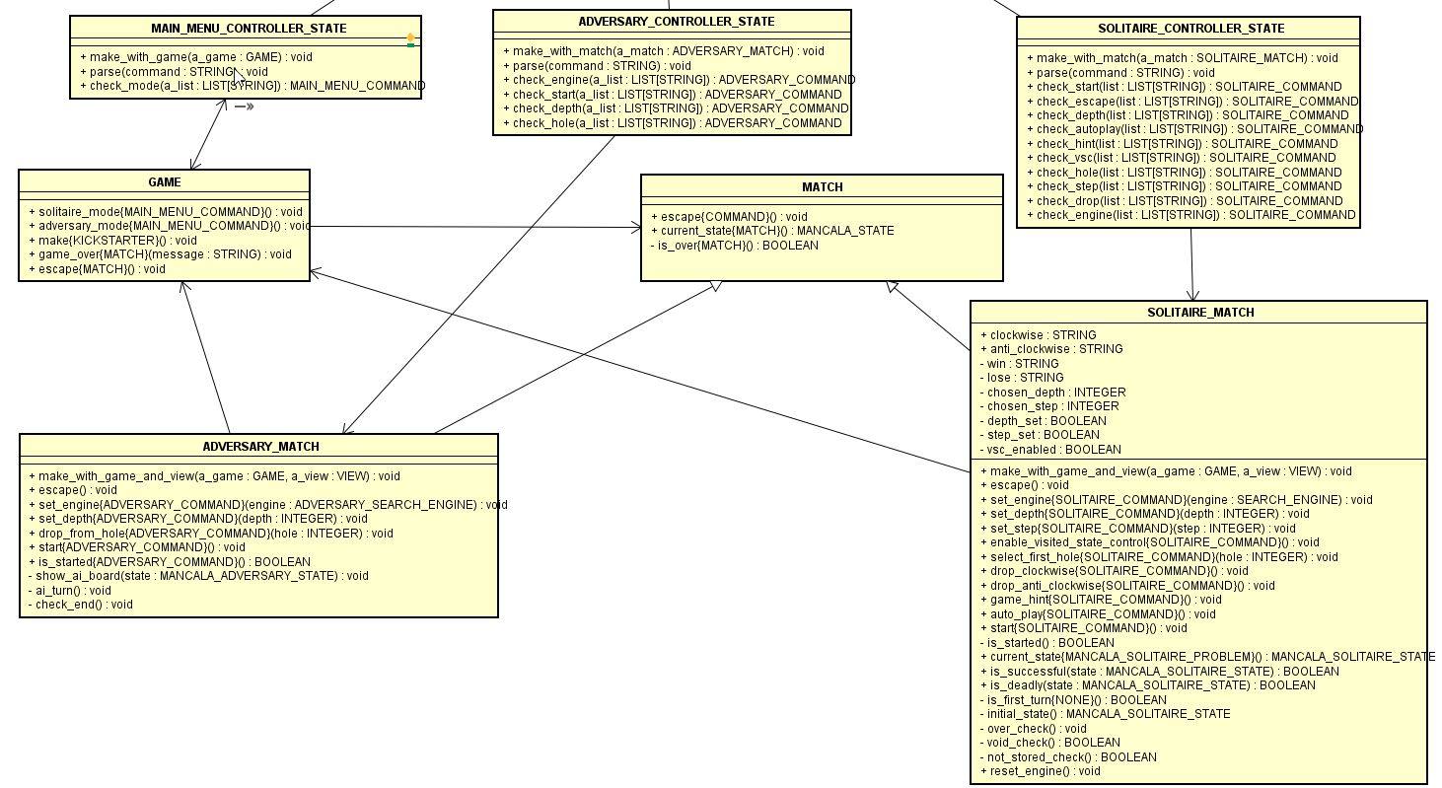
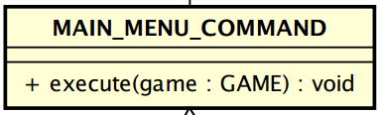
Controller - Model
Command Pattern is used to translate View messages into Model features
COMMAND_QUEUE
COMMAND_QUEUE
COMMAND_QUEUE

Slide 16
Adversary Game

Slide 17
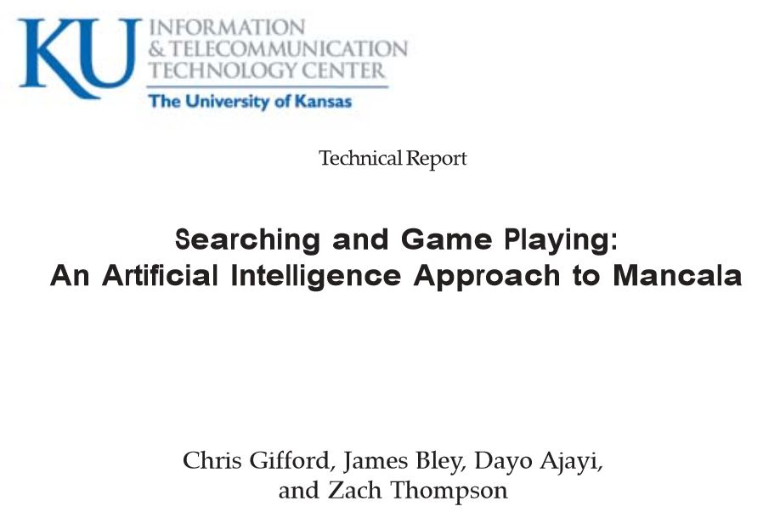
Heuristic function
H0: First valid move (furthest valid bin from my home)
H1: How far ahead of my opponent I am (My Mancala – Opponent’s Mancala)
H2: How close I am to winning (> half)
H3: How close opponent is to winning (> half)
H4: Number of stones close to my home
H5: Number of stones far away from my home
H6: Number of stones in middle of board (neither close nor far from home)
Source: www.ittc.ku.edu/publications/documents/Gifford_ITTC-FY2009-TR-03050-03.pdf
Result: H1, H3 and H2 were the best Heuristics in order

Slide 18
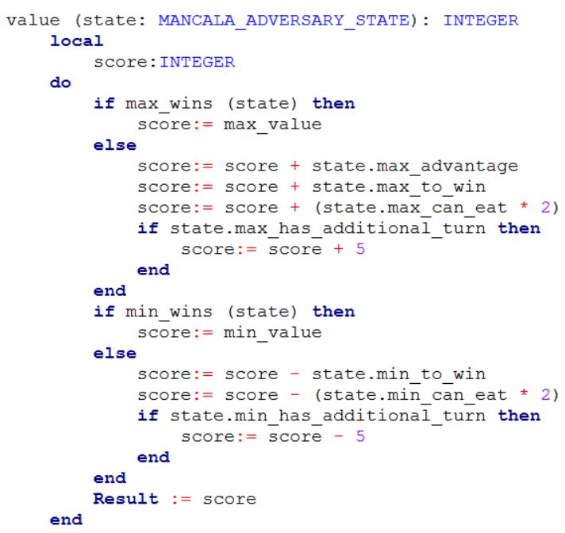
Heuristic function
H1: How far ahead of my opponent I am (My Mancala – Opponent’s Mancala)
H2: How close I am to winning (> half)
M1: How much can I eat (Doubled)
M2: I have an additional turn
H3: How close opponent is to winning (> half)
M3: How much can my opponent eat
M4: My opponent has an additional turn

Slide 20
Group 7 Bugs
22 Bugs Reported
Only 8 approved
14 Rejected

Slide 21
Approved Bugs
# | Bug | Cause
1 | Exception while starting Adversary game with negative depth | Due to misunderstanding message feature in VIEW was not working in main menu
2 | Exception while starting Adversary game with 0 depth | As point 1
3 | Can start Solitaire game with negative depth | Was working in Multithread but after switching to Single thread there was an error adapting the code because was not performed by the class developer
4 | Can start Solitaire game with negative step | As point 3
5 | Final values not shown in Adversary game | Final Value check did not update the view
6 | Label always shows “YOUR TURN” in Adversary Game | Should work in Multithread but using Single labels are updated only at the end of the function call (using buttons should solve it)
7 | Holes buttons disabled after clicking on an empty one | Blocking buttons should not be implemented in Single thread, was actually removed and solved but not merged
8 | Negascout Exception | Still unknown

Slide 22
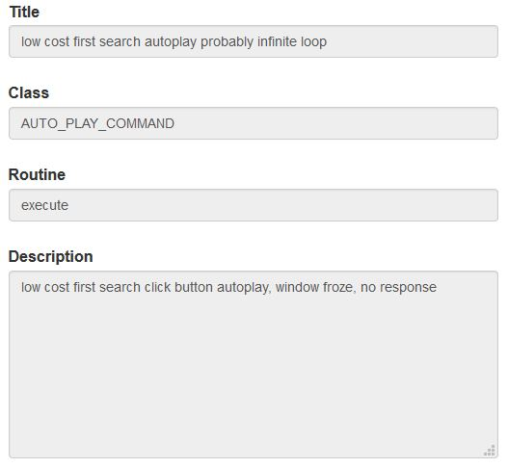
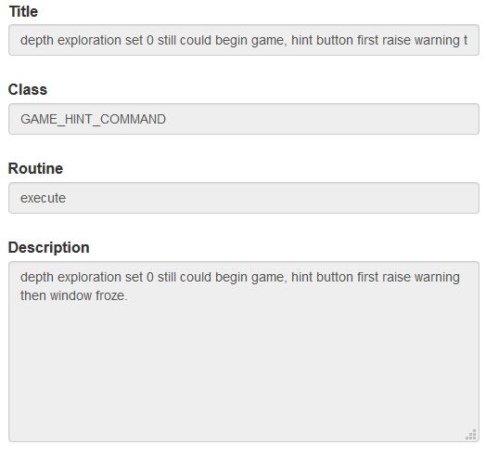
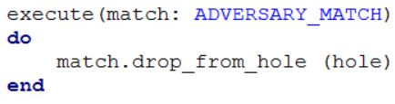
Rejected Bugs
Main Reasons:
Duplicates
Bad Documentation
Not a Bug
Cannot replicate
“Probably” infinite loop?
COMMAND.execute?
Depth in which engine?
Depth = 0 already reported first day

Slide 24

Foreign mates: Recap
Communication | No problem at all. They answered always in little time (considering the time zone) and participated to conversations on Skype and Telegram. At the end they asked for our pictures and congratulated for our nice work and leadership. They got the best mark in this project with professor Nazareno.
Library | Their code seemed well written but it didn’t even compile, lucky were just little errors (not creating an object, not resetting a variable). We spent a lot of time during the testing phase because they did not understand well how to set up test and still often their code did not compile, like they did not even try to execute it before pushing. We ended up correcting some part ourselves.
App | They were not so happy to work on the GUI but accepted and made a very nice Interface. They collaborate a lot with us during the final phase, the last day they woke up very early to stay with us all time till the deadline.

