Slide 1
Dose 2015
Group 7 - Milan 4

Slide 2
Members of Group 7
Team Milan 4
Team Rio Cuarto 7
Fabrizio Frasca
Luca Massaron
Calin Liviu Razvan
Alberto Fontana
Demian Romero
Romina Miranda
No Contract Design

Slide 3
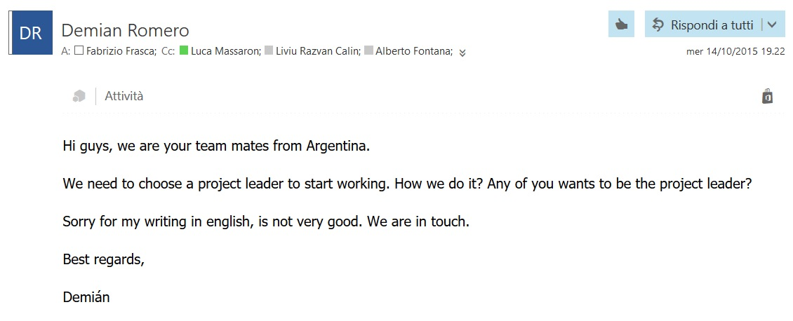
First Contact
0. Presentation
Skill checking
Project leader
Tasks assignment
Communication methods

Slide 4
1. Skill Checking
 | Milan | Argentina
English | All good | Only one speaks not so fluently
Education | 3 from Polimi, 1 from Polito | 4th year of university (last)
Eiffel | No knowledge | Lessons with Nazareno
Git | 2 Ok, 1 basic knowledge, 1 never used | All good
AI Background | 2 following AI course | Followed course of AI

Slide 5
2. Project Leader
Volunteers
Lessons Schedule
Work
Language Skills
Technical Skills
Possibly in Milan
Final Candidates: Luca and Fabrizio

Slide 6
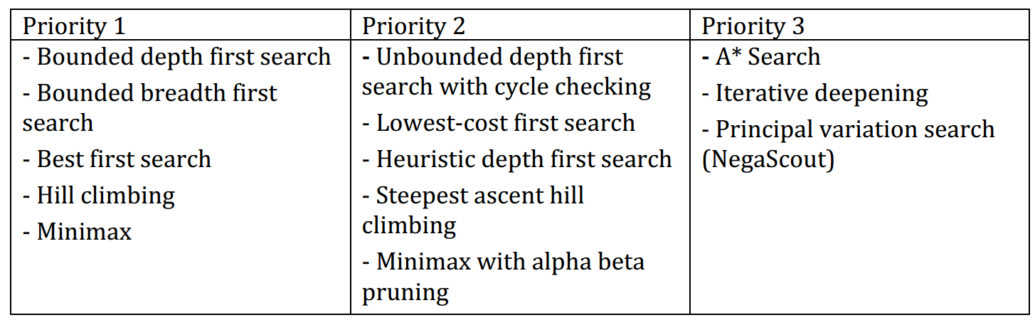
3. Task Assignment
13 Algorithms
2 algorithms each + 1 TBD (Negascout)
10 Single Agent Search + 3 Adversary Search

Slide 7
4. Communication Methods
Mailing List for official matter (documentation, instructions, meeting hour etc.)
Telegram group for instant messaging
Skype for periodic meetings and group working

Slide 8
Eiffel
Pros
Cons
Contract Design
Basic-like (well readable)
Object composed only by features
Better visibility management
Multiple Inheritance
Only one type of cycle
Basic-like (too much writing)
No polymorphism
Bad Exception Handling
Awful IDE
No Return in functions
No “main” method

Slide 9
Eiffel Configuration File .ecf
<?xml version="1.0" encoding="ISO-8859-1"?>
<system xmlns="http://www.eiffel.com/developers/xml/configuration-1-14-0" xmlns:xsi="http://www.w3.org/2001/XMLSchema-instance" xsi:schemaLocation="http://www.eiffel.com/developers/xml/configuration-1-14-0 http://www.eiffel.com/developers/xml/configuration-1-14-0.xsd" name="eiffel-ai-search" uuid="C7C425FB-CC6A-4F1D-A3D3-7765C54B8A0C" library_target="eiffel-ai-search">
<target name="eiffel-ai-search">
<root all_classes="true"/>
<option warning="true" is_attached_by_default="false" void_safety="none">
<assertions precondition="true" postcondition="true" check="true" invariant="true" loop="true" supplier_precondition="true"/>
</option>
<setting name="console_application" value="true"/>
<library name="base" location="$ISE_LIBRARY\library\base\base.ecf"/>
<library name="testing" location="$ISE_LIBRARY\library\testing\testing.ecf"/>
<cluster name="eiffel-ai-search" location=".\">
<file_rule>
<exclude>/EIFGENs$</exclude>
<exclude>/CVS$</exclude>
<exclude>/.svn$</exclude>
</file_rule>
<cluster name="single-agent-search" location=".\single_agent_search\"/>
<cluster name="single-agent-search-engines" location=".\single_agent_search\single_agent_search_engines\"/>
<cluster name="single-agent-search-examples" location=".\single_agent_search_examples\"/>
<cluster name="adversary-search" location=".\adversary_search\"/>
<cluster name="adversary-search-engines" location=".\adversary_search\adversary_search_engines\"/>
<cluster name="adversary-search-examples" location=".\adversary_search_examples\"/>
</cluster>
</target>
</system>

Slide 10
AI Library

Slide 11
Closed List
What is it?
Why?
Example of implementation in BDFS
Example with water jar and simpler problem
Importance of remove from visited states the ones with greater depth when decreasing the depth

Slide 12
Closed List
What is it?
A control which allow to not generate any state that was visited before.
Why?
no wasting time by expanding states that have already been encountered before on some other path.
moreover it makes an algorithm like BDFS complete, it means that if the solution is in the defined bound it will be found sooner or later
Price
Requires every state that was visited to be kept in memory, resulting in a possibly high consumption of memory.

Slide 13
Closed List - implementation
For instance, in the Bounded Depth First Search algorithm this was implemented using a list obj to store the already visited states and then:
before adding any child of a state to the frontier check if it was already visited or if it isn't already in the frontier
If the max depth was reached remove the states with greater depth from the visited once because could be a shorter path to that state
The feature may be enabled or disabled

Slide 14
Closed List – decreasing depth
Max depth: 3
Initial state: a
Goal state: f
a
b
c
d
e
f

Slide 15
Closed List – decreasing depth
Max depth: 3
Initial state: a
Goal state: f
a
b
c
d
e
f

Slide 16
Closed List – decreasing depth
Max depth: 3
Initial state: a
Goal state: f
a
b
c
d
e
f

Slide 17
Closed List – example with BDFS
Water Jar Puzzle:
Closed list disabled: unsolvable, the algorithm get stuck between one or more states
Closed list enabled: find the solution with max depth 16 in a few milliseconds, visiting 34 states
Road to Bucharest (max depth set to 20):
Closed list disabled: path length 19, visited states 88. The algorithm get stuck between two cities until the max depth is reached
Closed list enabled: path length 7, visited states 10

Slide 18
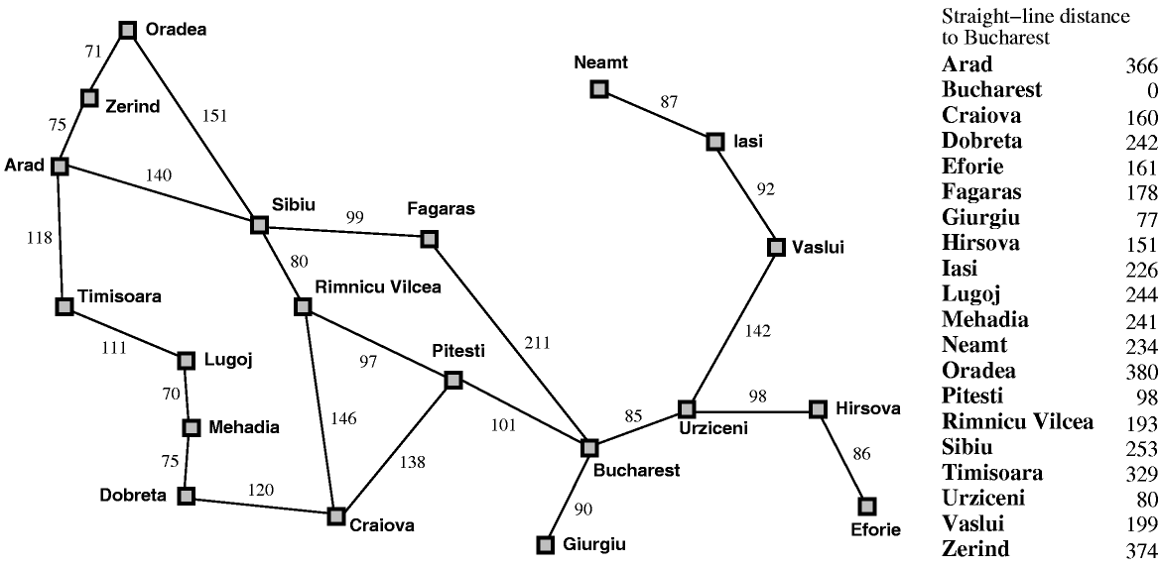
Closed List – road to Bucharest
All the children are in the visited states list or in the frontier already
Get stuck until max depth

Slide 19
Test
1. The Water Jar Puzzle and its drawbacks
2. The need for another test case
3. The Road to Bucharest problem
4. Extending the test case to stress heuristic engines
5. Adversary search tests missing

Slide 20
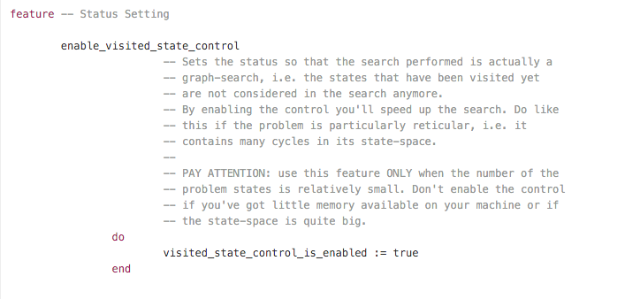

Slide 22
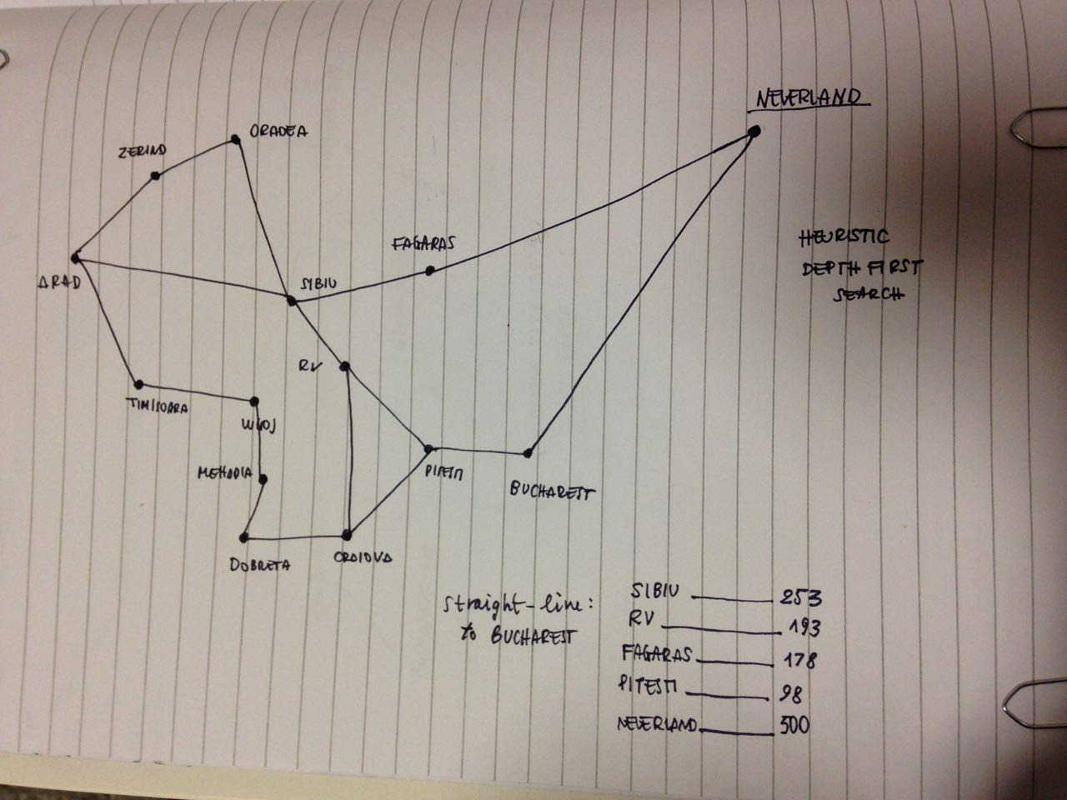
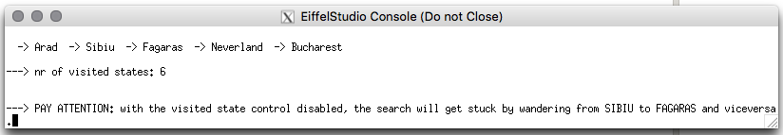

Slide 23
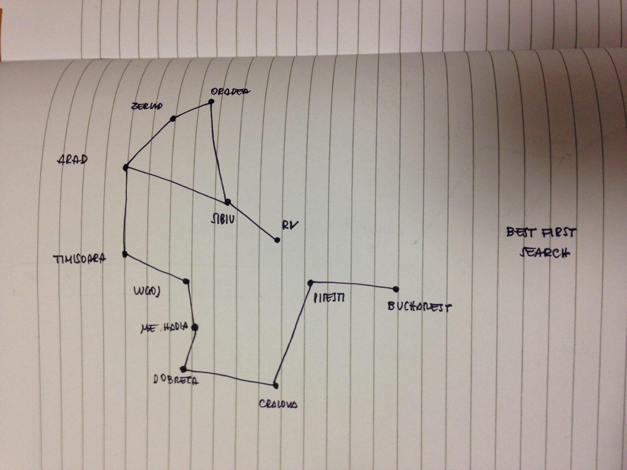
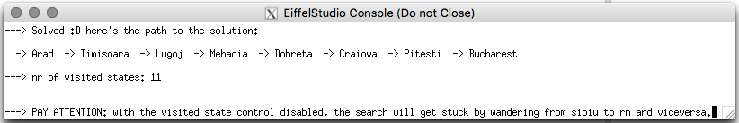

Slide 24
Application
Mancala Game

Slide 25
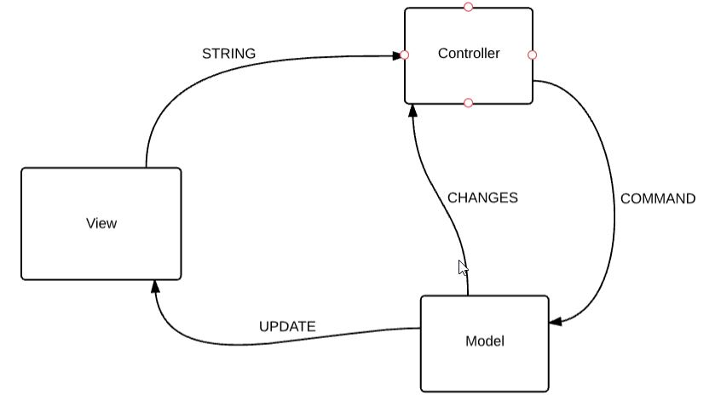
MVC Pattern
Simple Application
Easy job division
Already used
Common approach

Slide 26
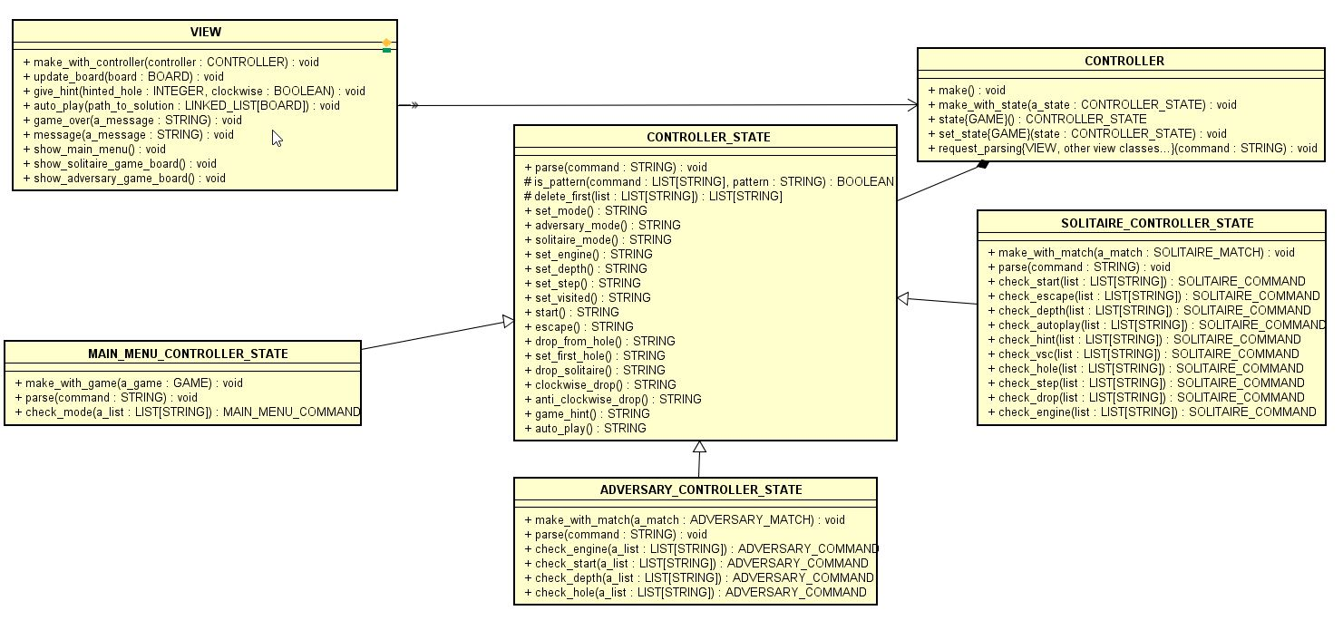
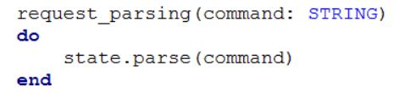
View - Controller
The State Pattern is used to filter different set of commands: Main Menu, Solitaire and Adversary

Slide 27
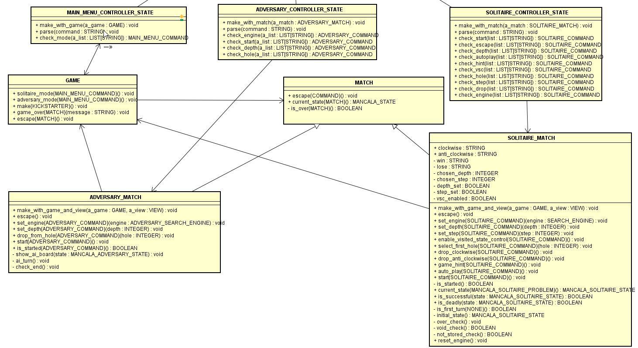
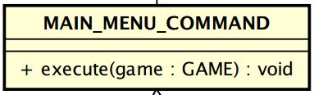
Controller - Model
Command Pattern is used to translate View messages into Model features
COMMAND_QUEUE
COMMAND_QUEUE
COMMAND_QUEUE

Slide 28
Designing the Model
1. Two models into one
2. The board shared class
3. Integrating the AI library
4. Keeping the game and the AI engine separated
5. Interfacing with the view

Slide 29
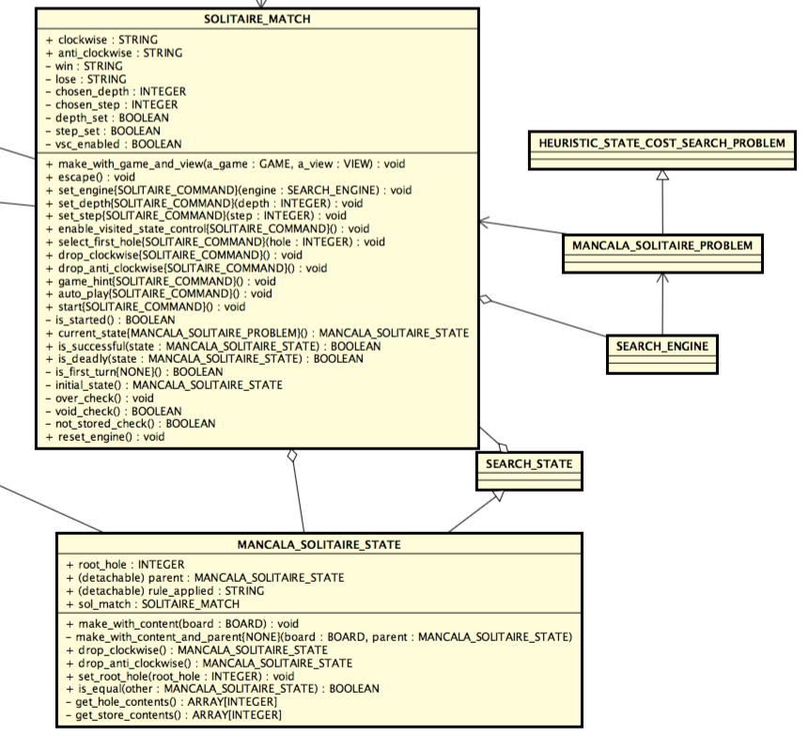

Slide 30
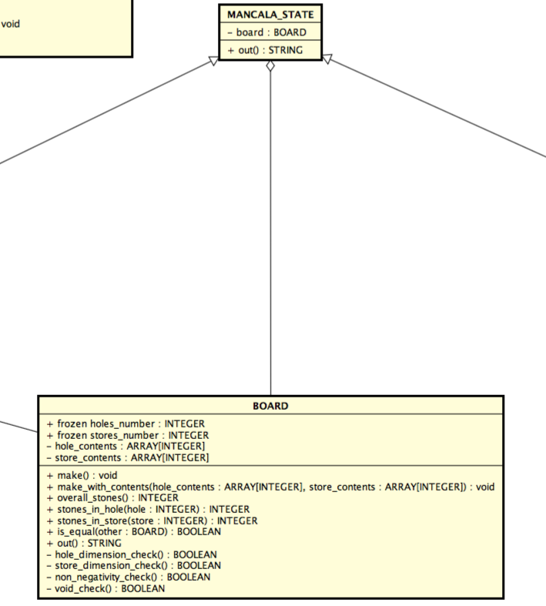

Slide 31
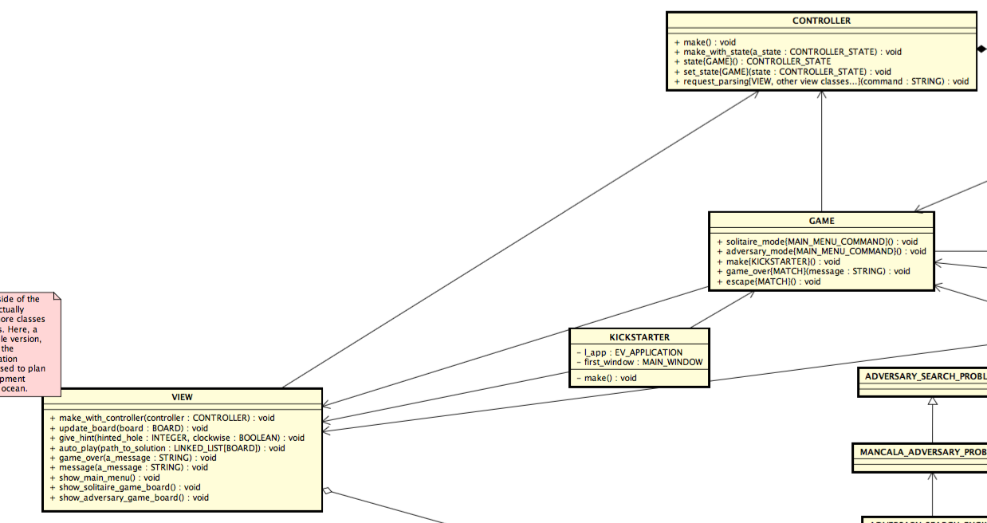

Slide 32
Thread
We thought it would be important to develop a multithread application with the aim of let the control of the app to the user, even after he ask for an automatic solution method, like 'hint' or 'solve'.
Especially in the solitaire mode, the execution of the ai algorithm could take a lot of time.
It might not even terminate cause the insolubility of the problem.

Slide 33
Thread - problem
We weren't able to synchronize the execution of the threads in a good way for the execution of the program and in the same way between different O.S..
We had different behaviors changing the O.S., for instance in Windows the application starts with a blank window while on Unix based O.S. it starts normally, but pretty often it get stuck and doesn't responds to commands any more.
Probably the differences are due to the different way in which the systems manage the scheduling of threads.

Slide 34
Thread – eiffel “tools”
The most important classes are:
THREAD: use this class as an ancestor for each class that allows starting new threads.
PROXY: use this class to refer to other threads' objects.
In class THREAD, there is a procedure launch. This procedure calls another, execute, deferred in THREAD. To describe the behavior of a thread on execution, simply redefine procedure execute in the appropriate descendant of THREAD.

Slide 35
Thread – proxy mechanism
To maintain the safety and consistency of a multithreaded application, within the use of other threads objects, there is a Basic Thread Rule:
“A thread must never keep references to another thread's objects.”
When a thread needs to access another thread's object, it will use a proxy for that object -- an instance of the EiffelThreads class PROXY[G].

Slide 36
Thread – proxy mechanism
To record the object foreign_object of type FOREIGN_TYPE in a proxy, it will execute
my_proxy.put (foreign_object)
where my_proxy is of type PROXY [FOREIGN_TYPE]. To access the object, it will then use the expression
my_proxy.item
This expression should only be used as a target of feature applications, as in
my_proxy.item.do_something
and never assigned to an attribute (as in my_attrib := my_proxy.item), as this would cause a violation of the Basic Thread Rule, and unpredictable results.

Slide 37
Thread – once routines
Eiffel introduced the powerful mechanism of once routines. A once routine has a body that will be executed only for the first call; This provides a simple way of sharing objects in an object-oriented context.
For multithreaded applications, the appropriate semantics is that once routines must be called once per thread (rather than once per process).

Slide 38
Solitaire Heuristic Function
1. Solitaire Mancala: an unsolvable problem
2. Fail to apply the most common approach
3. A customized approach: Life Expectancy

Slide 39
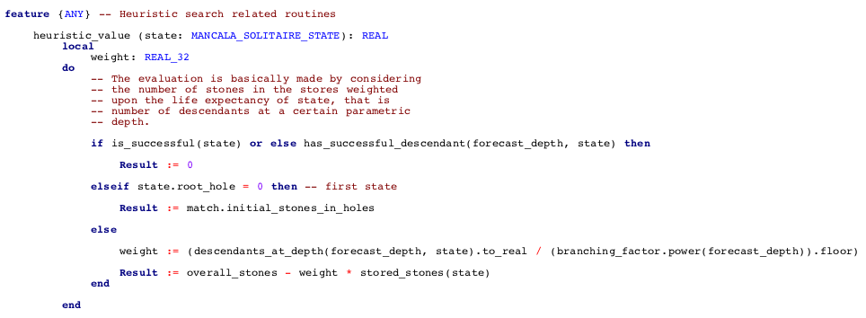

Slide 40
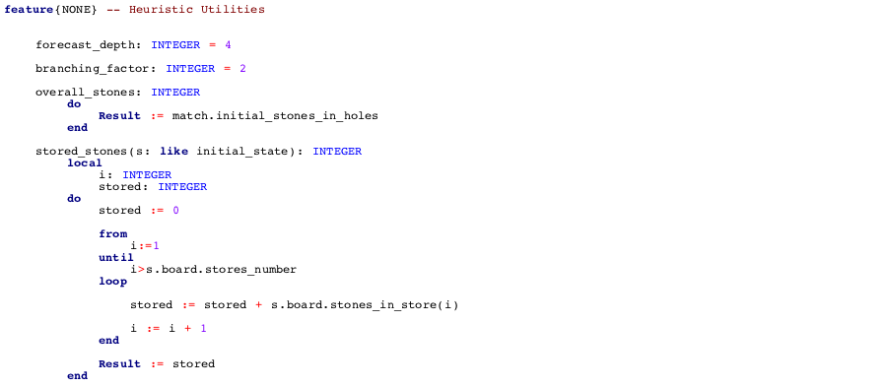

Slide 41
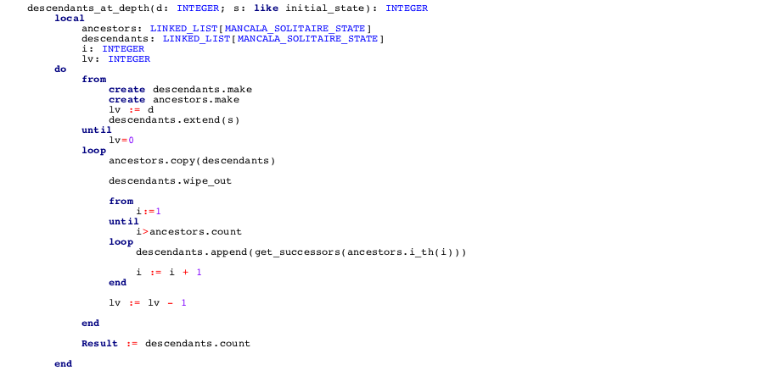

Slide 42
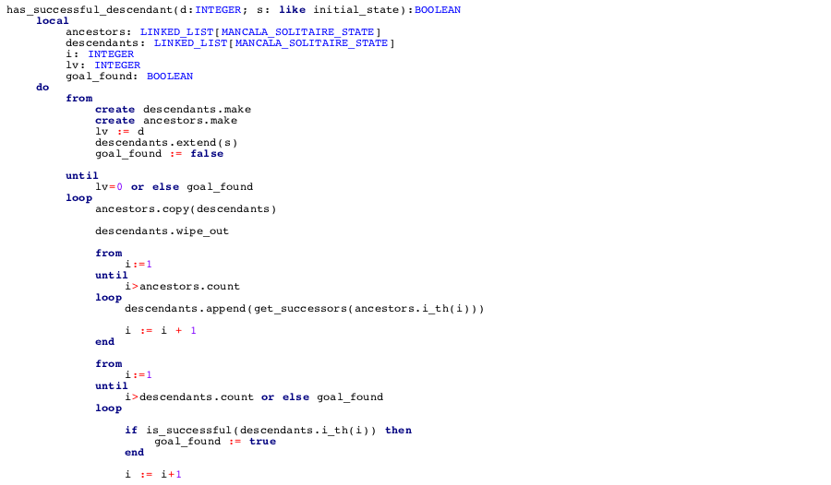
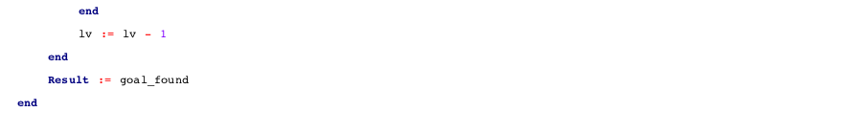

Slide 43
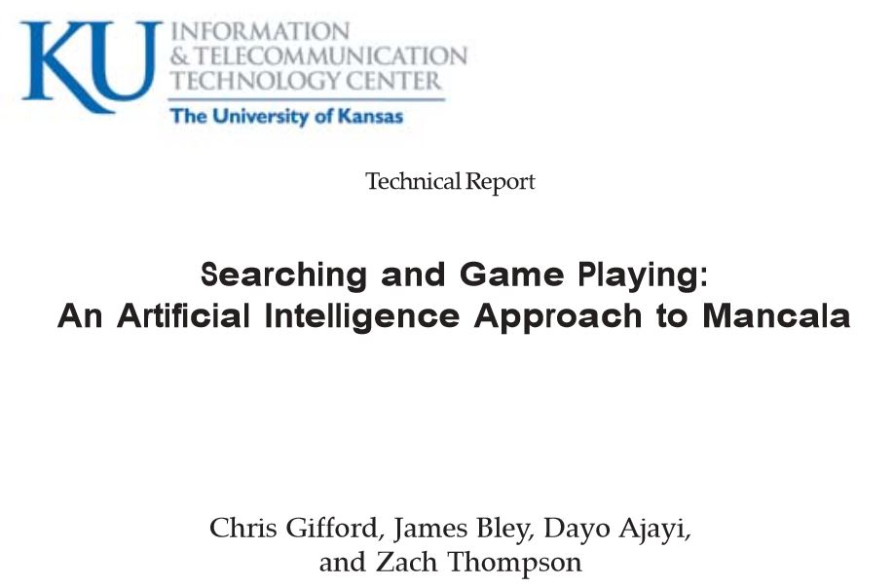
Adversary Heuristic function
H0: First valid move (furthest valid bin from my home)
H1: How far ahead of my opponent I am (My Mancala – Opponent’s Mancala)
H2: How close I am to winning (> half)
H3: How close opponent is to winning (> half)
H4: Number of stones close to my home
H5: Number of stones far away from my home
H6: Number of stones in middle of board (neither close nor far from home)
Source: www.ittc.ku.edu/publications/documents/Gifford_ITTC-FY2009-TR-03050-03.pdf
Result: H1, H3 and H2 were the best Heuristics in order

Slide 44
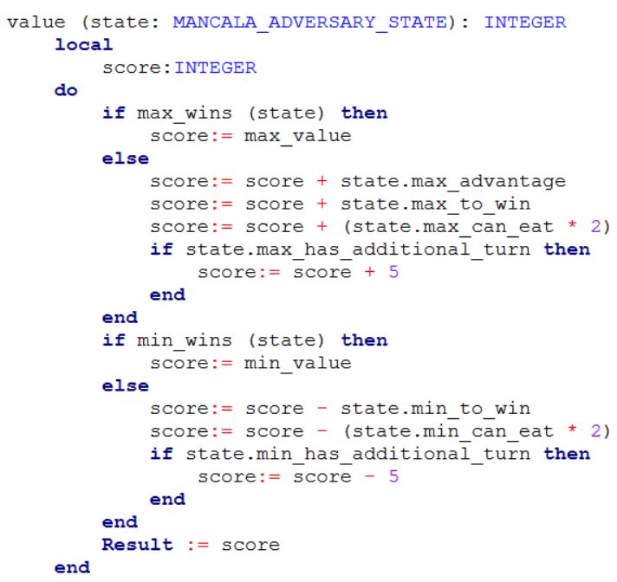
Adversary Heuristic function
H1: How far ahead of my opponent I am (My Mancala – Opponent’s Mancala)
H2: How close I am to winning (> half)
M1: How much can I eat (Doubled)
M2: I have an additional turn
H3: How close opponent is to winning (> half)
M3: How much can my opponent eat
M4: My opponent has an additional turn

Slide 45
Bug Competition

Slide 46
Group 7 Bugs
22 Bugs Reported
Only 8 approved
14 Rejected

Slide 47
Approved Bugs
# | Bug | Cause
1 | Exception while starting Adversary game with negative depth | Due to misunderstanding message feature in VIEW was not working in main menu
2 | Exception while starting Adversary game with 0 depth | As point 1
3 | Can start Solitaire game with negative depth | Was working in Multi Thread but after switching to Single thread there was an error adapting the code because was not performed by the class developer
4 | Can start Solitaire game with negative step | As point 3
5 | Final values not shown in Adversary game | Final Value check did not update the view
6 | Label always shows “YOUR TURN” in Adversary Game | Should work in Multi Thread but using Single labels are updated only at the end of the function call (using buttons should solve it)
7 | Holes buttons disabled after clicking on an empty one | Blocking buttons should not be implemented in Single thread, was actually removed and solved but not merged
8 | Negascout Exception | Still unknown

Slide 48
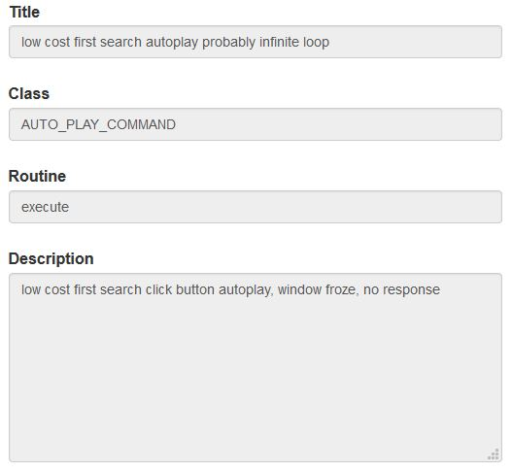
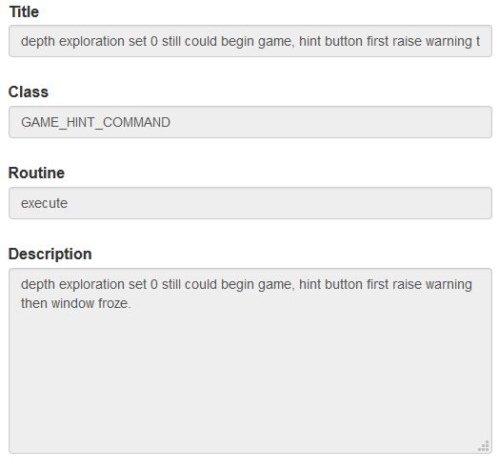
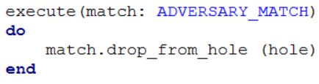
Rejected Bugs
Main Reasons:
Duplicates
Bad Documentation
Not a Bug
Cannot replicate
“Probably” infinite loop?
COMMAND.execute?
Depth in which engine?
Depth = 0 already reported first day

Slide 49
Bug Competition: Inspecting other teams' code
1. Where to look
2. Cohesion and coherence
3. (Missed) Separation between Game and AI

Slide 50
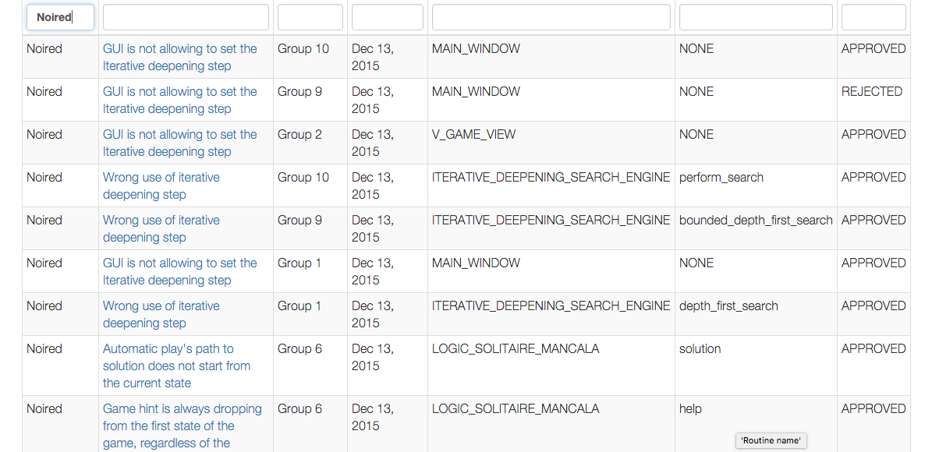

Slide 51
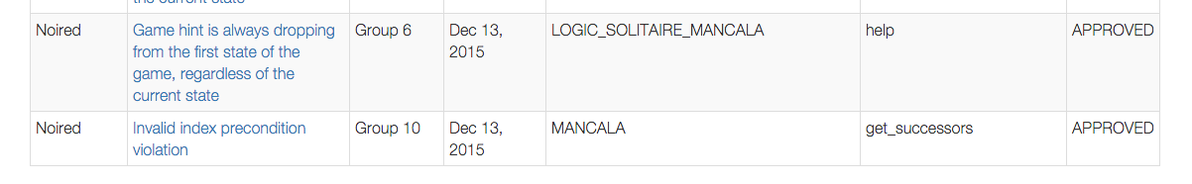
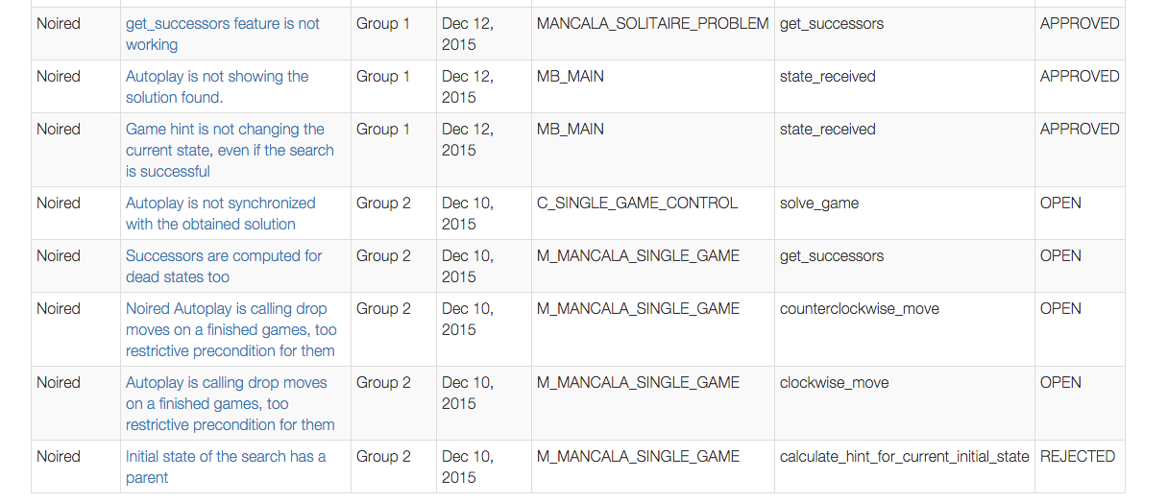

Slide 52
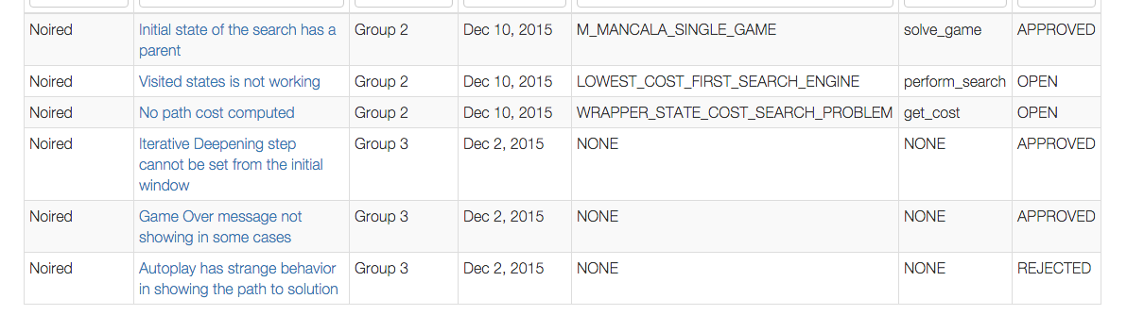

Slide 53
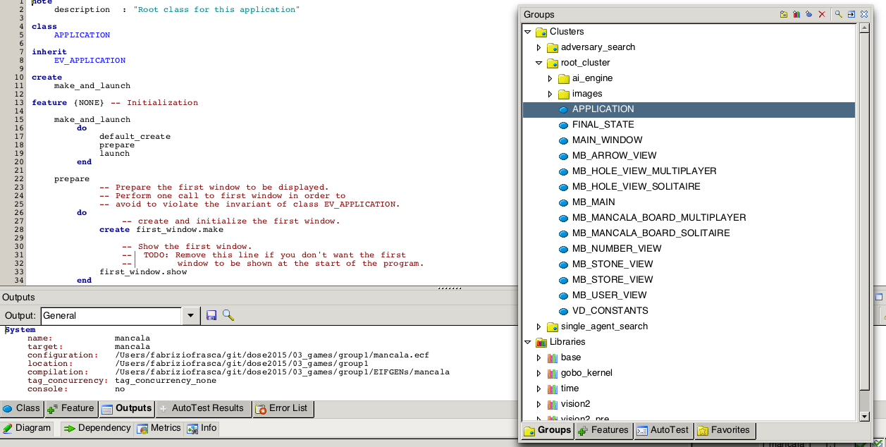

Slide 54
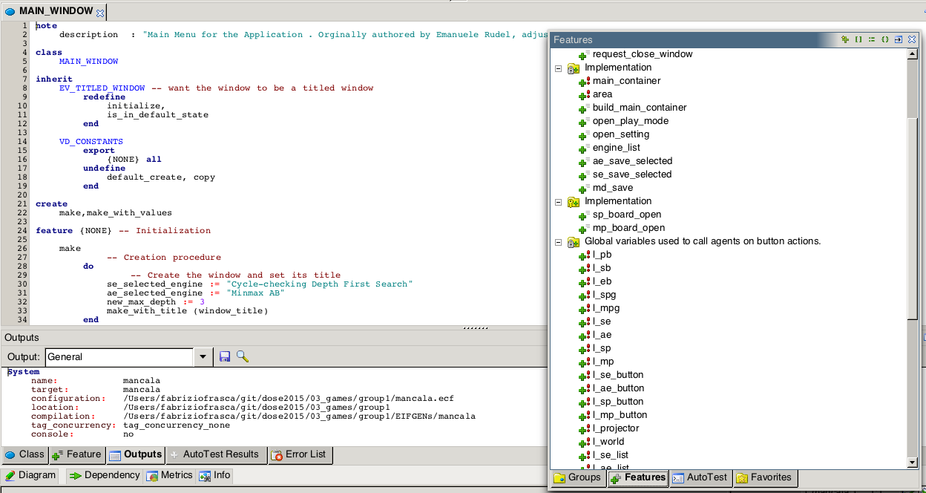

Slide 55

Foreign mates: Recap
Library | Their code seemed well written but it didn’t even compile, lucky were just little errors (not creating an object, not resetting a variable). We spent a lot of time during the testing phase because they did not understand well how to set up test and still often their code did not compile, like they did not even try to execute it before pushing. We ended up correcting some part ourselves.
App | They were not so happy to work on the GUI but accepted and made a very nice Interface. They collaborate a lot with us during the final phase, the last day they woke up very early to stay with us all time till the deadline.
Communication | No problem at all. They answered always in little time (considering the time zone) and participated to conversations on Skype and Telegram. At the end they asked for our pictures and congratulated for our nice work and leadership. They got the best mark in this project (considered like a final thesis) with professor Nazareno.

Slide 56

