Slide 1
Test
1. The Water Jar Puzzle and its drawbacks
2. The need for another test case
3. The Road to Bucharest problem
4. Extending the test case to stress heuristic engines
5. Adversary search tests missing

Slide 2
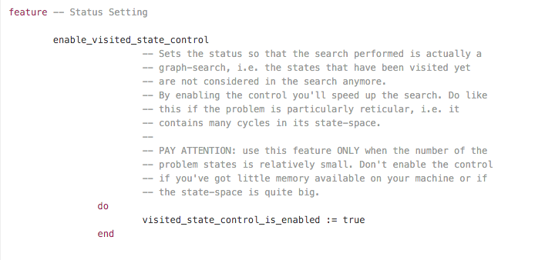

Slide 3
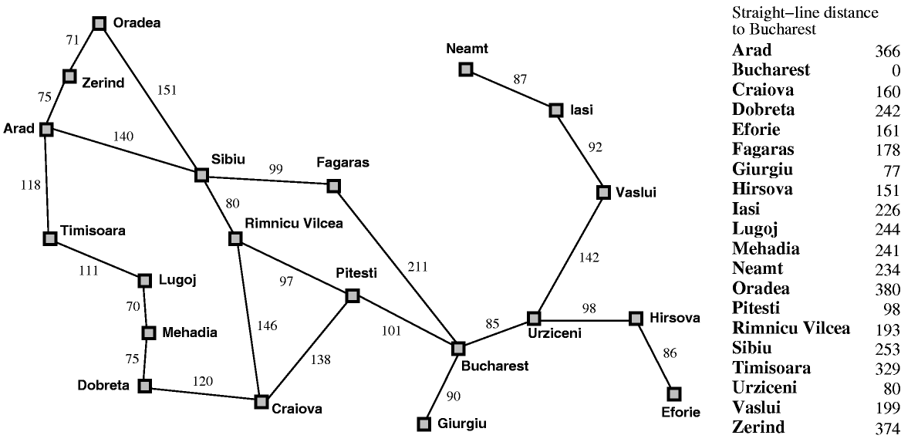

Slide 4
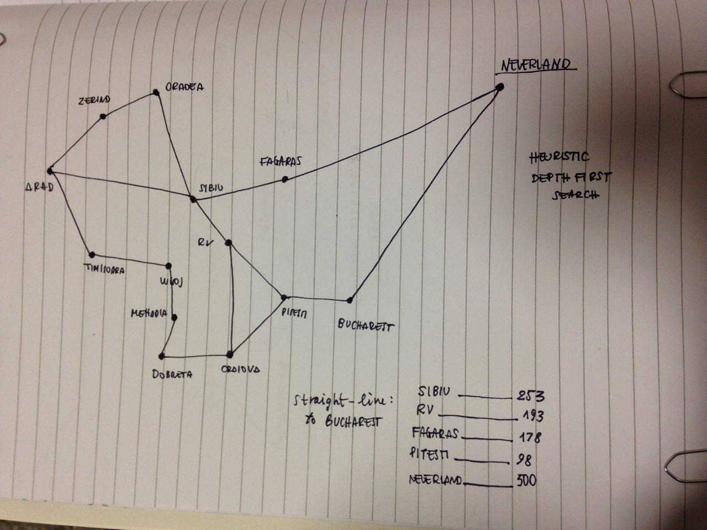
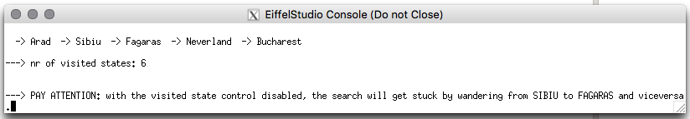

Slide 5
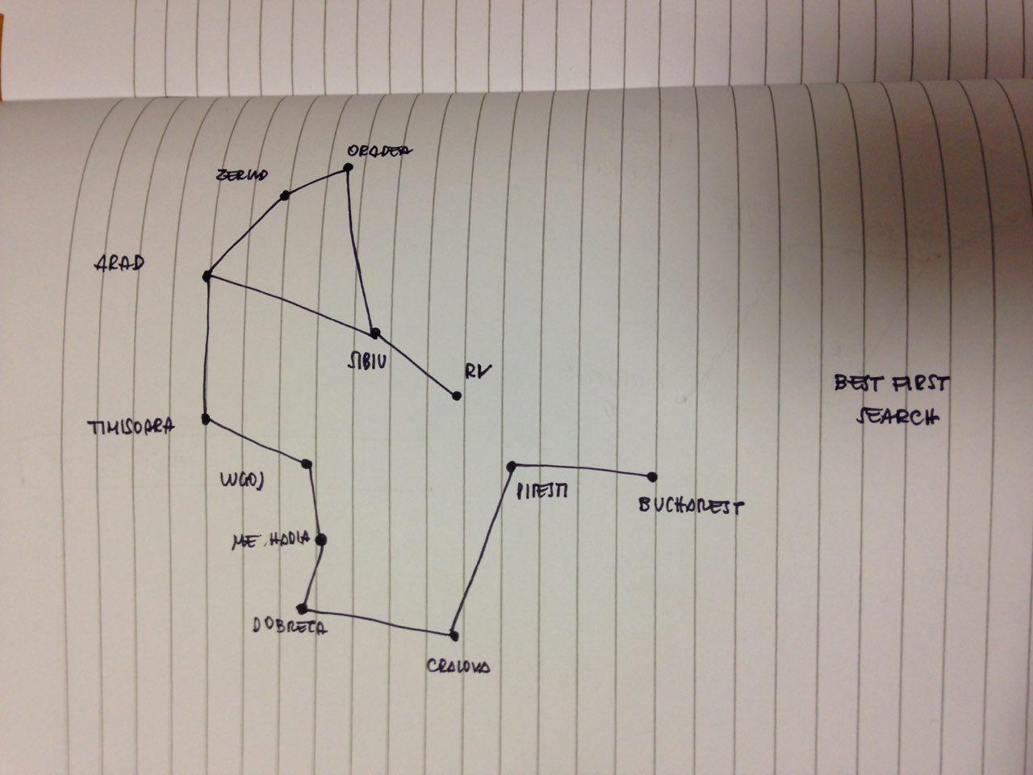
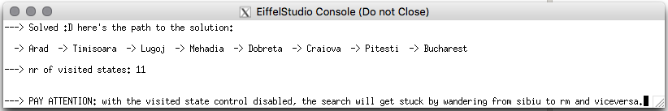

Slide 7
Designing the Model
1. Two models into one
2. Sharing classes
3. Integrating the AI library
4. Keeping the game and the AI engine separated

Slide 11
Solitaire Heuristic Function
1. Solitaire Mancala: an unsolvable problem
2. Fail to apply the most common approach
3. A customized approach: Life Expectancy

Slide 12
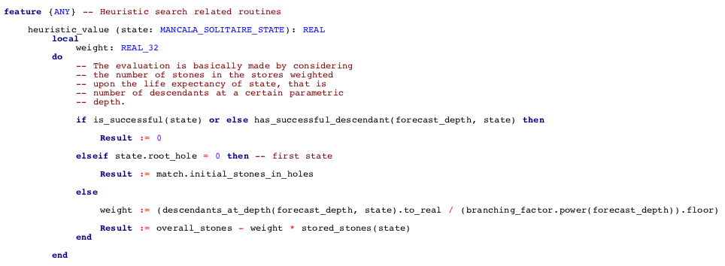

Slide 13
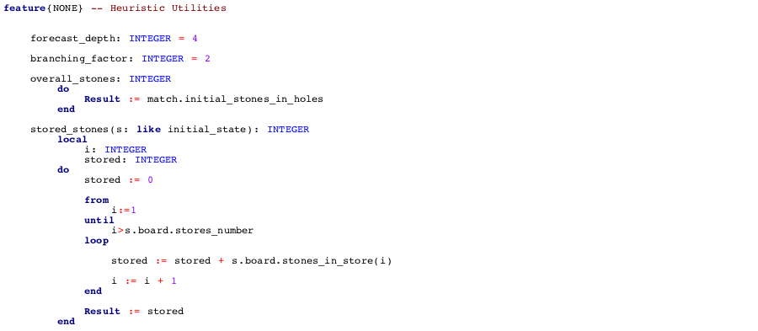

Slide 14
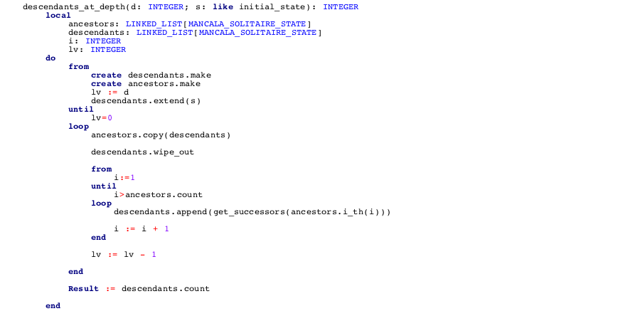

Slide 15
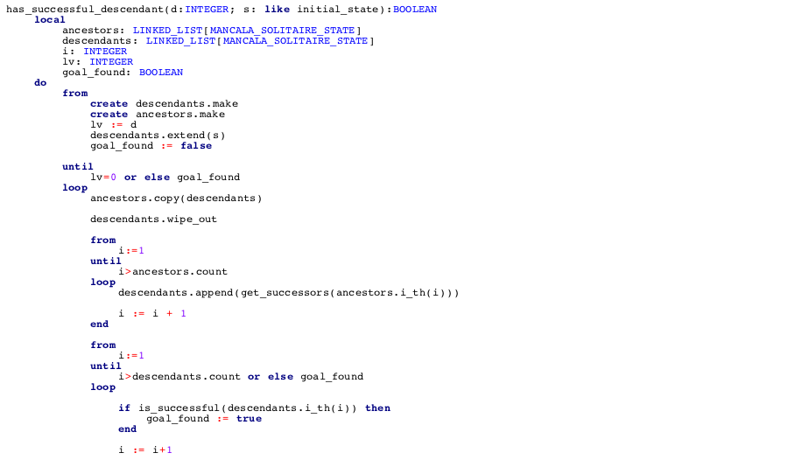
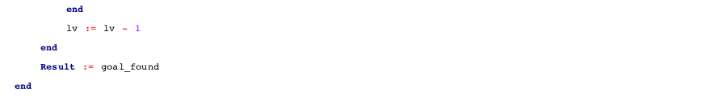

Slide 17
Bug Competition: Inspecting other teams' code

