Slide 1
Dose 2015
Group 7

Slide 2
Members
Team Milan 4
Team Rio Cuarto 7
Fabrizio Frasca
Luca Massaron
Calin Liviu Razvan
Alberto Fontana
Demian Romero
Romina Miranda

Slide 3
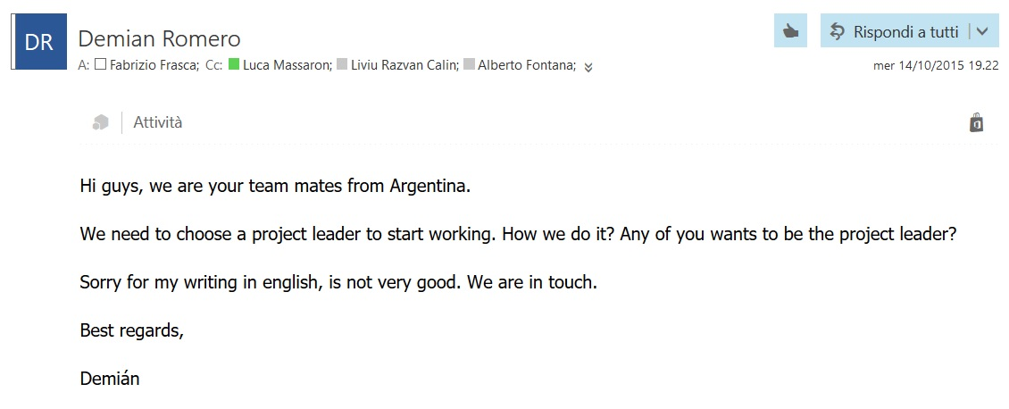
First Contact
0. Presentation
Skill checking
Project leader
Tasks assignment
Communication methods

Slide 4
1. Skill Checking
 | Milan | Argentina
English | All good | Only one speak not so fluently
Education | 3 from Polimi, 1 from Polito | 4th year of university (last)
Eiffel | No knowledge | Lessons with Nazareno
Git | 2 Ok, 1 basic knowledge, 1 never used | All good
AI Background | 2 following AI course | Followed course of AI

Slide 5
2. Project Leader
Volunteers
Lessons
Work
Language Skills
Technical Skills
Possibly in Milan

Slide 6
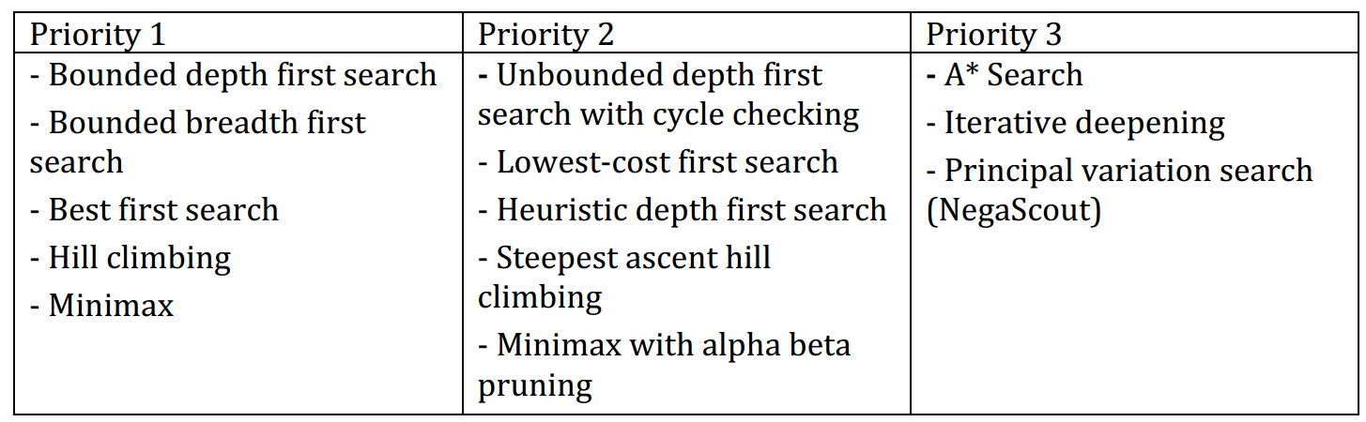
3. Task Assignment
13 Algorithms
2 algorithms each + 1 TBD (Negascout)
10 Single Agent Search + 3 Adversary Search

Slide 7
4. Communication Methods
Mailing List for official matter (documentation, instructions, meeting hour etc.)
Telegram group for instant messaging
Skype for periodic meetings and group working

Slide 9
Eiffel
Pros
Cons
Contract Design
Basic-like (well readable, no “;”)
Object composed only by features
Better visibility management
Multiple Inheritance
Only one type of cycle
Basic-like (too much writing)
No polymorphism
Bad Exception Handling
Bad IDE

Slide 10
Eiffel Configuration File .ecf
<?xml version="1.0" encoding="ISO-8859-1"?>
<system xmlns="http://www.eiffel.com/developers/xml/configuration-1-14-0" xmlns:xsi="http://www.w3.org/2001/XMLSchema-instance" xsi:schemaLocation="http://www.eiffel.com/developers/xml/configuration-1-14-0 http://www.eiffel.com/developers/xml/configuration-1-14-0.xsd" name="eiffel-ai-search" uuid="C7C425FB-CC6A-4F1D-A3D3-7765C54B8A0C" library_target="eiffel-ai-search">
<target name="eiffel-ai-search">
<root all_classes="true"/>
<option warning="true" is_attached_by_default="false" void_safety="none">
<assertions precondition="true" postcondition="true" check="true" invariant="true" loop="true" supplier_precondition="true"/>
</option>
<setting name="console_application" value="true"/>
<library name="base" location="$ISE_LIBRARY\library\base\base.ecf"/>
<library name="testing" location="$ISE_LIBRARY\library\testing\testing.ecf"/>
<cluster name="eiffel-ai-search" location=".\">
<file_rule>
<exclude>/EIFGENs$</exclude>
<exclude>/CVS$</exclude>
<exclude>/.svn$</exclude>
</file_rule>
<cluster name="single-agent-search" location=".\single_agent_search\"/>
<cluster name="single-agent-search-engines" location=".\single_agent_search\single_agent_search_engines\"/>
<cluster name="single-agent-search-examples" location=".\single_agent_search_examples\"/>
<cluster name="adversary-search" location=".\adversary_search\"/>
<cluster name="adversary-search-engines" location=".\adversary_search\adversary_search_engines\"/>
<cluster name="adversary-search-examples" location=".\adversary_search_examples\"/>
</cluster>
</target>
</system>

Slide 12
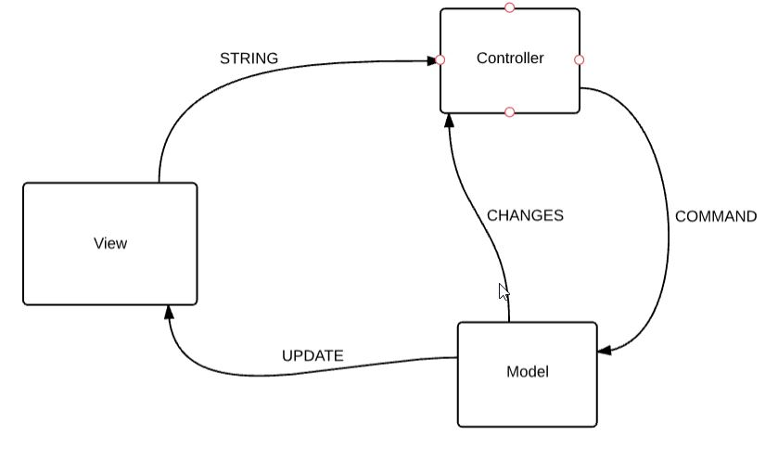
MVC Pattern
Simple Application
Easy job division
Already used
Common approach

Slide 13
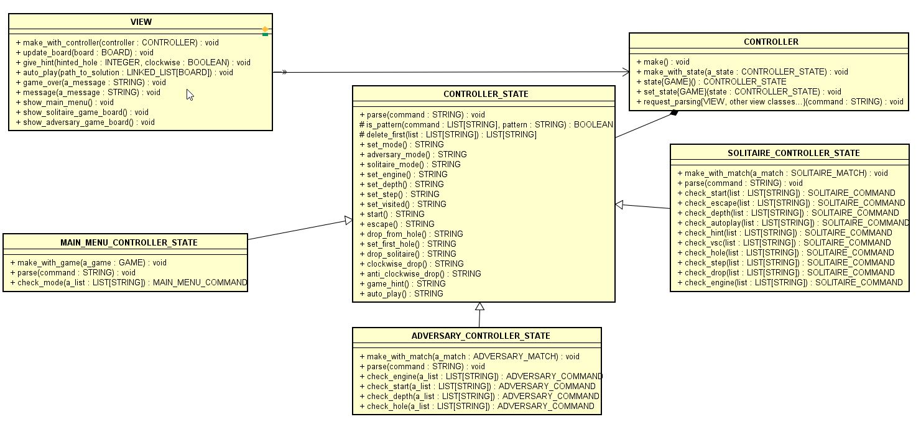
View - Controller
The State Pattern is used to filter different set of commands: Main Menu, Solitaire and Adversary

Slide 14
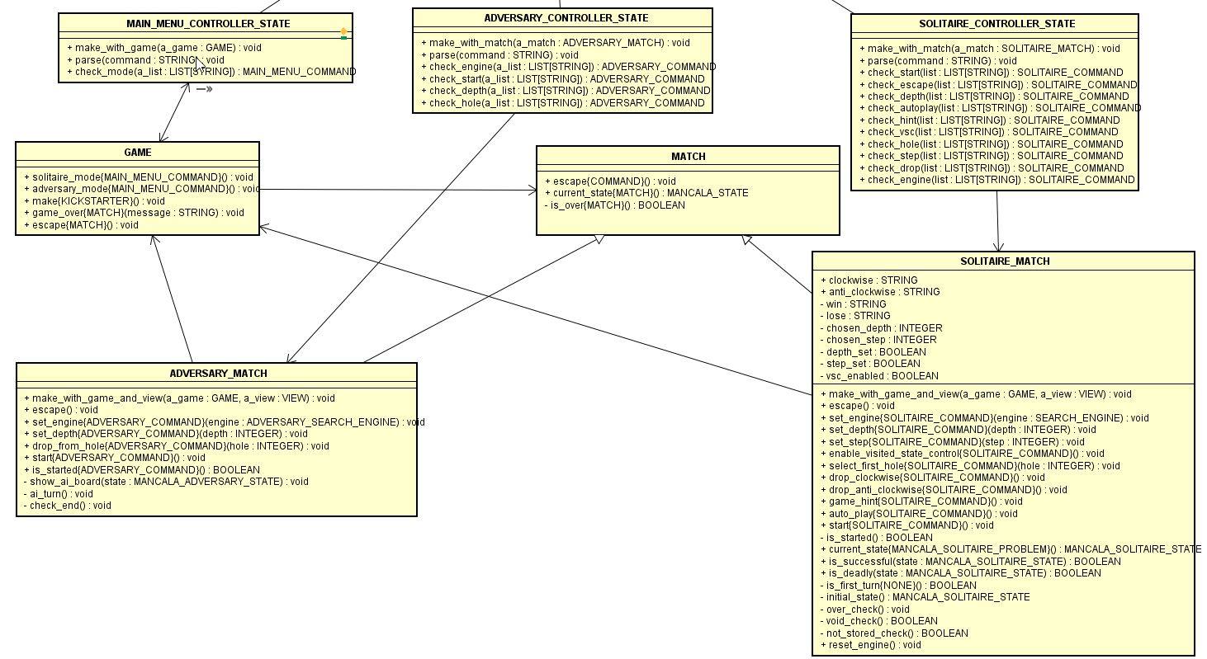
Controller - Model
Command Pattern is used to translate View messages into Model features
COMMAN_QUEUE
COMMAN_QUEUE

Slide 16
Adversary Game

Slide 17
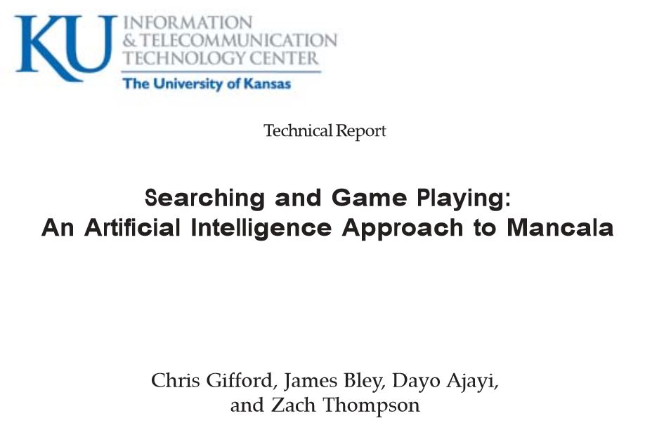
Heuristic function
H0: First valid move (furthest valid bin from my home)
H1: How far ahead of my opponent I am (My Mancala – Opponent’s Mancala)
H2: How close I am to winning (> half)
H3: How close opponent is to winning (> half)
H4: Number of stones close to my home
H5: Number of stones far away from my home
H6: Number of stones in middle of board (neither close nor far from home)
Source: www.ittc.ku.edu/publications/documents/Gifford_ITTC-FY2009-TR-03050-03.pdf
Result: H1, H3 and H2 were the best Heuristics in order

Slide 18
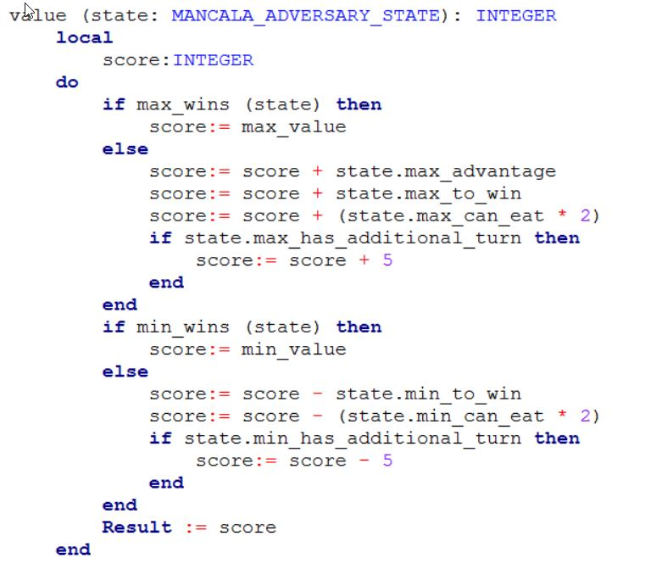
Heuristic function
H1: How far ahead of my opponent I am (My Mancala – Opponent’s Mancala)
H2: How close I am to winning (> half)
M1: How much can I eat (Doubled)
M2: I have an additional turn
H3: How close opponent is to winning (> half)
M3: How much can my opponent eat
M4: My opponent has an additional turn

Slide 20
Group 7 Bugs
22 Bugs Reported
Only 8 approved
14 Rejected

Slide 21
Approved Bugs
# | Bug | Cause
1 | Exception while starting Adversary game with negative depth | Due to misunderstanding message feature in VIEW was not working in main menu
2 | Exception while starting Adversary game with 0 depth | As point 1
3 | Can start Solitaire game with negative depth | Was working in Multithread but after switching to Single thread there was an error adapting the code because was not performed by the class developer
4 | Can start Solitaire game with negative step | As point 3
5 | Final values not shown in Adversary game | Final Value check did not update the view
6 | Label always shows “YOUR TURN” in Adversary Game | Should work in Multithread but using Single labels are updated only at the end of the function call (using buttons should solve it)
7 | Holes buttons disabled after clicking on an empty one | Blocking buttons should not be implemented in Single thread, was actually removed and solved but not merged
8 | Negascout Exception | Still unknown

Slide 22
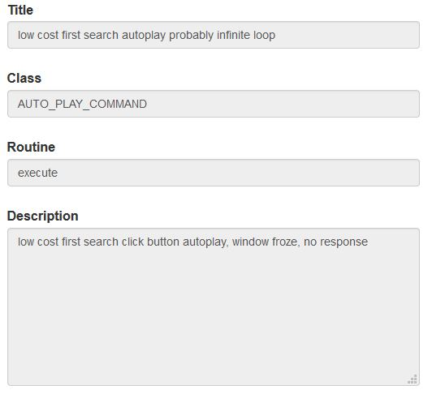
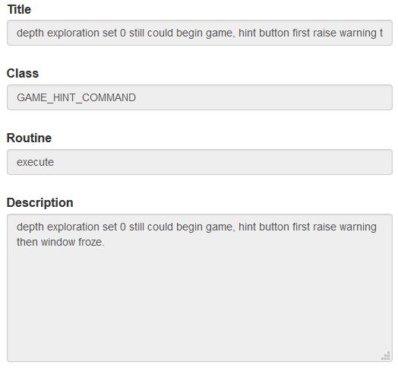
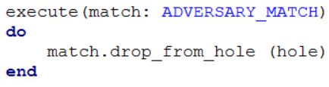
Rejected Bugs
Main Reasons:
Duplicates
Bad Documentation
Not a Bug
Cannot replicate
“Probably” infinite loop?
COMMAND.execute?
Depth in which engine?
Depth = 0 already reported first day

