Slide 1
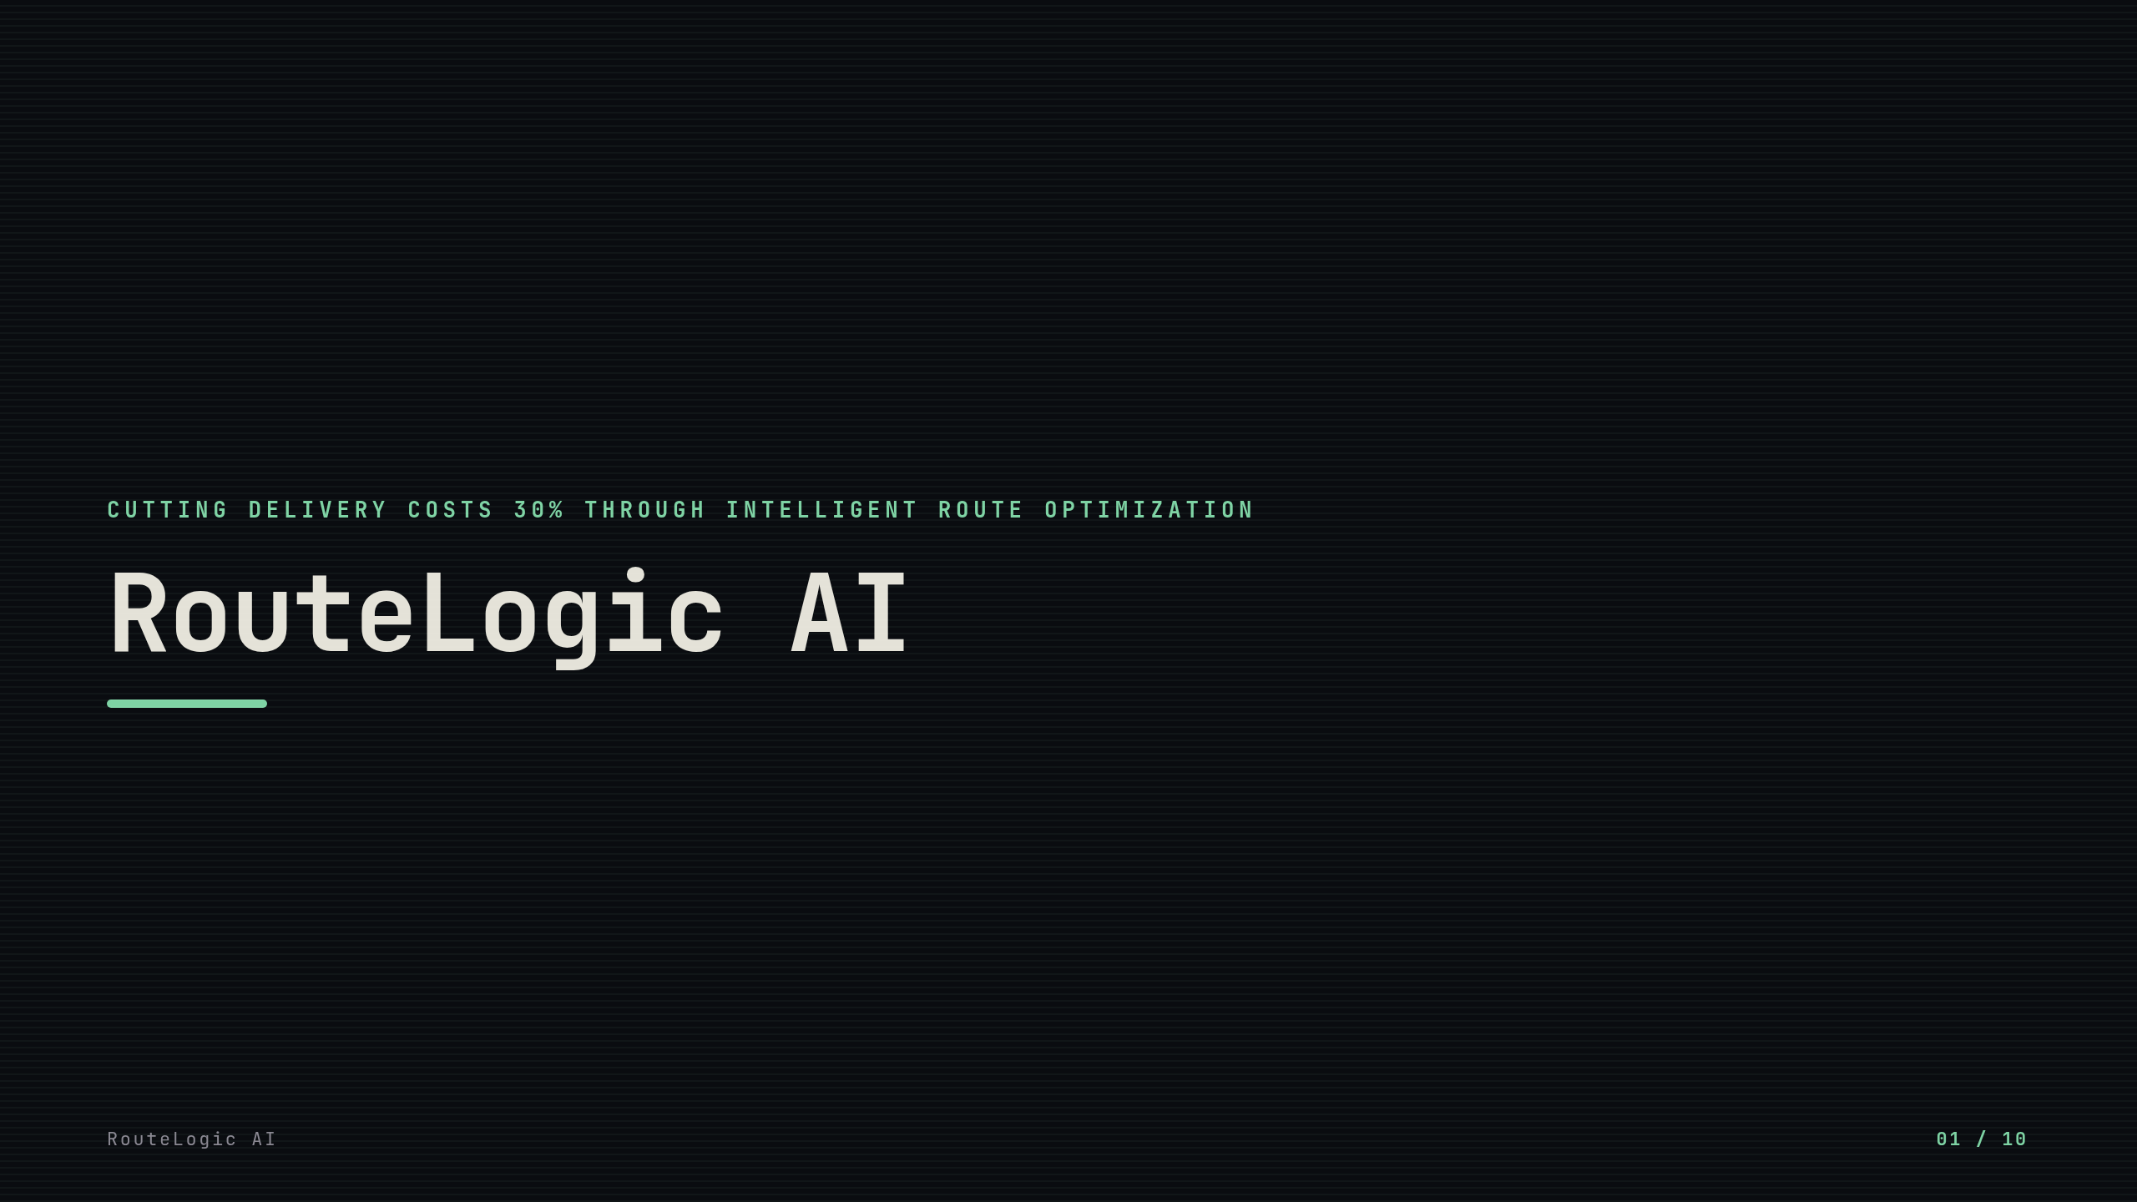
Notes:
Introducing RouteLogic AI, a revolutionary solution transforming delivery operations. Our intelligent optimization platform reduces costs by 30% while improving efficiency. [pause here] Let's explore how this technology is reshaping logistics.

Slide 2
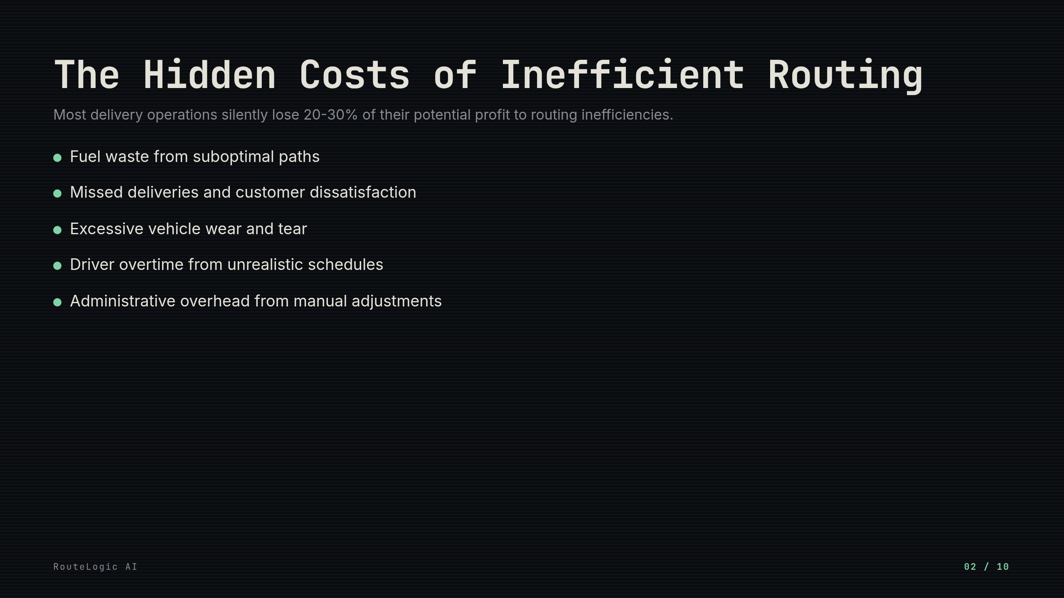
Notes:
These costs accumulate silently but significantly impact your bottom line. Many companies fail to recognize how routing inefficiencies directly erode profitability. [pause here] The solution lies in intelligent optimization, not just incremental improvements.

Slide 3
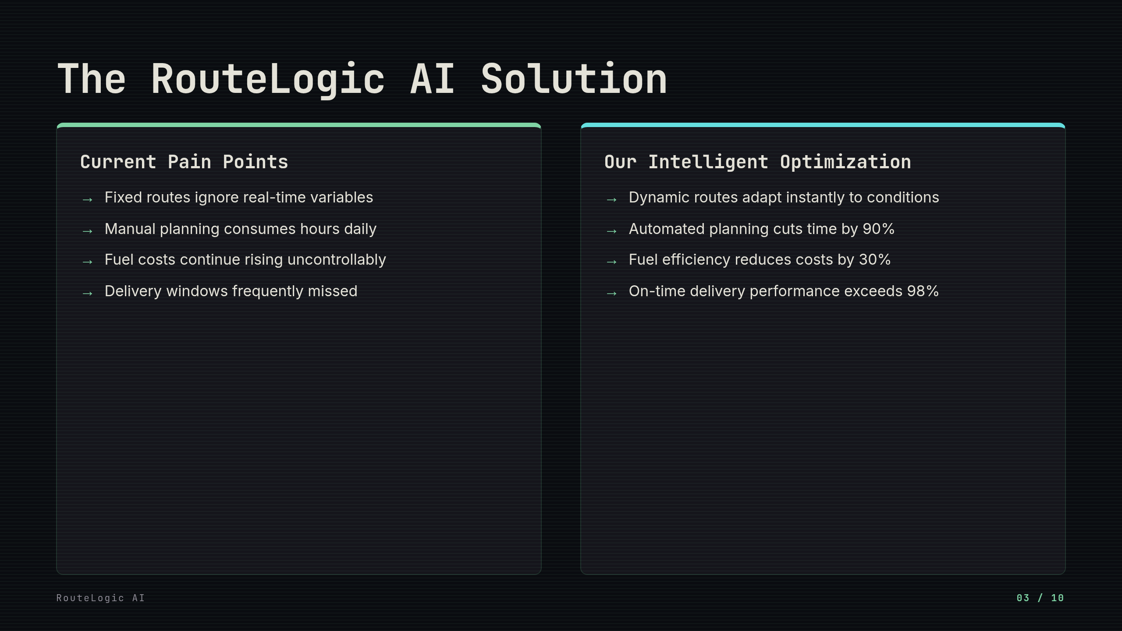
Notes:
The contrast between current inefficiencies and our solution is stark. Our AI transforms how delivery operations function at a fundamental level. [pause here] Notice how each pain point has a direct, measurable solution.

Slide 4
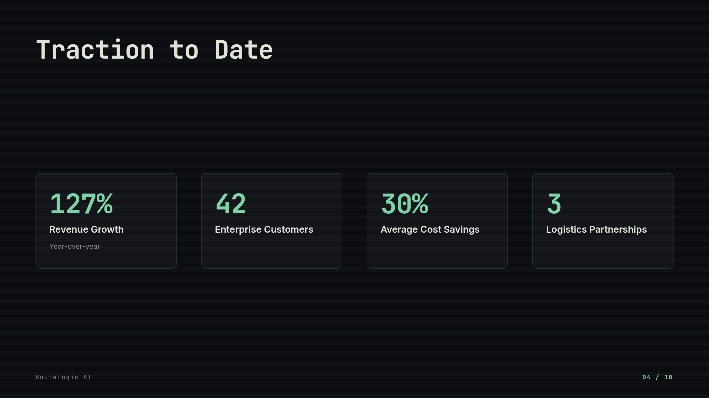
Notes:
Our growth demonstrates clear market validation. Enterprise clients see significant cost reductions immediately. These partnerships expand our service reach and capabilities. [pause here]

Slide 5
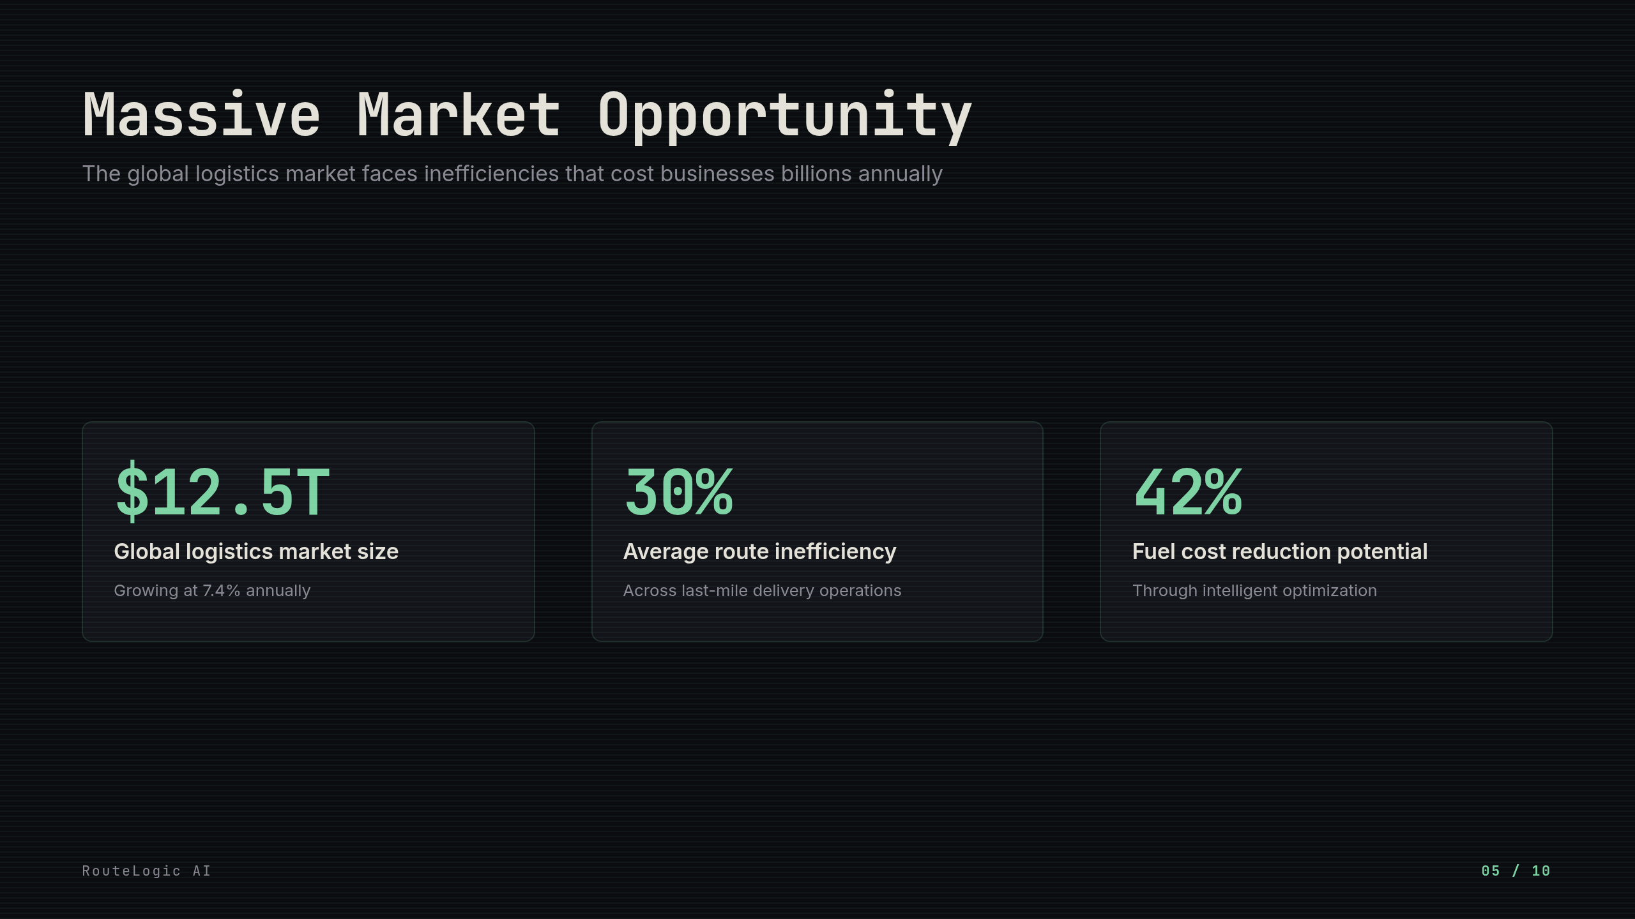
Notes:
The logistics market represents a massive opportunity with significant inefficiencies. Our solution addresses the 30% average route inefficiency that plagues last-mile delivery. The 42% fuel cost reduction potential demonstrates the tangible value we deliver. [pause here]

Slide 6
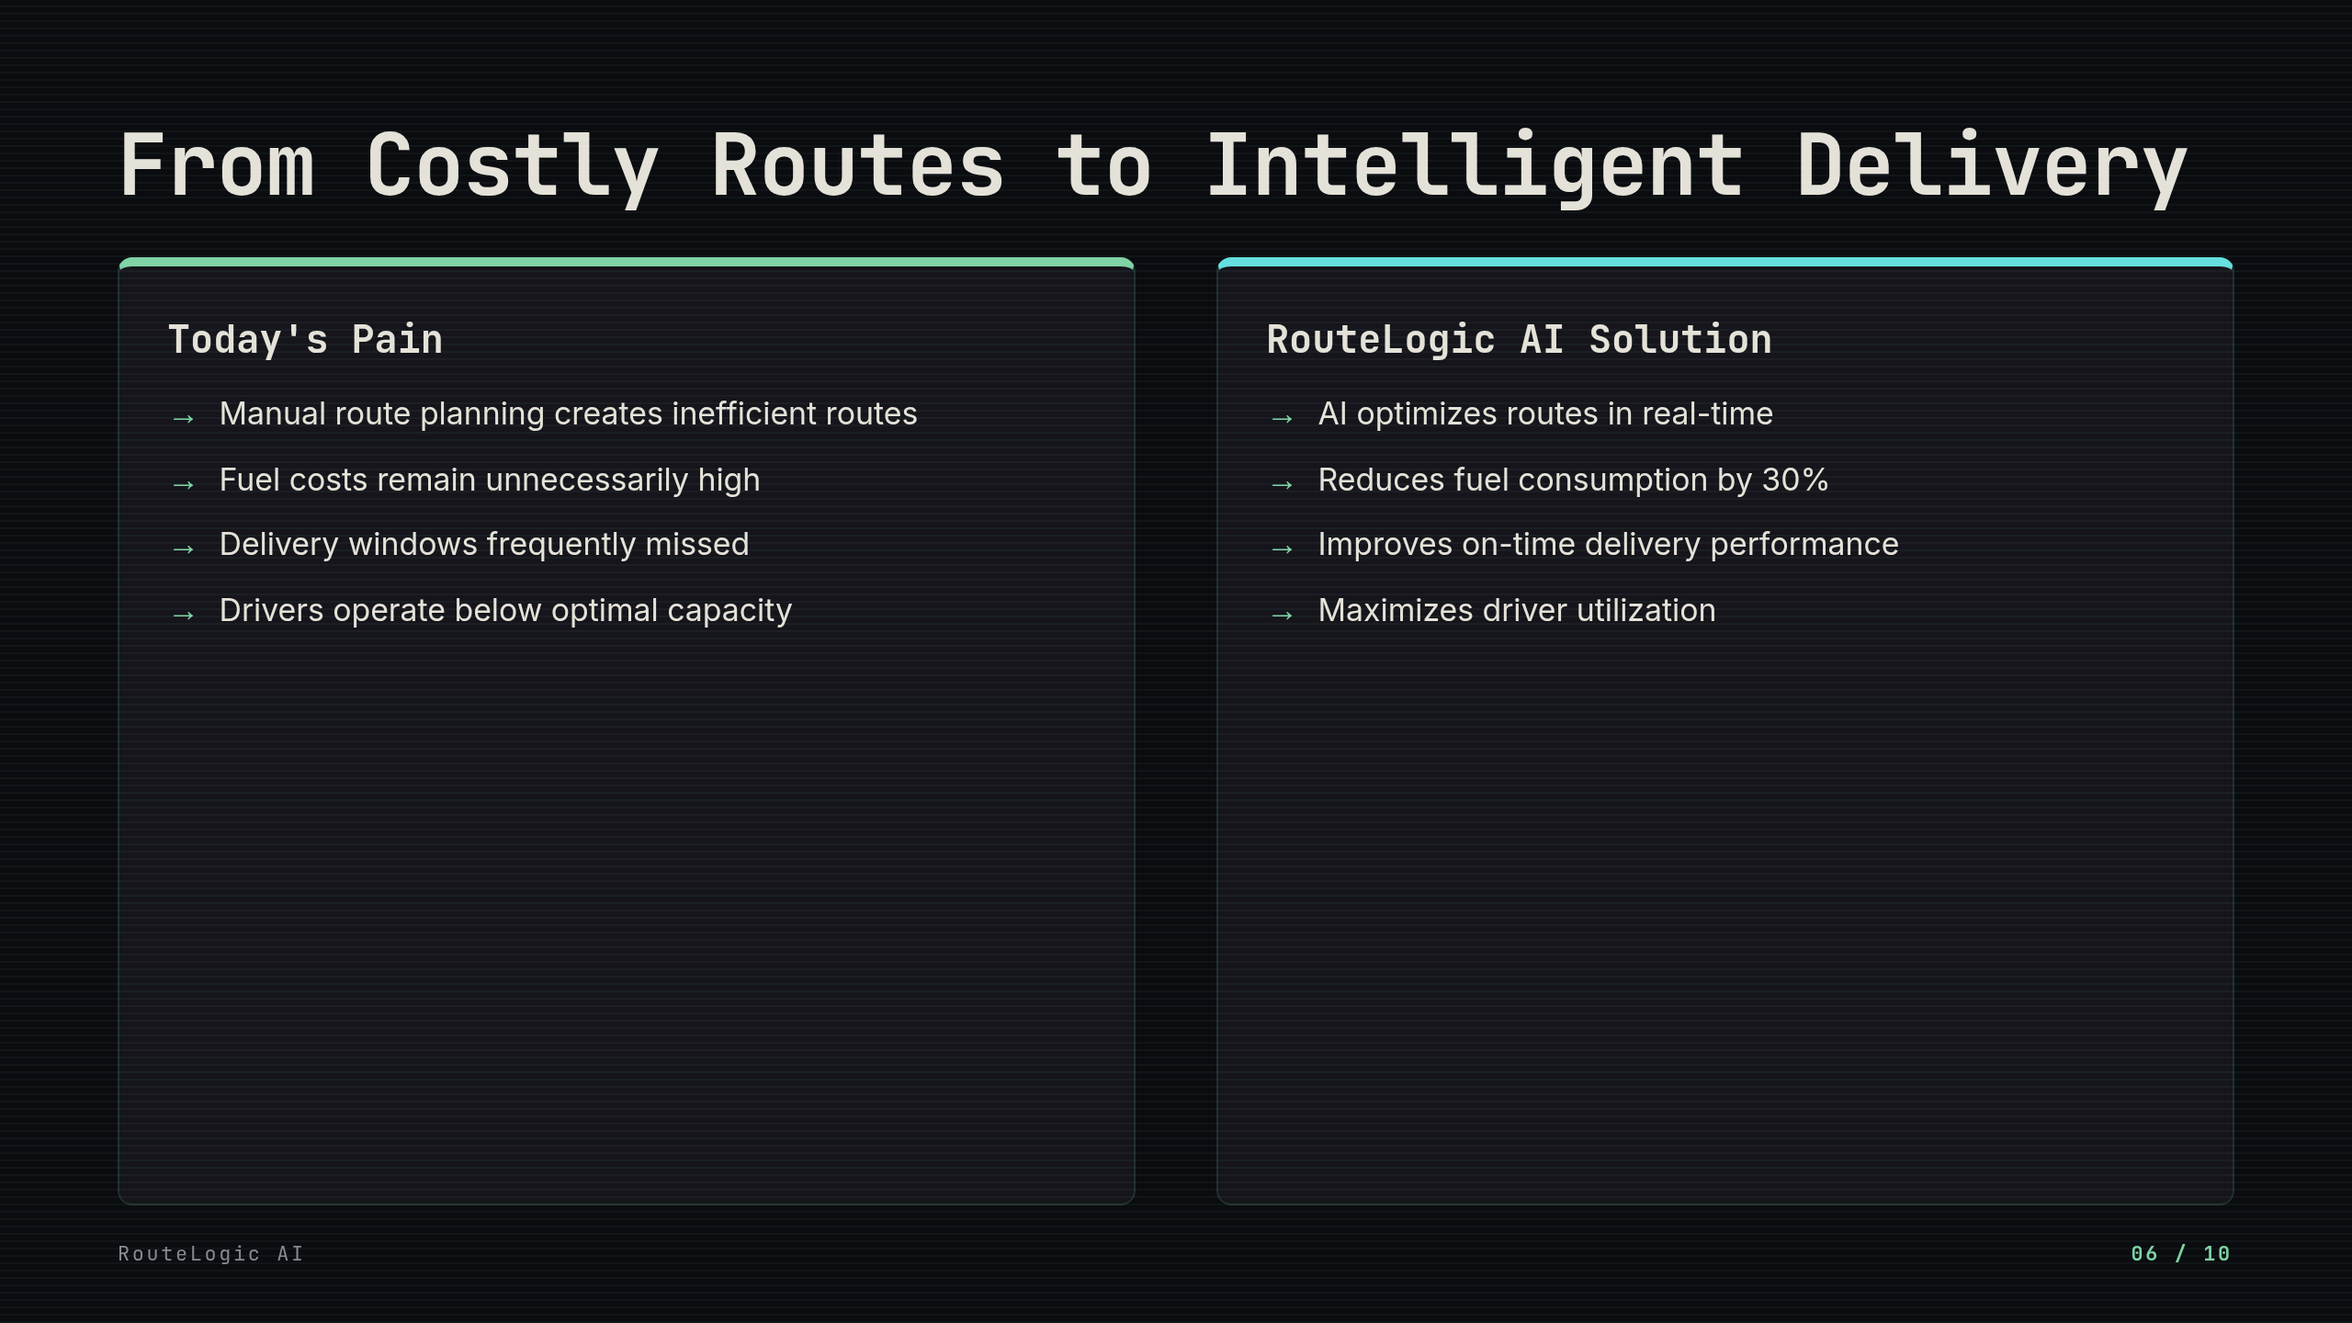
Notes:
Companies today struggle with manual routing that leads to unnecessary costs and inefficiencies. RouteLogic AI transforms this landscape by intelligently optimizing delivery operations. Our solution cuts fuel costs by 30% while improving delivery reliability. [pause here]

Slide 7
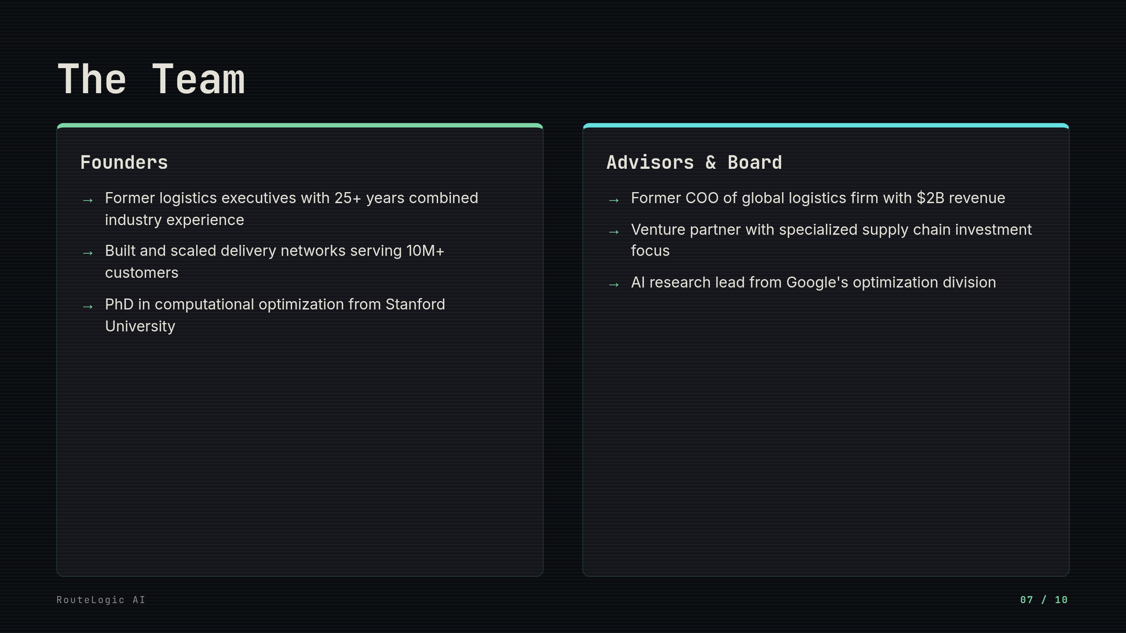
Notes:
Our team combines deep operational expertise with cutting-edge technical capabilities. We've solved these exact problems before at scale. [pause here] Our advisors bring the strategic relationships and domain knowledge to accelerate our market entry.

Slide 8
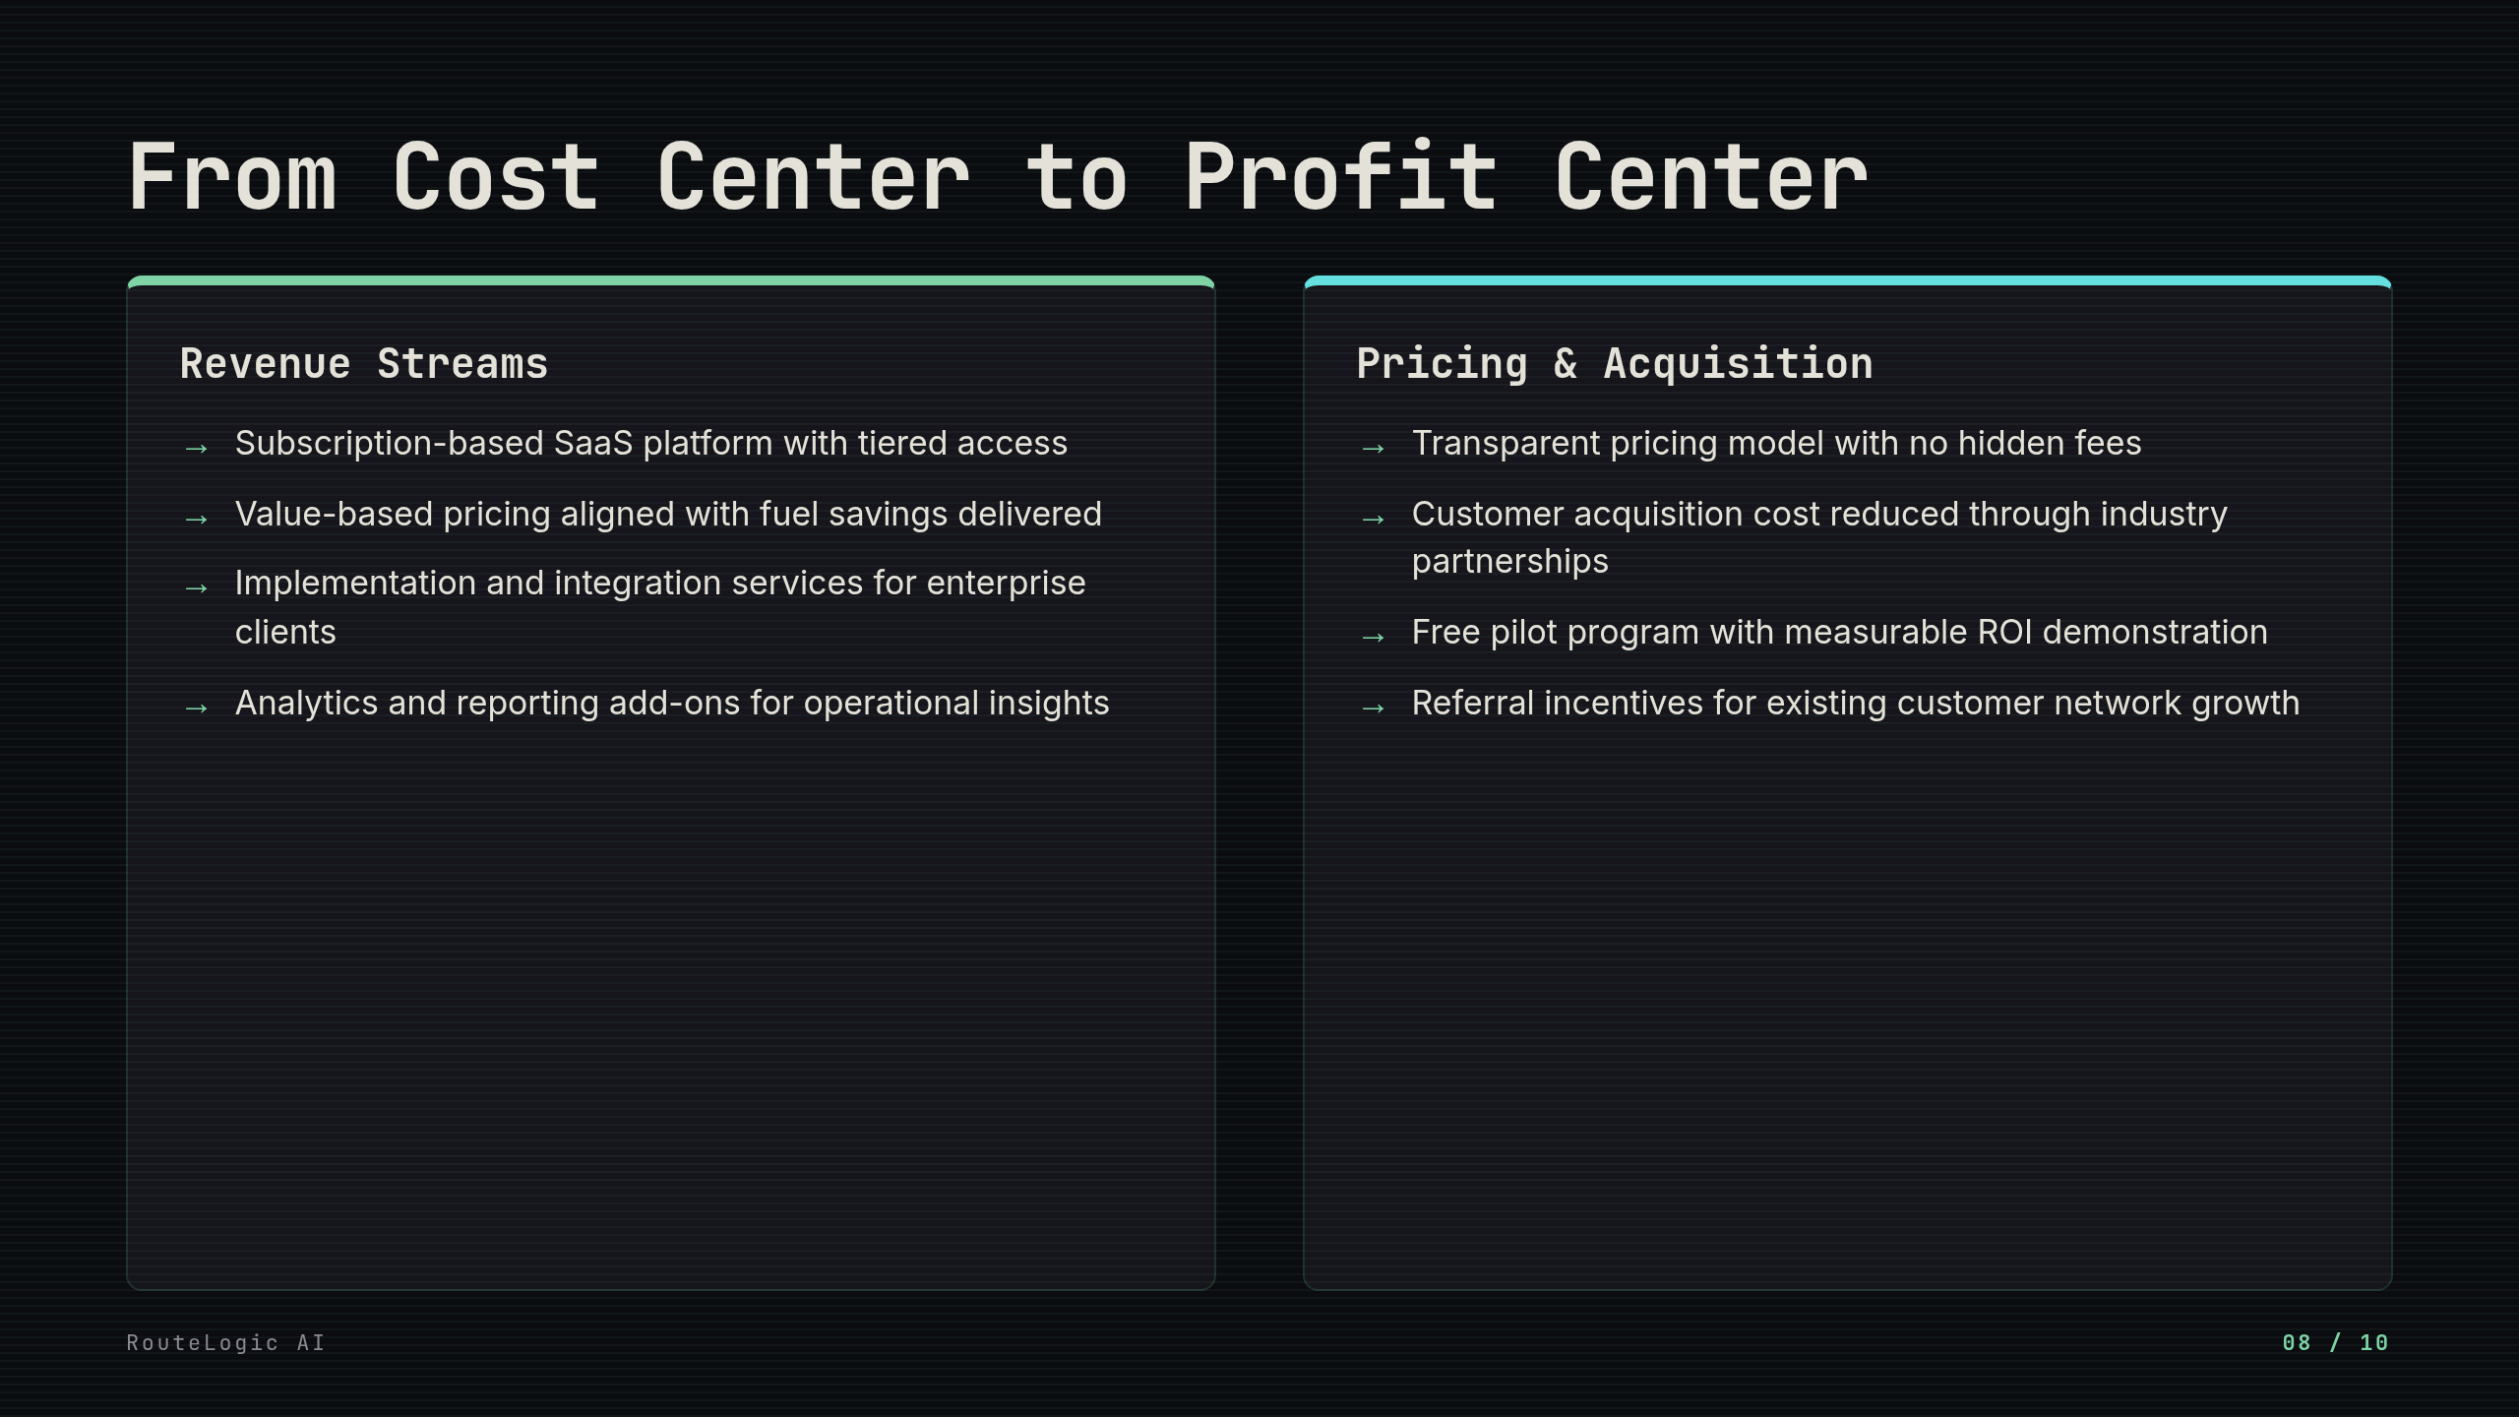
Notes:
Our model transforms delivery operations from cost centers into profit centers. The tiered subscription ensures accessibility while maximizing value for high-volume users. [pause here] The acquisition strategy leverages industry relationships and measurable ROI to minimize customer acquisition costs while maximizing retention.

Slide 9
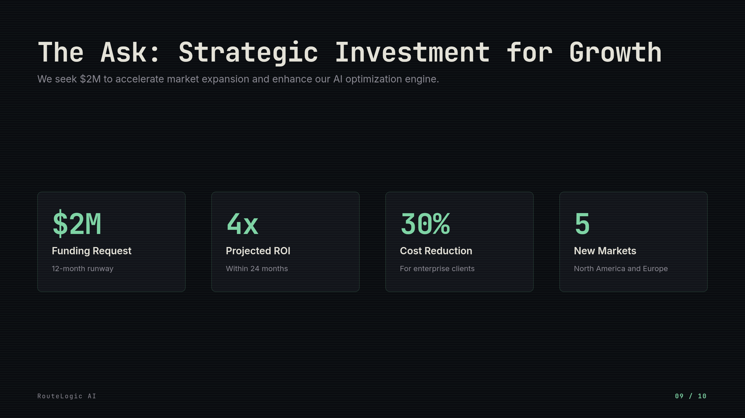
Notes:
This funding will enable us to scale operations and expand our AI capabilities. We're targeting a 4x return within two years through rapid customer acquisition and enterprise contracts. [pause here] The capital will be allocated equally between technology development and market expansion efforts.

Slide 10
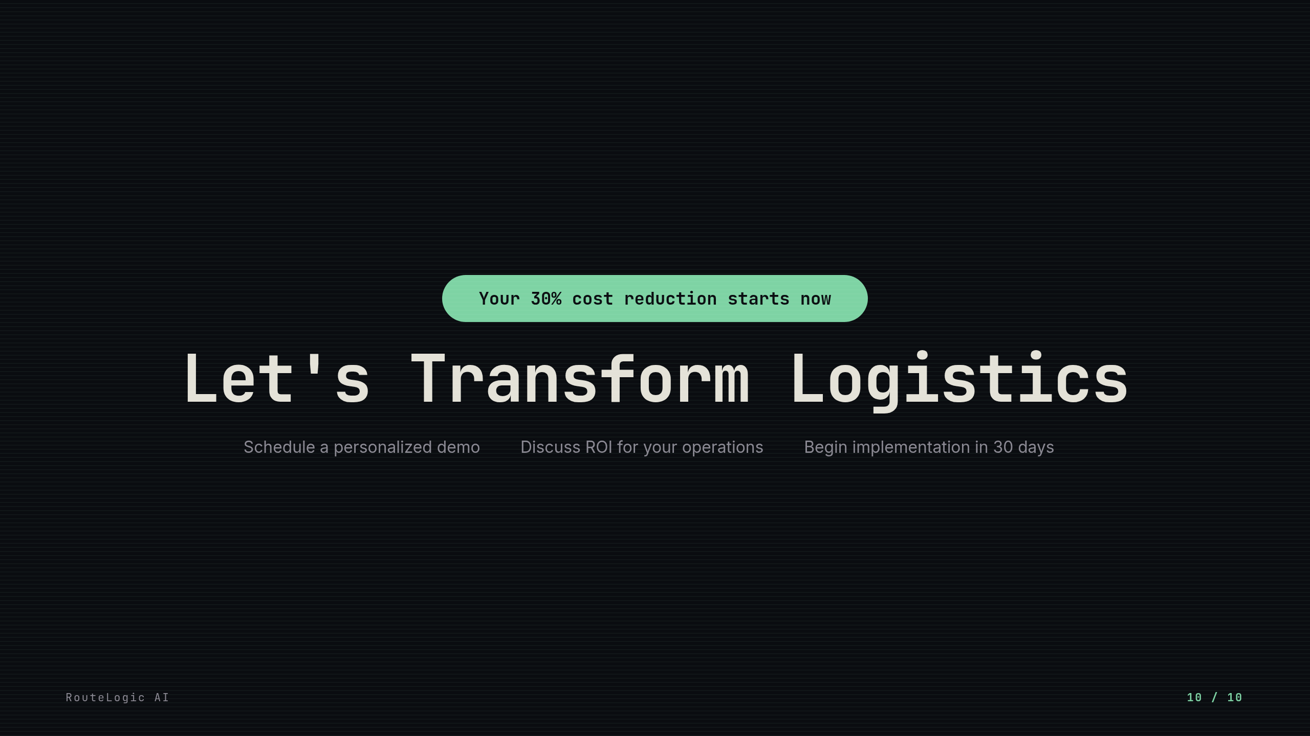
Notes:
RouteLogic AI delivers immediate, measurable value to your bottom line. Our implementation process is seamless, requiring minimal disruption to your existing operations. [pause here] Contact us today to schedule your consultation and discover how we can transform your logistics efficiency.

