Slide 1
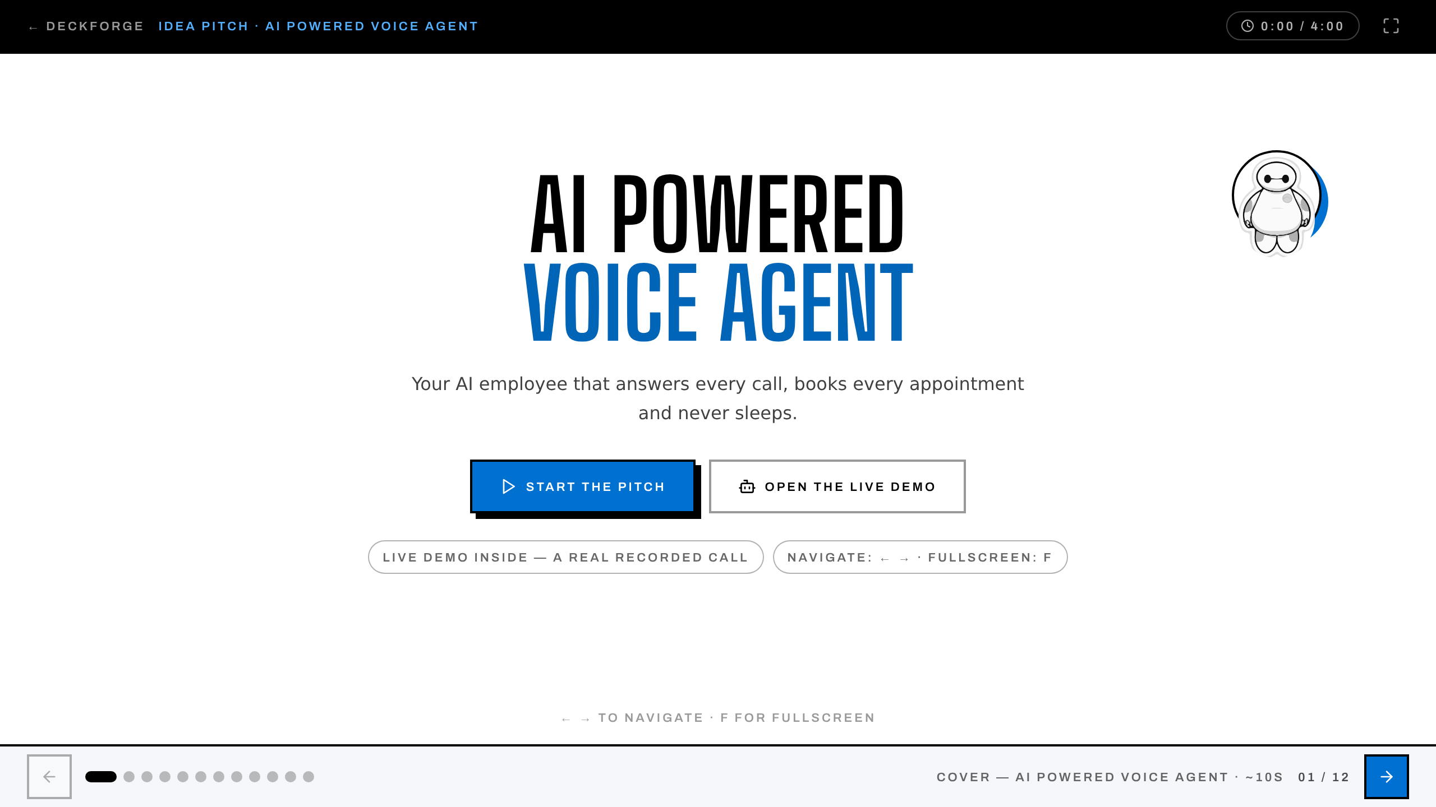
Notes:
COVER — AI POWERED VOICE AGENT · pace ~10s
Advance when the point lands — full pitch is ~4 minutes.

Slide 2
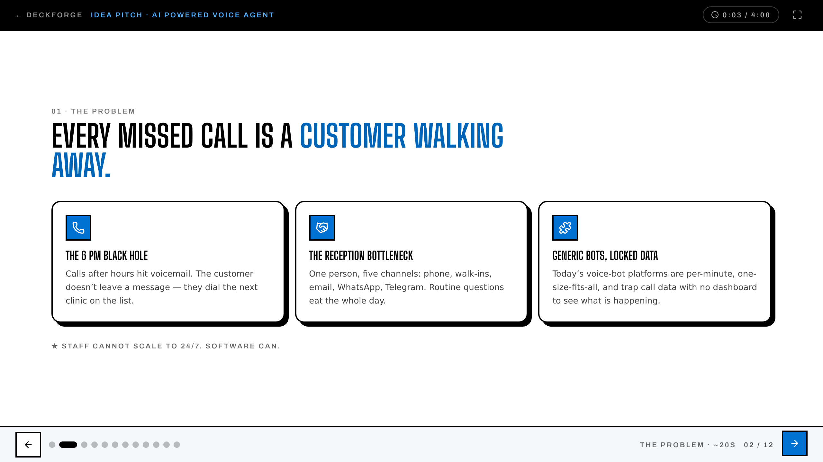
Notes:
THE PROBLEM · pace ~20s
Advance when the point lands — full pitch is ~4 minutes.

Slide 3
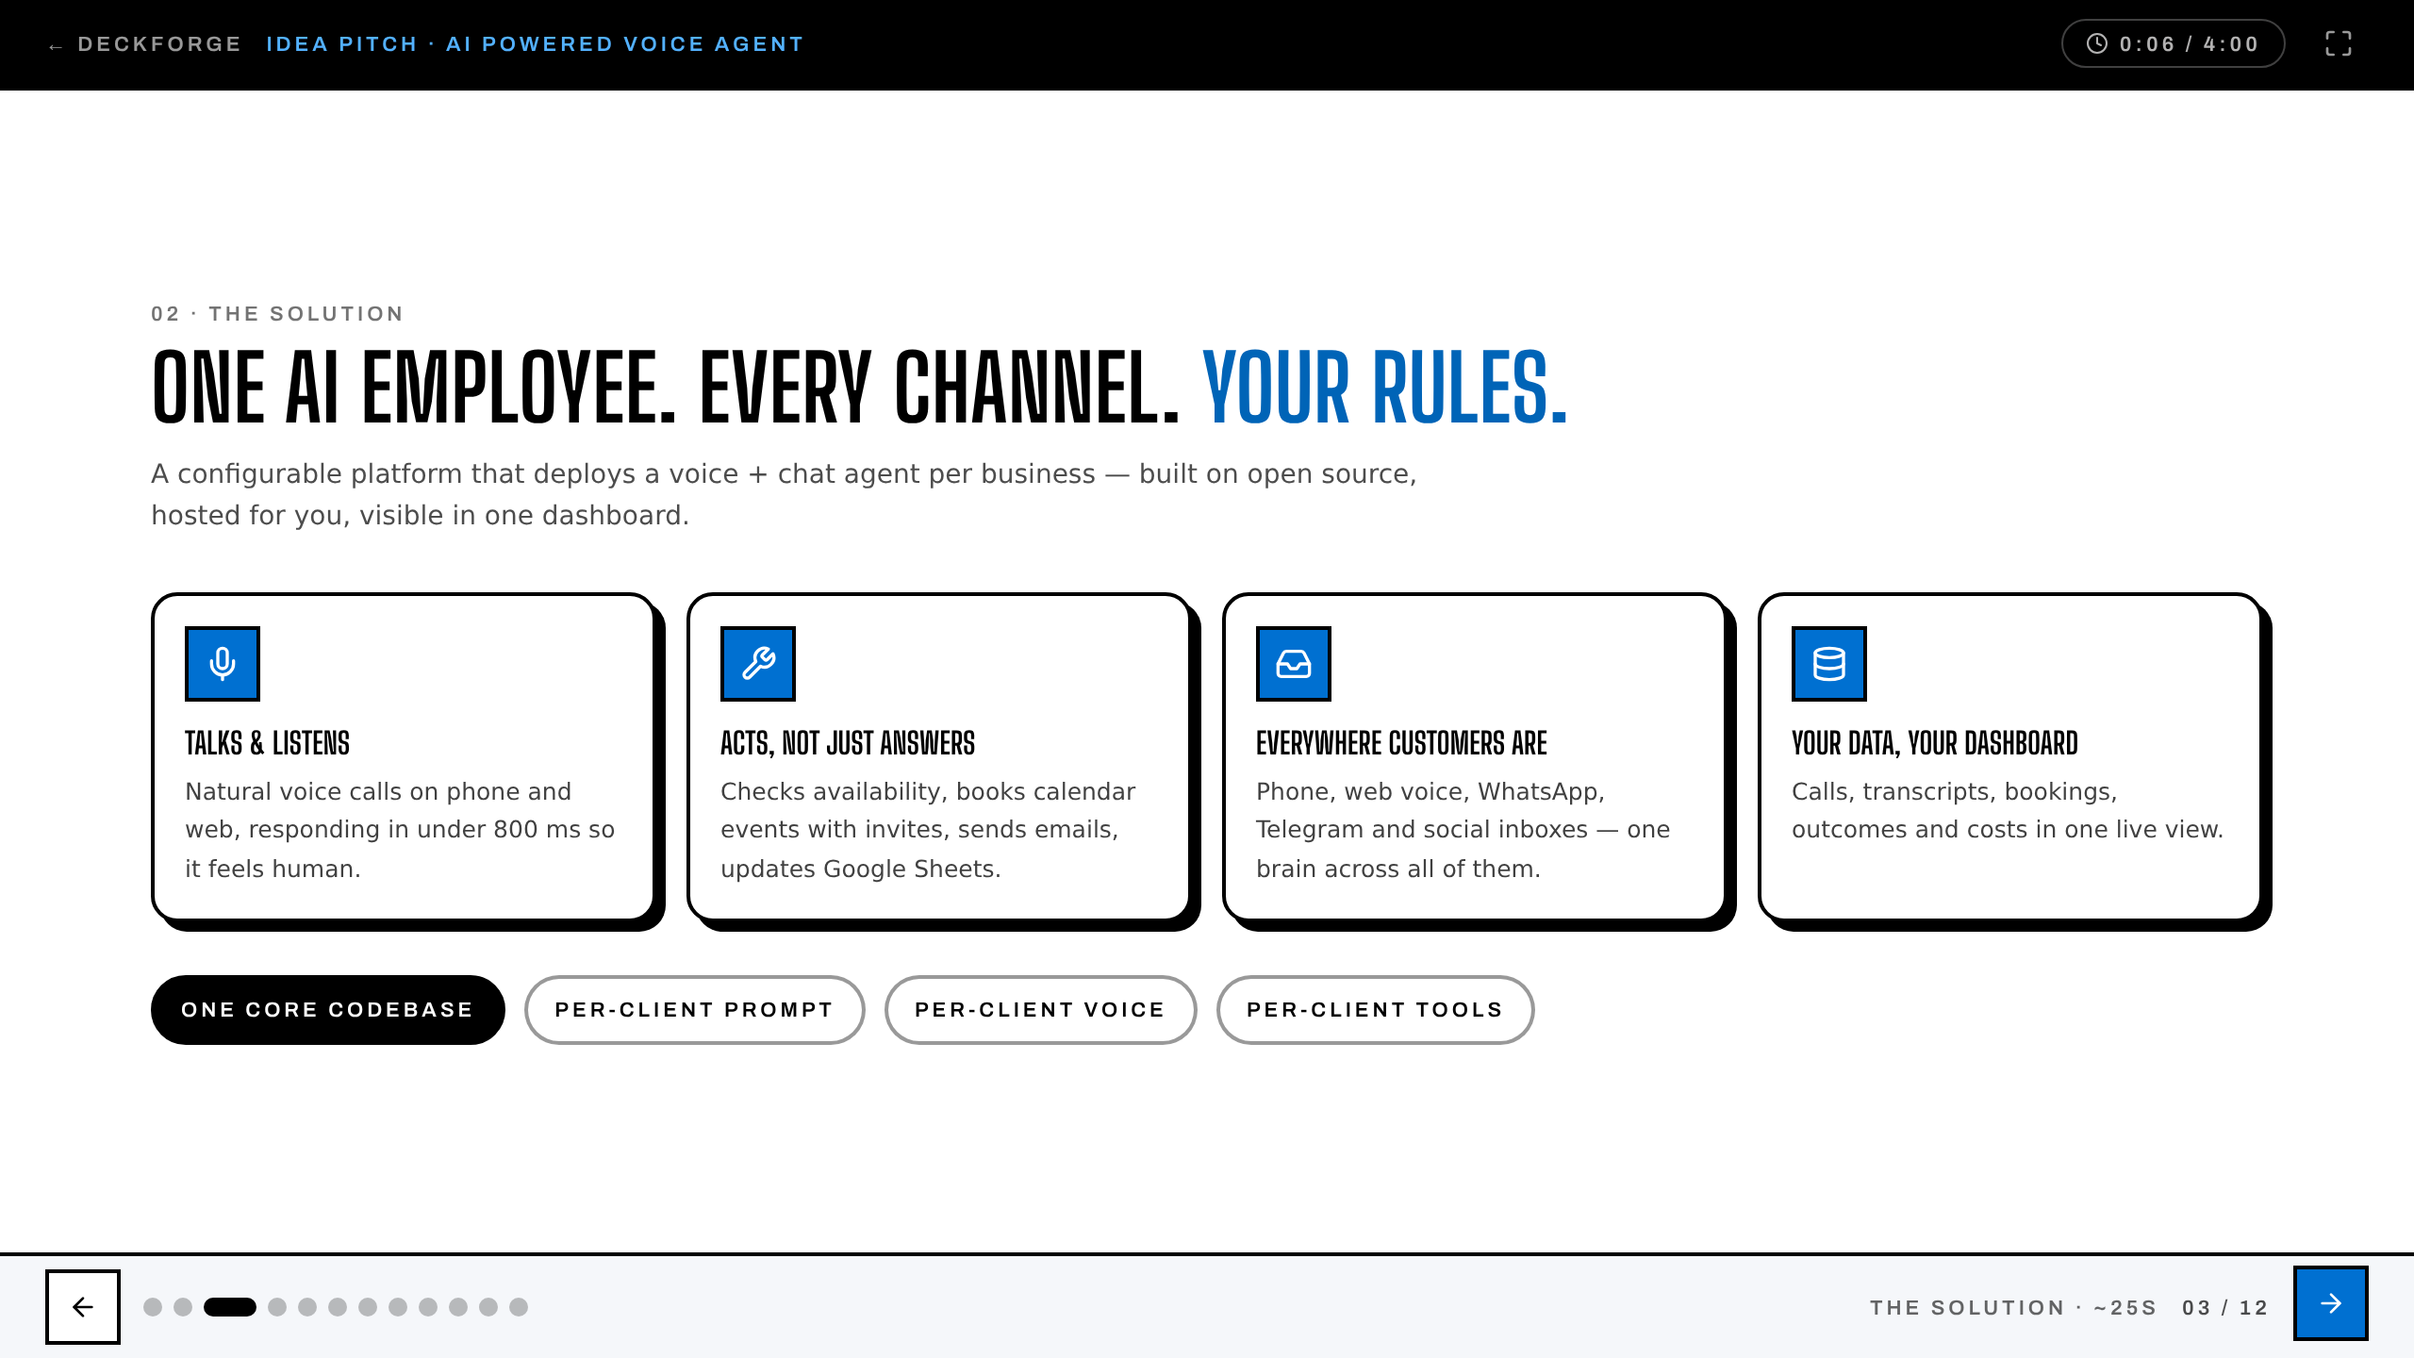
Notes:
THE SOLUTION · pace ~25s
Advance when the point lands — full pitch is ~4 minutes.

Slide 4
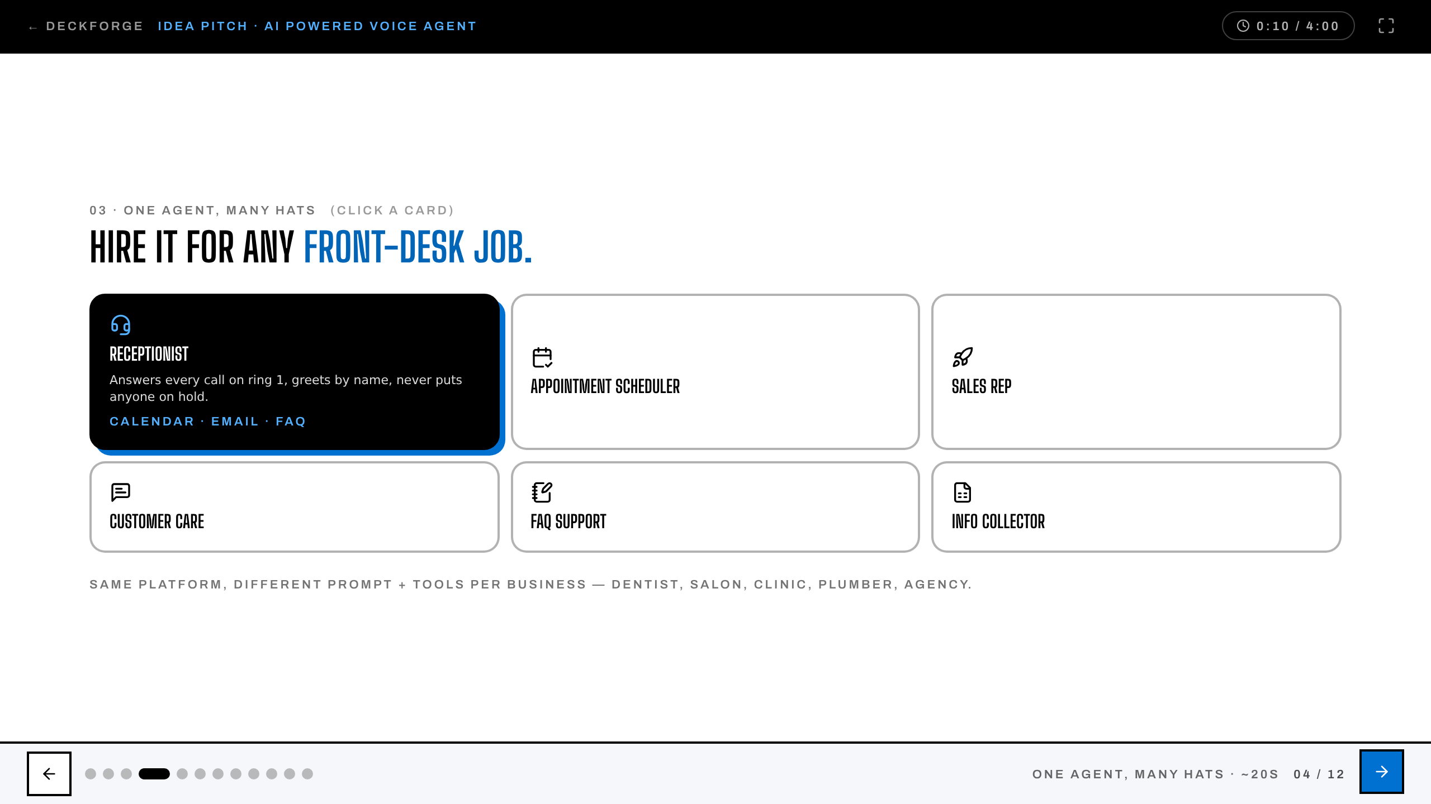
Notes:
ONE AGENT, MANY HATS · pace ~20s
Advance when the point lands — full pitch is ~4 minutes.

Slide 5
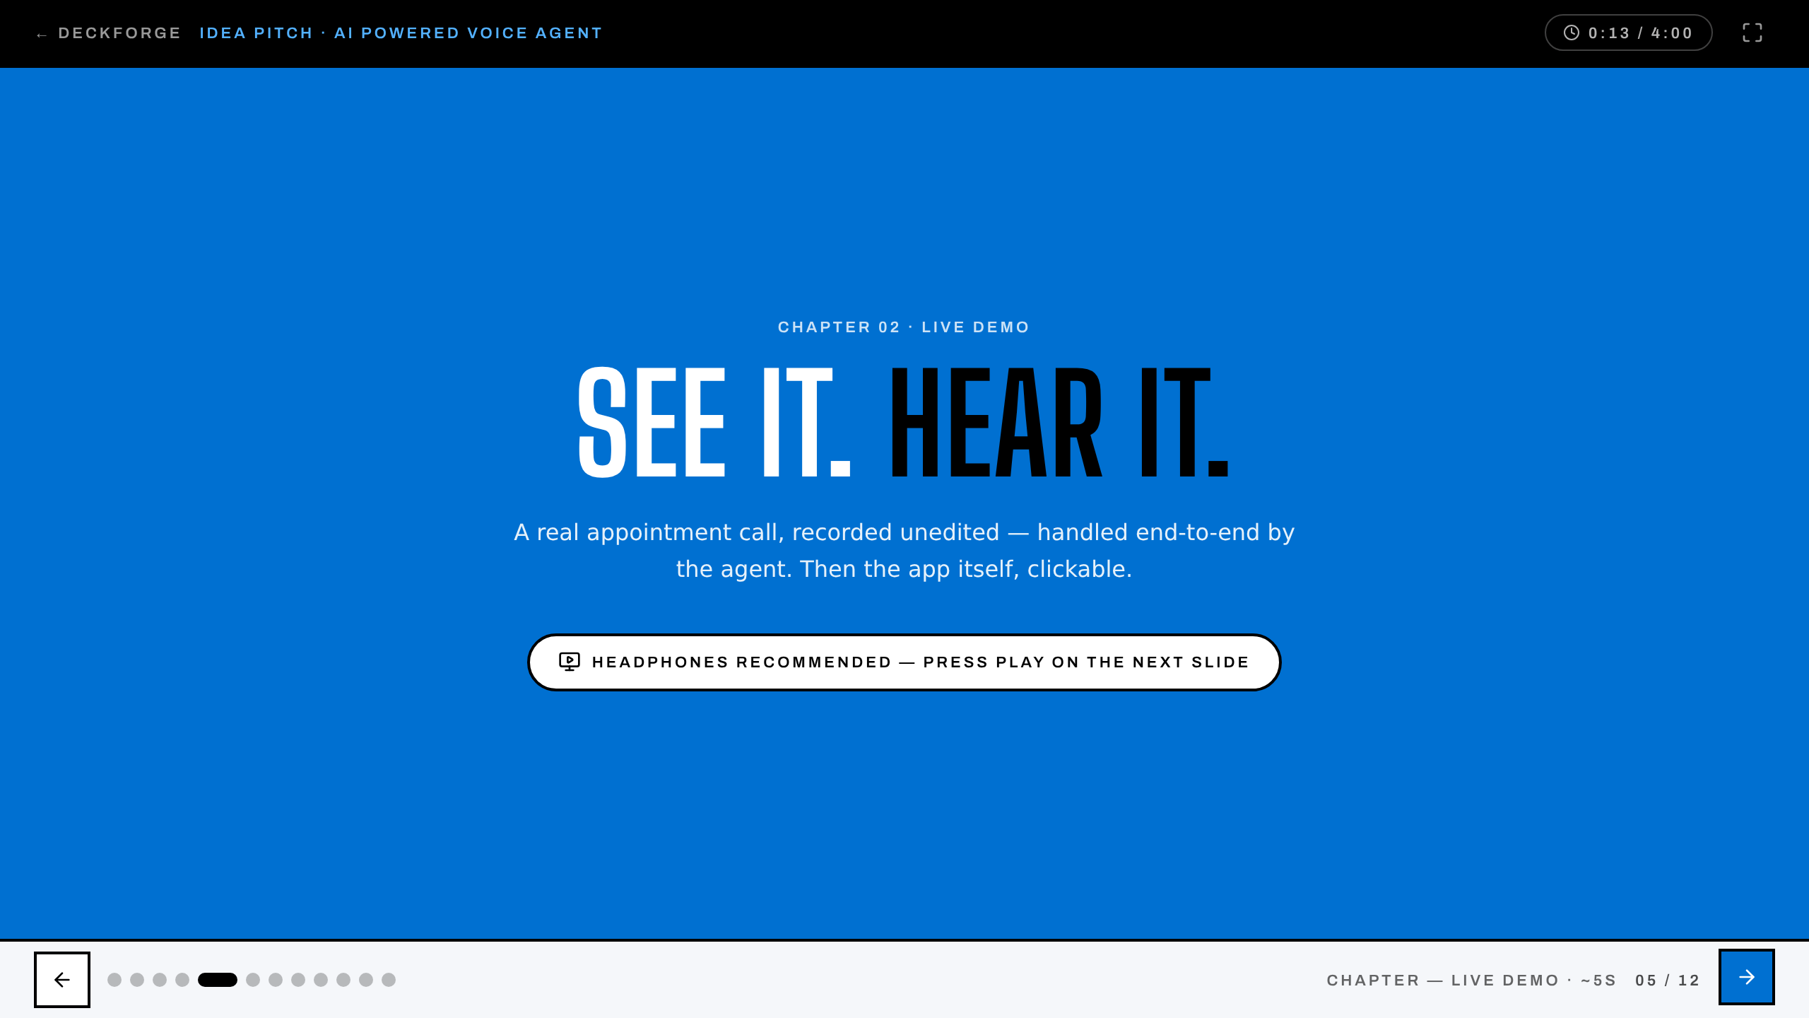
Notes:
CHAPTER — LIVE DEMO · pace ~5s
Advance when the point lands — full pitch is ~4 minutes.

Slide 6
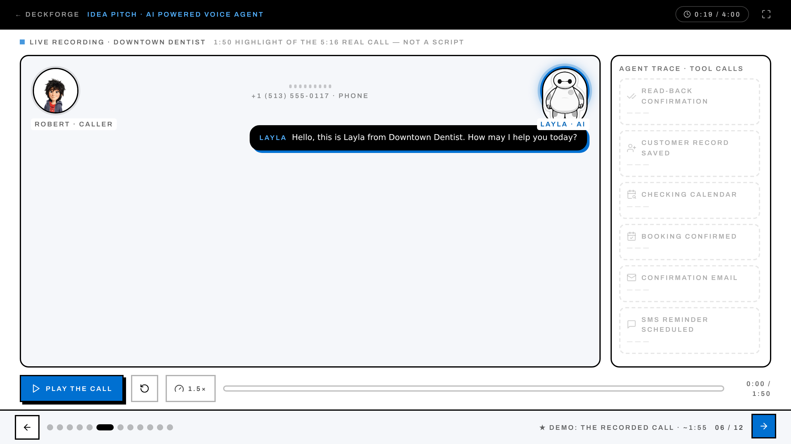
Notes:
★ DEMO: THE RECORDED CALL · pace ~115s
Advance when the point lands — full pitch is ~4 minutes.

Slide 7
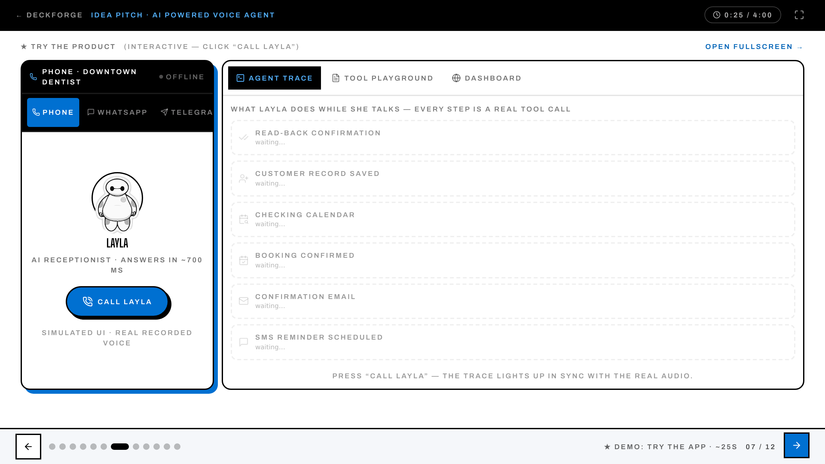
Notes:
★ DEMO: TRY THE APP · pace ~25s
Advance when the point lands — full pitch is ~4 minutes.

Slide 8
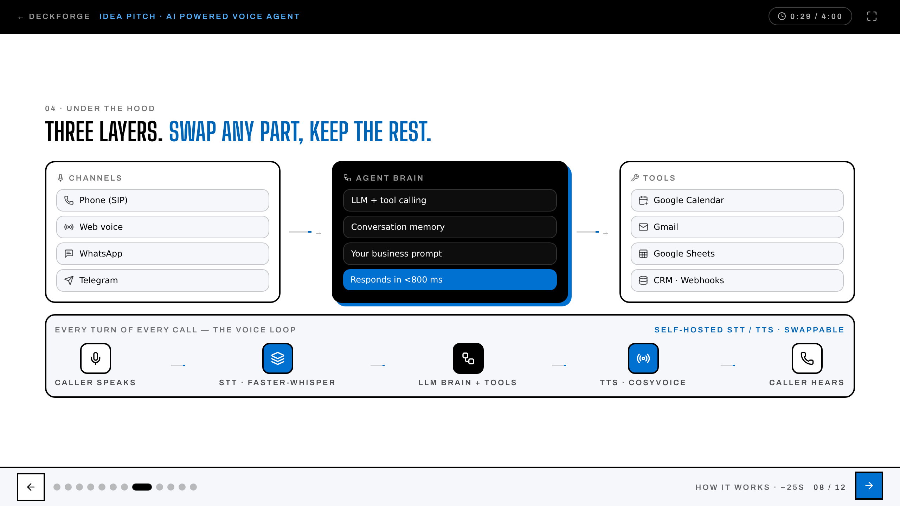
Notes:
HOW IT WORKS · pace ~25s
Advance when the point lands — full pitch is ~4 minutes.

Slide 9
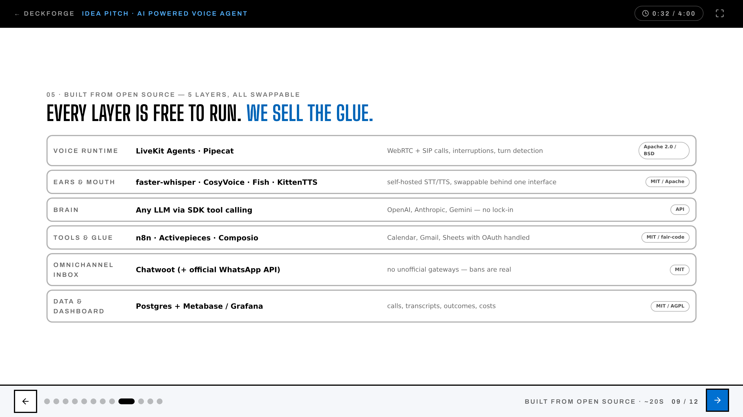
Notes:
BUILT FROM OPEN SOURCE · pace ~20s
Advance when the point lands — full pitch is ~4 minutes.

Slide 10
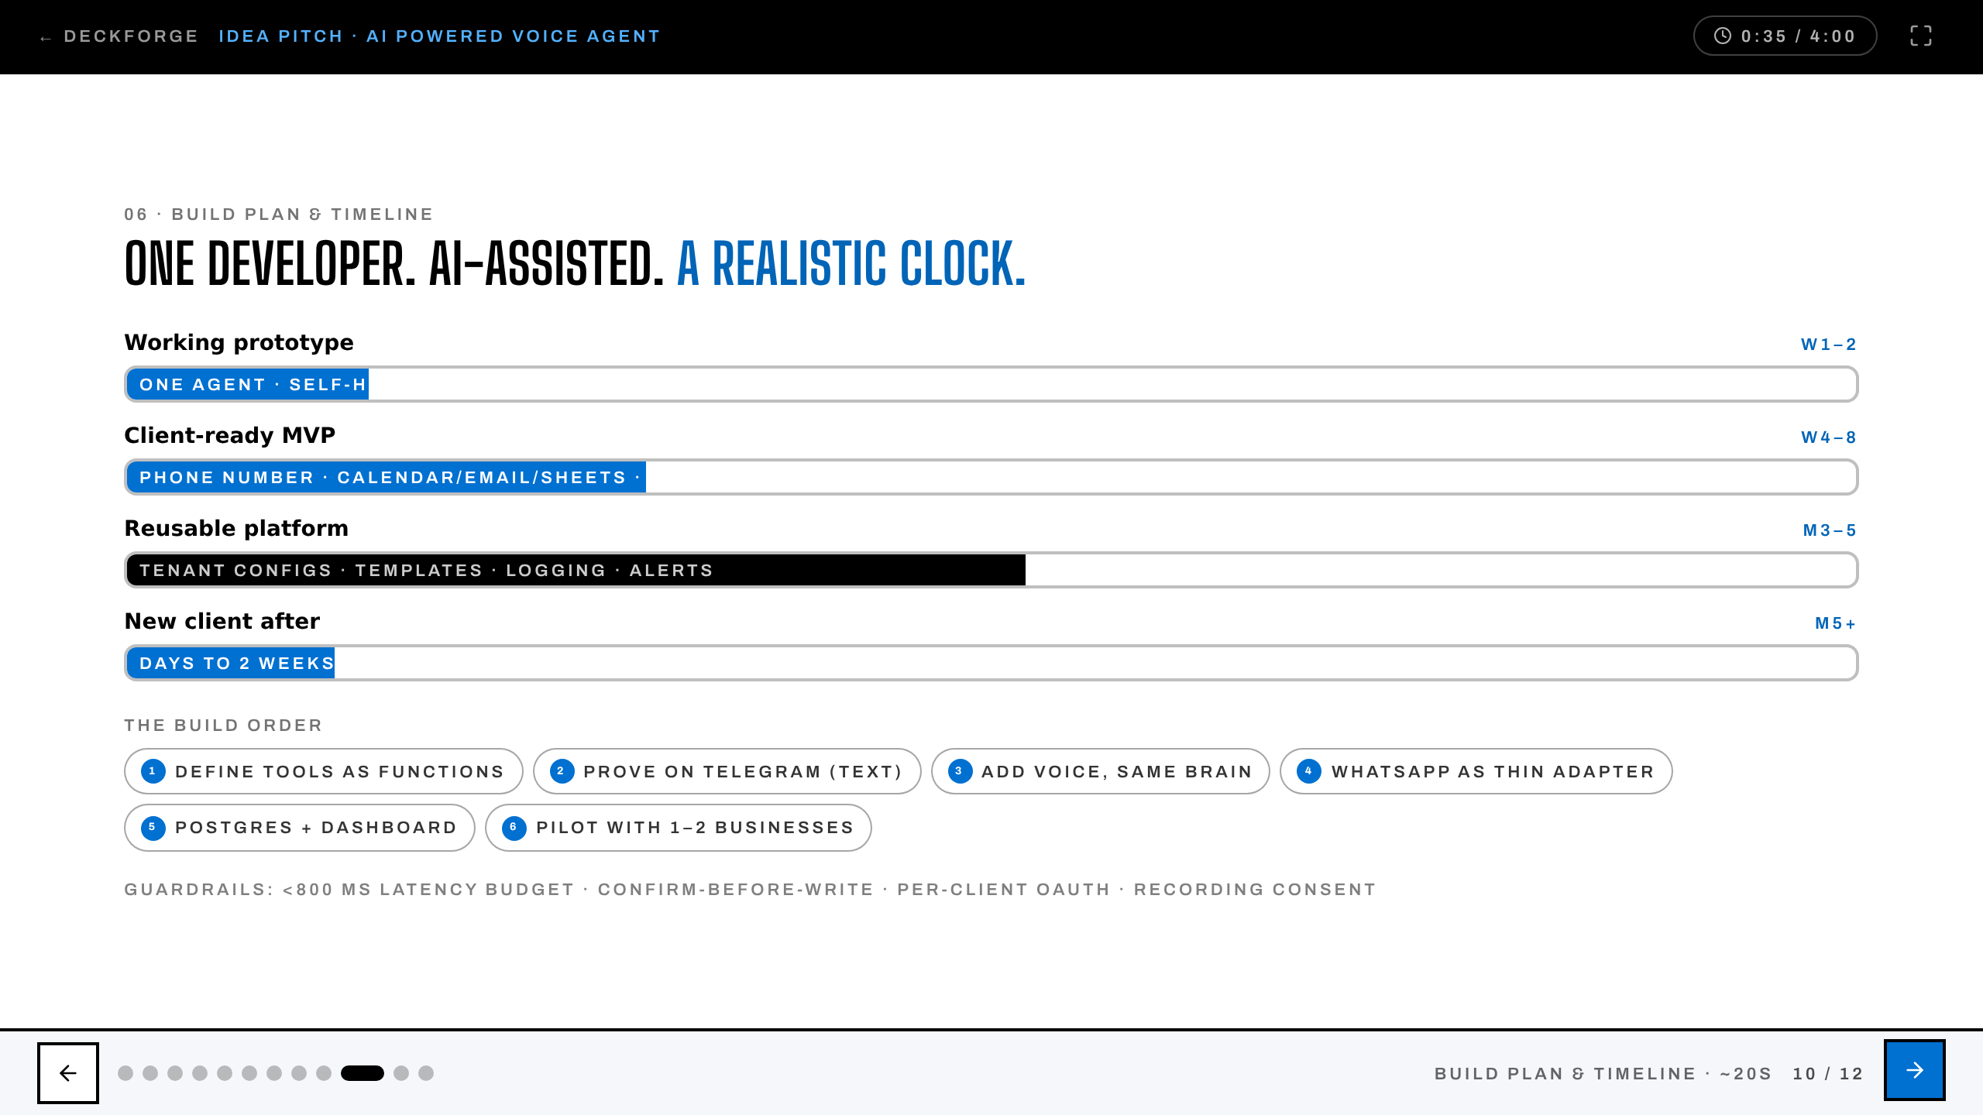
Notes:
BUILD PLAN & TIMELINE · pace ~20s
Advance when the point lands — full pitch is ~4 minutes.

Slide 11
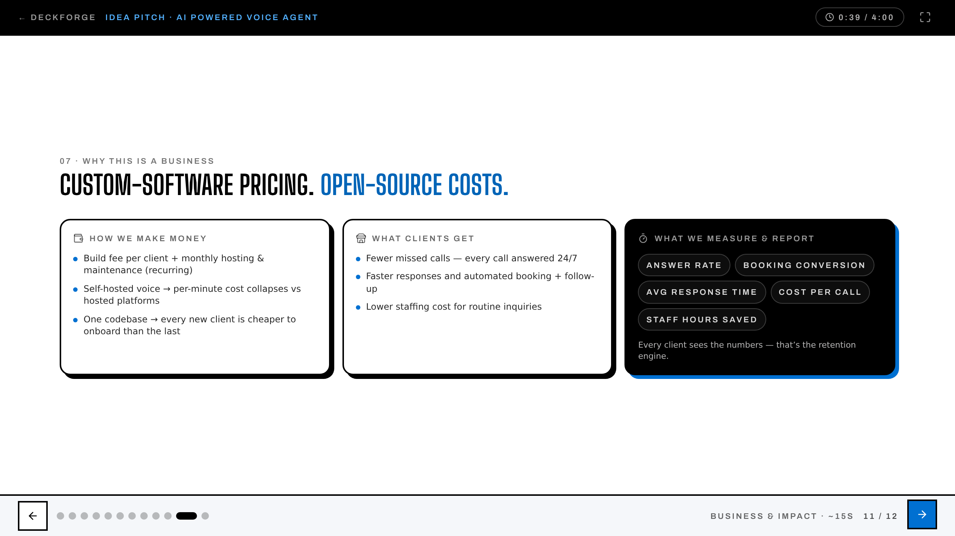
Notes:
BUSINESS & IMPACT · pace ~15s
Advance when the point lands — full pitch is ~4 minutes.

Slide 12
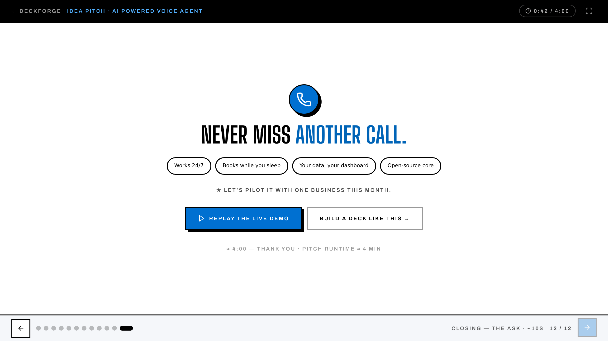
Notes:
CLOSING — THE ASK · pace ~10s
Advance when the point lands — full pitch is ~4 minutes.

