Slide 1
实验#02
基于Resnet18的猫狗分类任务
202228018670003 马天行

Slide 2
#01
项目结构

Slide 3
项目结构
STRUCTURE
Recorder
Resnet18Classifier
ModelHandlerCV
Trainer

Slide 4
#02
网络设计

Slide 5
网络设计: BasicBlock (Layer1)
DESIGN
Conv2D
BatchNorm2D
ReLU
KernelSize = 3*3
Stride = 1
Padding = 1
Conv2D
ReLU
BatchNorm2D

Slide 6
网络设计: BasicBlock with DownSample (Layer2~Layer4)
DESIGN
Conv2D
Conv2D
BatchNorm2D
BatchNorm2D
ReLU
Conv2D
ReLU
BatchNorm2D

Slide 7
网络设计: Layer0
DESIGN
Conv2D(x, 64)
BatchNorm2D
KernelSize = 7*7
Stride = 1
Padding = 3
PoolKernelSize = 3
PoolStride = 2
PoolPadding = 1
ReLU
MaxPool2D

Slide 8
网络设计: 整体
DESIGN
Layer0
BasicBlock
BasicBlock with DS
BasicBlock with DS
Resnet18：
17个卷积层
1个全连接
降采样层的卷积不算数
BasicBlock with DS
BasicBlock with DS
AdaptiveAvgPool2D
Linear

Slide 9
#03
参数配置

Slide 10
参数设置
CONFIG
config.model_class = ucv.nnmodels.Resnet18Classifier
config.model_params = {"num_classes": 2, "num_channels": 3, "from_pretrained": "imagenet"}
config.device = "cuda:0"
config.criterion_class = nn.CrossEntropyLoss
config.criterion_params = {}
config.log_path = "./logs/dogs_vs_cats.resnet18.log"
config.dataset = "dogs_vs_cats"
config.seed = 0
config.trn_preprocess = trans.Compose([…])
config.val_preprocess = trans.Compose([…])
config.batch_size = 32
config.num_epochs = 8
config.optimizer_class = optim.SGD
config.optimizer_params = {"lr": 0.001, "momentum": 0.9, "nesterov": True}
config.scheduler_class = optim.lr_scheduler.StepLR
config.scheduler_params = {"step_size": 4, "gamma": 0.1}
config.checkpoint_path = "./checkpoints/dogs_vs_cats.resnet18.pt"

Slide 11
#04
实验结果

Slide 12
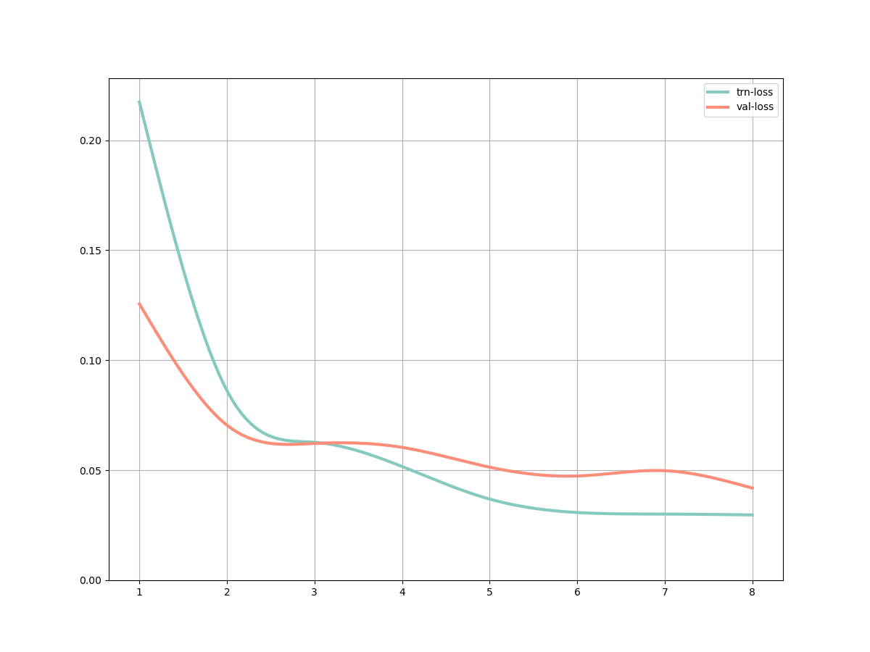
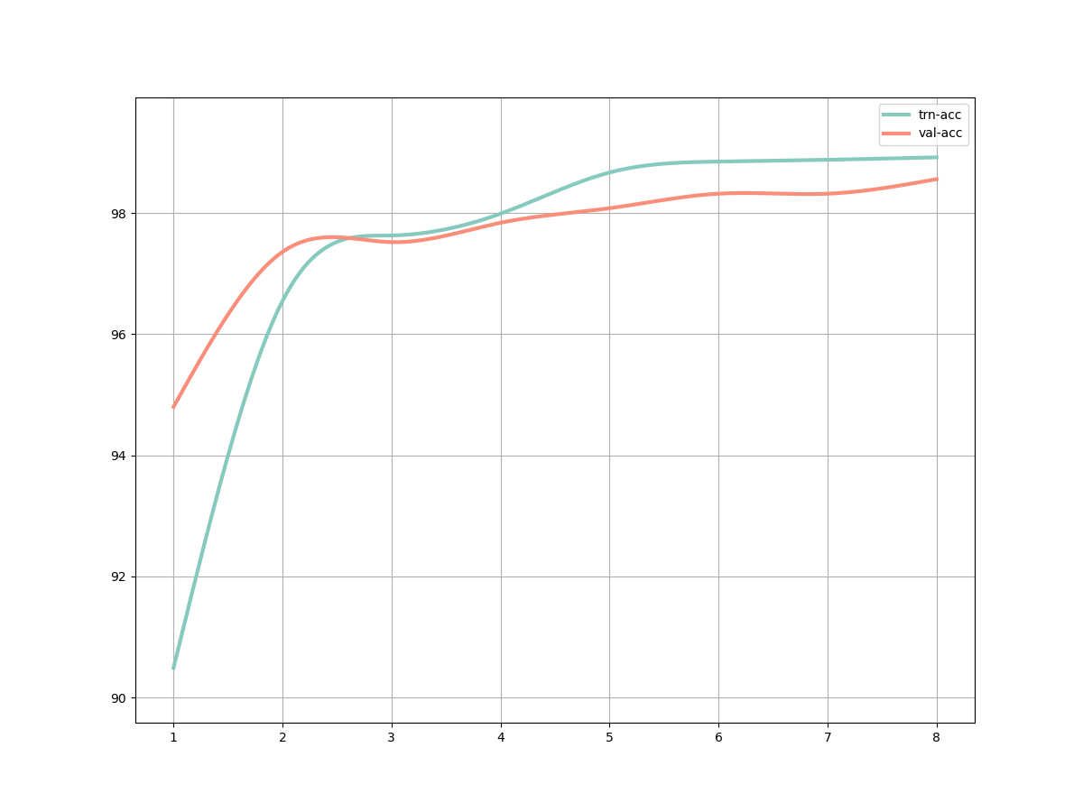
实验结果
RESULT
LOSS
ACCURACY

