Slide 1
实验#01
基于简单卷积网络的MNIST分类任务
202228018670003 马天行

Slide 2
#01
项目结构

Slide 3
项目结构
STRUCTURE
Recorder
SimpleConvClassifier
ModelHandlerCV
Trainer

Slide 4
#02
网络设计

Slide 5
网络设计: layer1
DESIGN
Conv2D(1, 16)
ReLU
ConvKernelSize = 5*5
Stride = 1
Paddings = 2
PoolKernelSize = 2
PoolStride = 2
BatchNorm2D
MaxPool2D

Slide 6
网络设计: layer2
DESIGN
Conv2D(16, 32)
ReLU
ConvKernelSize = 5*5
Stride = 1
Paddings = 2
PoolKernelSize = 2
PoolStride = 2
BatchNorm2D
MaxPool2D

Slide 7
网络设计: 整体
DESIGN
layer1
layer2
inputs: bs*1*28*28
layer1: bs*16*14*14
layer2: bs*32*7*7
flatten: bs*1568
outputs: bs*2
flatten
linear

Slide 8
#03
参数配置

Slide 9
参数设置
CONFIG
config.model_class = ucv.nnmodels.SimpleConvClassifier
config.model_params = {"num_classes": 10, "num_channels": 1}
config.device = "cuda:0"
config.criterion_class = nn.CrossEntropyLoss
config.criterion_params = {}
config.log_path = "./logs/mnist.conv.log"
config.dataset = "mnist"
config.seed = 0
config.trn_preprocess = trans.Compose([trans.ToTensor(), trans.Normalize(mean=[0.485], std=[0.229])])
config.val_preprocess = config.trn_preprocess
config.batch_size = 32
config.num_epochs = 8
config.optimizer_class = optim.SGD
config.optimizer_params = {"lr": 0.001, "momentum": 0.9, "nesterov": True}
config.scheduler_class = optim.lr_scheduler.MultiStepLR
config.scheduler_params = {"milestones": [4, 6], "gamma": 0.1}
config.checkpoint_path = "./checkpoints/mnist.conv.pt"

Slide 10
#04
实验结果

Slide 11
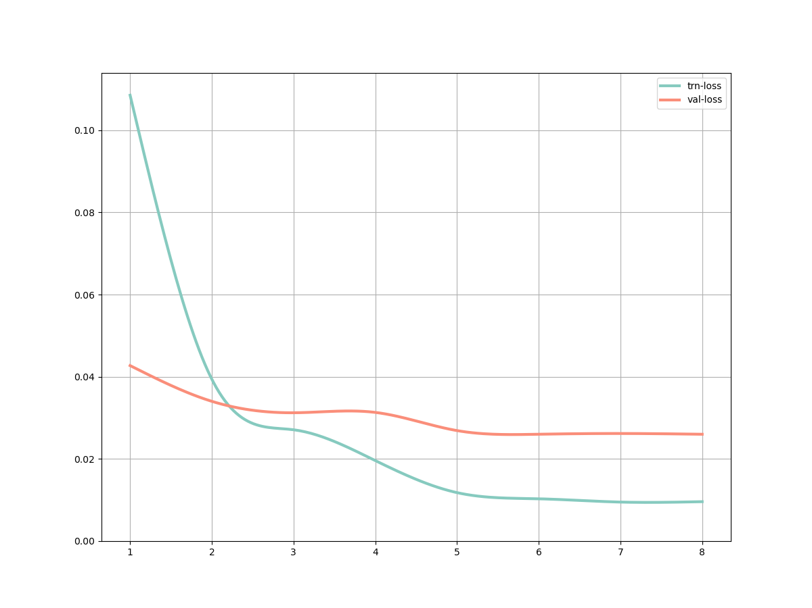
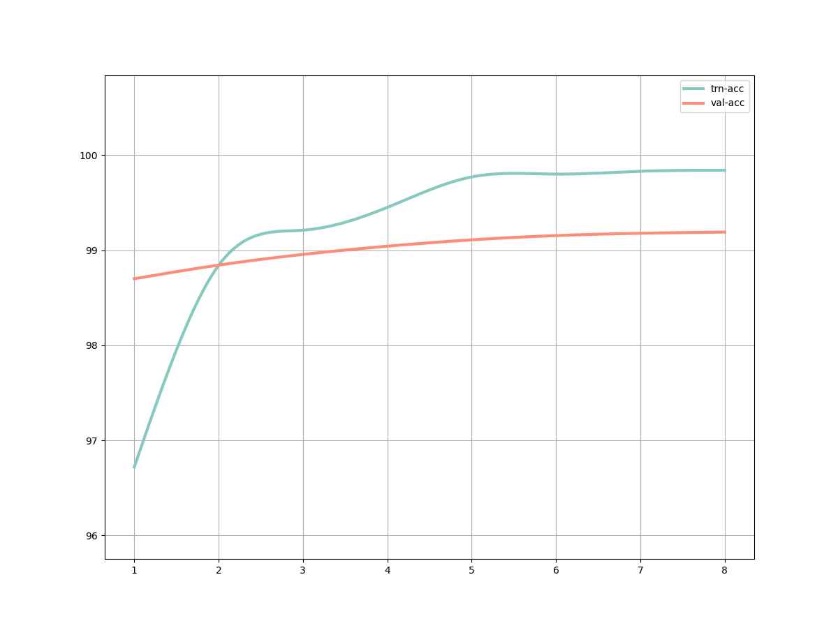
实验结果
RESULT
LOSS
ACCURACY

