Slide 1
实验#04
基于手工TextCNN的情感分类任务
202228018670003 马天行

Slide 2
#01
项目结构

Slide 3
项目结构
STRUCTURE
Recorder
TextConvClassifier
ModelHandlerClassifier
Trainer

Slide 4
#02
网络设计

Slide 5
网络设计: BasicBlock (Layer1)
DESIGN
Embedding (W2V)
Conv2D
Conv2D
Conv2D
ReLU
ReLU
ReLU
MaxPool1D
MaxPool1D
MaxPool1D
Concat + Dropout + Flatten + Linear

Slide 6
#03
参数配置

Slide 7
参数设置
CONFIG
config.model_class = unlp.nnmodels.TextConvClassifier
config.model_params = {"num_classes": 2, "dropout_rate": 0.1, "kernel_sizes": [2, 4, 6, 8], "conv_out_channelses": [32, 32, 24, 16], "freeze_embeddings": False, "pretrained_embeddings": unlp.dataset.DatasetSentimentClassifier.get_embeddings_weight()}
config.device = "cuda:0"
config.criterion_class = nn.CrossEntropyLoss
config.criterion_params = {}
config.log_path = "./logs/movie.conv.log"
config.dataset = "movie"
config.seed = 0
config.sequence_length = 80
config.batch_size = 32
config.num_epochs = 4
config.optimizer_class = optim.AdamW
config.optimizer_params = {"lr": 0.001, "weight_decay": 1e-4}
config.scheduler_class = optim.lr_scheduler.StepLR
config.scheduler_params = {"step_size": 2, "gamma": 0.1}
config.checkpoint_path = "./checkpoints/movie.conv.pt"

Slide 8
#04
实验结果

Slide 9
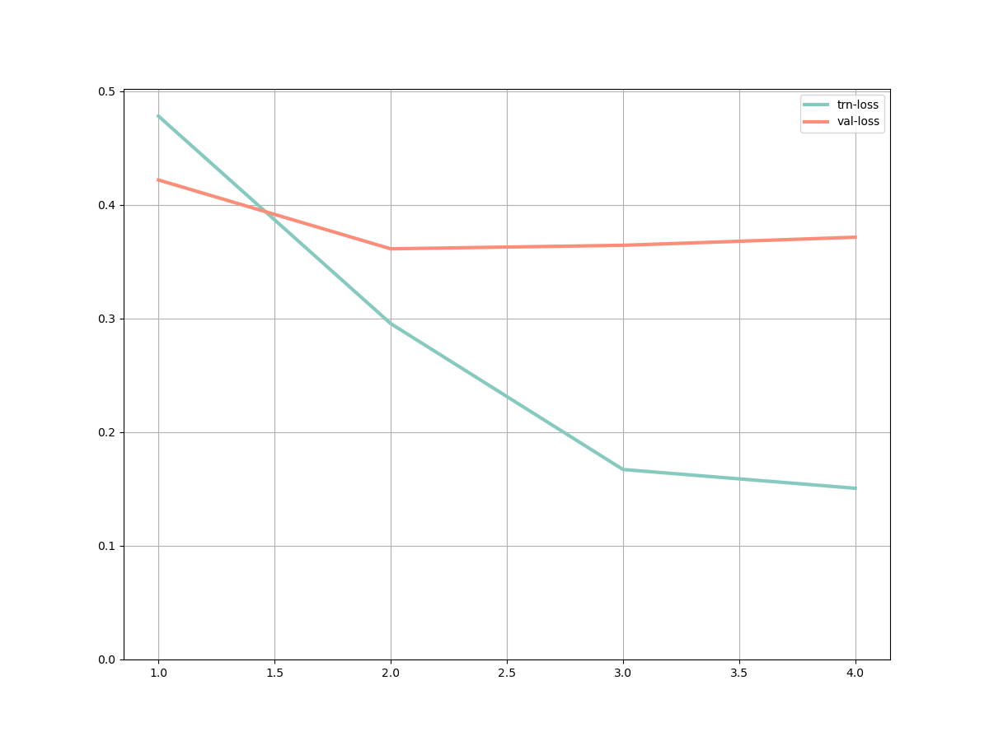
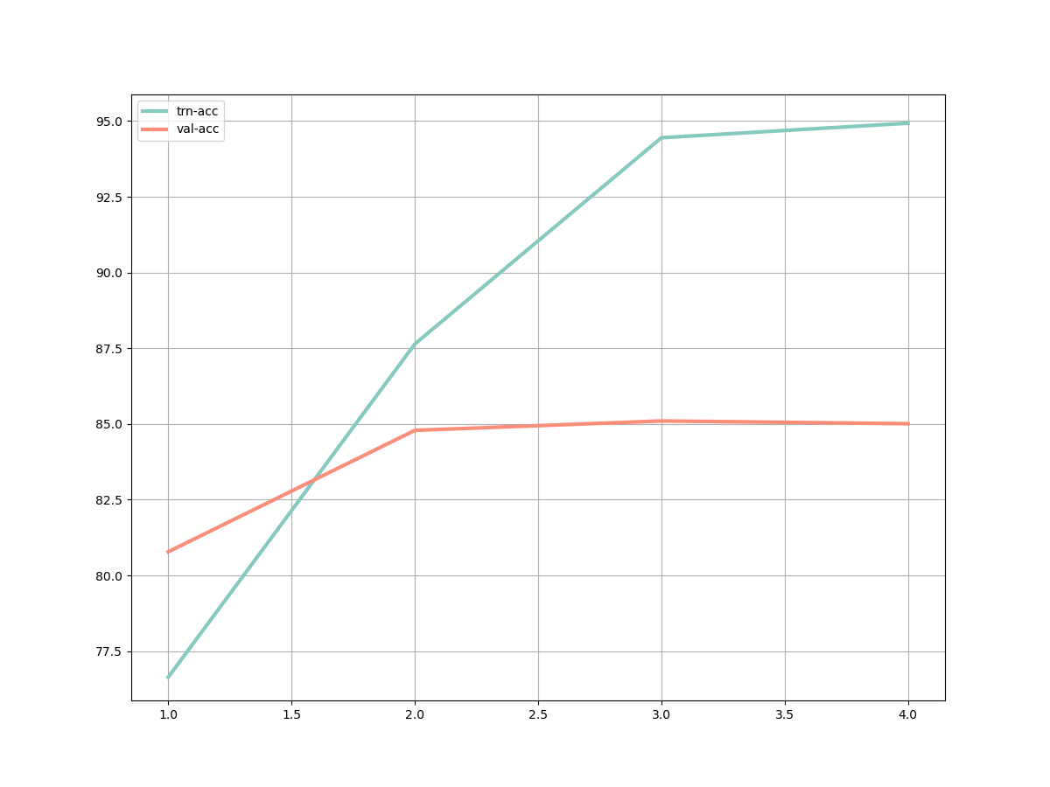
实验结果
RESULT
LOSS
ACCURACY

