Slide 1
Computer Science 2 Lecture 5
Advanced User Interfaces

Slide 2
Overview
Layout Management
Choices
Menus
Using Time Events for Animations
Mouse Events
JavaFX

Slide 3
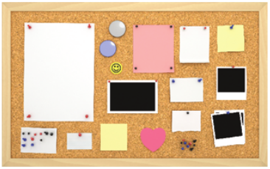
Layout Management
In Java, you build up user interfaces by adding components into containers such as panels
Each container has its own layout manager, which determines how components are laid out
Three useful layout managers are the flow layout, border layout, and grid layout

Slide 4
Flow Layout
By default, a JPanel uses a flow layout
A flow layout simply arranges its components from left to right and starts a new row when there is no room in the current row

Slide 5
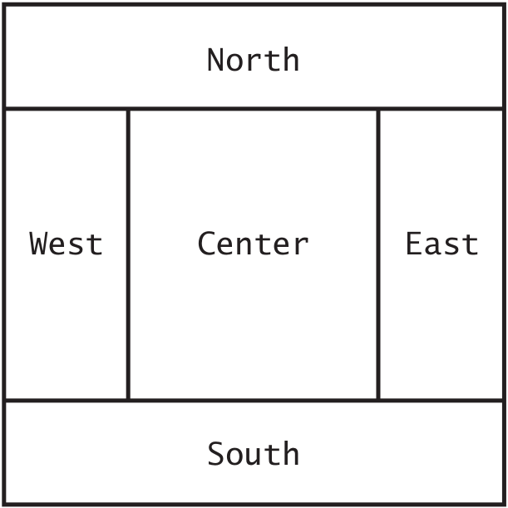
Border Layout
Another commonly used layout manager is the border layout
The border layout groups components into 5 areas (CENTER, NORTH, SOUTH, WEST, EAST)
It is the default layout manager for a frame, but you can also use it in a panel:
panel.setLayout(new BorderLayout());
Now the panel is controlled by a border layout, not the flow layout. When adding a component, you specify the position like this:
panel.add(component, BorderLayout.NORTH);

Slide 6
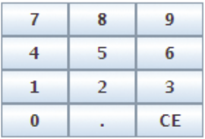
Grid Layout
The grid layout arranges components in a grid with a fixed number of rows and columns
All components are resized so that they all have the same width and height
Like the border layout, it expands each component to fill the entire allotted area
If not desirable, you need to place each component inside a panel
To create a grid layout, you supply the number of rows and columns in the constructor, then add the components row by row, left to right
JPanel buttonPanel = new JPanel();
buttonPanel.setLayout(new GridLayout(4, 3));
buttonPanel.add(button7);
buttonPanel.add(button8);
buttonPanel.add(button9);
buttonPanel.add(button4);
...

Slide 7
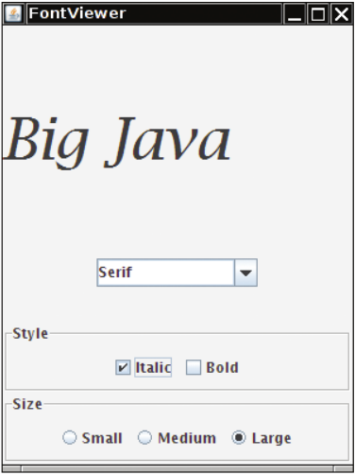
Choices
How to present a finite set of choices to the user?
Which Swing component you use if the choices are mutually exclusive or not?
What about the amount of space you have for displaying the choices?

Slide 8
Radio Buttons
If the choices are mutually exclusive, use a set of radio buttons
Only one button can be selected at a time
JRadioButton smallButton = new JRadioButton(“Small”);
JRadioButton mediumButton = new JRadioButton(“Medium”);
JRadioButton largeButton = new JRadioButton(“Large”);
ButtonGroup group = new ButtonGroup();
group.add(smallButton);
group.add(mediumButton);
group.add(largeButton);
…
if (largeButton.isSelected()) {
size = LARGE_SIZE;
}

Slide 9
Check Boxes
A check box is a UI component with 2 states: checked and unchecked
They are not exclusive
Check boxes are square and have a check mark when selected
Because check box settings do not exclude each other, you do not place a set of check boxes inside a button group
You can use isSelected method to find out whether a check box is currently checked or not
JCheckBox italicBox = new JCheckBox("Italic");
JCheckBox boldBox = new JCheckBox("Bold");

Slide 10
Combo Boxes
If you have a lot of choices and little space you can use a combo box
A combination of a list and a text field
If the combo box is editable you can also type in your own selection
To make a combo box editable, call the setEditable method
JComboBox combo = new JComboBox();
combo.addItem("Serif");
combo.addItem("SansSerif");
…
String select = (String) combo.getSelectedItem();

Slide 11
Menus
Anyone who has ever used GUI is familiar with pull-down menus
At the top of the frame is a menu bar that contains the top-level menus
Each menu is a collection of menu items and submenus

Slide 12
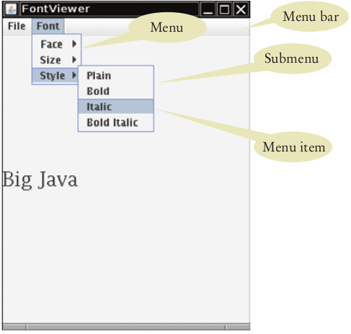
public class MyFrame extends JFrame {
public MyFrame() {
JMenuBar menuBar = new JMenuBar();
setJMenuBar(menuBar);
JMenu fileMenu = new JMenu("File");
JMenu fontMenu = new JMenu("Font");
menubar.add(fileMenu);
menubar.add(fontMenu);
JMenuItem exitItem = new JMenuItem("Exit");
fileMenu.add(exitItem);
…
JMenu styleMenu = new JMenu("Style");
fontMenu.add(styleMenu);
…
}
}

Slide 13
Menus
When the user selects a menu item, the menu item sends an action event. Therefore, you must add a listener to each menu item
ActionListener listener = new ExitItemListener();
exitItem.addActionListener(listener);
You add action listeners only to menu items, not to menus or the menu bar
When the user clicks on a menu name and a submenu opens, no action event is sent

Slide 14
Action Listeners
public JmenuItem createFaceItem(final String name) {
// Final variables can be accessed from an inner class method
class FaceItemListener implements ActionListener {
public void actionPerformed(ActionEvent event) {
faceName = name;
setLabelFont();
}
}
JMenuItem item = new JmenuItem(name);
ActionListener listener = new FaceItemListener(name);
item.addActionListener(listener);
return item;
}

Slide 15
Using Timer Events for Animation
The Timer class in the javax.swing package generates a sequence of action events, spaced at even time intervals
This is useful whenever you want to send continuous updates to a component
E.g., in an animation you may want to update a scene 10 times per second and redisplay the image to give the illusion of movement
When you use a time you specify the frequency of the events and an object of a class that implements the ActionListener interface
Place whatever action you want to occur inside the actionPerformed method
Start the timer

Slide 16
Example
class MyListener implements ActionListener {
public void actionPerformed(ActionEvent event) {
// Action that is executed at each timer event
}
}
MyListener listener = new MyListener();
Timer t = new Timer(TIME, listener); // TIME in milliseconds
t.start();

Slide 17
Mouse Events
If you write programs that show drawings, and you want the users to manipulate the drawings with a mouse, then you need to listen to mouse events
Mouse listeners are more complex than action listeners

Slide 18
Mouse Listener
A mouse listener must implement the MouseListener interface, which contains the following 5 methods
public interface MouseListener {
void mousePressed(MouseEvent event);
void mouseReleased(MouseEvent event);
void mouseClicked(MouseEvent event);
void mouseEntered(MouseEvent event);
void mouseExited(MouseEvent event);
}
It often happens that a particular listener specifies actions only for one or two of the listener methods. Nevertheless, all 5 methods of the interface must be implemented

Slide 19
JavaFX
JavaFX is a library that enables you to create and deploy a rich client application
The library is shipped along with the Java SDK by default (no separate installation required)
The main purpose of this library is to enable a developer to create a consistent look and feel across a variety of platforms such as cell phone, browser, car dashboard, and so forth

Slide 20
JavaFX and Swing
Swing has been around for quite some time with the same purpose of providing UI needs of Java
Swing offers superb flexibility and capability in creating a GUI
Swing classes are not built to leverage graphical hardware components. This reduces performance and lacks efficiency when dealing with complex graphics
JavaFX brought a fresh new UI framework as a full-blown UI library

Slide 21
Layouts and UI Controls
Layouts should have consistent arrangements of a UI control such as Buttons, Texts, Shapes, within the viewable area
JavaFX layouts are simpler and more intuitive to implement than Swing layouts
Some common layouts are:
javax.scene.layout.Hbox: Lays out UI controls within a horizontal box
javax.scene.layout.Vbox: Lays out UI controls within a vertical box
javax.scene.layout.FlowPane: UI controls are arranged in a flow that wraps at the flow pane interior
javax.scene.layout.BorderPane: UI controls are laid out in the left, top, right, bottom, and centre position of the scene
javax.scene.layout.GridPane: Lays out UI controls in a tabular fashion, in grids of rows and columns

Slide 22
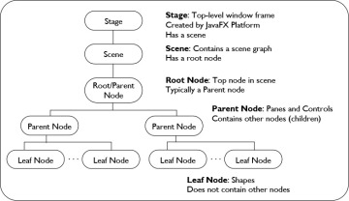
public class SimpleJavaFXApp extends Application {
public void start(Stage stage) {
stage.setTitle("Login");
BorderPane root = new BorderPane();
Scene scene = new Scene(root, 380, 150, Color.WHITE);
GridPane gridpane = new GridPane();
Label userNameLabel = new Label("User Name");
gridPane.setHalignment(userNameLabel, HPos.RIGHT);
gridpane.add(userNameLabel, 0, 0);
root.setCenter(gridpane);
stage.setScene(scene);
stage.show();
}
public static void main(String[] args) {
launch(args);
}
}

Slide 23
JavaFX Media
The JavaFX media API enables a developer to incorporate audio and video capabilities into a Java application
The Media API is designed to be cross platform; that means multimedia content can be implemented in an equivalent manner while coding across multiple devices (tablet, media player, TV, and the like)
The MediaPlayer class provides the controls for media playing but does not provide any view
A view can be realized with the help of MediaView

Slide 24
public class SimpleMediaPlayer extends Application {
public void start(Stage stage) {
Scene scene = new Scene(new Group(), 540, 209);
stage.setScene(scene);
stage.setTitle("Media Player");
stage.show();
String audio_source = "/home/mano/sonare.mp3";
String video_source = "/home/mano/Tintin.mp4";
File f = new File(video_source);
Media media = new Media(f.toURI().toString());
MediaPlayer mediaPlayer = new MediaPlayer(media);
mediaPlayer.setAutoPlay(true);
MediaView mediaView = new MediaView(mediaPlayer);
((Group) scene.getRoot()).getChildren().add(mediaView);
}
public static void main(String[] args) {
launch(args);
}
}

Slide 25
JavaFX Web
JavaFX provides capabilities to interoperate HTML5 contents with the help of WebKit rendering engine
Similar to MediaView, WebView is used to manage WebEngine and display its content
JavaFX can harness HTML5's rich Web content to create a Web user interface resembling the native desktop

Slide 26
public class SimpleWebViewer extends Application {
public void start(Stage stage) throws Exception {
stage.setTitle("Displaying Java documentation");
WebView browser = new WebView();
Scene scene = new Scene(browser, 320, 250, Color.rgb(0, 0, 0, .80));
stage.setScene(scene);
URL url = new URL("home/Java/java_doc/docs/index.html");
browser.getEngine().load(url.toExternalForm());
stage.show();
}
public static void main(String[] args) {
launch(args);
}
}

Slide 27
What we have learned
Layout Management
Choices
Menus
Using Time Events for Animations
Mouse Events
JavaFX

