Slide 1
Computer Science 2
Lecture 3
Inheritance

Slide 2
Overview
Principles of Object-Oriented Programming
Inheritance:
  Methods
  Fields
Class Converting
Abstract Classes
Access Control Modifiers
Class Object

Slide 3
Principles of Object-Oriented Programming
Principles discussed in the previous lectures:
  Information Hiding and Encapsulation
  Polymorphism
In this lecture we introduce:
  Inheritance

Slide 4
Why OOP?
To try to deal with the complexity of programs
To apply principles of abstraction to simplify the tasks of writing, testing, maintaining and understanding complex programs
To increase code reuse
  to reuse classes developed for one application in other applications instead of writing new programs from scratch ("Why reinvent the wheel?")
Inheritance is a major technique for realizing these objectives

Slide 5
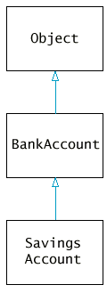
Inheritance
Inheritance is a OOP principle. It allows us to extend existing classes by adding methods and fields.
The more general class is called a super class;
The more specialized class that inherits from the superclass is called subclass;
class SavingsAccount extends BankAccount
{
new methods
new instance fields
}

Slide 6
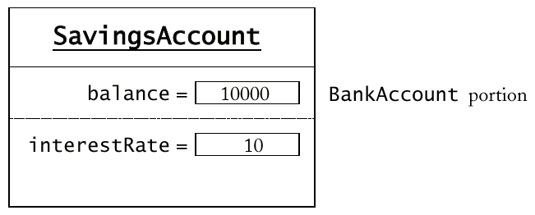
Example
When defining a subclass you specify added instance fields, added methods, and changed and overridden methods.
public class BankAccount
{ private double balance;
public BankAccount(double balance)
{ this.balance = balance;}
public void deposit(double amount)
{ balance = balance + amount; }
public void withdraw(double amount)
{ balance = balance - amount; }
public double getBalance()
{ return balance;
}
}
One advantage of inheritance is code reuse.
public class SavingsAccount extends BankAccount
{ private double interestRate;
public SavingsAccount(double rate)
{ interestRate = rate;}
public void addInterest()
{ double interest = getBalance()
* interestRate / 100;
deposit(interest);
}
}

Slide 7
Example
public class SavingsAccount extends BankAccount
{ public SavingsAccount(double rate)
{ interestRate = rate;}
public void addInterest()
{ double interest = getBalance()
* interestRate / 100;
deposit(interest);
}
private double interestRate;
}
extends keyword says we’re creating a subclass (in this example a subclass of the BankAccount class)
The constructor of SavingsAccount calls implicitly the default constructor of bankAccount.
addInterest() is a new method. It employs inherited getBalance() and deposit()

Slide 8
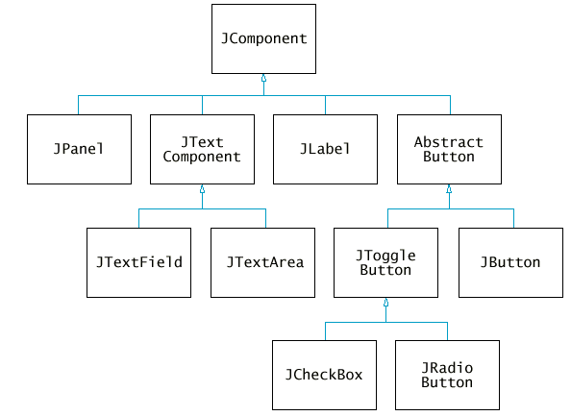
Inheritance
Inheriting from a class differs from realizing an interface:
  The subclass inherits behavior and the state of the super class;
  An interface is not a class. It has not state and no behavior.
Inheritance occurs between classes not objects;
There are two types of inheritance:
  Single inheritance is when children
  inherit characteristics from only one
  parent. Java employs single inheritance!
  Multiple inheritance is when children
  inherit characteristics from more than
  one parent.

Slide 9
Derived Classes: a Class Hierarchy
The super classes can be used to implement specialized classes
  For example: student, employee, faculty, and staff
Classes can be derived from the classes derived from the super class, etc., resulting in a class hierarchy.

Slide 10
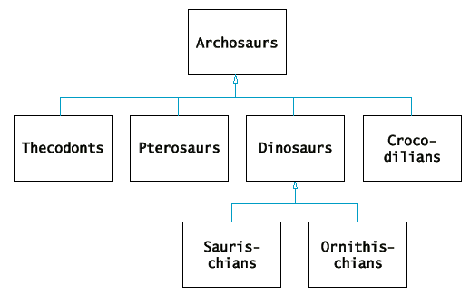
Derived Classes: a Class Hierarchy (cont.)

Slide 11
Derived Classes: a Class Hierarchy (cont.)
Person
Student
Employee
Undergraduate
Graduate
Faculty
Staff
MastersDegree
PhD
NonDegree

Slide 12
Derived Classes: a Class Hierarchy (cont.)

Slide 13
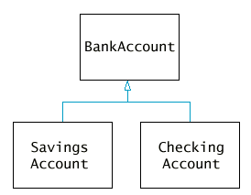
Derived Classes: a Class Hierarchy (cont.)

Slide 14
Inheritance and Methods
When writing a subclass of superclass:
You can override methods of the superclass;
You can inherit methods of the superclass;
You can write new methods.
We consider these three cases in the next slides

Slide 15
Inheritance and Methods
A method of a subclass overrides a method of a superclass if both methods have the same signature.
Assume that we have a class CheckingAccount with its own method deposit. deposit overrides the method deposit from BankAccount.
public class CheckingAccount extends BankAccount
{ …………
public void deposit(double amount)
{ transctCount++;
super.deposit(amount);
}
private int transctCount ;
…………
}

Slide 16
Inheritance and Methods
A subclass inherits a method from a superclass, if it does not have a method that overrides the superclass method.
The class SavingsAccount inherits the methods getBalance and deposit from BankAccount.
public class SavingsAccount extends BankAccount
{ public SavingsAccount(double rate)
{ interestRate = rate;}
public void addInterest()
{ double interest = getBalance()
* interestRate / 100;
deposit(interest);
}
private double interestRate;
}

Slide 17
Inheritance and Methods
A subclass can have new methods of which the names or signatures differ those from the superclass. These methods can be applied only of the objects of the subclass.
The class SavingsAccount has a new method addInterest.
public class SavingsAccount extends BankAccount
{ public SavingsAccount(double rate)
{ interestRate = rate;}
public void addInterest()
{ double interest = getBalance()
* interestRate / 100;
deposit(interest);
}
private double interestRate;
}

Slide 18
Inheritance and Fields
When writing a subclass of superclass:
You can inherit fields from the superclass;
You can define new fields.
We consider these two cases in the next slides.

Slide 19
Inheritance and Fields
You can inherit fields from the superclass. All fields from the superclass are automatically inherited.
The field balance is inherited in SavingsAccount;
But, since balance is private in BankAccount, SavingsAccount uses the method getBalance inherited from BankAccount.
public class SavingsAccount extends BankAccount
{ public void addInterest()
{ double interest = getBalance()
* interestRate / 100;
deposit(interest);
} …………….
private interestRate;
}

Slide 20
Inheritance and Fields
You can define new fields. In the class SavingsAccount the field interestRate is new.
public class SavingsAccount extends BankAccount
{ public void addInterest()
{ double interest = getBalance()
* interestRate / 100;
deposit(interest);
} …………….
private interestRate;
}

Slide 21
Inheritance and Fields
If a new field balance is defined in CheckingAccount, then an object of this class will have two fields with the same name. The newly defined field shadows the field inherited from the superclass.
public class CheckingAccount extends BankAccount
{ public void deposit(double amount)
{ transActionCount++;
balance = balance + amount
} …………….
private double balance;
private int transActionCount++;
}
Checking Account
BankAccount Portion
balance
transActionCount
balance

Slide 22
Constructors in a Subclass
The subclass constructor can call a superclass constructor using the keyword super. The call has to be in the first line.
If the subclass constructor doesn’t call the super-class constructor, the default constructor of the super-class is called implicitly.
public class CheckingAccount extends BankAccount
{ public CheckingAccount(int initialBalance)
{ super(initialBalance);
transctCount = 0;
}
……….
private int transctCount ;
}

Slide 23
Constructors in a Subclass
To call a constructor within a class use the keyword this.
this(0) below calls constructor CheckingAccount(int initialBalance) with initialBalance equal to 0.
public class CheckingAccount extends BankAccount
{ public CheckingAccount(int initialBalance)
{ super(initialBalance);
transctCount = 0;
}
public CheckingAccount()
{ this(0);}
……….
private int transctCount ;
}

Slide 24
Call to an Overridden Method
Use the keyword super to call a method from the superclass that was overridden in the subclass
deposit from CheckingAccount overrides deposit from BankAccount. deposit from BankAccount is called in deposit from CheckingAccount using super.
the keyword super can be used for calling superclass non-overriden methods as well.
public class CheckingAccount extends BankAccount
{ public void deposit(double amount)
{ transctCount++;
super.deposit(amount);
}
public void deductFees()
{ if (transctCount > FREE_TRANSCT)
{ double fees = FEE *(transctCount - FREE_TRANSCT);
super.withdraw(fees);
}
transctCount = 0;
}…………………
}

Slide 25
public class CheckingAccount extends BankAccount
{ public CheckingAccount(int initialBalance)
{ super(initialBalance);
transctCount = 0;
}
public void deposit(double amount)
{ transctCount++;
super.deposit(amount);
}
public void withdraw(double amount)
{ transctCount ++;
super.withdraw(amount);
}
public void deductFees()
{ if (transctCount > FREE_TRANSCT)
{ double fees = FEE *(transctCount - FREE_TRANSCT);
super.withdraw(fees);
}
transctCount = 0;
}
private int transctCount ;
private static final int FREE_TRANSCT = 3;
private static final double FEE = 2.0;
}

Slide 26
Converting from Subclasses to Superclasses
Subclass references can be converted to superclass references:
SavingsAccount collegeFund = new SavingsAccount(10);
BankAccount anAccount = collegeFund;
Object anObject = collegeFund;
Note that superclass references don't know the full story:
anAccount.addInterest(); // ERROR
Why would anyone want to know less about an object? This can happen when you reuse code! See next slide!

Slide 27
Polymorphism
Generic method:
public void transfer(double amount, BankAccount other)
{
withdraw(amount);
other.deposit(amount);
}
Works with any kind of bank account:
  BankAccount momsAcc = new BankAccount(100);
  CheckingAccount sonAcc = new CheckingAccount(100);
  momsAcc.transfer(100, sonAcc );
  sonAcc.transfer(100, momsAcc);
Why not just declare parameter as Object? Object class doesn't have the deposit method!

Slide 28
The final Modifier
In the case of methods: final specifies that a method definition cannot be overridden with a new definition in a subclass:
In the case of classes: final specifies that the class cannot be used as a base class to derive another class:
public final class String{ ….}
Allows the compiler to generate more efficient code

Slide 29
Abstract Classes
An abstract class is a placeholder in a class hierarchy that represents a generic concept;
An abstract class cannot be instantiated;
We use the modifier abstract on the class header to declare a class as abstract;
An abstract class often contains abstract methods (like an interface does), though it doesn’t have to;
public abstract class BankAccount
{ public abstract void deductFees();
……….
}

Slide 30
Abstract Classes
The subclass of an abstract class must override the abstract methods of the parent, or it too will be considered abstract;
An abstract method cannot be defined as final (because it must be overridden) or static (because it has no definition yet)
The use of abstract classes is a design decision; it helps us establish common elements in a class that is to general to instantiate
Usually concrete classes extend abstract ones, but the opposite is also possible.

Slide 31
References and abstract classes
Suppose the following two classes were defined:
  public abstract class Figure
  public class Rectangle extends Figure
Are these instantiations correct?
Rectangle r = new Rectangle(...);
Figure f = new Rectangle(...);
Figure f = new Figure(...);
//correct
//correct
//error

Slide 32
Access Control Modifiers
 | same class | same package | subclass | universal
private | X
public | X | X | X | X
protected | X | X | X
default | X | X
Notes:
Default is package access—class and same package, but not subclasses.
It's like protected but not across packages [where subclasses in other packages can access protected stuff but not default stuff]

Slide 33
Object: The Cosmic Superclass
Object is the superclass of all classes.
Every class extends Object.
Methods defined for Object are inherited by all classes.

Slide 34
Object: The Cosmic Superclass
Partial Method Summary
boolean equals(Object obj)
  Indicates whether some other object is "equal to" this one.
String toString()
  Returns a string representation of the object.
protected Object clone()
  Creates and returns a copy of this object.
Class getClass()
  Returns the runtime class of an object.
  getClass.getName() returns the name of the class as a String.

Slide 35
toString and Inheritance
public String toString() Returns a string representation of the object.
  Supply toString() in all classes.
  System.out.println() invokes toString()
  whenever its has to print an object.

Slide 36
toString and Inheritance
public class BankAccount
{
public String toString()
{ return getClass().getName() +
"[balance = " + balance + "]";
}
SavingsAccount momsSavings = new SavingsAccount(0.5);
CheckingAccount harrysChecking = new
CheckingAccount(100);
System.out.println(harrysChecking);
System.out.println(momsSavings);
Print:
CheckingAccount [balance = 100.0]
SavingsAccount [balance = 0.5]

Slide 37
toString and Inheritance
public class SavingsAccount extends BankAccount
{. . .
public String toString(){
return super.toString() + "[interestRate = " + interestRate + "]";
}
SavingsAccount momsSavings = new SavingsAccount(0.5);
CheckingAccount harrysChecking = new
CheckingAccount(100);
System.out.println(harrysChecking);
System.out.println(momsSavings);
Prints:
CheckingAccount [balance = 100.0]
SavingsAccount [balance = 0.5][interestRate = 0.5]

Slide 38
toString and Inheritance
If NO toString method is provided :
SavingsAccount momsSavings = new SavingsAccount(0.5);
CheckingAccount harrysChecking = new CheckingAccount(100);
System.out.println(harrysChecking);
System.out.println(momsSavings);
results:
CheckingAccount@eee36c
SavingsAccount@194df86
inherits Object's toString method.
from the API: This method returns a string equal to the value of:
getClass().getName() + '@' + Integer.toHexString(hashCode())

Slide 39
equals method
You should define the equals method to test whether two objects have equal state.
public boolean equals (Object otherObject)
{
// first statement will cast otherObject
// code defining equal state goes here
}

Slide 40
equals method
public boolean equals (Object otherObject)
{
if (otherObject == null) return false;
if (getClass() != otherObject.getClass())
return false;
// cast statement goes here
// code to compare equal state goes here
}

Slide 41
equals method
public class Coin{
...
public boolean equals (Object otherObject)
{
if (otherObject == null) return false;
if (getClass() != otherObject.getClass())
return false;
Coin other = (Coin) otherObject;
return name.equals(other.name) &&
value == other.value;
}

Slide 42
equals method and Inheritance
If you do not define equals in your class, you inherit Object's equals method.
From the API:
  The equals method for class Object implements the most discriminating possible equivalence relation on objects; that is, for any non-null reference values x and y, this method returns true if and only if x and y refer to the same object (x == y has the value true).

Slide 43
equals method and Inheritance
When defining equals in a subclass, first call equals in the superclass.
public boolean equals (Object otherObject)
{
if (! super.equals(otherObject)) return false;
// cast goes here
// code to compare states goes here.
}

Slide 44
equals method and Inheritance
When defining equals in a subclass, first call equals in the superclass.
public CollectCoin extends Coin{
…
public boolean equals (Object otherObject)
{
if (!super.equals(otherObject)) return false;
CollectCoin other = (CollectCoin)
otherObject;
return year == other.year;
}

Slide 45
clone method
The clone method makes a new object with the same state as the existing object.
public class BankAccount
{
public Object clone()
{
BankAccount cloned = new BankAccount();
cloned.balance = balance;
return cloned;
}
}

Slide 46
clone method
public class BankAccount
{
public Object clone()
{
BankAccount cloned = new BankAccount();
cloned.balance = balance;
return cloned;
}
}
You must cast the call:
BankAccount account1 = (BankAccount)
harraysChecking.clone();

Slide 47
clone method and Inheritance
Our previous method won't work for subclasses.
  SavingsAccount momsSavings = new SavingsAccount(0.5);
  Object cloned = momsSavings.clone();
constructs a new BankAccount, not SavingsAccount.

Slide 48
clone method and Inheritance
public class BankAccount implements Cloneable
{ public Object clone()
{
try
{
Object cloned = super.clone();
return cloned;
}
catch(CloneNotSupportedException e)
{ return null; }
}
}
If the object contains references, the Object.clone method makes a copy of the reference not a clone of the object.

Slide 49
Shallow copy of Customer
Customer
name =
account =
String
BankAccount
balance = 1000
Customer
name =
account =

Slide 50
Deep Copy of Customer
public class Customer implements Cloneable
{ . . .
public Object clone()
{ try
{ Customer cloned = (Customer) super.clone();
cloned.account = (BankAccount) account.clone();
return cloned;
}
catch(CloneNotSupportedException e) {
// Can't happen because we implement Cloneable return null;
}
}
private String name;
private BankAccount account;
}
If an object contains a reference to another mutable object, then you must call clone for that reference.

Slide 51
What we have learned
Principles of Object-Oriented Programming
Inheritance:
  Methods
  Fields
Class Converting
Abstract Classes
Access Control Modifiers
Class Object

