Slide 1
Computer Science 2
Lecture 1: Part 2
Non-Reference and Reference Variables,
Static Fields, and Static Methods

Slide 2
Overview
Comparison of Non-Reference and Reference Variables.
Static Fields
Static Methods

Slide 3
Difference between Non-Reference Variables and Reference Variables
Non-reference variables hold values of the same type;
Reference variables hold references to objects, not the objects themselves;
You can see the difference when you copy a variable.

Slide 4
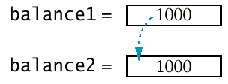
Copying Numbers
double balance1 = 1000;
double balance2 = balance1;
balance2 = balance2 + 500;
Change in balance2 does not affect balance1

Slide 5
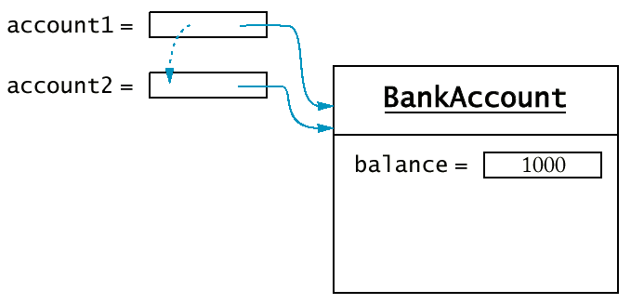
Copying Object References
BankAccount account1 = new BankAccount(1000);
BankAccount account2 = account1;
account2.deposit(500);
Change through account2 is also visible through account1

Slide 6
Variables in Method Calls
The way how the factual values are passed to methods in Java is called call-by-value;
This means that if a variable is passed to a method, the stored value of that variable in the calling method won’t be changed.
int n = 5;
do(n);
System.out.println(n);
static void do(int k)
{ k= k + 10;}

Slide 7
Variables in Method Calls
If non-reference variables are passed to a method, everything works as expected - the stored values of the variables won’t be changed.
int n = 5;
do(n);
System.out.println(n);
static void do(int k)
{ k= k + 10;}

Slide 8
Variables in Method Calls
If reference variables are passed to a method, the stored values of the variables (references to objects) won’t be changed. But, we can use the references inside the method to change the instance fields of the object.
BankAccount myAccount = new BankAccount ();
System.out.print(myAccount.getBalance());// prints 0.0
changeObject(myAccount);
System.out.print(myAccount.getBalance());// prints 0.05
static void changeObject(BankAccount b)
{ p.deposit(0.05);}

Slide 9
Overview
Comparison of Non-Reference and Reference Variables.
Static Fields
Static Methods

Slide 10
Static Fields
Static (Class) fields belongs to the class, not to any object of the class;
Static fields can be considered as fields that belong to all the objects of the class (black board)!
public class BankAccount
{ public BankAccount()
{ balance = 0;
lastAssignedNumber++;
accountNumber = lastAssignedNumber;
}
private static int lastAssignedNumber;
private int accountNumber;
private double balance;
}
Balance
accountNumber
lastAssignedNumber
Balance
accountNumber
Balance
accountNumber

Slide 11
Static Fields
There are three ways to initialize a static field:
  Do nothing (the default value is assigned);
  Use an explicit initializer;
  Use a static initialization block.
public class BankAccount
{ ……….
static
{ lastAssignedNumber = 0;
}
private static int lastAssignedNumber;
private int accountNumber;
private double balance;
}

Slide 12
Static and Instance Fields
Static (Class) fields belongs to the class, not to any object of the class;
Static fields can be considered as fields that belong to all the objects of the class (black board)!
Instance fields belongs to the object of the class;
Instance fields are hot shared between the objects of the class!
lastAssignedNumber
Balance
accountNumber
Balance
accountNumber
Balance
accountNumber

Slide 13
Overview
Comparison of Non-Reference and Reference Variables.
Static Fields
Static Methods

Slide 14
Static Methods
Static (Class) methods are those methods that do not have an implicit parameter; i.e., they do not operate on objects;
To define a static method, use the keyword static;
To call a static method, use the name of the class and the name of the method:
  <Class Name>.<Method Name>(<parameter List>)
Example: Math.sqrt(4.5);

Slide 15
Example
public class Numeric
{ public static boolean equal(double x, double y)
{
final double EPSILON = 1E-14;
if (x == 0) return Math.abs(y) <= EPSILON;
if (y == 0) return Math.abs(x) <= EPSILON;
return Math.abs(x - y) /
Math.max(Math.abs(x), Math.abs(y))
<= EPSILON;
}
}
Too many static methods are a sign of too little OO!

Slide 16
Static and Instance Fields and Methods
Rules:
Instance and static fields can be used from non-static methods;
Static fields can be used from static methods;
Instance fields cannot be used from static methods.

Slide 17
Static and Instance Fields, and Static and Instance Methods
public class BankAccountS
{ public BankAccountS()
{ lastAssignedNumber++;
accountNumber = lastAssignedNumber;
}
public void withdraw(double amount)
{ balance = balance - amount; }
public static int getNumberAccounts()
{ return lastAssignedNumber; }
…………
private static int lastAssignedNumber = 0;
private int accountNumber;
private double balance = 0;
}

Slide 18
Concepts Covered in the Lecture
Comparison of Non-Reference and Reference Variables.
Static Fields
Static Methods

