Slide 1
Computer Science 2
Lecture 1: Part 1
Objects and Classes

Slide 2
Overview
Problem Analysis
Objects and Classes
Class Elements: Instance Fields, and Methods
Encapsulation Principle
Object Creation
Class Run
Overloading Methods, Variable Initialization and Lifetime
Commenting Public Interface
Class Import
Approach to Design and Implement Classes

Slide 3

Problem
We have to write a program for a bank. The program has to allow a user to deposit and withdraw money from her bank account.

Slide 4
Problem Analysis
When we analyze a problem domain we identify:
Objects;
Possible states of the objects; and
Relationships between the objects.
In addition, we identify classes. A class is a set of objects in the problem domain that are unified by a reason. A reason may be a similar appearance, structure, or function.
Example. The set: {children, photos, cat, diplomas} can be viewed as a class “Most important things to take out of your apartment when it catches fire”.

Slide 5
Problem Analysis
For our problem domain we may find:
Bank-account objects;
the state of a Bank Account object is determined by the balance (the amount of money in the account);
a class Bank Account.
We assume that the bank accounts are not related. Thus, since we don’t have other classes of objects, no object relationships appear in our analysis.
Balance
Bank Account

Slide 6
Overview
Problem Analysis
Objects and Classes
Class Elements: Instance Fields, and Methods
Encapsulation Principle
Object Creation
Class Run
Overloading Methods, Variable Initialization and Lifetime
Commenting Public Interface
Class Import
Approach to Design and Implement Classes

Slide 7
Objects in OO Languages
Objects identified during problem analysis are represented as Objects in OO languages;
An object in OO languages consists of data encapsulated with a set of methods which operate only on these data;
The data of an object determine the state of the object;
The methods associated with an object can change the state of the object or can determine relationships of the object with other objects.

Slide 8
Example: Objects in OO Languages
In our case a Bank Account object consists of a double variable Balance:
  A variable is an item of information in memory whose location is identified by a symbolic name.
The object is associated with three methods: deposit, withdraw and getBalance.
Methods
deposit
withdraw
getBalance
double balance
Bank Account

Slide 9
Classes in OO Languages
Classes identified during problem analysis are represented as Classes in OO languages;
A class in OO languages is the prototype for the objects it represents.
The structure of a class is determined by:
  the instance fields which represent the state of an object of that class;
  the methods associated with the objects the class represents.

Slide 10
Example: Classes in OO Languages
public class BankAccount
{ public BankAccount(double initialBalance)
{ balance = initialBalance;
}
public void deposit(double amount)
{ double newBalance = balance + amount;
balance = newBalance;
}
public void withdraw(double amount)
{ double newBalance = balance - amount;
balance = newBalance;
}
public double getBalance()
{ return balance;
}
private double balance;
}

Slide 11
Overview
Problem Analysis
Objects and Classes
Class Elements: Instance Fields, and Methods
Encapsulation Principle
Object Creation
Class Run
Overloading Methods, Variable Initialization and Lifetime
Commenting Public Interface
Class Import
Approach to Design and Implement Classes

Slide 12
Instance Fields
Instance fields are variables that store the states of the objects.
An instance field declaration consists of:
access specifier (such as private or public);
type of variable (such as double);
name of variable (such as balance).
<access specifier> <variable type> <variable name>;
public class BankAccount
{ ……………………
private double balance;
}

Slide 13
Instance Methods
The methods change the object state or compute the relationships with other objects. A method definition in a class consists of:
access specifier (such as public);
return type (such as double or void);
method name (such as withdraw);
list of parameter variables (empty for getBalance());
method body in { }.
<accessSpecifier> <returnType> <methodName> (<Type> <Name>,...)
{
<method body>
}
public double getBalance()
{ return balance;}
The definitions of all the methods of a class is the public interface of the class!

Slide 14
The Return Statement
The return statement returns a value of an expression and exits the method immediately.
If the type of the method is different from void then the returned value has to be of the same type as the type of the method.
return <expression>;
public double getBalance()
{ return balance; }
……………………
private double balance;

Slide 15
The Return Statement
If the type of the method is void then there is no returned value: return;
public void deposit(double amount)
{ double newBalance = balance + amount;
balance = newBalance;
}
public void deposit(double amount)
{ double newBalance = balance + amount;
balance = newBalance;
return;
}

Slide 16
Example: Methods
public class BankAccount
{ ………………
public void deposit(double amount)
{ double newBalance = balance + amount;
balance = newBalance;
}
public void withdraw(double amount)
{ double newBalance = balance - amount;
balance = newBalance;
}
public double getBalance()
{ return balance;
}
private double balance;
}

Slide 17
Parameter and Local Variables
Parameter variables are the variables in the method’s definition. When a method is called with factual values, their types have to match the types of the parameter variables!
Local variables are the variables defined in the method’s bodies.
public class BankAccount
{ ………………
public void withdraw(double amount)
{ double newBalance = balance - amount;
balance = newBalance;
}
…………….
}

Slide 18
Overview
Problem Analysis
Objects and Classes
Class Elements: Instance Fields, and Methods
Encapsulation Principle
Object Creation
Class Run
Overloading Methods, Variable Initialization and Lifetime
Commenting Public Interface
Class Import
Approach to Design and Implement Classes

Slide 19
Encapsulation
How an object performs its duties is hidden from the outside world.
  Methods can be used without the knowledge of the inner workings
  Inner workings can be modified without impacting use (as long as the interface is unchanged)

Slide 20
Example
public class BankAccount
{ public BankAccount(double nBalance)
{ balance = nBalance;
}
public void deposit(double amount)
{ double newBalance = balance + amount;
balance = newBalance;
}
public void withdraw(double amount)
{ double newBalance = balance - amount;
balance = newBalance;
}
public double getBalance()
{ return balance;
}
private double balance;
}
public class BankAccount
{ public BankAccount(double nBalance)
{ balance = nBalance;
}
public void deposit(double amount)
{ balance = balance + amount;
}
public void withdraw(double amount)
{ balance = balance - amount;
}
public double getBalance()
{ return balance;
}
private double balance;
}

Slide 21
Overview
Problem Analysis
Objects and Classes
Class Elements: Instance Fields, and Methods
Encapsulation Principle
Object Creation
Class Run
Overloading Methods, Variable Initialization and Lifetime
Commenting Public Interface
Class Import
Approach to Design and Implement Classes

Slide 22
Constructors
A class constructor is a special method that creates an object of the class and initializes instance variables.
A constructor has the same name as the class.
Unlike other methods constructors don’t have return type.
<access specifier> <class name> (<Type> <Name>,...)
{<constructor’s body>} ;
public class BankAccount
{ public BankAccount(double initialBalance)
{ balance = initialBalance;
}
…………………
private double balance;
}

Slide 23
Operator new
The new operator creates an object of a class using the class constructor and returns the object reference.
We create an object with new as follows:
  We type the new keyword;
  We give the name of the class;
  We supply construction parameters (if any).
BankAccount
balance = 500
Example.
new BankAccount(500);

Slide 24
Reference Variables
To manipulate the object, its reference has to be stored in an reference variable.
The type of the reference variable has to match the type of the object created.
To be able to use an object we execute 4 steps:
  Define a reference variable; (doesn’t create the object)
  Construct an object with the new operator;
  Store the object location in a reference variable;
  Call methods on the object variable.
BankAccount myAccount;
myAccount = new BankAccount(500);
myAccount.deposit(500000);

Slide 25
Reference Variables and Object Manipulation
BankAccount myAccount;
myAccount = new BankAccount(500);
myAccount.deposit(400);
myAccount =
BankAccount
balance = 500
myAccount =
BankAccount
balance = 900
myAccount =

Slide 26
Multiple Object Variables
Multiple object references can contain reference to the same object.
BankAccount myAccount = new BankAccount(900);
BankAccount myNewAccount = myAccount;
BankAccount
balance = 900
myAccount =
myNewAccount =

Slide 27
Overview
Problem Analysis
Objects and Classes
Class Elements: Instance Fields, and Methods
Encapsulation Principle
Object Creation
Class Run
Overloading Methods, Variable Initialization and Lifetime
Commenting Public Interface
Class Import
Approach to Design and Implement Classes

Slide 28
Class Run: Option 1
Provide a main method into the class that is being run. The main method has:
  to construct one or more objects of the class;
  to invoke one or more methods;
  to print one or more results.
public class BankAccount
{ ………………
public static void main(String[] Args)
{ BankAccount b = new BankAccount(0);
b.deposit(100);
b.withdraw(50);
System.out.println(b.getBalance());
} …………….
}

Slide 29
Class Run: Option 2
Provide a running class with the same main method.
To run, combine the class to be run and the running class:
  Make a new subfolder;
  Make two files, one for each class;
  Compile both files;
  Start the running class.
public class BankAccountRun
{ public static void main(String[] Args)
{ BankAccount b = new BankAccount(0);
b.deposit(100);
b.withdraw(50);
System.out.println(b.getBalance());
}
}

Slide 30
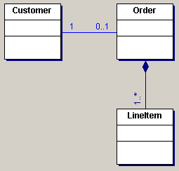
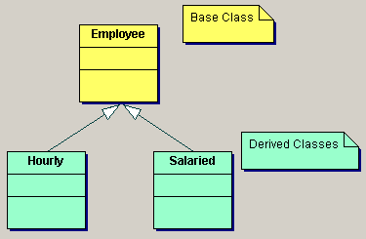
Object-Oriented Programming
Since we have the test program, a program that manipulates with objects, we can define Object-oriented programming.
Object-oriented programming is a discipline of programming where each program is a simulation of the domain of interest. The program is populated by objects, and these objects communicate with one another to solve a problem using methods.

Slide 31
Overview
Problem Analysis
Objects and Classes
Class Elements: Instance Fields, and Methods
Encapsulation Principle
Object Creation
Class Test
Overloading Methods, Variable Initialization and Lifetime
Commenting Public Interface
Class Import
Approach to Design and Implement Classes

Slide 32
More about Constructors
A class can have no constructors, one constructor, or more than one constructor.
A constructor is supposed to initialize all the instance fields. If not, then these variables receive their default values:
  Numerical fields receive value 0 (0.0);
  Reference fields receive value null.
public class BankAccount
{ public BankAccount()
{ balance = 0.0;}
public BankAccount(double initialBalance)
{ balance = initialBalance;}
…………..
private double balance;
}

Slide 33
Overloading
Overloaded methods are methods with the same name but different parameter types.
  If we have new BankAccount(), then the first constructor is called;
  If we have new BankAccount(20), then the second constructor is called;
  If we have new BankAccount(“abba”), then the compiler generates error.
public class BankAccount
{ public BankAccount()
{ balance = 0.0;}
public BankAccount(double initialBalance)
{ balance = initialBalance;}
…………..
private double balance;
}

Slide 34
More about Variables:
Explicit and Implicit Parameters
A parameter is explicit if it is explicitly named in the method definition. Otherwise, it is called an implicit parameter.
Example:
public class BankAccountTest
{ public static void main(String[] Args)
{ BankAccount b = new BankAccount(0);
b.deposit(100);
b.withdraw(50);
System.out.println(b.getBalance());
}
}
Implicit
Explicit

Slide 35
More about Variables:
Variable Types and Lifetime
Instance fields are created when the object is constructed. They ‘die’ when the object ‘dies’ (no object variable refers the object).
Local and parameter variables are created when the method starts. They ‘die’ when the method exits.
public class BankAccountTest
{ public static void main(String[] Args)
{ ………
b.deposit(100);
b = null;
………
}
}
public class BankAccount
{ ………………
public void deposit(double amount)
{ balance = balance + amount;}
private double balance;
}

Slide 36
More about Variables:
Variable Types and Initialization
Instance fields are initialized by the constructor. If not, the variables receive their default values:
  Numerical fields receive value 0 (0.0);
  Reference fields receive value null.
public class BankAccount
{ ………………
private double balance;
private String name;
}
public class BankAccountTest
{ public static void main(String[] Args)
{………
BankAccount accnt = new BankAccount();
………
}
}
balance = 0
name = null

Slide 37
More about Variables:
Variable Types and Initialization
Parameter variables are initialized with the values supplied in the method call. Thus, the call has to be correct. Otherwise, the compiler generates an error.
public class BankAccountTest
{ public static void main(String[] Args)
{ BankAccount b = new BankAccount(0);
b.deposit(100);
b.withdraw();
System.out.println(b.getBalance());
}
}
The compiler generates an error here!

Slide 38
More about Variables:
Variable Types and Initialization
Local variables are initialized in the method. Otherwise, the compiler generates an error.
public class BankAccount
{ …………
public void deposit(double amount)
{ double newBalance;
balance = newBalance;
}
……………
private double balance;
}
The compiler generates an error here!

Slide 39
Overview
Problem Analysis
Objects and Classes
Class Elements: Instance Fields, and Methods
Encapsulation Principle
Object Creation
Class Test
Overloading Methods, Variable Initialization and Lifetime
Commenting Public Interface
Class Import
Approach to Design and Implement Classes

Slide 40
Commenting the Public Interface
A documentation comment starts with /** and end with */.
For each method parameter you supply a line that starts with @param tag followed by the parameter name and description.
For each non-void method you supply a line that starts with @return tag followed by the parameter name and description.
When ready, start javadoc on your file.

Slide 41
Commenting the Public Interface
/**
A bank account has a balance that can be changed by deposits and withdrawals.
*/
public class BankAccount
{ ………..
/**
Constructs a bank account with a given balance
@param initialBalance the initial balance
*/
public BankAccount(double initialBalance)
{ balance = initialBalance;
}
…..
private double balance;
}

Slide 42
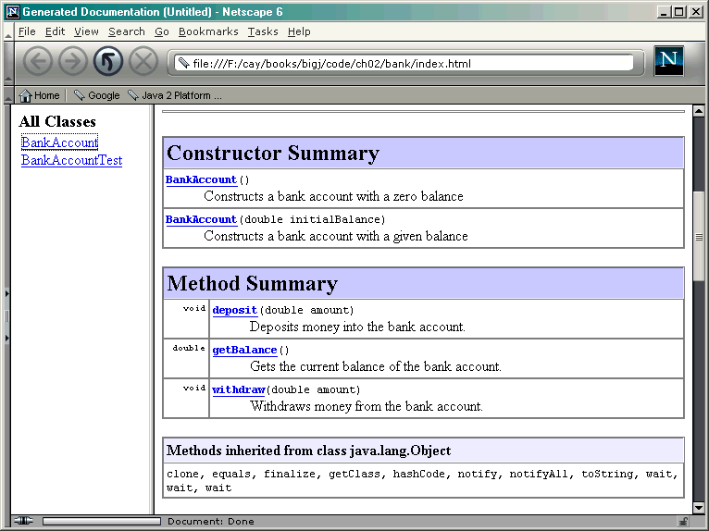
Commenting the Public Interface

Slide 43
Overview
Problem Analysis
Objects and Classes
Class Elements: Instance Fields, and Methods
Encapsulation Principle
Object Creation
Class Test
Overloading Methods, Variable Initialization and Lifetime
Commenting Public Interface
Class Import
Approach to Design and Implement Classes

Slide 44
Importing Classes from Packages
Java classes are grouped in packages. If you use a class from another package (other than the java.lang package), you have to import the class at the beginning of your program.
import <packageName>.<ClassName>;
Example:
  import java.awt.Rectangle;
  import java.awt.*; (import all the classes)

Slide 45
Overview
Problem Analysis
Objects and Classes
Class Elements: Instance Fields, and Methods
Encapsulation Principle
Object Creation
Class Test
Overloading Methods, Variable Initialization and Lifetime
Commenting Public Interface
Class Import
Approach to Design and Implement Classes

Slide 46
Designing and Implementing Classes
Find out what you are asked to do with an object of the class.
Suppose you implement a Person class. The application to be written requires:
    To get the name of the person;
    To set a new name of the person .

Slide 47
Designing and Implementing Classes
Find names for the methods
Come up with the method names and apply them to a sample object, like this:
Person suspect = new Person(“John Lee”);
suspect.getName();
suspect.setName(“John Smeet”);

Slide 48
Designing and Implementing Classes
Document the public interface
public class Person
{ /**
Set new name of the person
@param name new name of the person
*/
public void setName(String newName)
{}
/**
Get the name of the person
@return the name of the person
*/
public String getName()
{}
}

Slide 49
Designing and Implementing Classes
Determine instance variables
private String name;

Slide 50
Designing and Implementing Classes
Determine constructors
/**
Constructs a new person object
@param name name of the person
*/
public Person(String newName)
{
name = newName;
}

Slide 51
Designing and Implementing Classes
Implement methods; i.e., the class is ready.
/**
Set new name of the person
@param name new name of the person
*/
public void setName(String newName)
{
name = newName;
}
/**
Get the name of the person
@return the name of the person
*/
public String getName()
{
return name;
}

Slide 52
Designing and Implementing Classes
Test your class
public class BankAccountTest
{
public static void main(String[] Args)
{
Person suspect = new Person(“John Lee”);
System.out.println(suspect.getName());
suspect.setName(“John Smeet”);
System.out.println(suspect.getName());
}
}

Slide 53
Concepts Covered in the Lecture
Problem Analysis
Objects and Classes
Class Elements: Instance Fields, and Methods
Encapsulation Principle
Object Creation
Class Test
Overloading Methods, Variable Initialization and Lifetime
Commenting Public Interface
Class Import
Approach to Design and Implement Classes

