Slide 1
ML-Lifecycle-Overview (using Sagemaker Built-In-Algorithms)
By
Prudhvi Nokku

Slide 2
Current Scenario
There will be sagemaker Notebooks in which logic is written by datascience team where output artifacts like model, other artifacts are stored in s3.Then Mlops team productionize model and send to Sysops team for model maintenance.
Problems:
There is no automation in some tasks related to preprocessing ,training by datascience team which may lead to issue when retraining or generating same model artifacts again .There will also an issue in tracing the changes occurred during preprocessing/training.
There is no orchestration between different tasks of preprocessing and training which may lead to manual intervention to again generate the same model artifacts or to retrain the model
There is no proper CI/CD approach to deliver the model effectively to production with proper quality gates
There need to rework need to be done by MLOps engineers to productionize the tasks

Slide 3
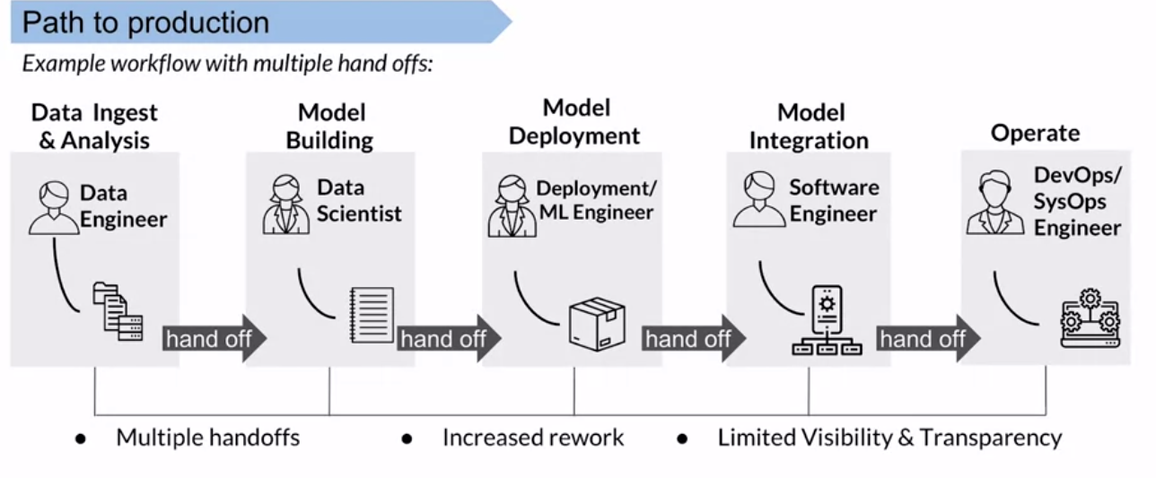
Current Scenario( one of the problem)

Slide 4
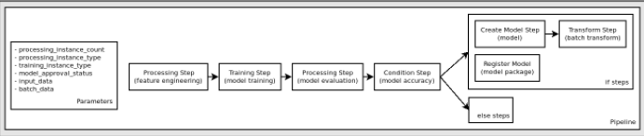
Introducing automation and orchestration
We can achieve automation and orchestration between tasks using sagemaker pipelines

Slide 5
Sagemaker pipelines
Although it solves the problem of automation and orchestration , there are still some problems like:
There is no proper CI/CD approach to deliver the model effectively to production with proper quality gates(Approvals)
There need to rework need to be done by MLOps engineers to productionize the tasks

Slide 6
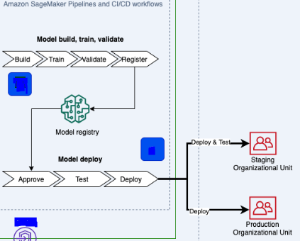
CI/CD using github,codebuild,codepipeline

Slide 7
CI/CD using github,codebuild,codepipeline
Although this approach solves CI/CD pipeline
There is still rework need to be done by MLOps engineers to productionize the tasks

Slide 8
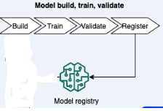
Sagemaker projects
Using this approach we can give customized mlops templates for training to datascients so that they can utilize them during development
Note: This below sagemaker project is in addition to before mentioned CI/CD pipelines for training and deployment using sagemaker-pipelines,codebuild,codepipeline

Slide 9
