Slide 1
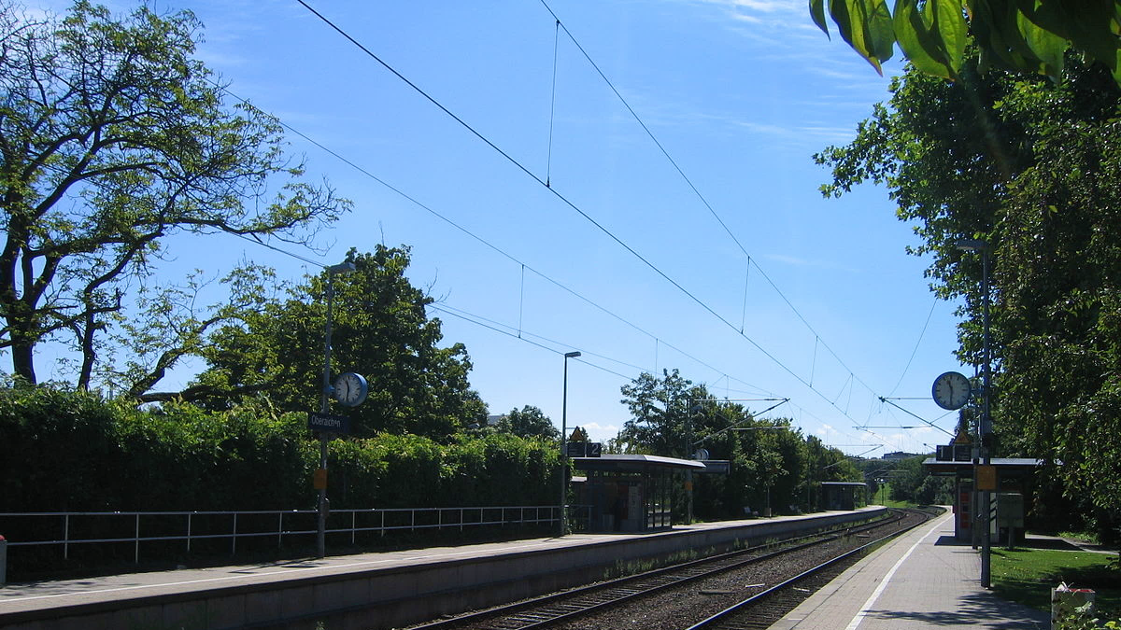

Team 1: Nils Ayral, Michael Kampmann
Title: Fantastic Trains and when to find them
Motivation: Research causalities and bottlenecks to improve the Bahn infrastructure
Stakeholder: Deutsche Bahn
Goal: Analyse delay patterns for geographical and chronical causalities and/or bottlenecks to predict future delays from a momentary snapshot.
Methods: EDA, Random Forest, ANN, Time Series Analysis (?), K-mean

