Slide 1
MSSIA
Multi-Sensor Spatial Intelligence and Analytics Platform
"Every building has invisible data — MSSIA makes it visible."
Nokuvimba Natalie Chiyaka
Bachelor of Engineering (Honours) in Software and Electronic Engineering
Atlantic Technological University · 2025/2026
Project Engineering · Year 4

Slide 2
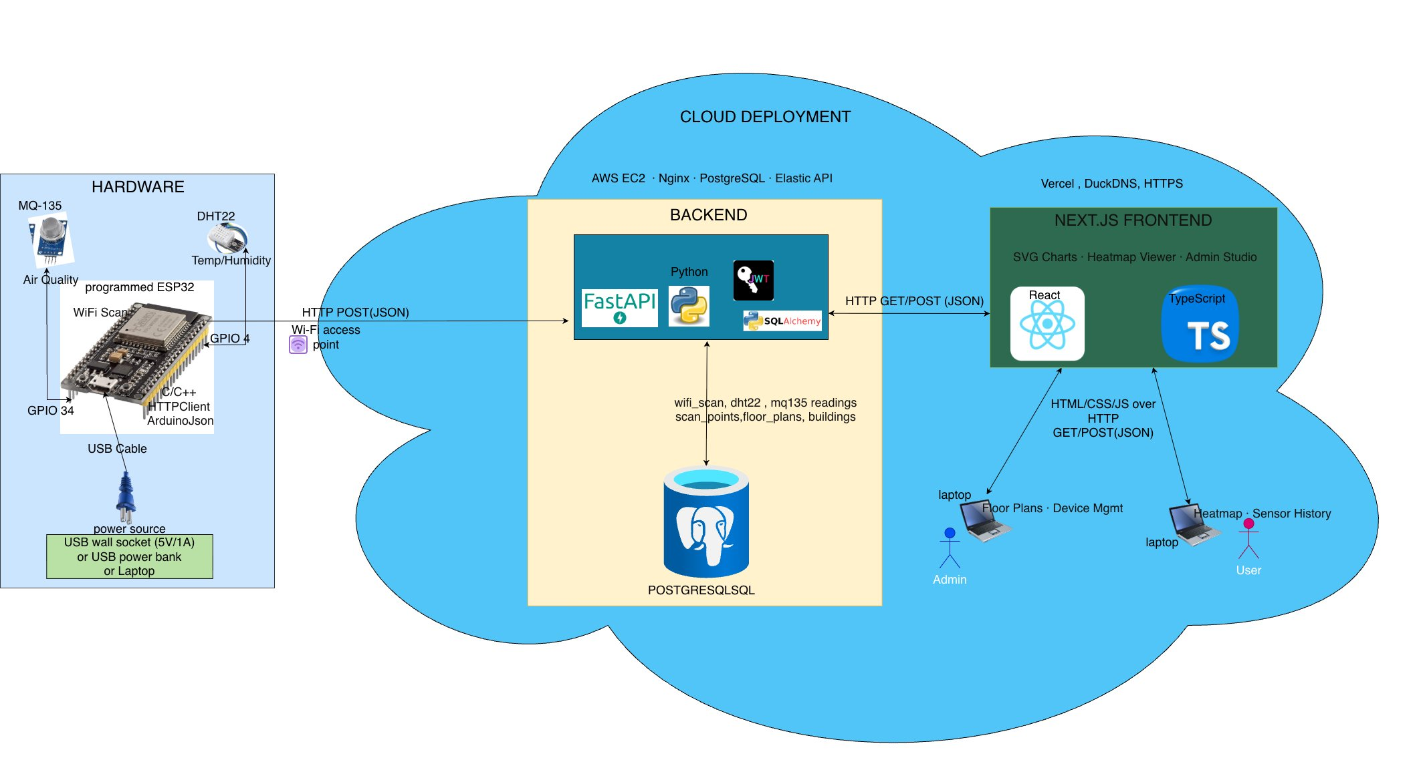
MULTI-SENSOR SPACIAL INTELLIGENCE & ANALYTICS PLATFORM· MSSIA
Nokuvimba · B.Eng Software & Electronic Engineering · ATU Galway · 2026

Slide 3
Project Organisation
How the project was planned, tracked, and managed throughout development
📋 Jira
📓 OneNote
🐙 GitHub
Sprint-based Agile workflow
Epics broken into user stories & tasks
Bug tracking & backlog management
Weekly sprint reviews to adjust priorities
Research notes & literature review
Meeting notes from supervisor sessions
Prompt log documentation
Design decisions & reasoning records
Version control for all code changes
Feature branch workflow
Commit history as dev timeline
README & project documentation

Slide 4
Technologies Used
🔧 HARDWARE
⚙️ BACKEND & DATABASE
🖥️ FRONTEND & CLOUD
ESP32 Microcontroller
C/C++ · Arduino framework
DHT22 – Temp & Humidity
MQ-135 – Air Quality
Wi-Fi scanning via HTTPClient
ArduinoJson · GPIO pins 4 & 34
FastAPI (Python 3)
SQLAlchemy ORM
PostgreSQL database
JWT authentication
AWS EC2 · Nginx · Elastic IP
DuckDNS · Let's Encrypt HTTPS
Next.js 16 · React 18
TypeScript
Custom SVG charts
Heatmap visualisation
Vercel (deployment)
Admin Studio + Floor Plans UI
🤖 AI TOOLS USED
Claude Main dev — code, debug & docs
ChatGPT Early brainstorming & documentation
Amazon Q CLI edits & error detection
Figma AI UI prototypes & DB schemas

Slide 5
Key Challenges & How I Solved Them
🗄️ Database — 3-Stage Evolution
Stage 1 — scan_session + room_scan
Stage 2 — active_room (in-memory)
Stage 3 — scan_point (current)
wifi_scan → room_scan → scan_session → room
active_room_id variable → stamp room_id on /ingest
scan_point (x,y on map) → all sensors attach via scan_point_id
3 table hops · manual start/stop sessions
2-table query · no sessions · one API call
Sub-room precision · extensible to any sensor
☁️ Cloud Deployment — AWS Amplify → Vercel + EC2
BEFORE — AWS Amplify
AFTER — Vercel + AWS EC2 + DuckDNS
Build failures — Next.js version conflicts
No control over env config · tightly coupled
Frontend → Vercel · Backend → EC2 + Nginx + systemd
DuckDNS + Let's Encrypt → free HTTPS custom domain

Slide 6
Testing Strategy
Four layers of testing to validate correctness, behaviour, and usability
🧪 Unit Tests
🎭 End-to-End Tests
Tool: pytest
Tool: Playwright
Tested individual FastAPI route handlers and database functions in isolation. Verified CRUD operations for buildings, rooms, and scans with mock sessions. Ensured edge cases (missing data, duplicates) returned correct HTTP status codes.
Simulated real user flows through the browser — logging in, navigating to a building, viewing rooms, and triggering scan start/stop. Verified the full stack from frontend click to database write.
⚙️ UI / Component Tests
👤 Manual Tests
Tool: Jest
Tool: Live system
Tested React components in isolation using Jest. Verified that UI elements render correctly with given props, that loading/error states are handled, and that buttons trigger the right callbacks.
Hands-on testing of the full system with a real ESP32 device. Verified that scans appeared in the correct room, the heatmap updated in real time, and the admin controls responded as expected.

Slide 7
System Flow — How Data Moves
ESP32
Node
Wi-Fi
Access Point
FastAPI
Backend
PostgreSQL
Database
Next.js
Frontend
C/C++ · Arduino
HTTP POST (JSON)
Python · SQLAlchemy
scan_point · wifi_scan
dht22 · mq135
React · TypeScript
🗺️ Admin — Place Scan Point
4 Heatmap Types:
Upload floor plan → Click floor plan → pin (x, y) coordinate → assign ESP32 node ID
All sensor data from that device references this scan_point_id
📶 Wi-Fi Signal · RSSI dBm
🌡️ Temperature · °C DHT22
💧 Humidity · %RH DHT22
🌫️ Air Quality · ppm MQ-135
👤 User View — accessible from any browser, no install required
🗺️
📶
🌡️
💧
🌫️
Floor plan
+ heatmap overlay
Wi-Fi RSSI
per scan point
Temperature
history chart
Humidity
history chart
Air quality
history chart

Slide 8
Conclusion
MSSIA — Multi-Sensor Spatial Intelligence & Analytics Platform
proves that a single generic platform can ingest readings from any sensor, map them spatially onto a floor plan, and visualise them as live interactive heatmaps accessible from any browser. The four sensor types demonstrated (Wi-Fi, Temperature, Humidity, Air Quality) each produce distinct colour-differentiated heatmaps — confirming the concept works end-to-end from hardware to cloud to user. Unlike commercial systems such as NetSpot which focus only on Wi-Fi, MSSIA is not limited to a single data type. Built from open-source hardware and free-tier cloud services, it delivers comparable insight at a fraction of the cost.
📡 Full IoT Pipeline Built
ESP32 → FastAPI → PostgreSQL → Next.js — deployed live on Vercel + AWS EC2.
🗄️ 3-Stage Database Evolution
scan_session → active_room → scan_point. Each step simpler and more powerful.
☁️ Cloud Deployment Solved
Frontend on Vercel, backend on EC2 + Nginx + DuckDNS + HTTPS — fully live.
🧪 Multi-Layer Testing
Unit (pytest), E2E (Playwright), UI (Jest), and manual — across the full stack.
🤖 AI-Assisted Development
Claude, ChatGPT, Amazon Q, and Figma AI — used responsibly with full prompt logs.

Slide 9

Try It Live
Scan the QR code or visit the link below
final-year-project-alpha-azure.vercel.app

Slide 10
Thank you for listening
Any Questions?

