Slide 1
⛳
Golf Performance Analytics
Regression Analysis of Scoring, Putting & Driving
Statistical Analysis of PGA Tour Performance Metrics
RESEARCH QUESTIONS • Q1 • Q2 • Q3

Slide 2
Research Questions Overview
Q1
Putting vs. Driving: Which Has a Stronger Impact on Scoring?
Comparing regression models to evaluate which skill type is more predictive of score.
Q2
Which Variables Are Statistically Significant with the Largest Coefficients?
Analyzing regression output for significance levels and effect sizes across all metrics.
Q3
Do Top Earners Share Similar Performance Characteristics?
Investigating whether success is driven by balanced skills or dominance in a single area.
Golf Performance Analytics

Slide 3
RESEARCH QUESTION 1
Putting vs. Driving:
Which Has a Stronger Impact on Scoring?
Comparing regression models across putting accuracy and driving distance metrics

Slide 4
Q1 — Putting vs. Driving: Key Findings
Q1
Putting shows a stronger and more consistent relationship with scoring,
while driving distance has a weaker and less differentiating impact.
🟢 PUTTING (Stronger Impact)
⚪ DRIVING (Weaker Impact)
• Statistically significant regression coefficients
• Consistent relationship across player skill levels
• Higher R² — explains more variance in scoring
• Putts per round directly tied to lower scores
• Strong predictor across both regression models
• Weaker regression coefficients overall
• Less differentiating across player tiers
• Lower R² — explains less scoring variance
• Distance alone doesn't consistently lower scores
• More indirect path to scoring outcomes
Golf Performance Analytics

Slide 5
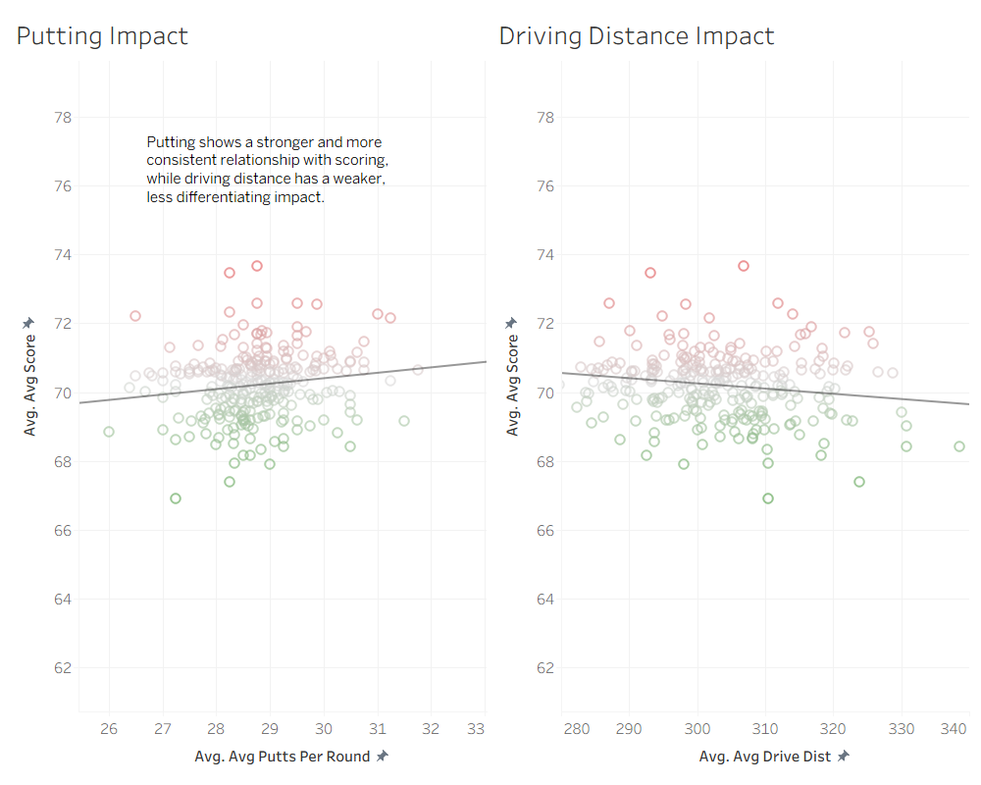
Q1 — Regression Scatter: Putting vs. Driving Distance
Q1
Golf Performance Analytics

Slide 6
RESEARCH QUESTION 2
Statistical Significance
& Largest Regression Coefficients
Which variables best explain scoring differences across PGA Tour players?

Slide 7
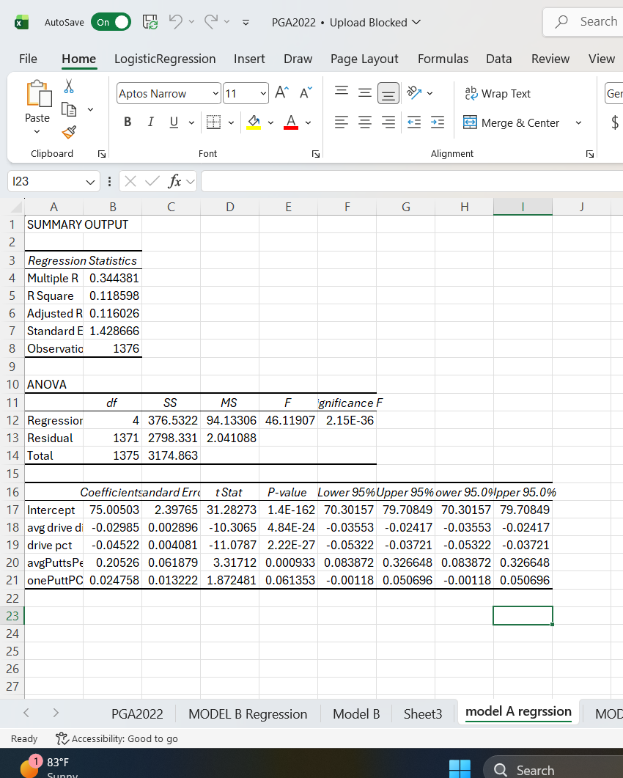
Q2 — Model A: Full Regression Output
Q2
KEY VARIABLE FINDINGS
Putting (Strongest)
Avg Putts Per Round: coeff +0.205, p=0.0009. Largest effect — more putts = meaningfully higher score average.
Drive Accuracy (Important)
Drive Pct: coeff −0.045, p<0.001. Higher accuracy = better (lower) scores. Second most impactful variable.
Drive Distance (Moderate)
Avg Drive Dist: coeff −0.030, p<0.001. Statistically significant but smaller effect than accuracy.
One-Putt % (Not Significant)
Coeff +0.025, p≈0.061. Falls just outside the 0.05 threshold — not reliably predictive when other variables are present.
Model R² = 0.1186 — ~11.9% of scoring variation explained; additional factors contribute beyond these metrics.
Golf Performance Analytics

Slide 8
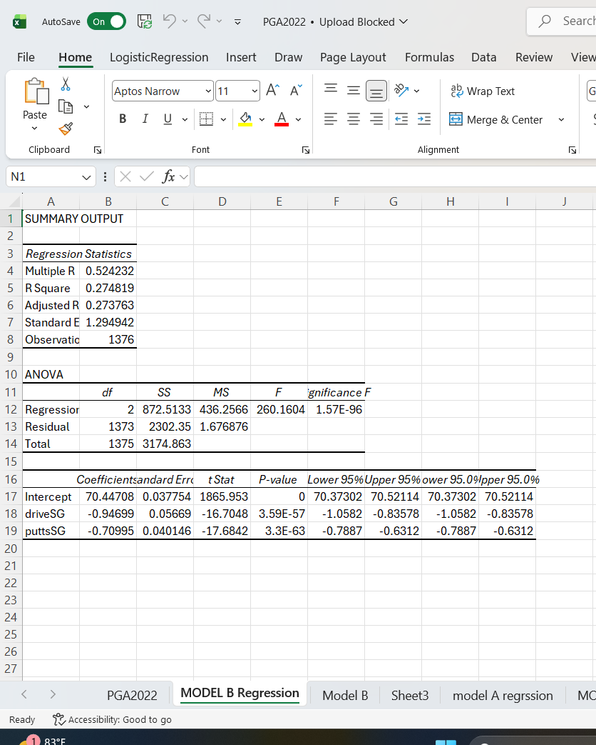
Q2 — Model B: Strokes Gained Regression
Q2
MODEL B FINDINGS
Putting SG — Significant
puttsSG: coeff −0.710, p=3.3E-63. Each unit improvement in strokes gained putting lowers score average by ~0.71 strokes. Highly significant.
Driving SG — Significant
driveSG: coeff −0.947, p=3.6E-57. Larger coefficient than putting but similar direction — gaining strokes off the tee strongly lowers scores.
Model Fit (R² = 0.274)
Model B explains 27.4% of scoring variance — more than Model A. Strokes gained metrics capture performance quality more precisely than raw stats.
Overall Conclusion
Both SG metrics are significant. Putting SG has a slightly smaller raw coefficient but both are equally critical to scoring.
Golf Performance Analytics

Slide 9
Q2 — Summary: What the Regression Tells Us
Q2
VARIABLE IMPACT RANKING
FULL ANALYSIS
1
Putting
Using the full regression model (Model A), putting has the strongest impact on scoring, as it has the largest coefficient (0.205) and is statistically significant. This indicates that an increase in putts per round leads to a meaningful increase in scoring average.
Driving accuracy is the next most important factor, with a negative coefficient (−0.045), showing that higher accuracy is associated with better (lower) scores.
Driving distance also has a statistically significant negative effect (−0.029), but its impact is smaller than accuracy.
One-putt percentage was not statistically significant (p ≈ 0.06), suggesting it does not meaningfully influence scoring when other variables are considered.
The model explains approximately 11.9% of the variation in scoring (R² = 0.1186), indicating that additional factors beyond these metrics also contribute to performance.
Strongest → biggest impact on score average
2
Drive Accuracy
Important → more accurate = better scores
3
Drive Distance
Moderate → helps, but smaller effect
4
One-Putt %
Not Significant → not reliable predictor
Golf Performance Analytics

Slide 10
RESEARCH QUESTION 3
Do Top Earners Share
Similar Performance Profiles?
Justin Thomas · Scottie Scheffler · Will Zalatoris — top-3 earning players compared across key metrics

Slide 11
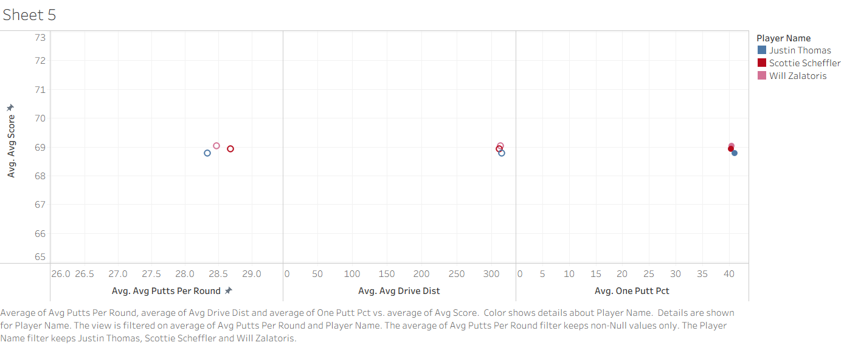
Q3 — Top Earners: Multi-Metric Comparison
Q3
Putts / Round
Drive Distance
One-Putt %
All 3 cluster tightly ~28–28.5. Nearly identical putting volume.
Clustered near 310 yds. No significant separation between top earners.
Grouped around 40%. Again tightly clustered — shared trait.
Golf Performance Analytics

Slide 12
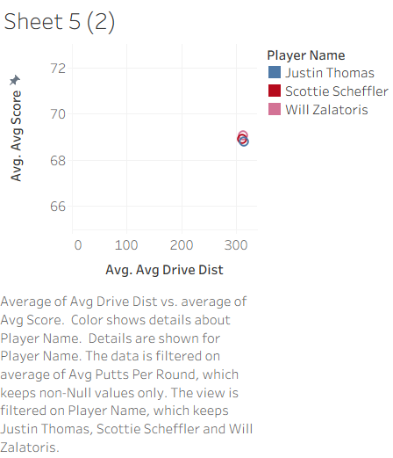
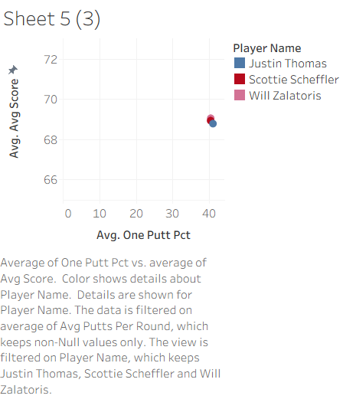
Q3 — Drive Distance & One-Putt % Detail View
Q3
Golf Performance Analytics

Slide 13
Q3 — Do Top Earners Share a Performance Profile?
Q3
Yes — top earners cluster closely on every key metric, suggesting success is driven
by a balanced, well-rounded skill set rather than dominance in a single area.
Similar Putting Volume
Shared Drive Distance
Comparable One-Putt %
Justin Thomas, Scottie Scheffler, and Will Zalatoris all average ~28–28.5 putts per round — virtually identical. Elite putting is a shared baseline, not a differentiator.
All three cluster near 310 yards off the tee. No top earner significantly out-drives the others, suggesting distance alone is not the winning factor.
One-putt percentage is grouped around 40% for all three. Despite differing styles, their converting ability is similarly strong.
Balanced Skills Drive Elite Success
The tight clustering across putts per round, driving distance, and one-putt percentage indicates that the highest-earning PGA Tour players share a common performance profile. Rather than dominating in one area (e.g., being exceptional off the tee but average on the green), these players maintain strong, consistent performance across all key metrics. This supports the conclusion that elite scoring is the result of a balanced, multi-dimensional skill set.
Golf Performance Analytics

Slide 14
CONCLUSIONS & TAKEAWAYS
Key Insights from the Analysis
Q1
Putting > Driving for Scoring
Putting has a stronger, more consistent statistical relationship with scoring. Driving distance is a weaker, less differentiating predictor across all regression models.
Q2
Putting & Driving Both Significant
Model A: Putting (0.205) has the largest coefficient; drive accuracy (−0.045) and distance (−0.030) follow. One-putt % is not significant. Model R² = 0.119.
Q3
Top Earners Share a Balanced Profile
Justin Thomas, Scottie Scheffler, and Will Zalatoris cluster tightly on every metric. Elite success is driven by balanced, multi-dimensional performance — not dominance in one area.
Golf Performance Analytics

