Slide 1
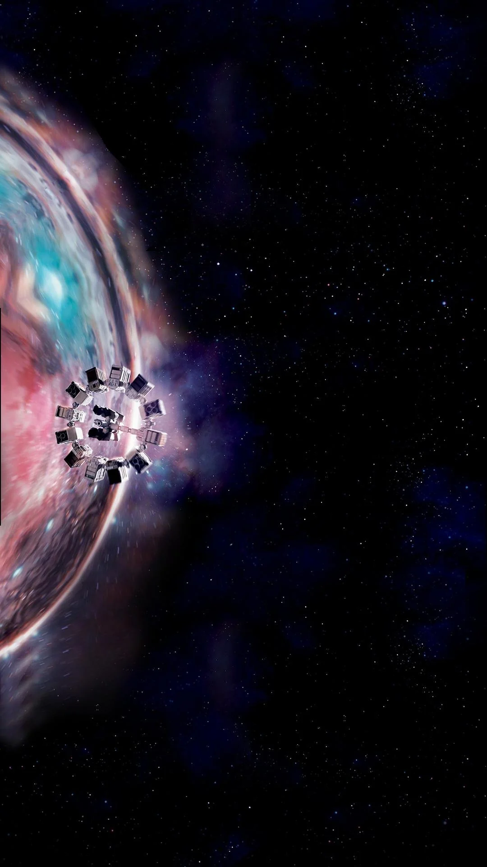
“Mankind was born on Earth. It was never meant to die here.” — Cooper, Interstellar

Slide 2
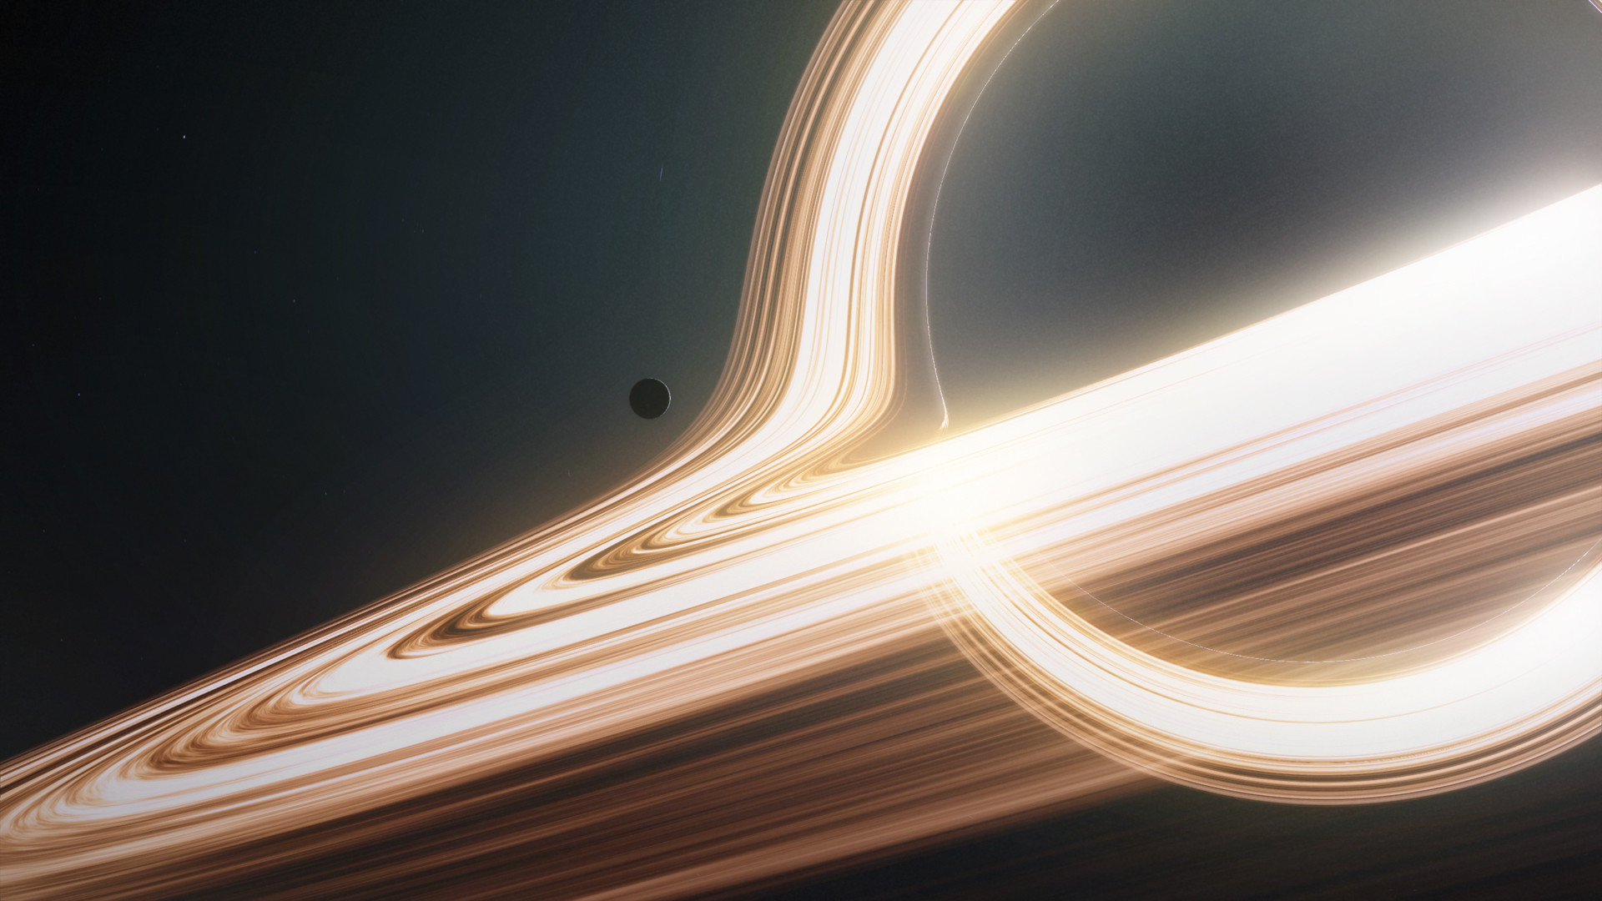
INTERSTELLAR (2014)
A Cosmic Parable of Love, Time,
and Survival
Mid-term Presentation | Presented by: Nuo, Xu

Slide 3
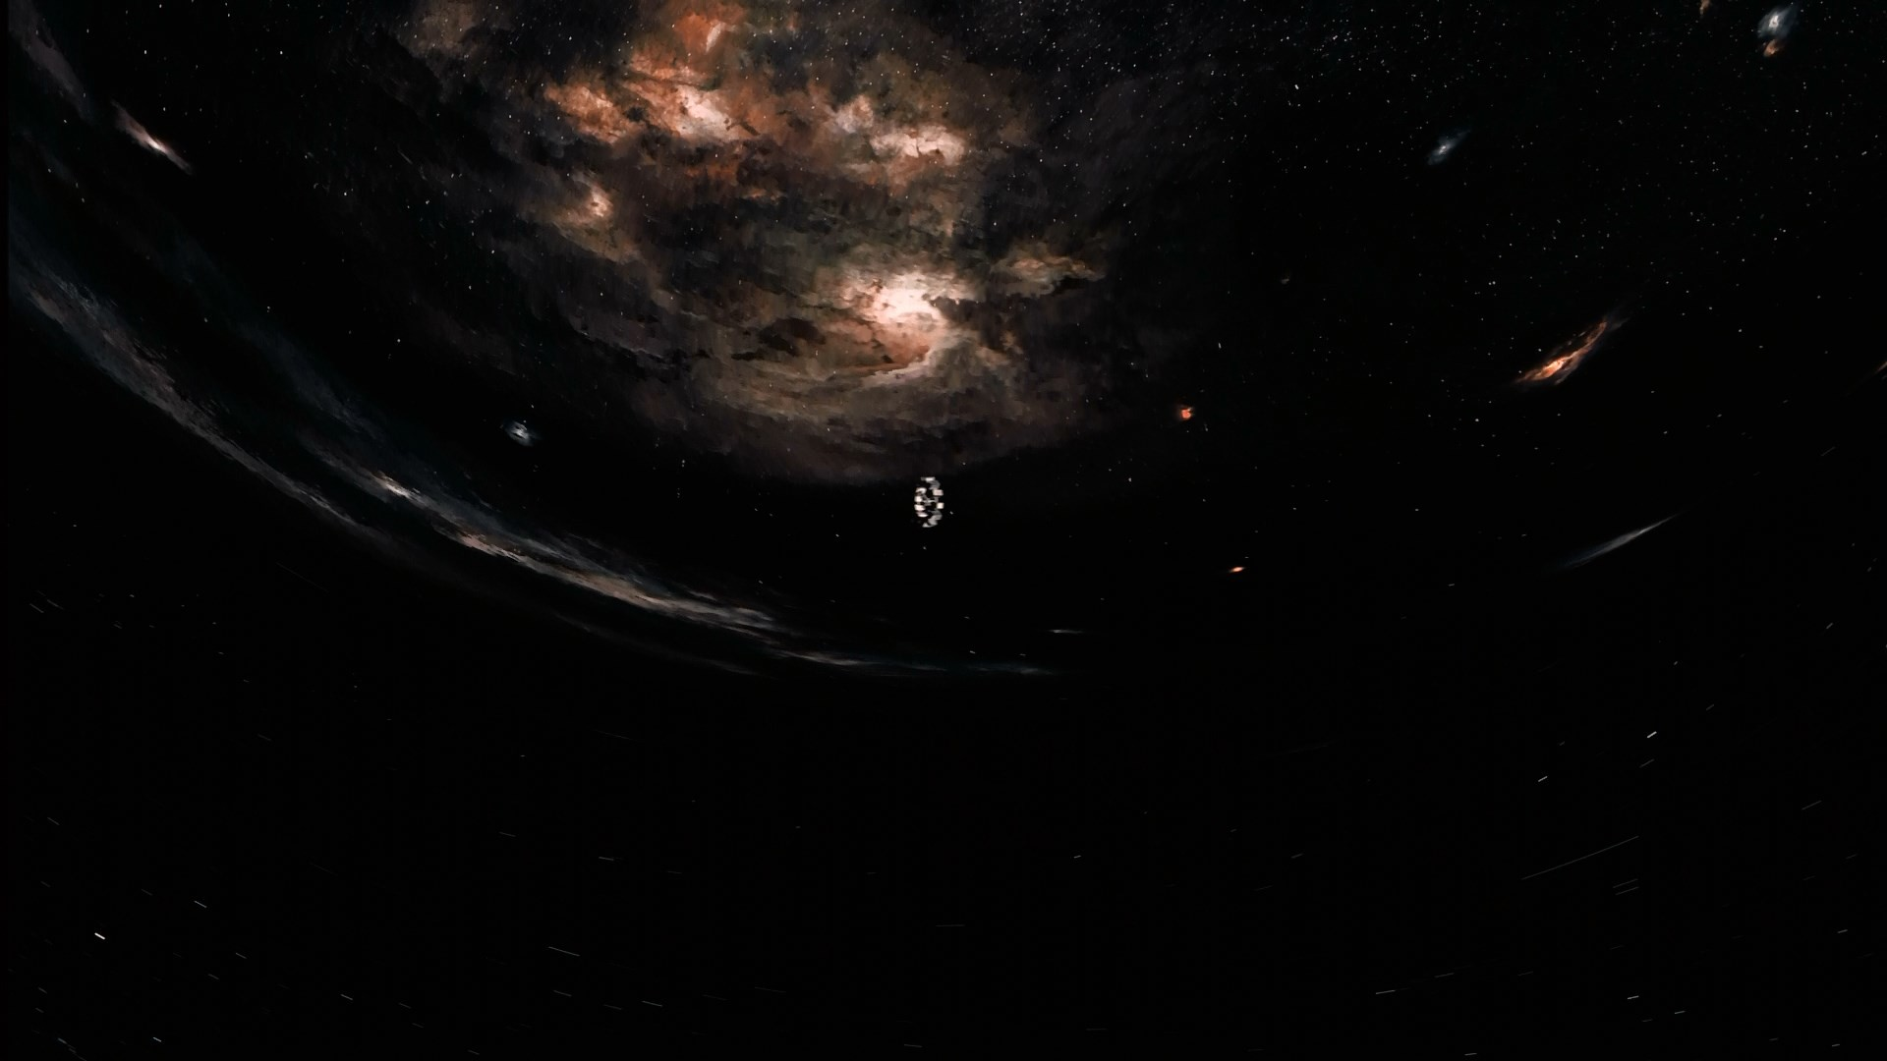
I. Introduction to INTERSTELLAR
II. Reception, Themes & Critique
III. Conclusion

Slide 4
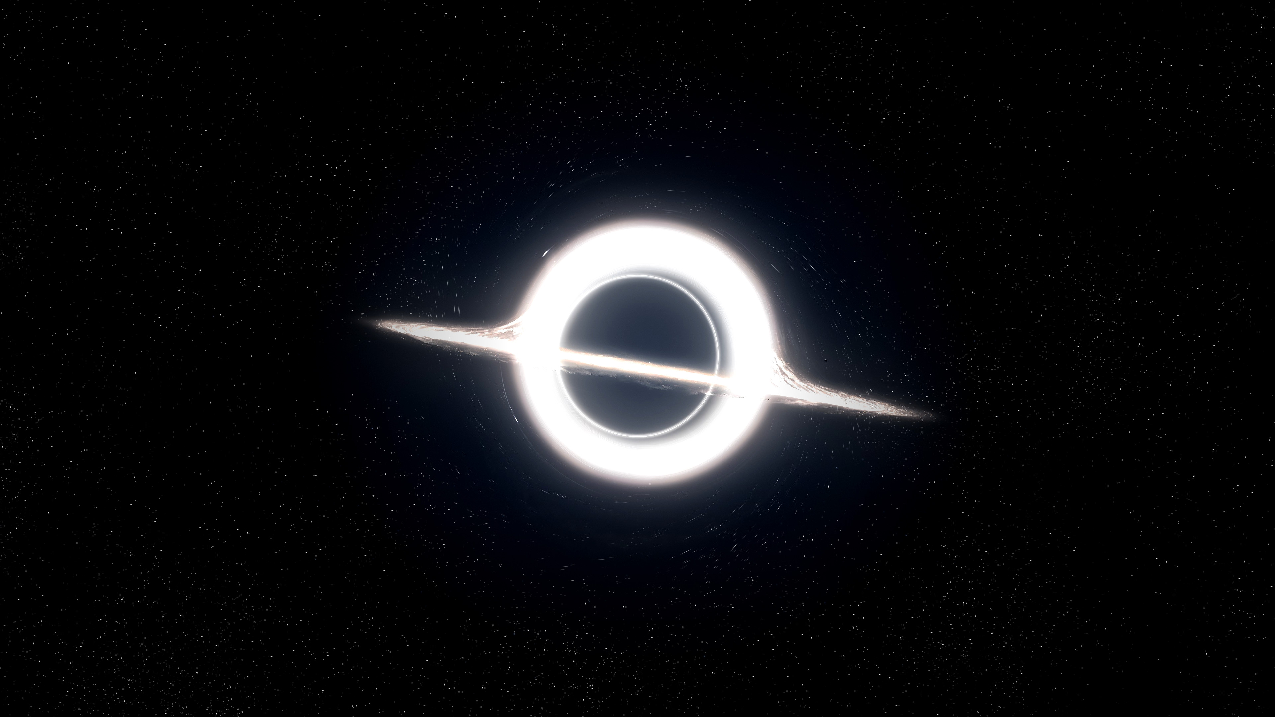
I. Introduction to INTERSTELLAR
Genre:
Science Fiction
Adventure
Cosmic Epic
Year: November 11, 2014
Medium: 2D
Director: Christopher Nolan

Slide 5
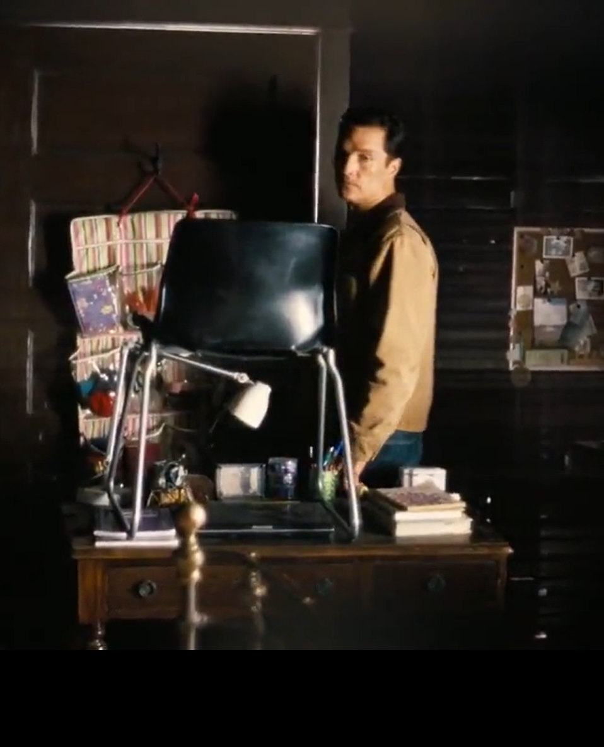
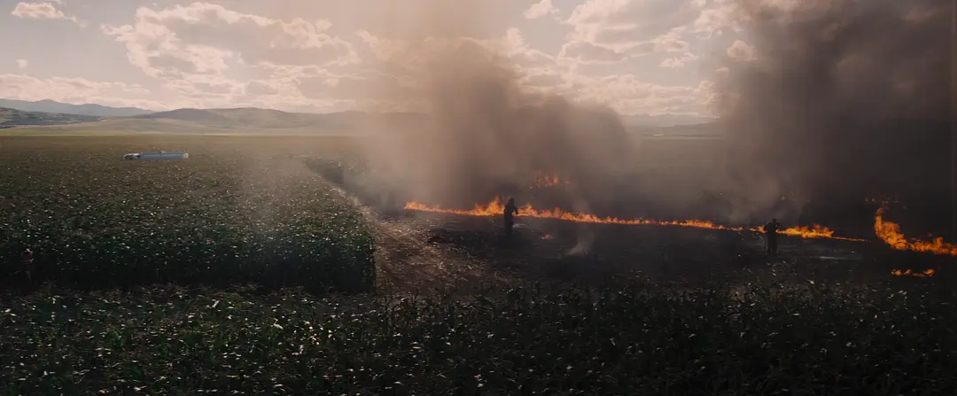
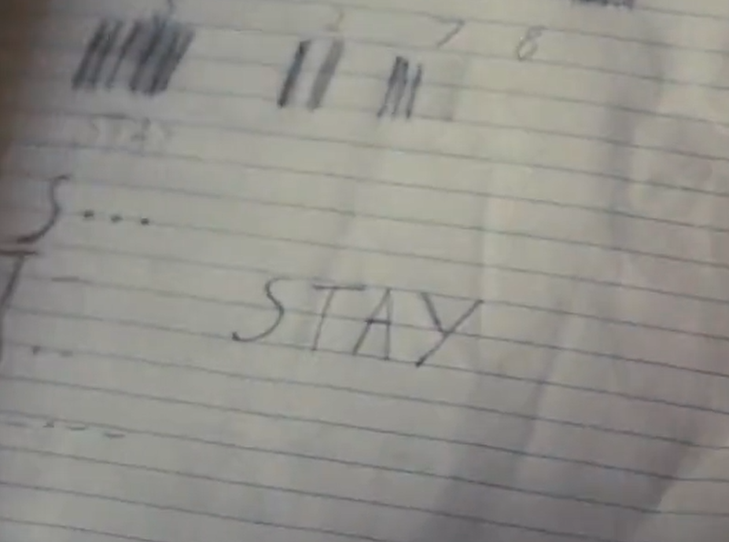
I. Introduction to INTERSTELLAR
In a dying future Earth, former pilot Cooper embarks on a desperate mission through a wormhole to find a new home for humanity.

Slide 6
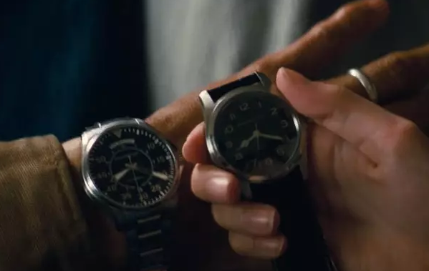
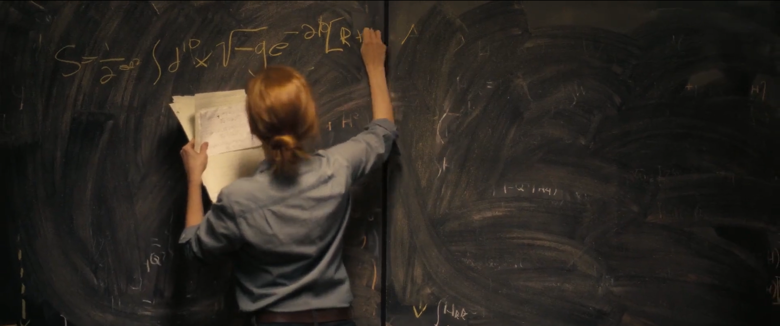
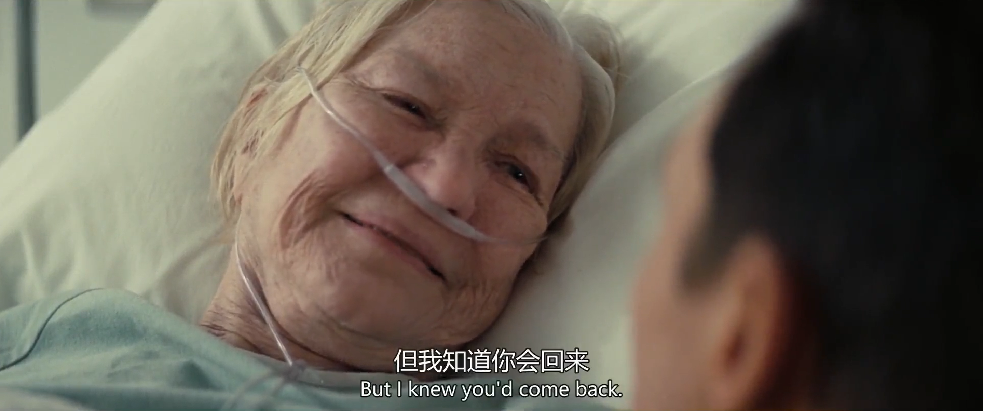
I. Introduction to INTERSTELLAR
While his daughter Murph fights to save those left behind — their bond transcends time and space.

Slide 7
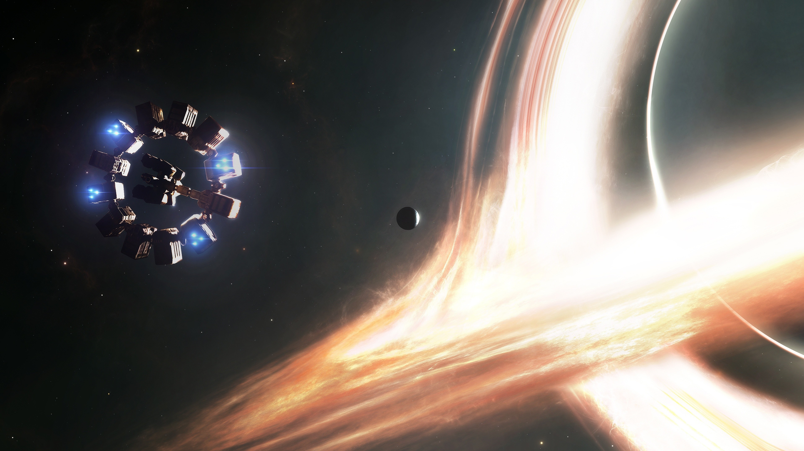
II. Reception, Themes & Critique
Commercial Success
"an amazing achievement"
$758 million worldwide
“Simultaneously a big-budget science fiction endeavor and a very simple tale of love and sacrifice.”
——James Berardinelli

Slide 8
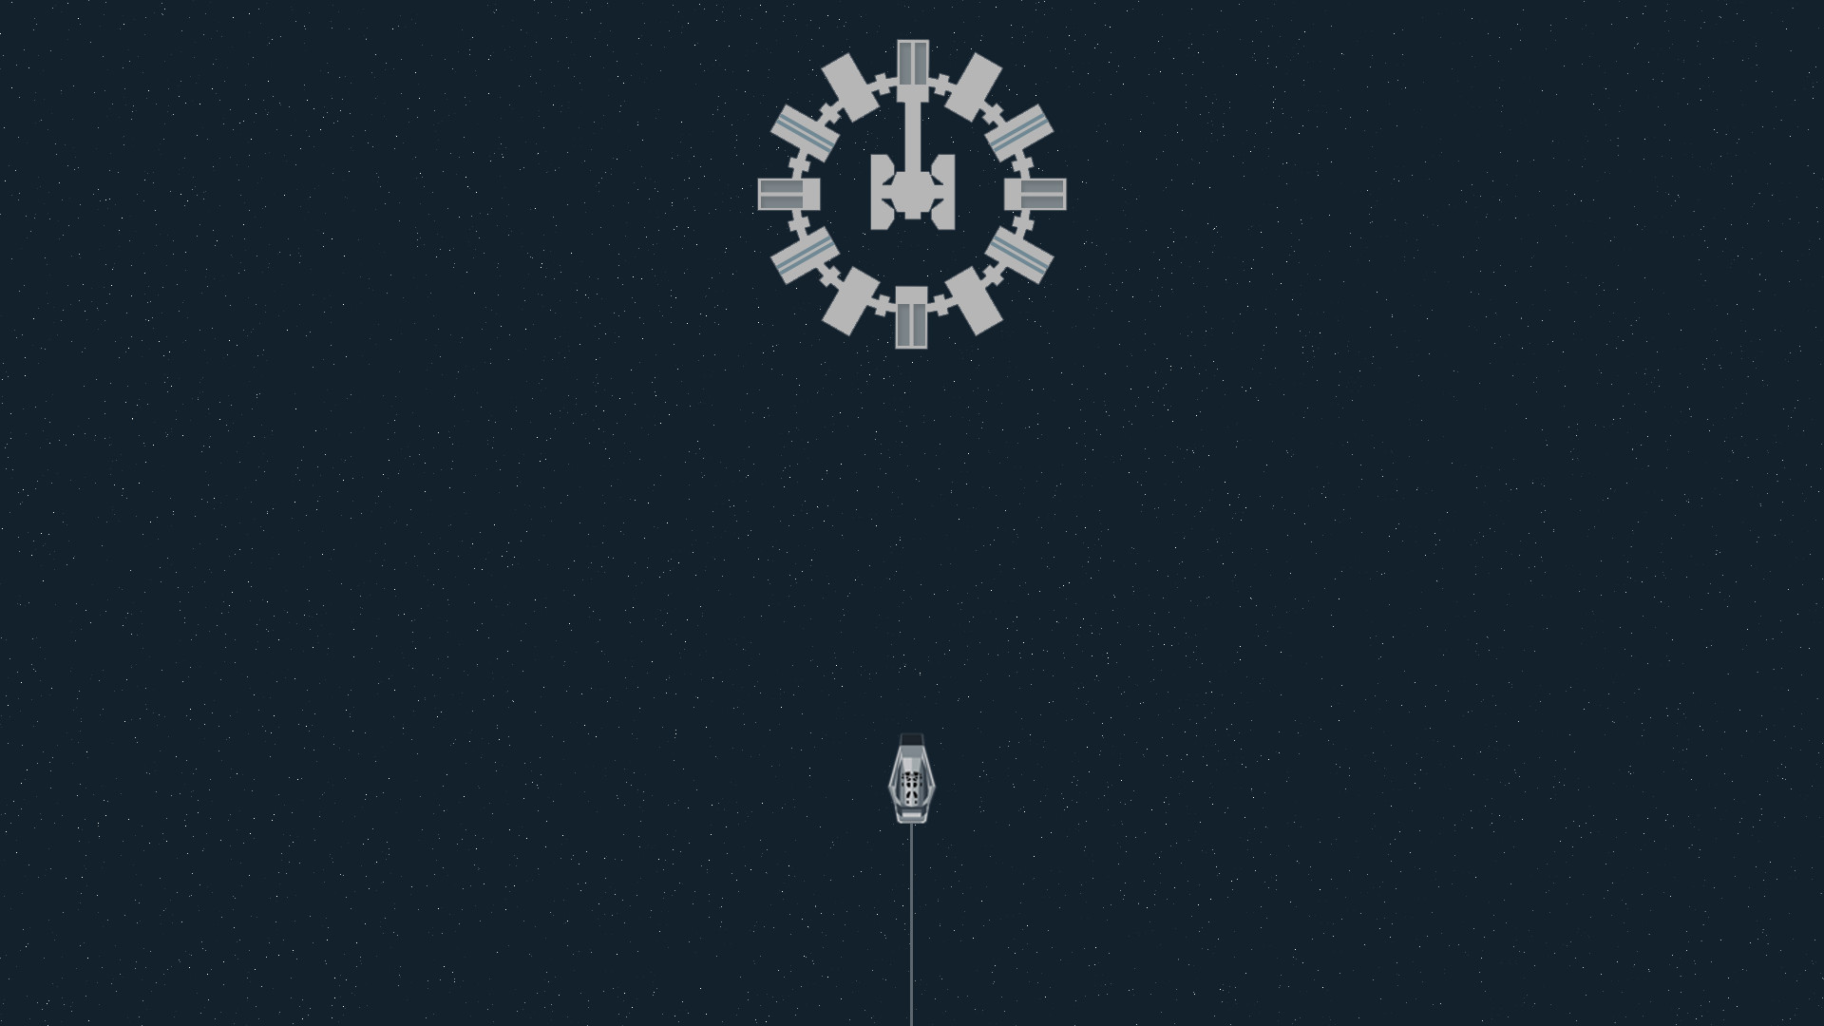
II. Reception, Themes
& Critique
Hopes
Hyper-Fast Interstellar Travel^{[1]}
Technology Advancement
Humankind Self-Rescue ^{[3]}
Enduring Love, Striving, Bravery
Anxieties
Human Fate, Mortality^{[2]}
Catastrophic Weather ^{[2]}
Failing World ^{[2]}
Selfishness and Lying ^{[2]}
Betrayal of Trust ^{[2]}

Slide 9
II. Reception, Themes
& Critique
Reflection
Climate Change
Individual Selfishness & Egoism
Utopian Ending
Simplified Complexity
TARS, CASE vs HAL
Heroism OR Collective Efforts
Compliment
Love Trascends Time and Space
Sacrifice, Bravery For Survival
Scientific Accuracy^{[4]}
Aesthetically Blockbuster
Criticism
On
Reality

Slide 10
II. Reception, Themes
& Critique
Advanced AI Companions for Space Missions
What’s
For
Future?
Climate Change (happening)
Deep space exploration and Mars colonization plans
Collapsing World
Gravitational Wave Detection and Black Hole Imaging
Catastrophic Weather

Slide 11
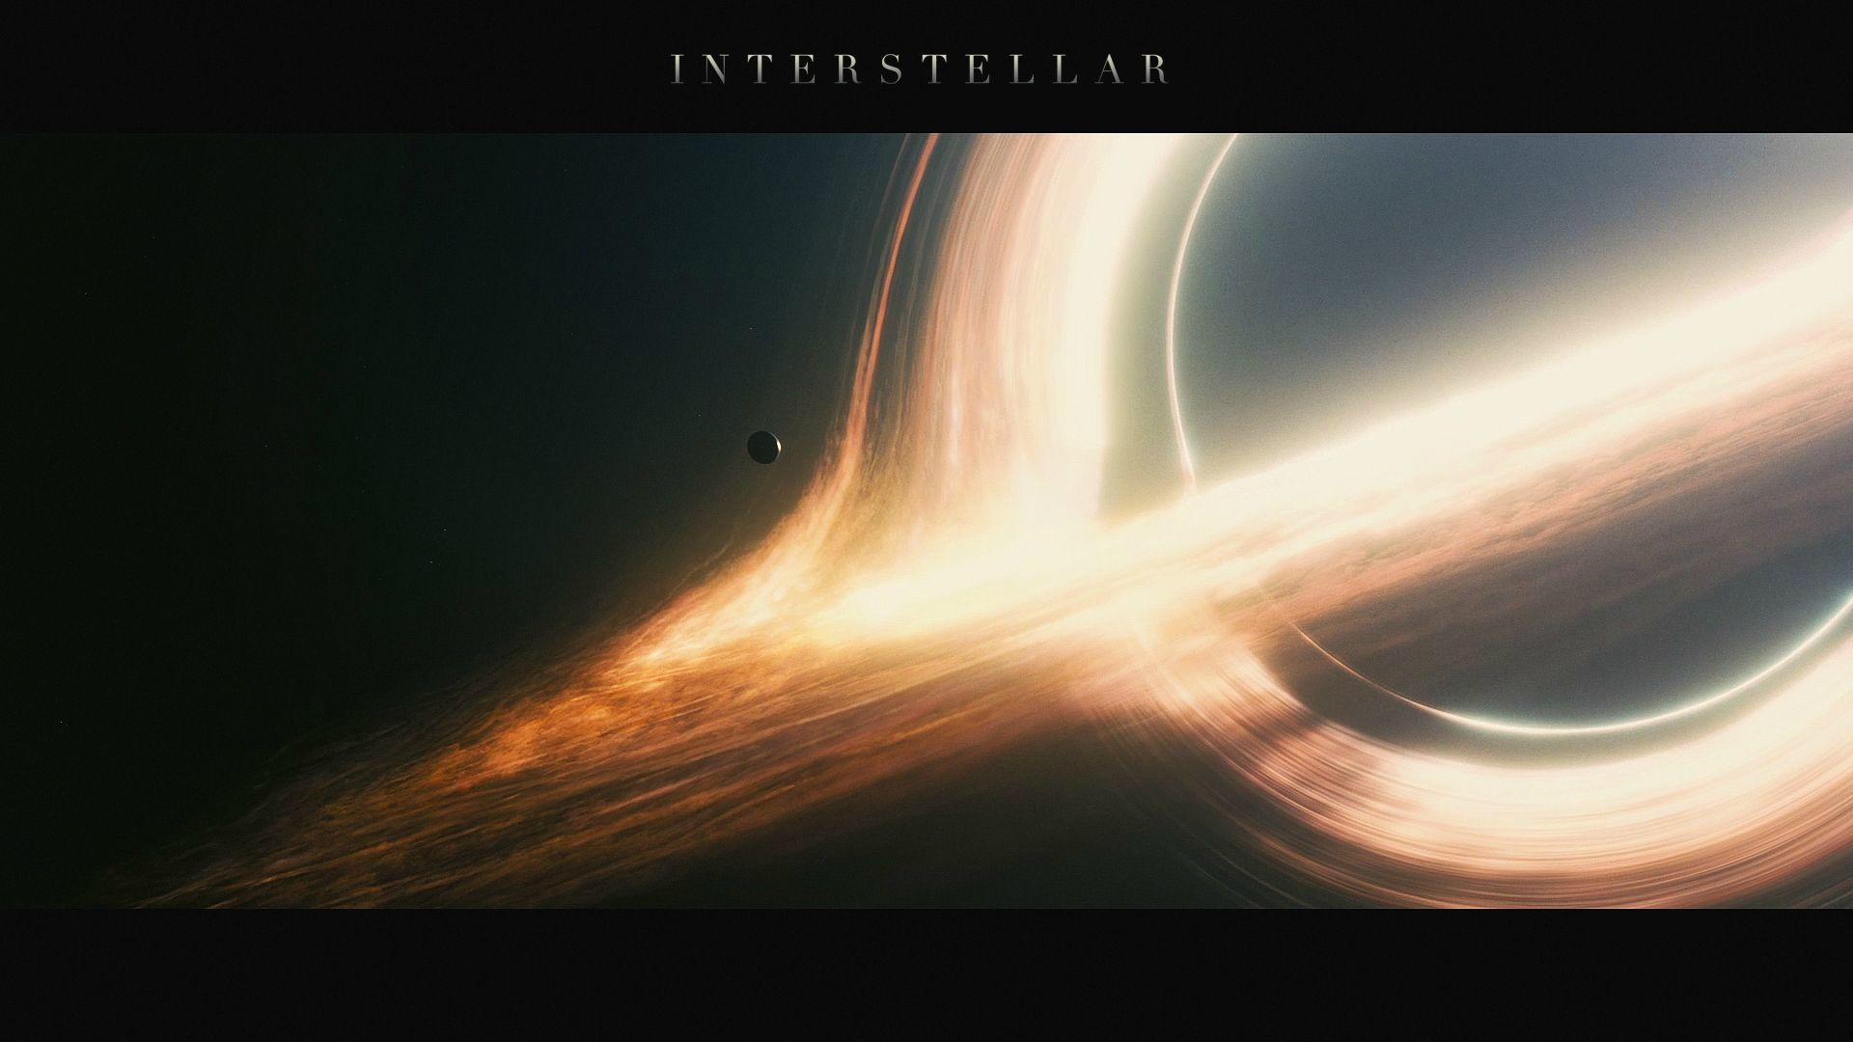
III. Conclusion
Best Recommended Science Fiction
Accurate Visualization
Ground-Breaking
Life Movie
Scientific Ambition
Emotional depth
Incredible Cinematography & Music
Intellectually and Emotionally Brilliance
“Do not go gentle into that good night. Rage, rage against the dying of the light.”

Slide 12
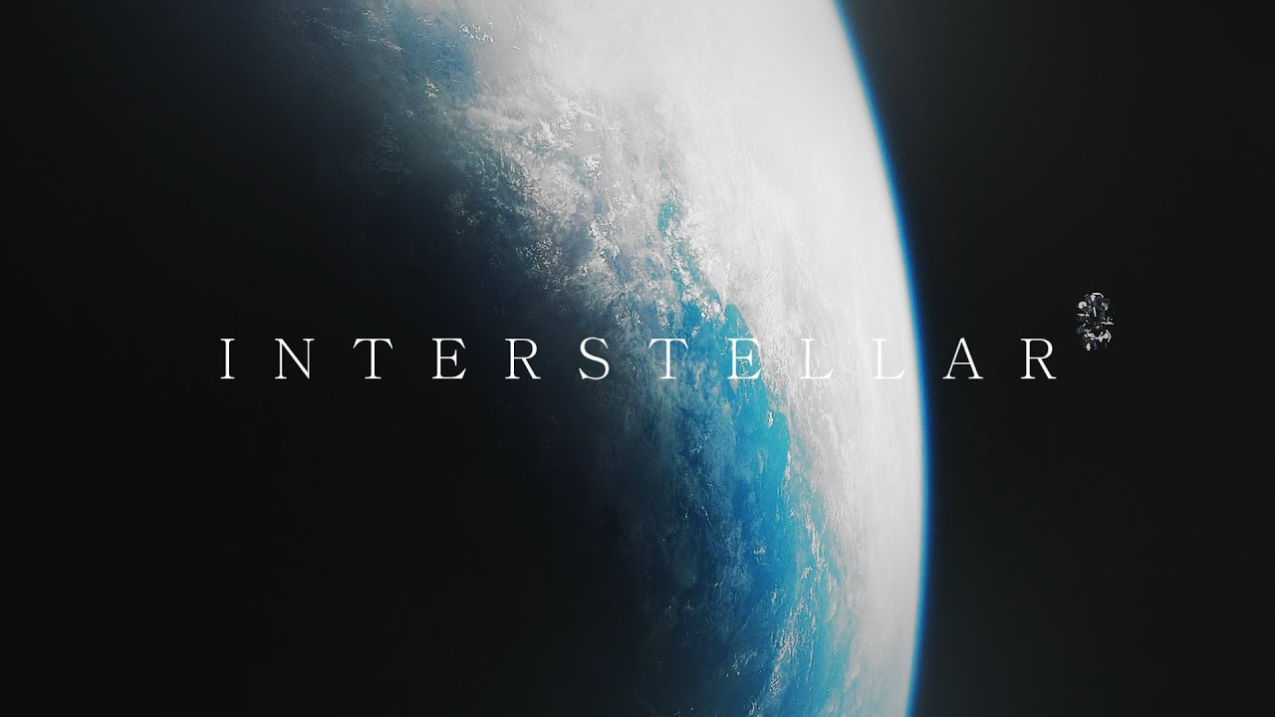
III. Conclusion
In a vast, uncaring universe, love and connection may be the only forces that give life meaning.

Slide 13
Thank You For Listening
Mid-term Presentation | Presented by: Nuo, Xu

Slide 14
Citations
[1] Kokosková, B. (2018). The emotional appeal of science fiction cinema in awe of Interstellar. *Acta Universitatis Lodziensis: Folia Litteraria et Artium*, 44, 55–68. https://doi.org/10.18778/0860-0273.44.05
[2] Dolan, R. (2021). Public anxieties in WALL-E, Interstellar, Captain Marvel, and Don't Look Up. *Science Fiction Film and Television*, 14(3), 365–387.
https://doi.org/10.3828/sfftv.2021.22
[3] Ramos, J. M. (2015). The wrath of Gaia vs. the second coming of science: Beyond Interstellar’s dualistic narrative. *Journal of Futures Studies*, *20*(2), 133–140. https://doi.org/10.6531/JFS.2015.20(2).E133
[4] Thorne, K. S. (2014). *The science of interstellar*. W. W. Norton & Company.
Images
[1] Image source. (n.d.). *Interstellar wallpaper*. Pinterest. https://www.pinterest.com/ideas/interstellar-wallpapers

