Slide 1
Predicting Attrition and Monthly Income
By Nolan Dulude

Slide 2
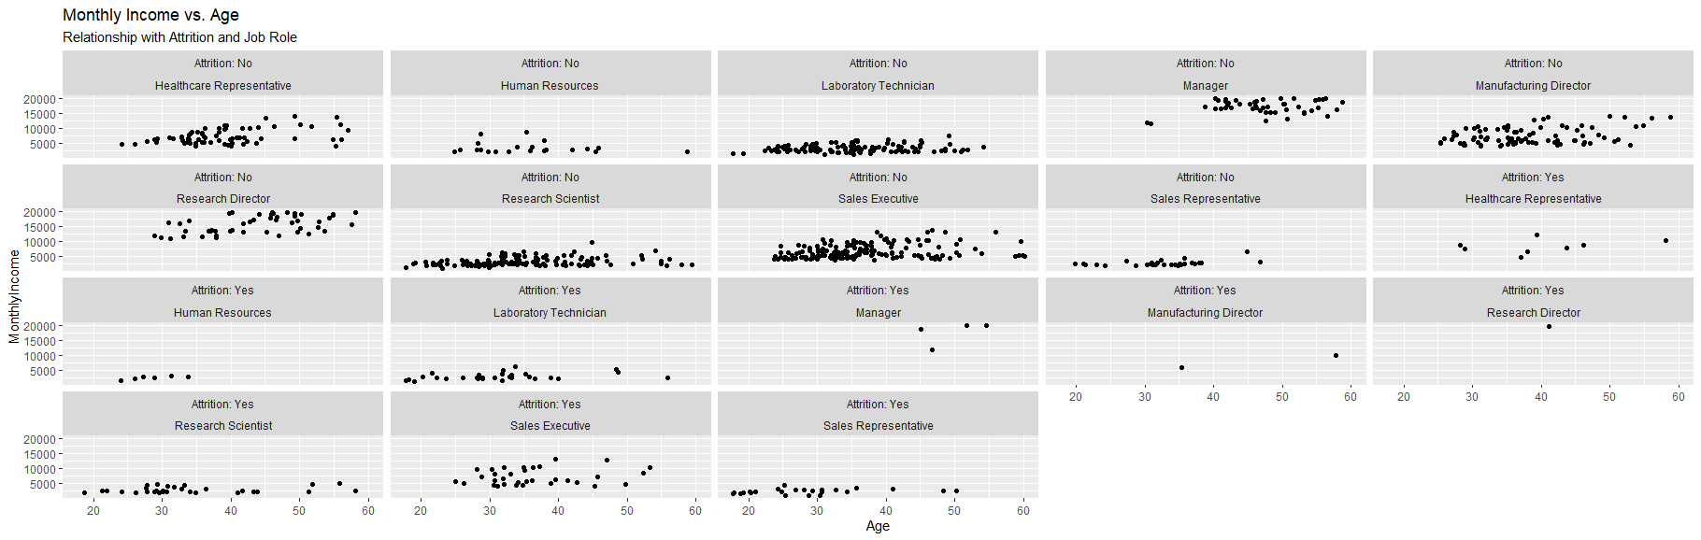
Initial Exploratory Data Analysis
Based on this initial analysis I was trying to determine any sort of pattern or correlation between the Monthly Income of people and their Age with respect to Attrition. This is also broken down into whether an individual left the company or not and which Job Role they possess. It appears that Sales Executives and Sales Representatives had a higher levels of attrition. Age and Monthly income was less conclusive.

Slide 3
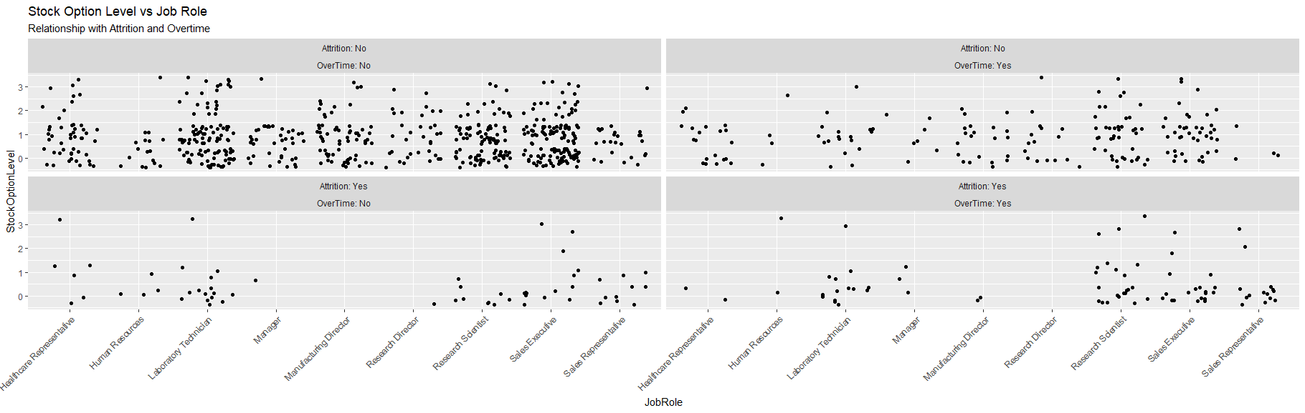
Exploratory Data Analysis
I wanted to look at more variables to get a better idea of what is going on, so I also looked at the Stock Option Level and whether the individuals did Overtime or not. This along with the roles allowed me get a better picture of who was leaving your company.

Slide 4
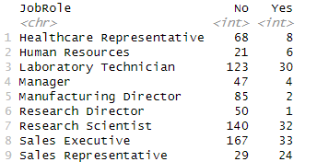
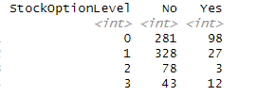

Comparing Attrition
After determining what I wanted to look at, I want to see exactly how many individuals from each Job Role, Overtime, and Stock Option Level left and stayed. From this data I could determine that 24 out of 53, or 45.3% of Sales Representatives left, 80 out of 252, or 31.7% of people doing Overtime left, and 98 out of 379 people with Stock Option Level of 0 left. It can also be noted that 6 out of 27 or 22.2% of Human Resources left and 12 out of 55, or 21.8% of people with the highest Stock Option Level of 4 left. Also, from this data it can be determined that what Job Roles had low attrition levels. These were Research directors with 1.96% and Manufacturing Director with 2.29%. In relation with Overtime only 9.7% of individuals that were not performing overtime left the company.

Slide 5
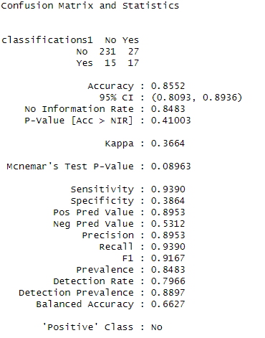
Initial KNN Model
I chose to use KNN model with the variables of Job Role, Overtime, and Stock Option level to determine Attrition. With these variables I was initially able to achieve a Sensitivity of 0.9390 and a Specificity of only 0.3864. This means that the initial model had a high ability to classify an employee’s No Attrition as No and a low ability to classify the Yes Attrition as Yes.

Slide 6
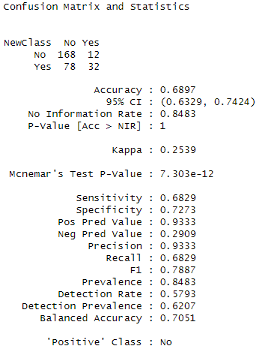
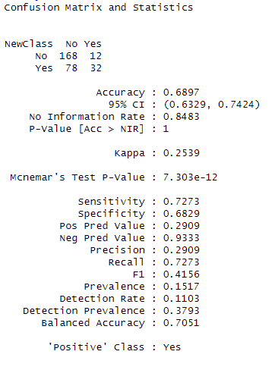
Modified KNN Model
After the initial KNN Model I determine that the model needed to be modified to increase the Specificity. I was able to do this by decreasing the threshold from 0.5 to 0.12.
This gave me a better Specificity of 0.7273 and Sensitivity of 0.6829 with respect to the No attritions. Also, a Specificity of 0.6829 and Sensitivity of 0.7273 with respect to the Yes Attritions.
The mean F1 score was 0.606.

Slide 7
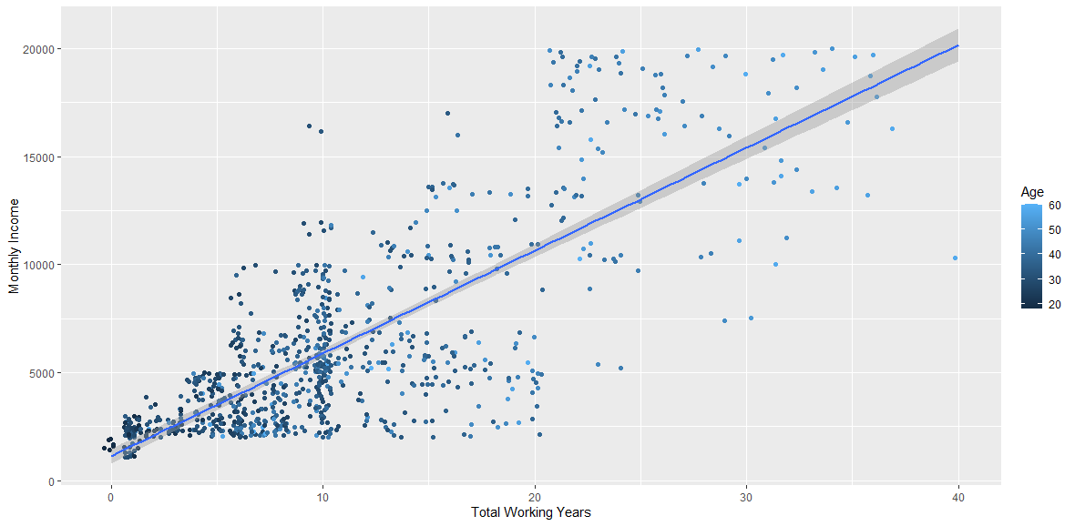
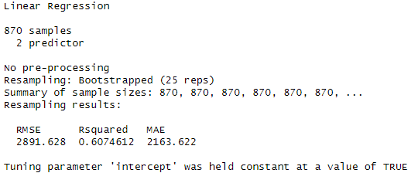
Multiple Regression Model
I chose to use a Multiple Regression model to determine the Monthly Income based on the Total Working years and the Age of the employees. This Model gave me a RMSE of 2891 and an R² of 0.607.

Slide 8
Summary
Based on my analysis it appears that my top variables for determining attrition were Job Role, Overtime, and Stock Option Level.
With these variables I was able to create a model for both respect to No attrition and Yes attrition that had above a 0.6 specificity and sensitivity. Specificity of 0.7273 and Sensitivity of 0.6829 with respect to the No attritions. Specificity of 0.6829 and Sensitivity of 0.7273 with respect to the Yes Attritions.
I was also able to create a Multiple Regression Model that was used to predict the Monthly Income of employees based on their Total Working Years and Age that had a RMSE of <3000. The RMSE was 2891.

Slide 9
Questions

