Slide 1
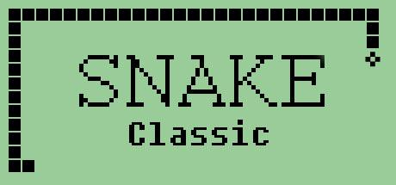
CECS 361 Final Project
By: Nolan Nguyen, Tri Nguyen, Jordan Havelaar

Slide 2
Game Overview
Objective: Win by collecting fifteen apples that randomly spawn on screen.
The snake is controlled via the four onboard push buttons on the FPGA board.
The snake will grow by one pixel every time an apple is collected.
Player will lose the game if a fatal collision occurs either by making the snake hit itself or if it hits the wall.
Once player obtains nine points, the player wins! And the game will reset.

Slide 3
Implementation Overview
Five modules
scoreCountTop: Used to control and display the game score on one onboard seven-segment LED display
vgaController: Controls VGA synchronization at 25 MHz pixel rate
food: Controls positioning of the apples generated onscreen
snake_game: Contains logic for initializing the snake, as well as the logic for growing the snake, fatal and non-fatal collisions, the four directional inputs, and pixel generation
top: Connect modules together

Slide 4
VGA

Slide 5
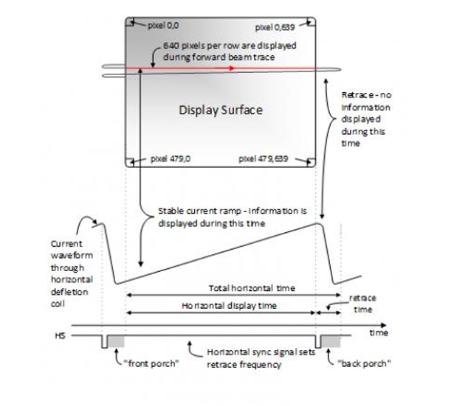
VGA Details
Maximum Resolution: 640 x 480
Signals: Red, Green, Blue, HSync and VSync.
Each color signal is 4-bits.
While horizontal is high, deflection coil waveform is created.
HSync is faster than VSync.

Slide 6
Game Logic

Slide 7
snake_game
Movement
If you are going up, you cannot go down. (Vice Versa)
If you are going left, you cannot go right. (Vice Versa)
Reset Button
Reset any time using button in the middle.
Snake Growth
When the snake eats food, a segment is added to the snake’s body and the score is incremented.
Collisions
Border Collision: Check if the snake’s head hit the border.
Self Collision: Check if the snake’s head collides with it’s own body.
Game Over:
When there is a border or self collision, the game ends by pausing.
Score Tracker
Score increments by one for every apple eaten; max is nine points
Combines the food module with game logic.
Fatal Collisions: Collision with border or yourself
Good Collisions: Collision with Apple

Slide 8
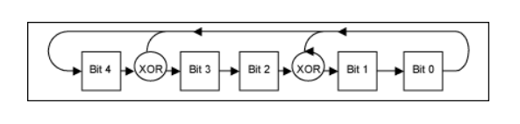
food
Food generated through a pseudo-random sequence
Achieved using a linear shift feedback register

Slide 9
Score Counter

Slide 10
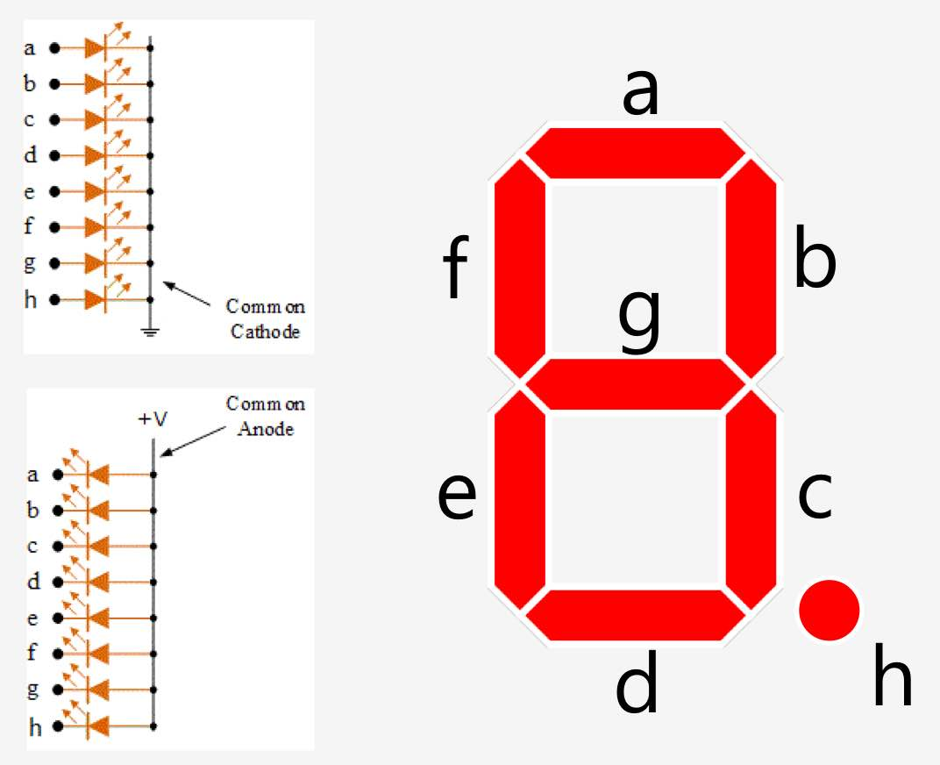
Score Counter Details
Modules:
Anode - Activates specific seven segment display
Cathode - Activate specific segments to represent number
BCD - Checks to see if value can be displayed
The current value of the score is compared to the cases in the cathode module
If the score matches a case, it is shown on the display

Slide 11
Demo Time
Thank You

