Slide 1
Tableau Uses, Examples & Methods

Slide 2
Table of Contents
What is Tableau....................................................................................3
Why Tableau.........................................................................................4
Basic functionalities.............................................................................5

Slide 3
What is Tableau?
Analysis
Reporting
Visualization
Tableau

Slide 4
Why Tableau
Technical Capabilities
End User Experience
Link to most common data storage files and servers
User friendly development
Comprehensive

Slide 5
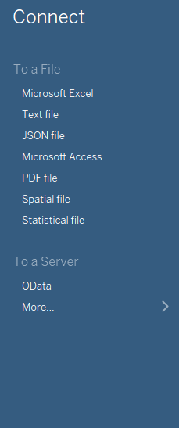
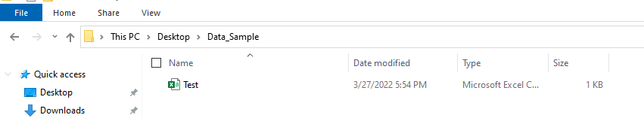
Reading in Data
Select your file type. Note: CSV files are considered “Test Files”.

Slide 6
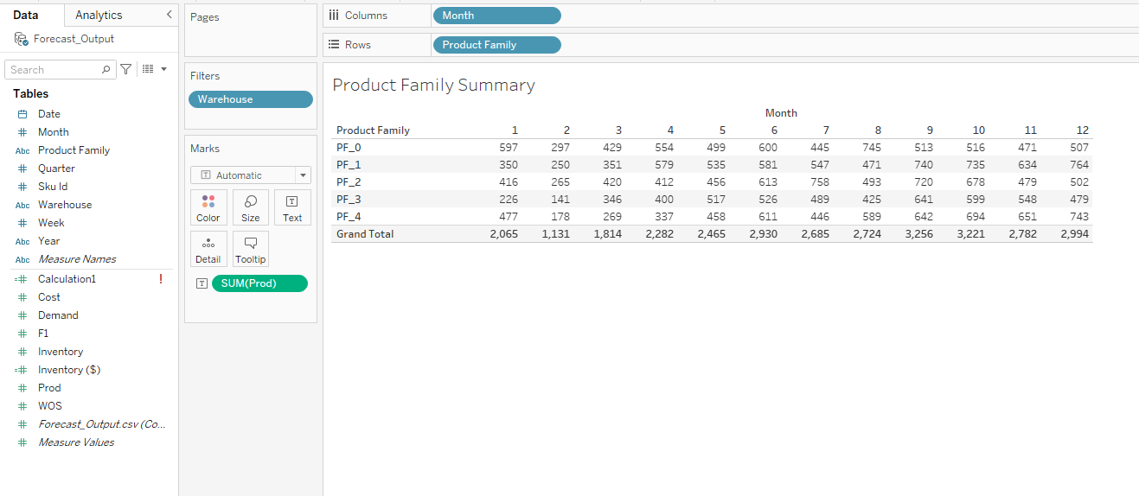
Pivoting Data
Data Filters
Column / Row Partitions
All Fields and Measures
Quantitative Values

Slide 7
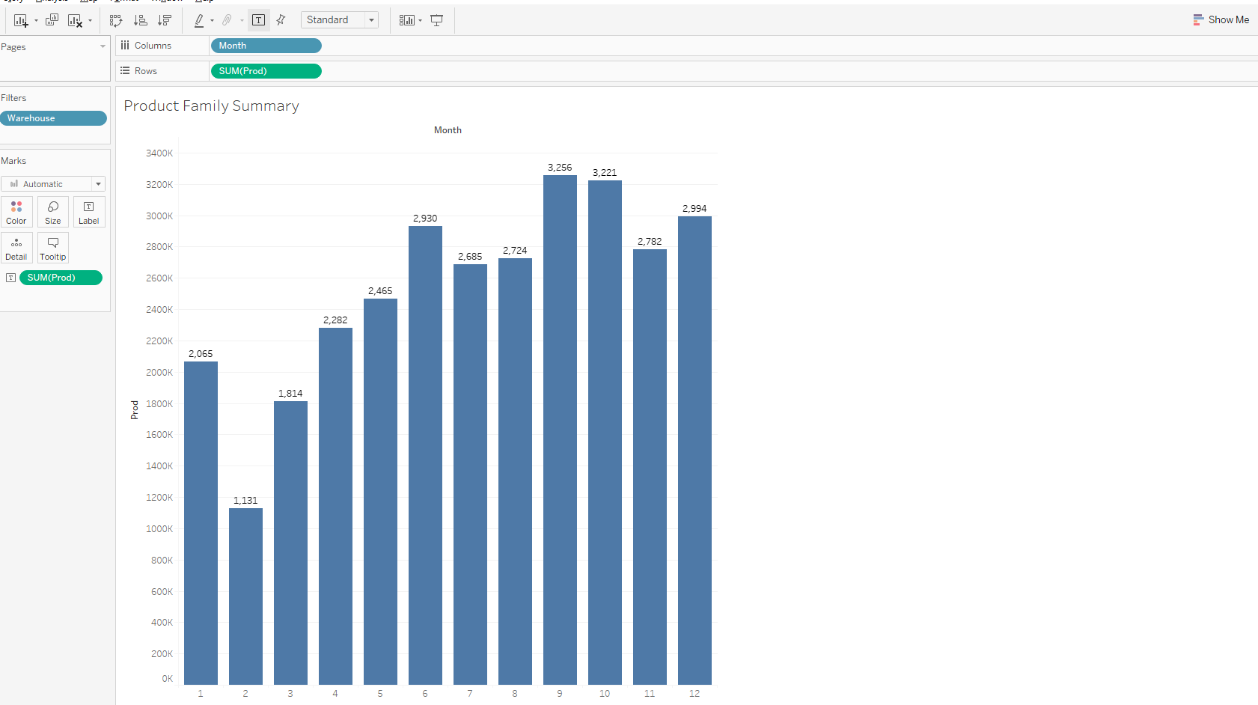
Charting
Identifies how the data is being partitioned for the graph
Opens Chart Options
Data Filters
What quantitative data is being summarized in the graph

Slide 8
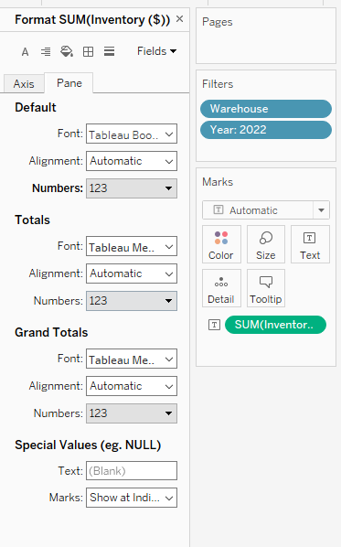
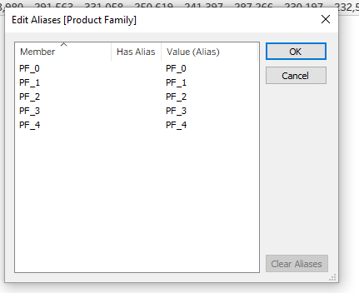
Formatting
Aliases for ugly names

Slide 9
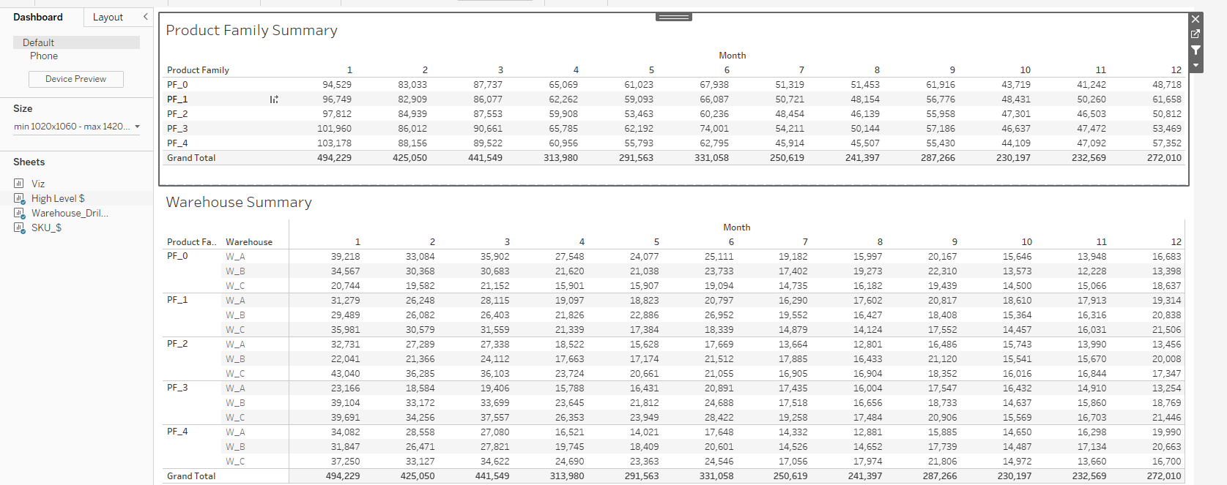
Dashboards

Slide 10
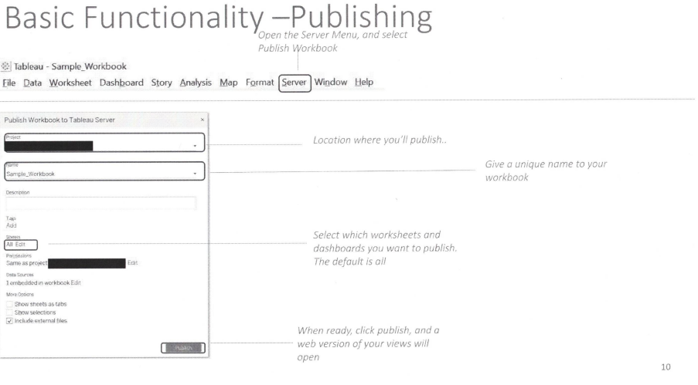
Publishing

Slide 11
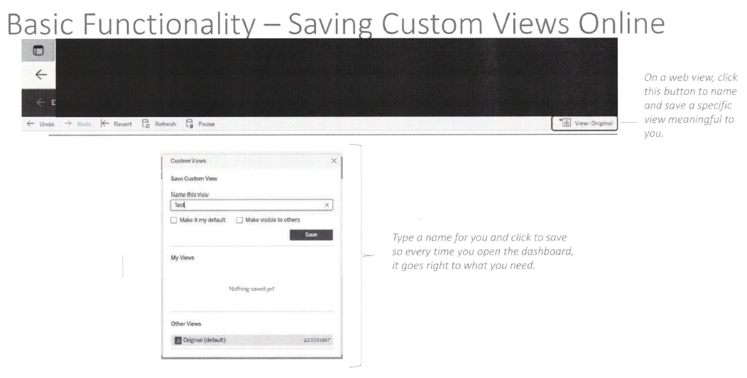
Online Views

Slide 12
Live Example
TRY ME

