Slide 1

Introducing Quantum Computing to Computer Science Students
STEM REx
Presented by Nole Stites

Slide 2
What makes quantum computing interesting?
Quantum computers have a massive increase in computational power compared to classical computers.
Can solve many complex problems in a reasonable amount of time, unlike classic computers.
Classical computers can only represent one state at a time.
Quantum computers can represent exponentially many states at once.
It has important applications in cyber security.
Can improve the likelihood of stopping cyber attacks before they happen.
Can create even more secure systems.
Downside: it would create new vulnerabilities to be fixed.
It uses quantum mechanics, a strange yet fascinating new area of study for computer scientists.
IBM, Google, Microsoft, and many more are all working to advance quantum computing research.
The title slide image is IBM’s quantum computer called System One.

Slide 3
Quantum computing cont.
A couple of problems arise when trying to teach quantum computing:
The nature of quantum mechanics is strange and hard to grasp.
Quantum computing relies heavily on linear algebra, a topic that most CS students may not know.

Slide 4
Goals
Research an effective, minimized quantum computing learning path for students that doesn’t involve linear algebra.
Prepare an introductory lecture on quantum computing to be presented to CS 418 students.

Slide 5
Steps to achieve the goals
Learn quantum computing the traditional way through self-study.
Draft a lecture outline, receive feedback, and repeat until a satisfactory outline is found.
Encode my knowledge of quantum computing into a graph that follows the structure of the lecture outline.
Create a list of resources and exercises for students to use to expand on their knowledge.

Slide 6
Step 1: Learn Quantum Computing
The Traditional Way
Learn Quantum Mechanics
Superposition
Entanglement
Schrodinger’s Equation
Particles vs. Waves
Repeated Measurements
Etc.
(In other words, the strange quirks of the quantum world)
Learn Quantum Computing
Linear Algebra
Dirac Notation
Qubits & Mixed States
Quantum Gates/Circuits
Quantum Complexity Theory
Etc.
(Applying quantum weirdness to make it useful)

Slide 7
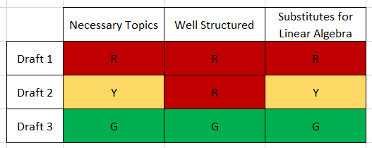
Step 2: Draft Lecture Outlines
Why drafting is important: it allows me to modify and expand upon my initial ideas, organize the content in a meaningful way, make the content more concise, etc.
Draft 1 (lecture_topics.txt):
Lengthy; unnecessary topics; unorganized; too complex of a substitute for linear algebra
Draft 2 (lecture_outline_DRAFT.txt):
Better structured, but can be improved; still has some unnecessary topics; lacking complexity theory relevance
Draft 3 (lecture_outline_DRAFT_2.txt):
Only (for the most part) has essential topics; has complexity theory; organized well; sections are too big (not digestible sizes)
The graph will take the best parts of Draft 3 and work to make the sections smaller and more digestible.

Slide 8
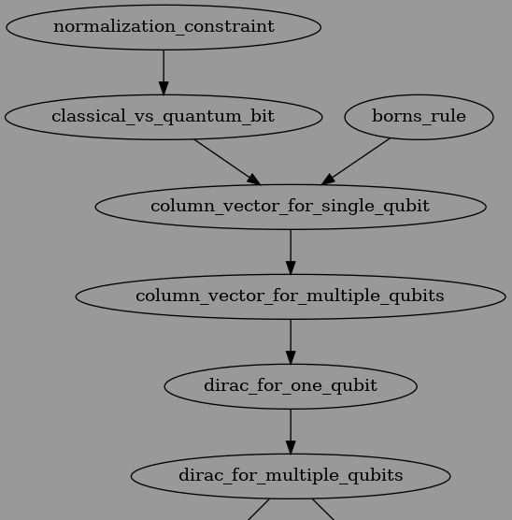
Step 3: Encode Knowledge Into Graph
Why use a graph?
So that others can use, rearrange, and build upon my current design.
To help future learners of quantum computing by providing a roadmap of topics to learn and in what order.
To allow for an easy way to reorganize the structure of the learning path by moving around the nodes.

Slide 9
Step 6: Brainstorm Tools and Assignments
Tools
Qiskit website for use of the qiskit library
IBM website for creating quantum circuits and simulating them on real quantum computers
Assignments
Some theory and some practice
(Pending)

Slide 10
Sources
IBM Quantum Field Guide: https://quantum-computing.ibm.com/lab/docs/iqx/guide
Online lecture series: https://youtube.com/playlist?list=PLkespgaZN4gmu0nWNmfMflVRqw0VPkCGH
Books:
“The Strange World of Quantum Mechanics” by Daniel F. Styer
“An Introduction to Quantum Computing” by Phillip Kaye, Raymond Laflamme and Michele Mosca

