Slide 1
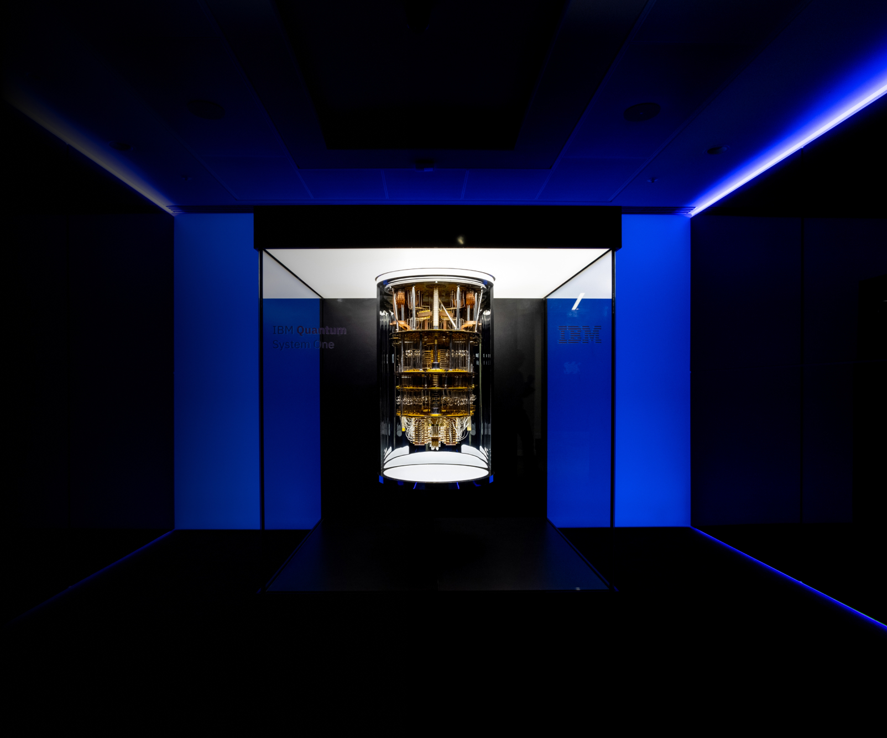
Introducing Quantum Computing to Computer Science Students
STEM REx
Presented by Nole Stites
Notes:
- System One was finished in the summer of 2018 after precise testing.
- The computers are super cold: Absolute Zero = -460 Fahrenheit.
- System One’s exist in North America, Germany, and Japan, soon to be more.
- IBM had quantum computers on the cloud as early as 2016.
- IBM allows users to create quantum circuits and run them on their quantum computers.

Slide 2
What makes quantum computing interesting?
Quantum computers have a massive increase in computational power compared to classical computers.
Can solve many complex problems in a reasonable amount of time, unlike classic computers.
Classical computers can only represent one state at a time.
Quantum computers can represent exponentially many states at once.
It has important applications in cyber security.
Can improve the likelihood of stopping cyber attacks before they happen.
Can create even more secure systems.
Downside: it would create new vulnerabilities to be fixed.
It uses quantum mechanics, a strange yet fascinating new area of study for computer scientists.
IBM, Google, Microsoft, and many more are all working to advance quantum computing research.
The title slide image is IBM’s quantum computer called System One.

Slide 3
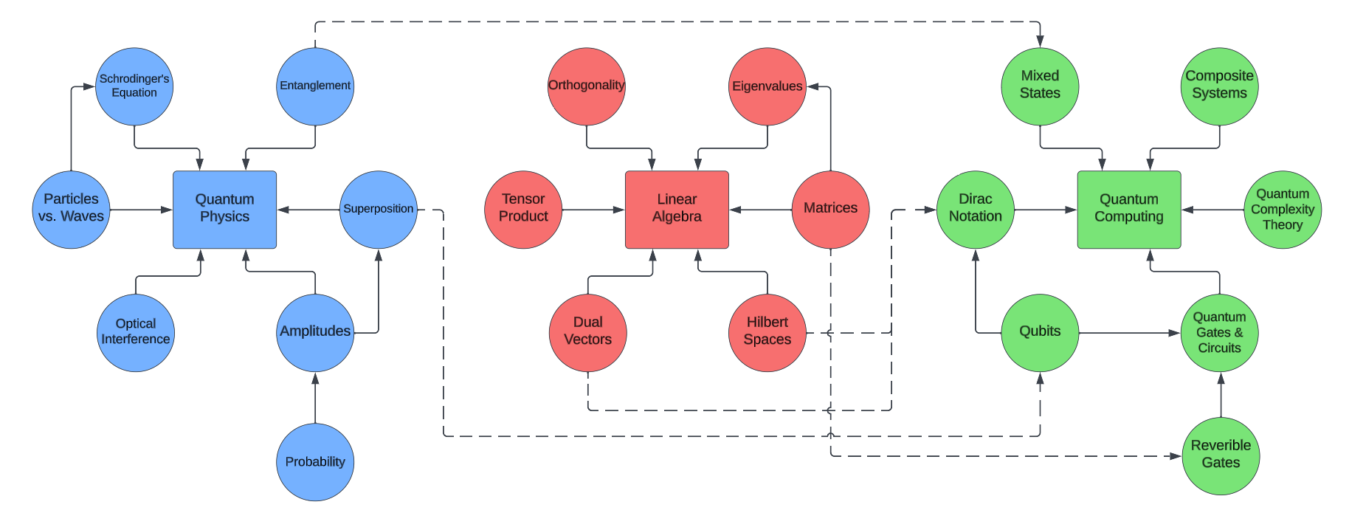
Traditional Learning Path for Quantum Computing
Graph:
a collection of vertices (nodes) and edges such that any edge in the graph will connect two nodes.
Dependencies in a graph:
Directed edges in a graph are known as dependencies. The node that the edges points to depends upon the node at the origin of the edge.

Slide 4
Problems when teaching quantum computing
A couple of problems arise when trying to teach quantum computing:
The nature of quantum mechanics is strange and hard to grasp.
I am giving an introductory lecture on quantum computing to a class that does not require linear algebra as a prerequisite.

Slide 5
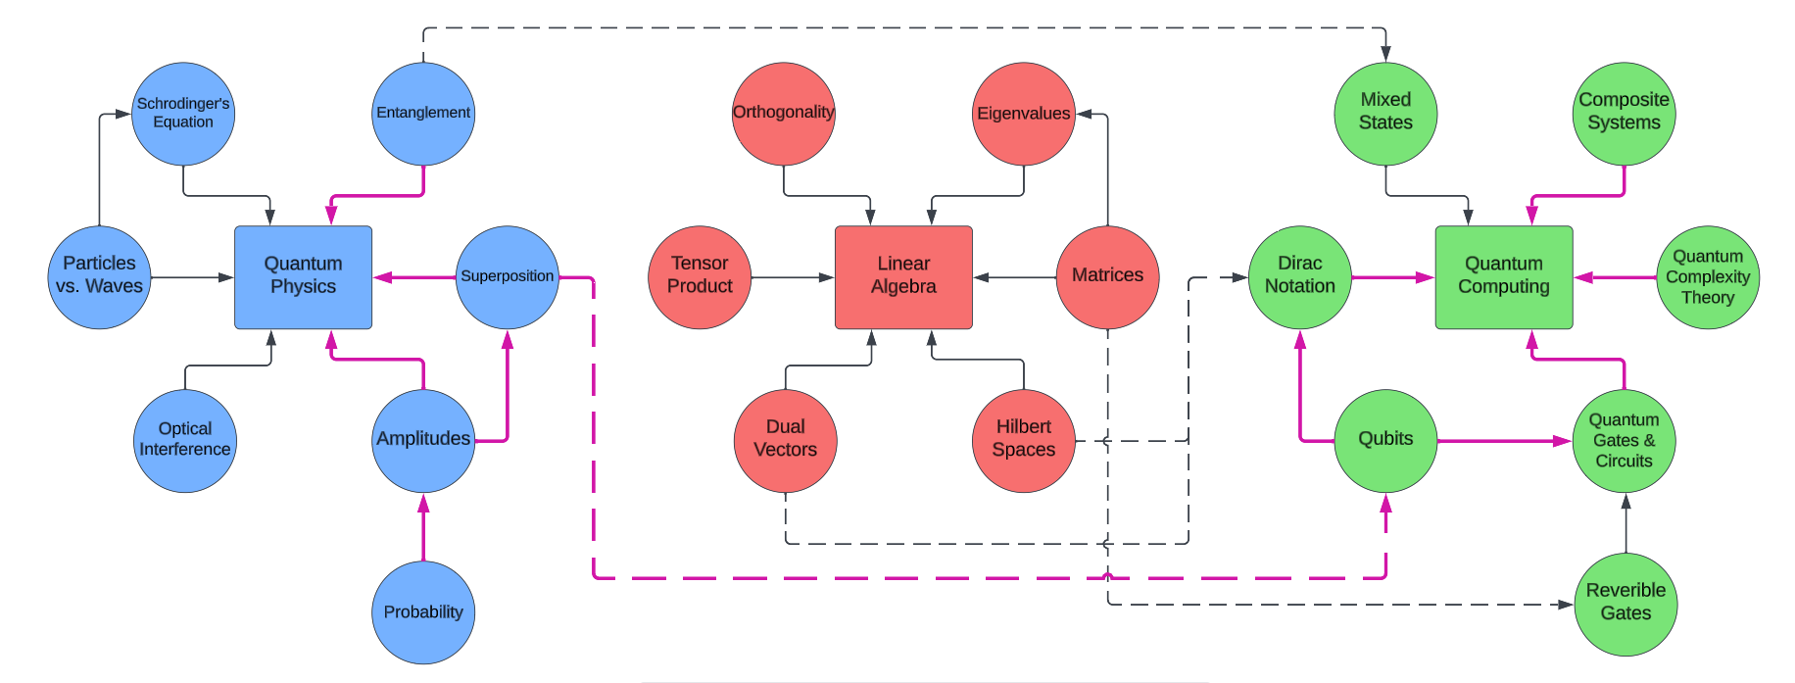
Contributions
Researched an effective slice through the traditional graph to serve as a quantum computing learning path for students that doesn’t involve linear algebra.
Prepared an introductory lecture on quantum computing to be presented to CS 418 students.
Created a machine-readable knowledge graph to represent the quantum computing learning path.
Learning Path Slice:
a smaller collection of vertices and edges from within a larger graph.

Slide 6
Steps to achieve the resulting contributions
Learn quantum computing the traditional way through self-study.
Draft a lecture outline, receive feedback, and repeat until a satisfactory outline is found.
Encode my knowledge of quantum computing into a graph that follows the structure of the lecture outline.

Slide 7
Step 1: Learn Quantum Computing
The Traditional Way
Learn Quantum Mechanics
Superposition
Entanglement
Schrodinger’s Equation
Particles vs. Waves
Repeated Measurements
Etc.
(In other words, the strange quirks of the quantum world)
Learn Quantum Computing
Linear Algebra
Dirac Notation
Qubits & Mixed States
Quantum Gates/Circuits
Quantum Complexity Theory
Etc.
(Applying quantum weirdness to make it useful)

Slide 8
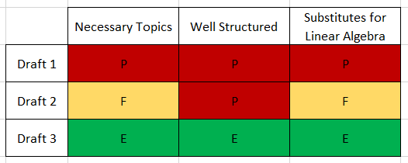
Step 2: Draft Lecture Outlines
Necessary Topics: Does the draft contain digestible and meaningful topics for an introductory lecture?
Well Structured: Is the content of the draft organized in a clear and understandable way?
Substitutes for Linear Algebra: Does the draft avoid the use of linear algebra by using another effective method?
Poor
Fair
Excellent
Notes:
Discuss why drafting is important. Just look what would’ve happened if you stopped at Draft 1!

Slide 9
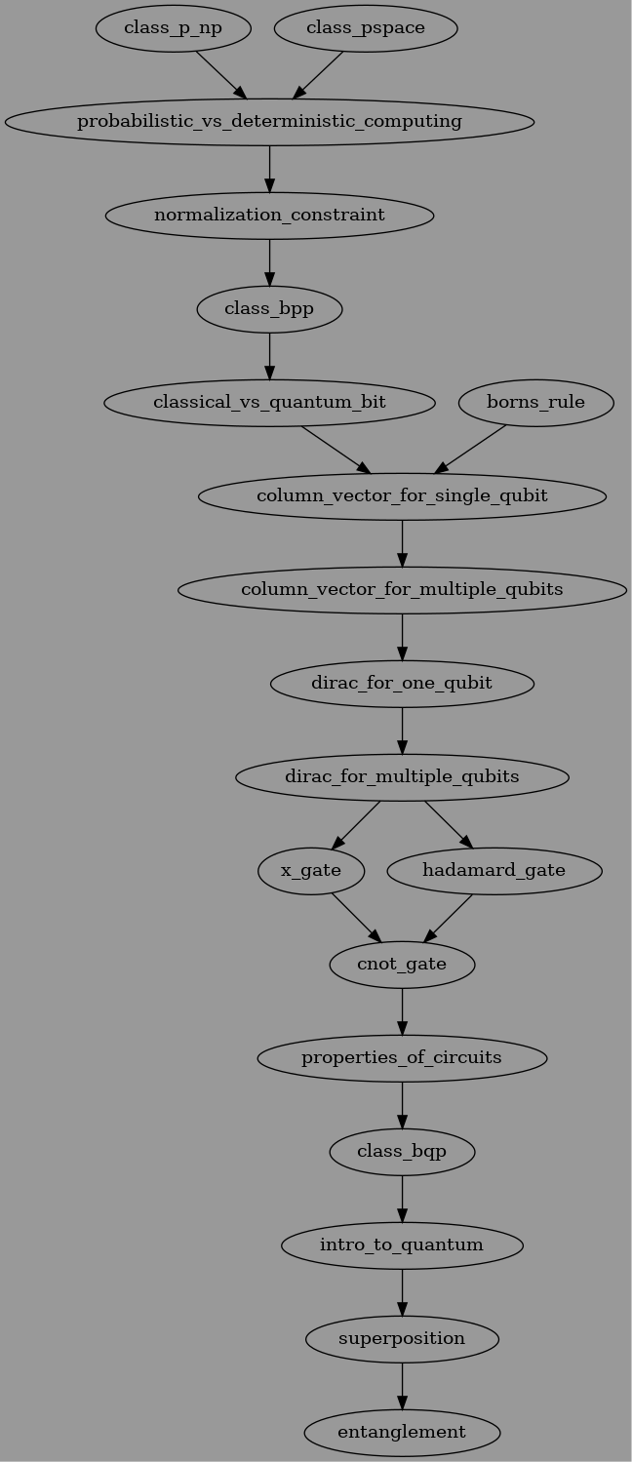
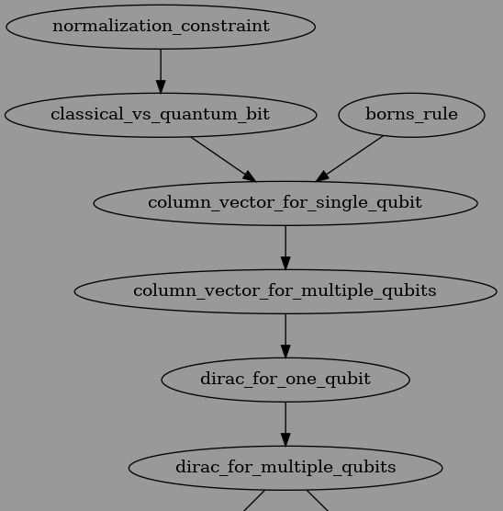
Step 3: Encode Knowledge Into Graph
Why use a graph?
So that others can use, rearrange, and build upon my current design.
To provide learners with a roadmap of topics to learn and in what order (knowledge graphs have been shown to be useful for this)
To allow for an easy way to reorganize the structure of the learning path by moving around the nodes.
To have a machine-readable format for a variety of uses.

Slide 10
Sources
IBM Quantum Field Guide: https://quantum-computing.ibm.com/lab/docs/iqx/guide
Online lecture series: https://youtube.com/playlist?list=PLkespgaZN4gmu0nWNmfMflVRqw0VPkCGH
Books:
“The Strange World of Quantum Mechanics” by Daniel F. Styer
“An Introduction to Quantum Computing” by Phillip Kaye, Raymond Laflamme and Michele Mosca
Slide 8:
Aidan Hogan, Eva Blomqvist, Michael Cochez, Claudia d'Amato, Gerard de Melo, Claudio Gutierrez, José Emilio Labra Gayo, Sabrina Kirrane, Sebastian Neumaier, Axel Polleres, Roberto Navigli, Axel-Cyrille Ngonga Ngomo, Sabbir M. Rashid, Anisa Rula, Lukas Schmelzeisen, Juan Sequeda, Steffen Staab, and Antoine Zimmermann. 2020. Knowledge Graphs. arXiv:2003.02320 [cs.AI]

