Slide 1
Using Content Security Policy Report Only to Detect Malicious JavaScript
Author: Michal Glinski Supervisor: Dr. Sergio Maffeis

Slide 2
Agenda
Introduction
Project Goals
Demo
Results
Conclusion

Slide 3
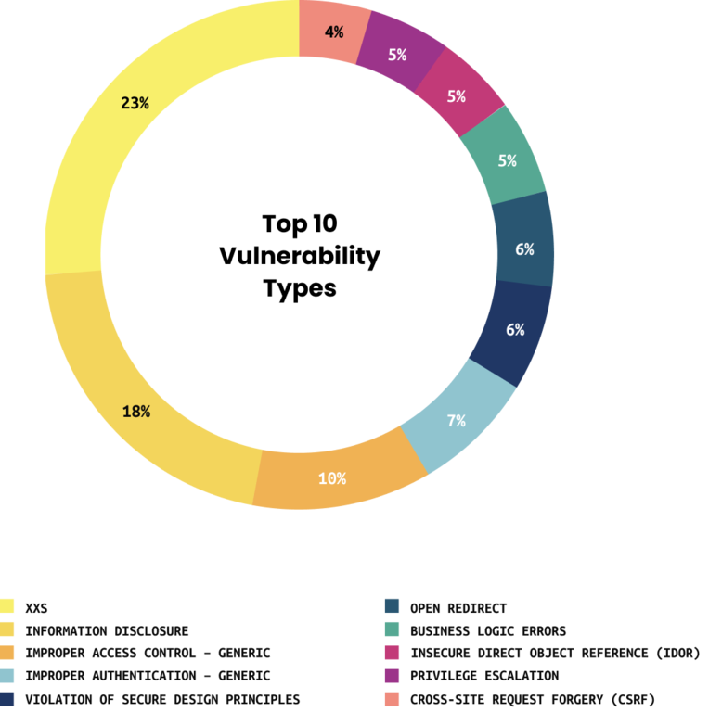
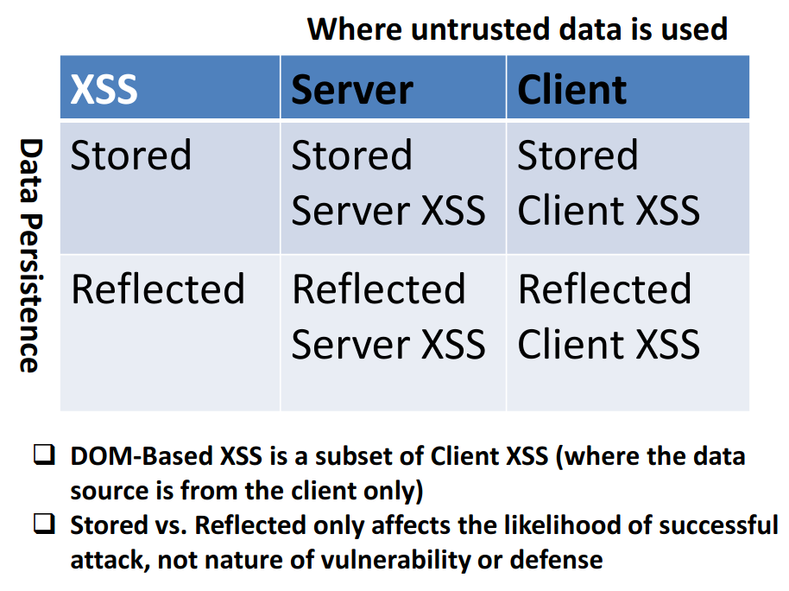
Cross Site Scripting
https://owasp.org/www-community/Types_of_Cross-Site_Scripting
https://www.hackerone.com/top-ten-vulnerabilities

Slide 4
Content Security Policy
A way to selectively load resources
Can protect from Cross Site Scripting
upgrade-insecure-requests ;
default-src ’none’ ;
script-src ’report-sample’ ;
script-src-elem ’report-sample’ https://testing.site/index.js
’sha256-f2KDabOBheatnkXlUGlWthbaCaKmlDSpV5682oXCFAw=’ ’nonce-OEdqEL1Z’;
script-src-attr ’report-sample’ ;
frame-src testing.site ;
font-src *;
img-src https: ;
report-uri https://reporting.project

Slide 5
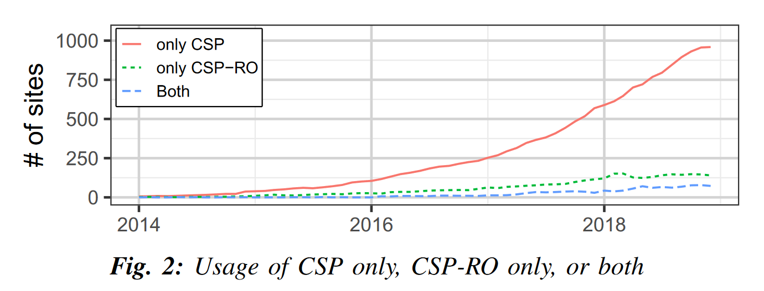
CSP Usage
1 million websites
14% use CSP
4% use reporting
1% use CSPRO
50% use reporting
0.2% use both
https://par.nsf.gov/servlets/purl/10173479

Slide 6
CSP Pitfalls
Policies are not strict enough
94% are trivially bypassable because of whitelisting
Unsafe domain
Wildcard
Unsafe inline
Expected
Malicious
Content-Security-Policy: default-src 'self' ajax.googleapis.com
https://ajax.googleapis.com/ajax/libs/jquery/2.1.3/jquery.min.js
ajax.googleapis.com/ajax/services/feed/find?v=1.0%26callback=alert%26context=1337
https://storage.googleapis.com/pub-tools-public-publication-data/pdf/45542.pdf
https://github.com/cure53/XSSChallengeWiki/wiki/H5SC-Minichallenge-3:-%22Sh*t,-it%27s-CSP!%22

Slide 7
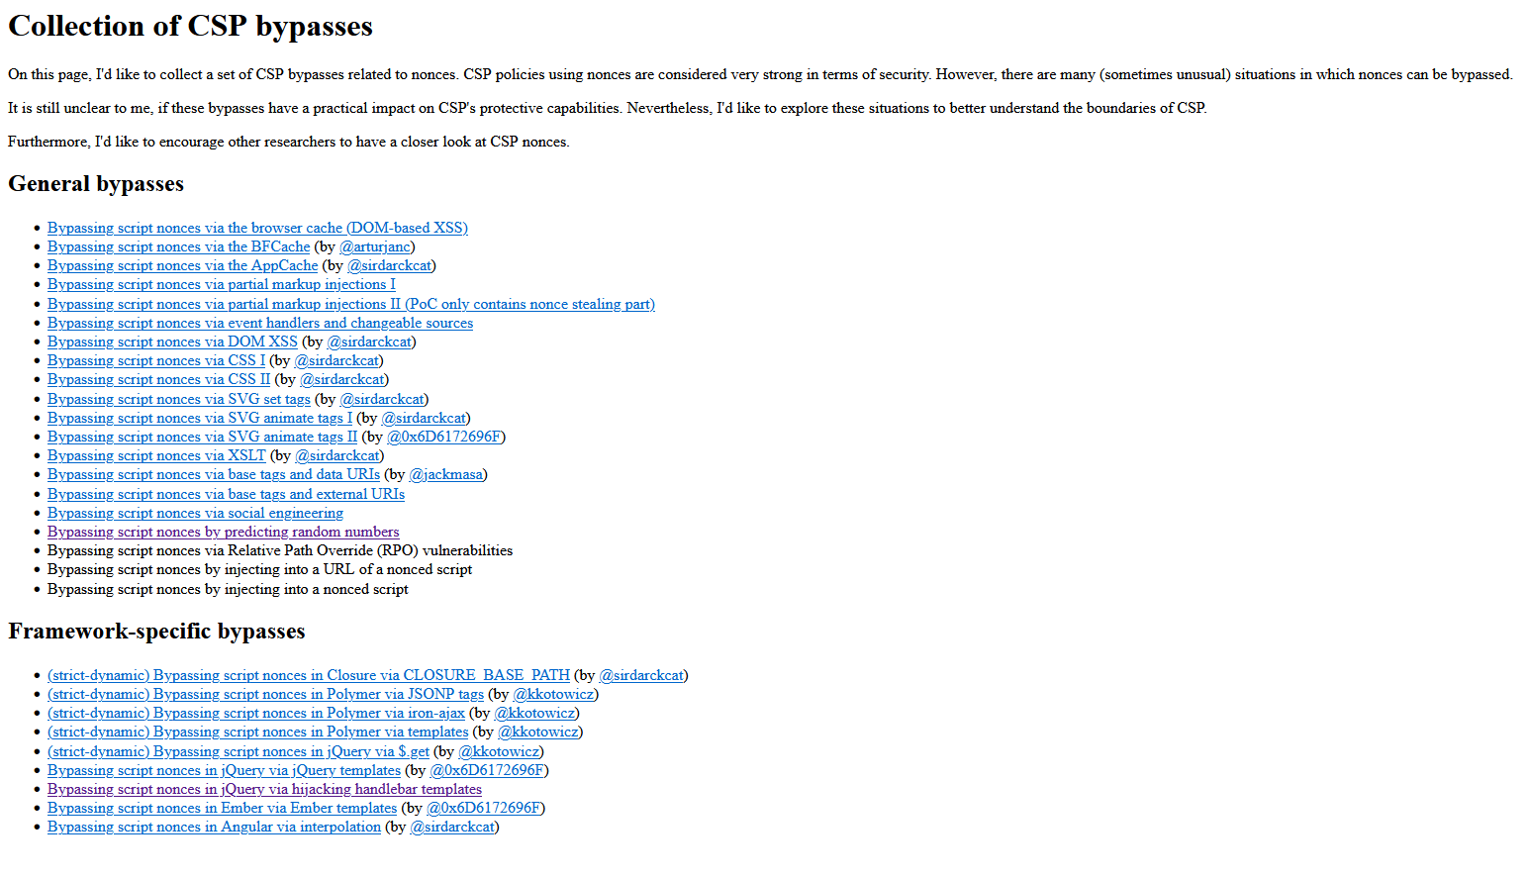
Many nonce bypasses
http://sebastian-lekies.de/csp/bypasses.php

Slide 8
The Policy Maker Project
Detect every piece of malicious JavaScript
Create the strictest policy possible
Occasionally remove sources
Stay Report Only forever
Do not interfere with user experience
Updates itself

Slide 9
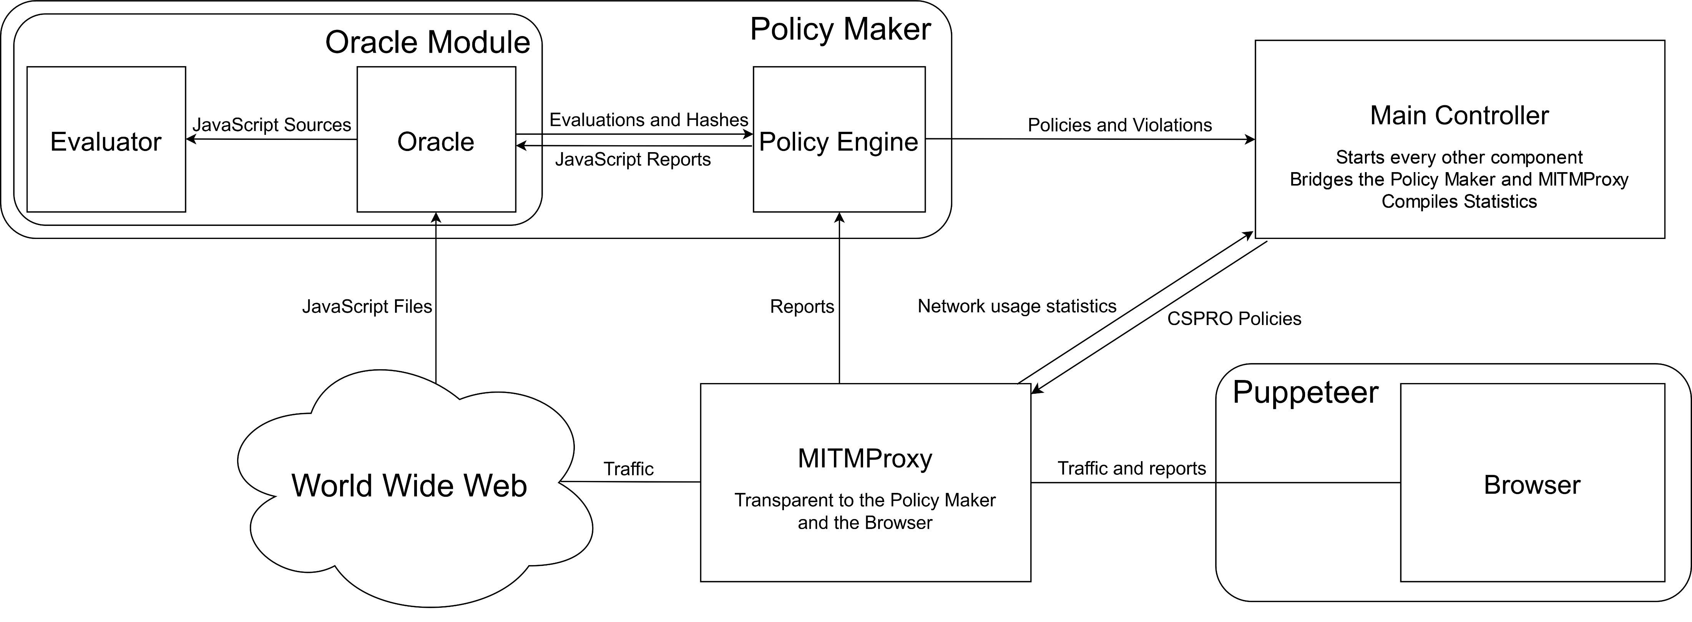
Project Structure

Slide 10
DEMO

Slide 11
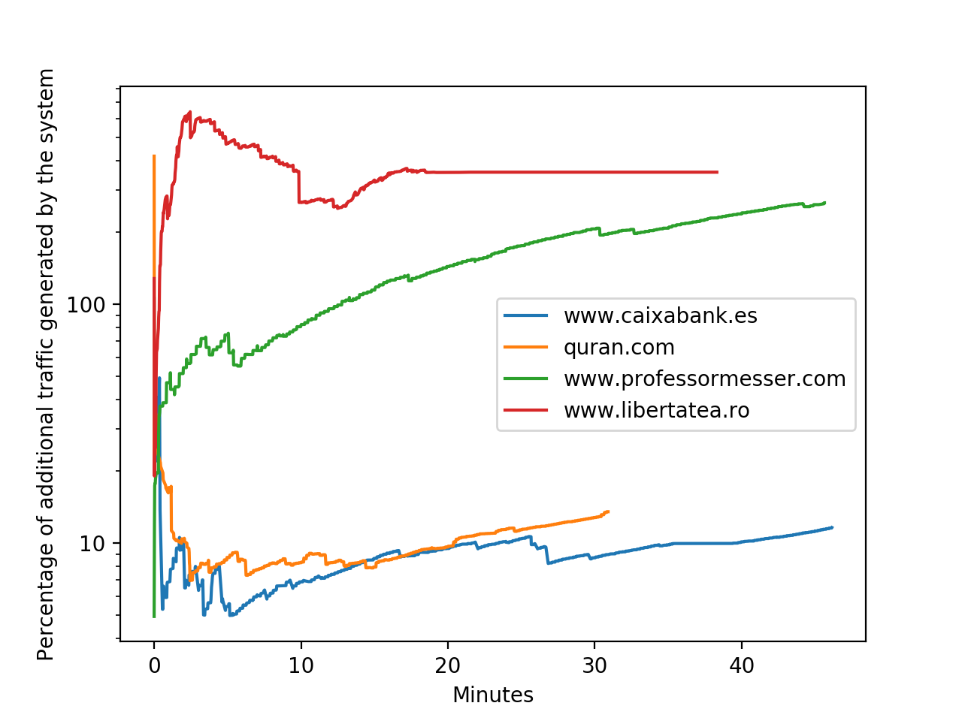
Longer Experiments
Crawl 171 websites
Estimate the impact to the server and the user

Slide 12
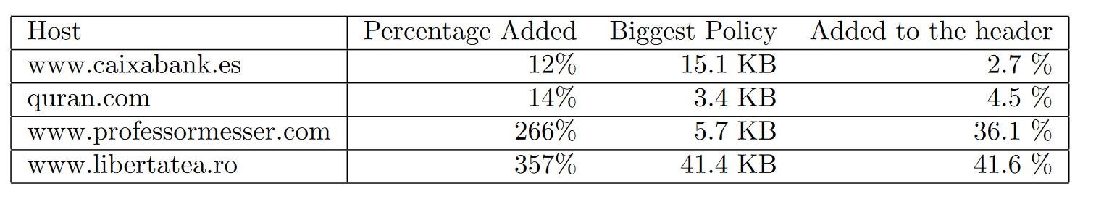
Longer Experiments
Final results

Slide 13
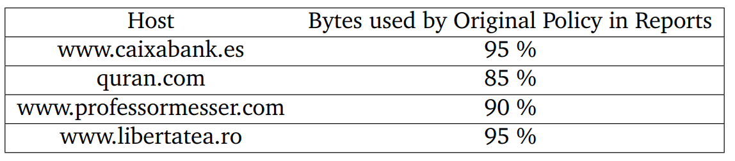
CSP Pitfalls
Reports are too big
Inability to use hashes for non-inline script elements
Lack of hashes in the reports

Slide 14
Future work
More testing / Real life deployment
Securing iframes and styles
Improving the Evaluator

