Slide 1
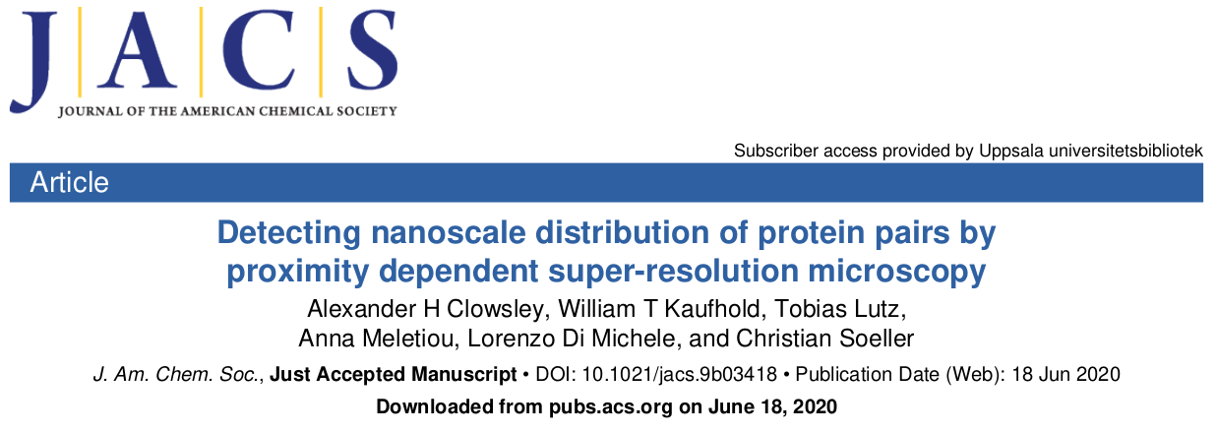
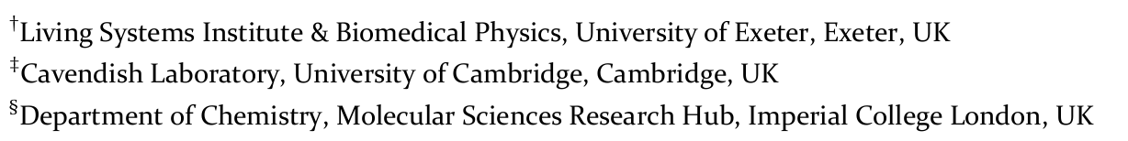
Journal Club – Optics
07/07/2020
https://doi.org/10.1021/jacs.9b03418

Slide 2
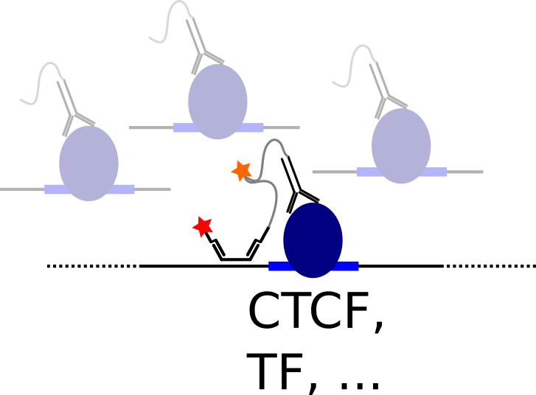
Why I picked that paper
label DNA binding protein (CTCF, TF, …) by proximity to Oligopaint FISH probe
genomic specificity
remove “background” from other binding sites

Slide 3
Scope/Claim
“Characterizing protein interactions by detection of protein-protein complexes is the basis of understanding many processes in biology.”
“Fluorescent super-resolution techniques: unequivocal identification of protein-protein pairs is complicated by the fact that co-localization can be prone to false-positive signals, as the precision of co-localization is directly dependent on the local imaging resolution.”
proximity-sensitive super-resolution imaging
Proximity-Dependent PAINT (PD-PAINT)
“enables detection of the presence and characterization of the local density and nanoscale distribution of protein-protein complexes”

Slide 4
Method
two proteins of interest are labeled with DNA constructs, which are designed to interact when in molecular proximity, and as a result allow for a DNA-PAINT signal to be detected. One construct includes a DNA-PAINT docking sequence, which however is protected by a stable DNA stem loop structure, rendering the docking site effectively inaccessible. If the second target is within a distance of approximately 10 to 20 nm (depending on the specific design, see below), the second DNA construct associated with it can displace the stem of the hairpin, thereby unfolding the loop, fully exposing the docking site, and enabling DNA-PAINT imaging of the structure.

Slide 5
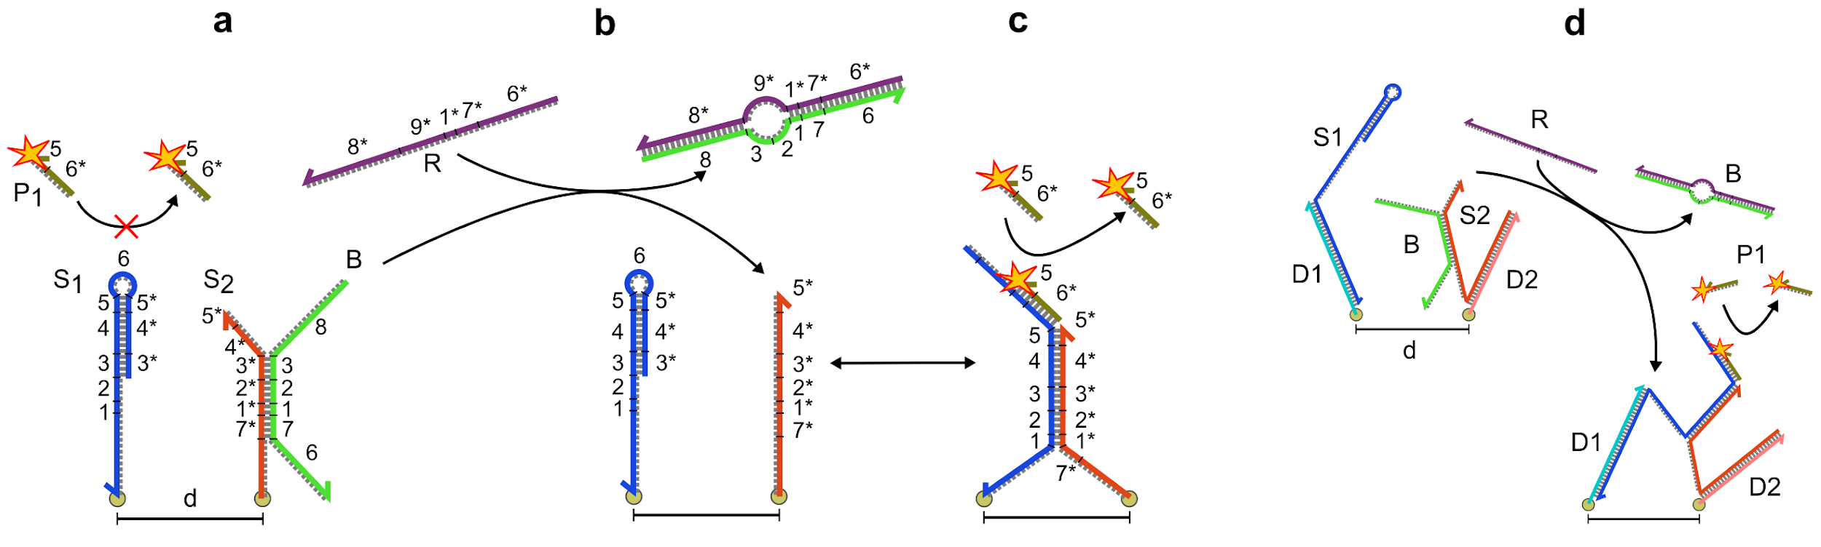
Method
S1 forms a stem loop structure which prevents imagers (P1) binding to the docking domain (5*-6)
shield strand B in order to prevent unwanted S1-S2 dimerization during the sample functionalization stages.
shield remover R
two designs: 10nm (a-c) and 20nm cutoff (d)

Slide 6
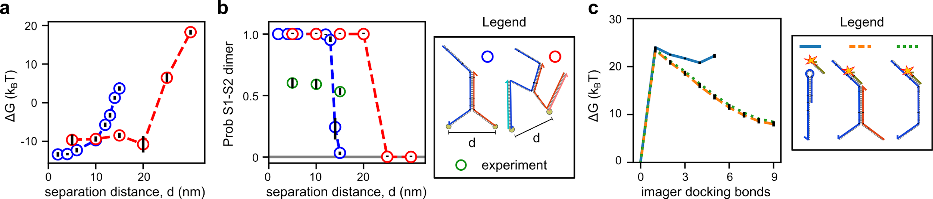
Method Validation
coarse-grained simulation
“simulations are found to overestimate the experimental dimerization probability”
experiment (green marker in panel b)
20nm cutoff design (???)
there are at least 2 data points missing to make it useful

Slide 7
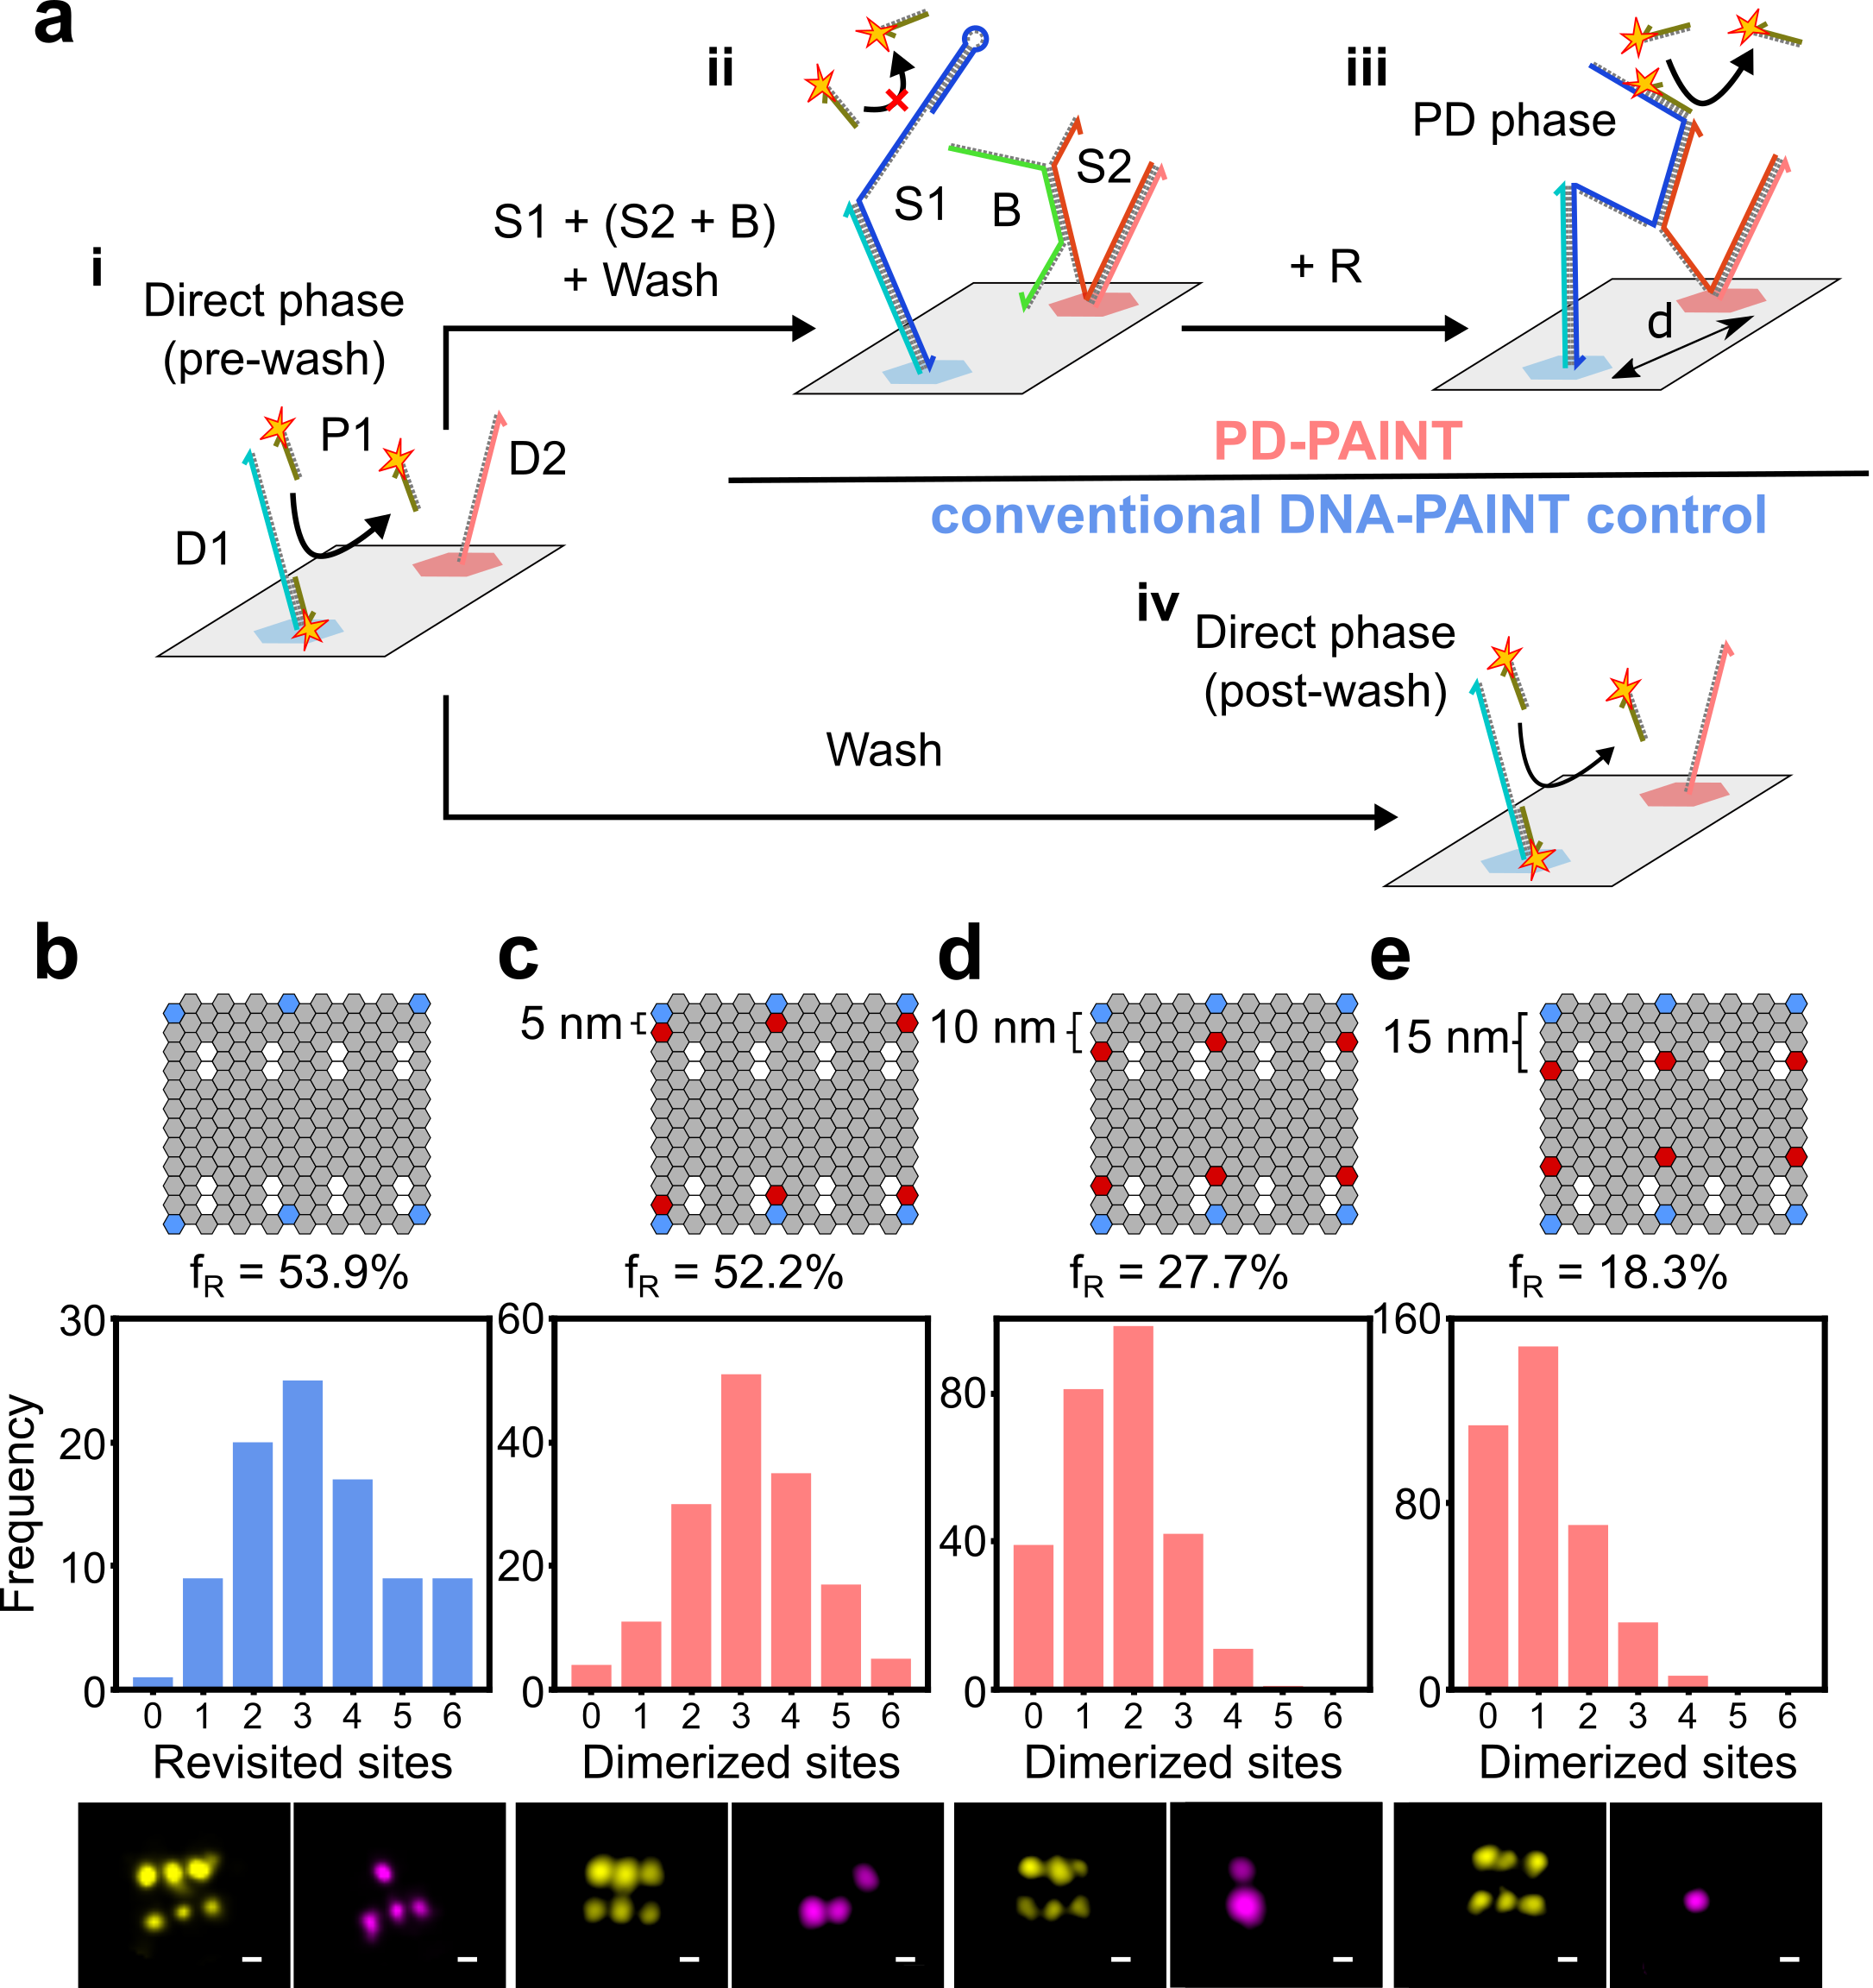
Method Validation
b) is control: image normally, wash, image normally. => only ~54% of the sites are recovered.
“Progressive site loss is expected for DNA-PAINT and has been previously documented”
increasing the distance (c-e) => lower recovery as no hybridization possible anymore
but it seems to be not a very steep transition?
this is supposed to be the 20nm cutoff design (???)

Slide 8
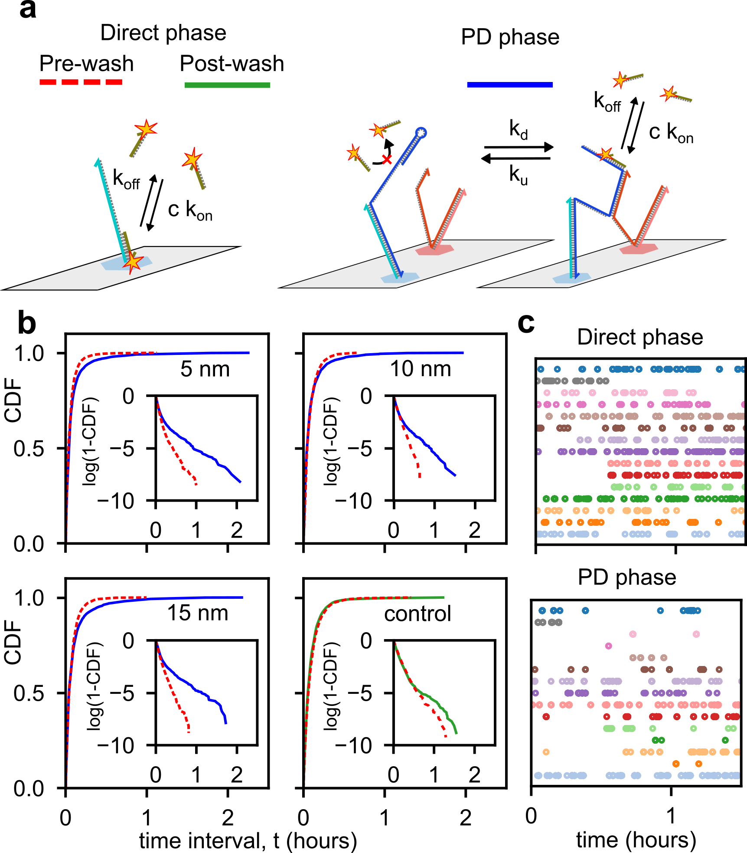
Method Validation
dark time histograms
long dark times for PD-PAINT as S1-S2 hybrid unfolds
how long from removal strand B to first blinking events? -> Supp, but not online (yet)
what’s with the “ON” time histograms?
how much less detections per time than the standard PAINT?

Slide 9
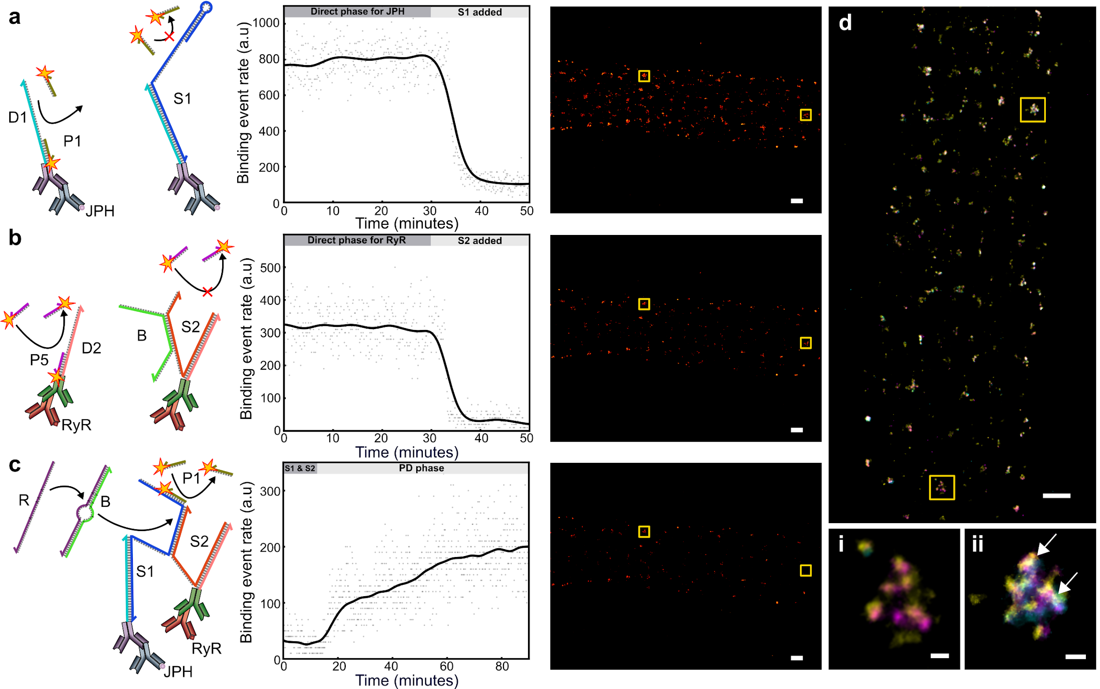
Results
two cardiac proteins (JPH and RyR), each tagged with primary and secondary AB
hybridization of S1-S2 takes more than an hour (c, right)
in d)-i JPH: yellow, RyR: magenta; no co-localization
in d)-ii white spots correspond to JPH + RyR + co-localization
frame numbers: 30k or 60k frames
100nm
100nm

Slide 10
Conclusion
nice idea: proximity detection is decoupled from the imaging resolution
“especially important in biological cell and tissue samples where the achievable resolution can vary greatly due to refractive index inhomogeneities and related optical challenges”
a lot of validation missing

Slide 11
Application

Slide 12
Limitations

Slide 13
Pros/Cons/Missing

