Slide 1
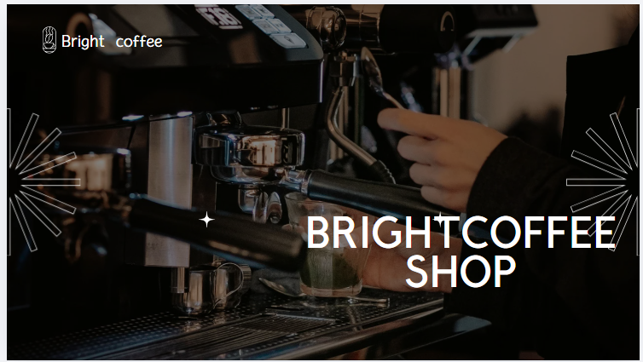

Slide 2
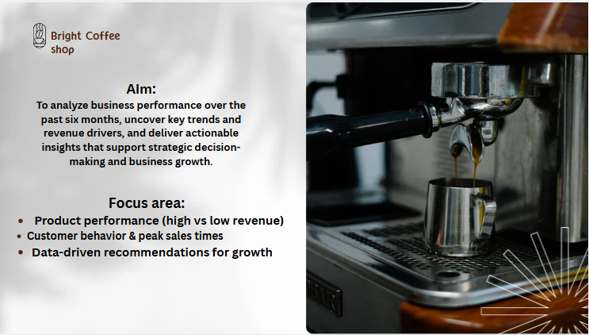

Slide 3
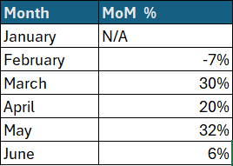
Consistent growth across locations
After a 7% decline in February, the business experienced a strong and sustained recovery, with peak growth of 32% in May, before momentum began to slow in June (6%), signaling a potential stabilization phase.

Slide 4
Revenue Performance by Day
Sales are heavily concentrated on weekdays, accounting for 72% of total revenue, highlighting strong weekday demand and an opportunity to boost weekend performance through targeted promotions and events.

Slide 5
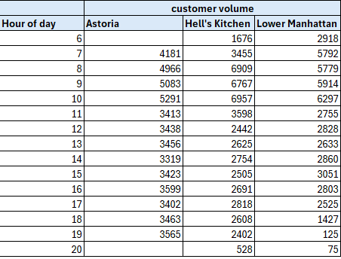
Demand Skews Heavily Toward Morning Hours
Mornings drive peak revenue, while afternoons and evenings lag.
Happy hour specials and evening events can boost off-peak sales and balance daily traffic

Slide 6
Product Category Performance
Low-selling categories can boost revenue when bundled with top sellers and promoted strategically.
Premium niches like coffee beans and Drinking Chocolate drive strong revenue despite low sales, so we should invest in both top sellers and high‑value niches to boost profit.

Slide 7
Recommendations
Implement targeted February promotions or loyalty incentives to counter seasonal sales dips
Turn weekend slowdowns into revenue wins with targeted promotions, events and special offers.
Offer deals and events in slow afternoons and evenings to bring in more customers and increase sales
Invest in top sellers and high-value niches like coffee beans and drinking chocolate to maximize profit.
Bundle low-performing categories with top sellers and run targeted promotions

