Slide 1







Two Weeks of Attacks on a Three-Cloud T-Pot Honeynet
TU DUBLIN | SCHOOL OF INFORMATICS & CYBERSECURITY
MACSH6011 | INCIDENT REPORT
Kassim Nomaan Sayad | A00083522
MACSH6011 Network Security | Lecturer: Mark Lane
Technological University Dublin
Notes:
TIME PLAN for the short deck (spoken at about 150 words a minute). Full talk: about 6 min 55 s. slide 1: 15 s, slide 2: 40 s, slide 3: 25 s, slide 4: 50 s, slide 5: 30 s, slide 6: 55 s, slide 7: 45 s, slide 8: 20 s, slide 9: 35 s, slide 10: 20 s, slide 11: 35 s, slide 12: 45 s. Slides 11 and 12 lead into the live demo. The last three slides are backup and are not spoken.
SAY THIS (about 15 seconds, 39 words): Hi, I'm Kassim. For my Network Security project I ran a T-Pot honeynet on three clouds for about two weeks. I'll show you what attacked it, how I worked out which attacks were really malicious, and what surprised me.

Slide 2

What I found, in one slide
1,257,851
19,336
38%
91 h
honeypot events in about 15 days
different source addresses
of events came from just 10 addresses
of data lost to a default daily reboot
Cowrie took about 50% of events
Banatsync led with 82 quiet addresses
The reputation tools did not agree
Mostly because my two sensors ran little else
Spread, not strength: its busiest address logged only 17,994 events
SANS ISC scored 9 of the top 10 as 0, but three other tools flagged all four I checked
My conclusion: a honeynet is both a learning tool and a security tool.
Notes:
SAY THIS (about 40 seconds, 94 words): Here's the whole project on one slide. In about fifteen days my honeynet logged 1,257,851 events from 19,336 addresses, and just ten addresses made 38% of them. Cowrie, the fake SSH server, took about half of all events, mostly because my two sensors ran little else. The top network, Banatsync, got there with 82 quiet addresses, not one loud one. The reputation tools didn't agree with each other. And a default setting cost me 91 hours of data. So my conclusion is that a honeynet is both a learning tool and a security tool.
IF YOU HAVE MORE TIME: A quick note on what an event is. One failed login, one connection and one session each count as an event, so I count events, not attacks, and I say so in the report.

Slide 3
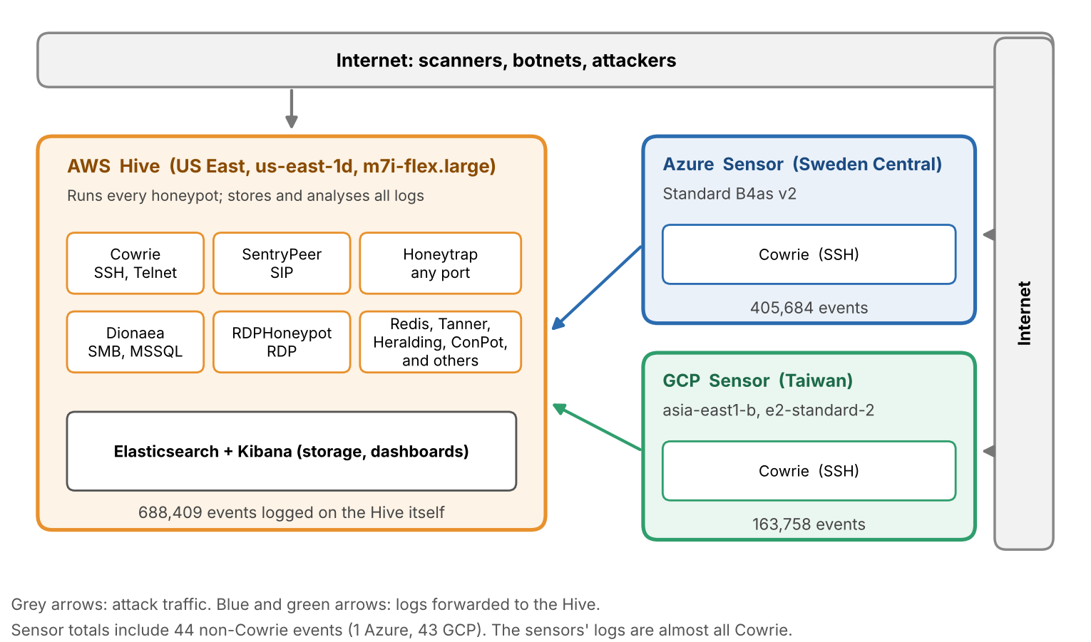


My setup: one Hive, two sensors, three clouds
Hive: AWS us-east-1d
m7i-flex.large, 2 vCPU, 8 GiB. 688,409 events
Sensor: Azure, Sweden Central
Mostly Cowrie. 405,684 events
Sensor: GCP, asia-east1-b
Mostly Cowrie. 163,758 events
My one weak spot
The Hive had 8 GB of RAM. T-Pot recommends 16 GB.
Notes:
SAY THIS (about 25 seconds, 65 words): Quick look at the setup. I used T-Pot, which is a bundle of honeypots with Suricata, p0f, Elasticsearch and Kibana. The Hive on AWS runs the honeypots and stores all the logs. Two sensors, one on Azure and one on GCP, mostly run Cowrie and send their logs to the Hive. One weak spot: the Hive had 8 GB of RAM, and T-Pot recommends 16.
IF YOU HAVE MORE TIME: The Hive logged 688,409 events, Azure 405,684 and GCP 163,758. The data runs from 17 October 00:00 to 31 October 20:00 UTC, which is 356 hours. The report says the 8 GB may explain some of the Suricata noise I show later.

Slide 4
How I decided they were malicious
109.198.192.113
Rostelecom, Russia: the top address
194.50.16.198
Alsycon B.V., Amsterdam
Banatsync Srl
82 addresses, the top network
WHAT IT DID
WHAT IT DID
WHAT IT DID
143,622 events in one day. 28,724 failed root logins on the SSH honeypot, often with a different password.
102,557 events in 3 days, across 15 types of honeypot. Mostly Redis, printing and mail ports.
56,722 SSH connections from a Go client. One password guess each, then it hung up.
WHY I CALL IT MALICIOUS
WHY I CALL IT MALICIOUS
WHY I CALL IT MALICIOUS
GreyNoise: SSH Bruteforcer. AbuseIPDB 88%. Looks like a hacked mail server (my guess).
AbuseIPDB 100%. GreyNoise: FortiOS CVE-2018-13379 and a Python client. SANS: two threat feeds, linked to Mirai-labelled articles.
Two addresses checked: AbuseIPDB 100%, VirusTotal 13 of 92, GreyNoise malicious. DShield list had one block at number 1.
WHAT IT GAINED
WHAT IT GAINED
WHAT IT GAINED
Nothing. No login worked.
Nothing. The honeypots only pretend.
Almost nothing. 184 logins, one uname command each.
Notes:
SAY THIS (about 50 seconds, 127 words): I called an address malicious when three things pointed the same way: what it did on my honeypots, what the reputation tools said, and who owned it. The top address, from Rostelecom, made 28,724 failed root logins in about twelve hours. GreyNoise tags it as an SSH bruteforcer, and it looks like a hacked mail server, though that part is my guess. Alsycon, in Amsterdam, is the one I would label malicious with the most confidence: 102,557 events across 15 types of honeypot, AbuseIPDB at 100%, and two threat feeds linked to articles labelled Mirai. Banatsync was the quiet one: one guess per connection from a Go client, and a DShield block list entry. In all three cases the attackers gained nothing, because the honeypots only pretend.
IF YOU HAVE MORE TIME: For the top address, a ban would work because it was noisy and stopped after one day, but the tools give its range as a /22, a /21 and a /19, so a broad Rostelecom ban would hit real customers. For Alsycon, Shodan shows CentOS with OpenSSH 7.4 and Apache 2.4.6, which I think is the old CentOS 7, but I did not verify that. For Banatsync I checked two of its addresses in the six tools.

Slide 5

The reputation tools did not agree
ABOUT THE TOOLS
Shown by: SANS ISC, AbuseIPDB, VirusTotal, GreyNoise, IPinfo and Shodan (Table 1, Figs. 11 to 14)
Tool | 109.198.192.113 Rostelecom | 194.50.16.198 Alsycon | 109.160.32.200 Banatsync | 77.239.124.47 Banatsync
AbuseIPDB | 88%, 32 reports | 100%, 47,988 reports | 100%, 6,154 reports | 100%, 3,468 reports
VirusTotal | 4 of 92 vendors | 11 of 92 | 13 of 92 | 13 of 92
GreyNoise | Malicious | Malicious | Malicious | Malicious
SANS ISC risk | 0 | 1 | 0 | 0
Checked 1 November 2026. IPinfo and Shodan gave ownership and open services (Figs. 11 to 14).
SANS ISC: 9 of 10 scored 0
Three tools flagged all four
Countries differed for 4 of 10
A score of 0 only means nobody reported the address
AbuseIPDB 88 to 100%, VirusTotal 4 to 13 of 92, GreyNoise malicious
T-Pot and SANS gave different countries
Notes:
SAY THIS (about 30 seconds, 79 words): This is why I never rely on one reputation tool. SANS ISC gave nine of my top ten addresses a score of 0, even though each sent between 17,897 and 143,622 events. For four addresses I added AbuseIPDB, VirusTotal and GreyNoise, and they flagged all four: AbuseIPDB 88 to 100%, VirusTotal 4 to 13 vendors out of 92, and GreyNoise malicious. A zero only means nobody reported it. The tools measure different things, so they can all be right.
IF YOU HAVE MORE TIME: Only 194.50.16.198 got a 1 at SANS. SANS gathers firewall logs from volunteers, AbuseIPDB scores abuse reports, VirusTotal counts the vendors that flag an address, and GreyNoise says who is scanning the internet. Even the country disagreed for four of the ten addresses between T-Pot and SANS.

Slide 6
Suricata: 5 in 6 alerts were noise
ABOUT THE TOOLS
Shown by: Suricata, counted with my script whole.py ids (Figs. 15 and 16)
Top alerts once the decoder noise is removed
13,689,578
Suricata entries in all
5,699,488
of them were alerts
4,835,236
Generic Protocol Command Decode: 84.8% of the alerts
Why it is interesting: these alerts are about packet capture, not attackers. Do not count alerts as attacks.
Notes:
SAY THIS (about 55 seconds, 132 words): First, a finding about a tool. Suricata is the intrusion detection system inside T-Pot. It logged 13.7 million entries, and 5.7 million of them were alerts. But 84.8% of those alerts, about 4.8 million, were one category called Generic Protocol Command Decode. That is not an attacker. It mostly comes from three decoder rules about truncated packets and gaps in the stream, so it points to a capture problem on my side. T-Pot recommends 16 gigabytes of RAM and my Hive had 8, which is a possible reason but not proven. With the noise removed, the top alerts are ICMP ping, a python-requests client, RDP traffic, the DShield block list and DoublePulsar. If I had counted every alert as an attack, my number would have been more than six times too big.
IF YOU HAVE MORE TIME: DoublePulsar is the backdoor linked to the MS17-010 SMB flaw, but an alert only means the traffic matched the rule, not that a machine was hacked. The chart names are shortened from Suricata's own signature names, which are in Fig. 15.
IF ASKED, what is Generic Protocol Command Decode? It is a Suricata alert category for packets it could not decode properly. In my data it came mostly from three decoder rules about truncated packets and stream gaps.

Slide 7
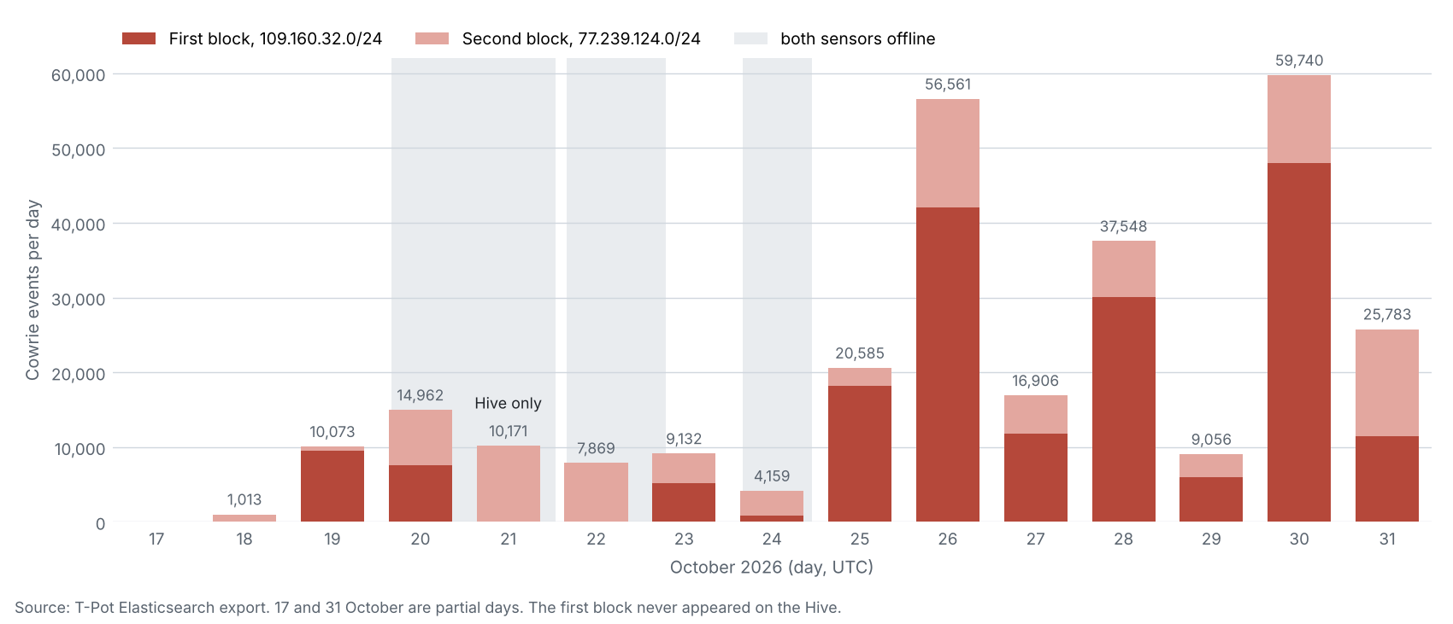
Banatsync: 82 quiet addresses
ABOUT THE ATTACKERS
Shown by: Kibana, extra.py banat and the Cowrie logs (Figs. 8, 18 to 20)
56,722
184
1
SSH connections from two blocks
got in (Cowrie lets some through)
command, run once: uname -s -v -n -r -m
A Go client (banner SSH-2.0-Go) made one password guess, then hung up
They tried root, ubuntu and admin with 123456, 123 and 1234
What they learned: only my honeypot's made-up system details
What they lost: their cover. No address made more than about 1,200 connections a day, but one banner, one command and one habit link them
Registered to other hosting firms, so Banatsync looks like a network that carries rented servers (my guess)
Banatsync events per day, by block
109.160.32.0/24: 38,068
77.239.124.0/24: 18,654
The DShield list had 77.239.124.0/24 at number 1 on 1 November
Notes:
SAY THIS (about 45 seconds, 118 words): Banatsync is my favourite finding. Two address blocks made 56,722 SSH connections, using a Go client, one password guess each, and then hanging up. Only 184 got in, because Cowrie lets some guesses through on purpose, and each of those ran one uname command and left. So all they learned was my honeypot's made-up system details. But they lost their cover. No address made more than about 1,200 connections a day, yet one banner, one command and one habit link them, and the DShield block list had one of the blocks at number one. It's the quiet kind of attack: harmless on its own, obvious as a network. The next slide shows which tool showed me each part.
IF YOU HAVE MORE TIME: The blocks are 109.160.32.0/24 with 38,068 connections and 77.239.124.0/24 with 18,654. IPinfo shows two of its addresses are routed by Banatsync but registered to two other hosting firms, so I read Banatsync as a network that carries rented servers. That part is my guess. If someone asks about 80 versus 82 addresses: the report says one banner, one command and one habit link 80 addresses, and Fig. 8 counts 82 addresses in the whole network. I use the script's network total of 82 and I did not chase the difference of two.

Slide 8
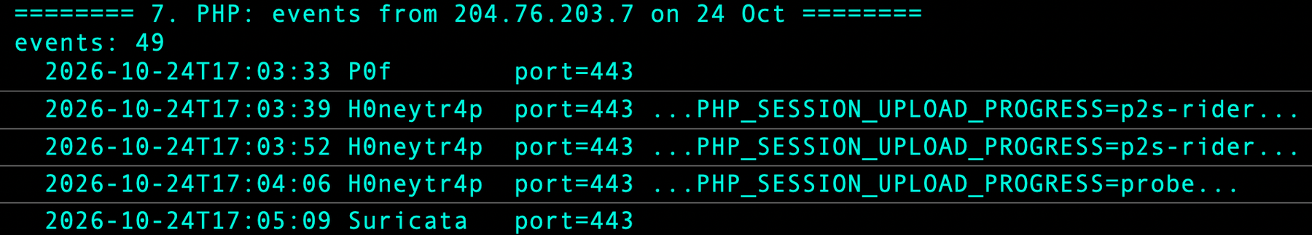
PHP2Shell: three probes, not an attack
ABOUT THE ATTACKERS
Shown by: a search of the web-honeypot events in Elasticsearch (Fig. 24)
3 of 336,511
Akamai reported PHP2Shell on 20 October
I searched for its first request: PHP_SESSION_UPLOAD_PROGRESS
All three came from 204.76.203.7 on 24 October, around 17:03 UTC
That looks like testing, not an attack
web-honeypot events had the PHP2Shell marker
Events from 204.76.203.7 on 24 October
A new vulnerability in the news did not mean a wave of attacks on my honeypots.
Notes:
SAY THIS (about 20 seconds, 46 words): PHP2Shell was the newest thing I could check. Akamai reported it on 20 October, so I searched my 336,511 web honeypot events for its first request. Only three events had it, all from one address on 24 October. That looks more like testing than an attack.
IF YOU HAVE MORE TIME: The first request contains PHP_SESSION_UPLOAD_PROGRESS. The three requests came from 204.76.203.7 at around 17:03 UTC. The screenshot at the bottom is that address's events on 24 October.
IF ASKED, was it a real attack? I cannot tell. Three requests from one address look more like tests than an attack.

Slide 9
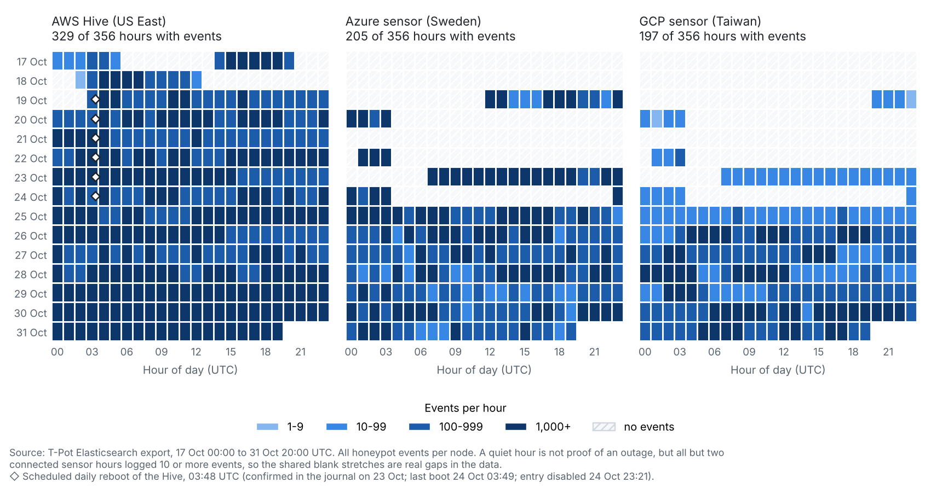
A default setting cost me 91 hours of data
ABOUT THE TOOLS
Shown by: T-Pot's default daily reboot, my crontab edit and events per hour per node (Fig. 25, Listing 1)
Both sensors went silent together at 04:00 UTC
45 h
27 h
19 h
20 Oct
22 Oct
24 Oct
45 + 27 + 19 = 91 hours
THE FIX
On 24 Oct at 23:21 I commented out the Hive's daily reboot line in root's crontab. The sensors came back that hour and stayed up.
Events per hour per node (Fig. 25). Below: the commented-out reboot line and my edit (Listing 1)
Azure logged 205 of 356 hours, GCP 197
Likeliest cause, not proven: I did not check the sensors' own crontabs
The gaps weaken first-seen dates and node comparisons
#48 3 * * * bash -c 'systemctl stop tpot.service && ...; /usr/sbin/shutdown -r +1 "T-Pot Daily Reboot"'
Oct 24 23:21:34 crontab[571658]: (root) REPLACE (root)
Notes:
SAY THIS (about 35 seconds, 88 words): This one is my own mistake, and it's a good lesson. T-Pot adds a daily reboot by default. Both sensors went silent together on 20, 22 and 24 October, for 91 hours in all. On 24 October I fixed it on the Hive by commenting out the reboot line in root's crontab, and after that there were no more gaps. I didn't check the sensors' own crontabs, so the reboot is the likeliest cause, but it's not proven. It weakens my first-seen dates and the comparison between nodes.
IF YOU HAVE MORE TIME: On the Hive the reboot ran at 03:48 UTC until I commented it out at 23:21 on 24 October. The sensors went silent at 04:00 on 20, 22 and 24 October, for 45, 27 and 19 hours. Azure logged in only 205 of 356 hours and GCP in 197. It is also a security lesson: a default setting I did not read cost me data.
IF ASKED, how did you stop the reboot? I ran sudo crontab -e on the Hive and put a # in front of the T-Pot Daily Reboot line at 23:21 on 24 October. The sensors came back in the 23:00 hour and there were no gaps after that. I did not check the sensors' own crontabs, so the cause is likely, not proven.

Slide 10
Conclusion
A honeynet is a good learning tool, and a source of local blocklists, if its numbers are read carefully.
1,257,851
19,336
91 h
events
addresses
of data lost
Scripts and extra screenshots
github.com/NomaanS/Tpot
Next: live demo
Notes:
SAY THIS (about 20 seconds, 54 words): To finish: 1,257,851 events, 19,336 addresses, about 15 days. A honeynet is a good learning tool, and a source of local blocklists, if its numbers are read carefully. My scripts and extra screenshots are on GitHub. Now I'll show you the dashboards and run the scripts live. Thanks, and I'm happy to take questions.

Slide 11
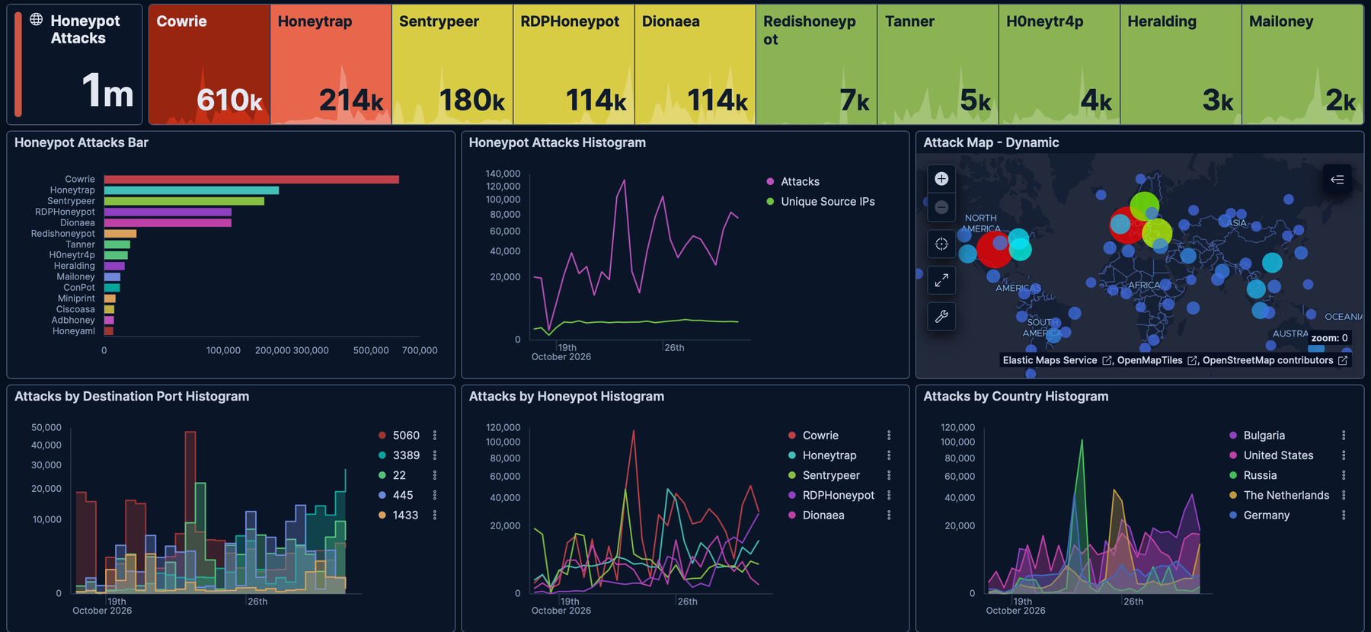
Live demo: the Kibana dashboard
TOP ROW
Events per honeypot: Cowrie 610k, Honeytrap 214k, SentryPeer 180k.
PORTS
5060 (SIP), 3389 (RDP), 22 (SSH), 445 (SMB), 1433 (SQL Server).
COUNTRIES
Bulgaria, United States, Russia. GeoIP labels, which I found unreliable.
Kibana is good for the overview.
It only shows top 10 tables and cuts long cells, so for the detail I wrote two read-only scripts.
TIME RANGE
17 to 31 October 2026. Set it first when showing Kibana live.
Notes:
SAY THIS (about 35 seconds, 86 words): Now the demo. This is the Kibana dashboard that T-Pot gives you, with my whole fifteen days. The top row counts events per honeypot: Cowrie 610 thousand, Honeytrap 214 thousand, SentryPeer 180 thousand. The port panel shows 5060, 3389, 22 and 445, which are internet phone calls, remote desktop, SSH and file sharing. The country panel is the GeoIP label, which I found unreliable. Kibana is great for the overview, but it only shows top ten tables, so for the detail I wrote two read-only scripts.
IF YOU HAVE MORE TIME: Before showing the live Kibana, set the time range to 17 to 31 October 2026, otherwise the numbers will not match my report. The same panels are in Figs. 3 to 5 of the report.
IF ASKED, why do Kibana and your script give different totals for a network? They group networks differently, so a few totals differ (Figs. 4 and 8 in the report). I use the script's totals.

Slide 12
Live demo: my own dashboard
1,257,851
19,336
38%
91 h
events in about 15 days
different source addresses
of events from just 10 addresses
of data lost to a daily reboot
Events by honeypot
Busiest ports
Top networks
Where the events were logged
Hive (AWS)
688,409 (55%)
Azure
405,684 (32%)
GCP
163,758 (13%)
Notes:
SAY THIS (about 45 seconds, 114 words): This is my own dashboard. It shows the same data as Kibana on one screen, in the order of my talk. The top row is the headline: 1,257,851 events from 19,336 addresses, the top ten addresses made 38%, and 91 hours of data were lost. The three charts show what was attacked, which ports, and who attacked. Cowrie is first because of my design, port 5060 is first because a few addresses sent most of the SIP traffic, and Banatsync is the top network with 82 quiet addresses. The bar at the bottom shows where the events were logged: the Hive 55%, Azure 32% and GCP 13%. Now I'll switch to the live demo.
IF YOU HAVE MORE TIME: Every number here comes from my scripts and the report, Figs. 6 to 9. This slide is a picture of those numbers, not a live tool, so the live numbers come from Kibana and from whole.py and extra.py.
IF ASKED, is this live? No. It is drawn from the numbers my scripts printed and that are in the report. The live ones are Kibana and the scripts.

Slide 13
Numbers to remember
1,257,851
19,336
356 h
610,494
honeypot events
source addresses
17 Oct 00:00 to 31 Oct 20:00 UTC
Cowrie events, about 50%
483,553
283,559
143,622
5,699,488
events from the top 10 addresses
Banatsync events, from 82 addresses
top address, in one day (23 Oct)
Suricata alerts, of 13,689,578 entries
148,979
56,722
91 h
8 GB
events with a username
Banatsync SSH connections, 184 logged in
of data lost (45 + 27 + 19)
Hive RAM. T-Pot recommends 16 GB
Notes:
BACKUP slide. This is the cheat sheet. Learn these twelve numbers and you can answer most questions.
1,257,851 honeypot events from 19,336 addresses over 356 hours. Cowrie 610,494, about 50%. Top ten addresses 483,553. Banatsync 283,559 from 82 addresses. Top address 143,622 in one day. Suricata 13,689,578 entries, 5,699,488 alerts. 148,979 events with a username. Banatsync SSH connections 56,722, with 184 logins. 91 hours lost, 45 plus 27 plus 19. Hive RAM 8 GB against the recommended 16 GB.

Slide 14
Scripts I can run live
whole.py: the whole two weeks
extra.py: follow-up questions
python3 whole.py hp honeypots, sensors
python3 whole.py geo countries, networks, ports
python3 whole.py creds usernames, passwords
python3 whole.py ids Suricata alerts, CVEs
python3 whole.py os p0f operating systems
python3 whole.py ips top source addresses
python3 whole.py all
python3 extra.py bynode honeypots per node
python3 extra.py ports what each port was used for
python3 extra.py banat the Banatsync network
python3 extra.py ip 109.198.192.113
Which command made which figure
hp
geo
ips
extra ip
ids
creds
extra banat
Fig. 6
Figs. 7, 8
Fig. 9
Fig. 10
Figs. 15, 16
Fig. 17
Figs. 19, 20
Notes:
BACKUP slide. For the live demo.
Both scripts are read-only. They only send search queries to the Elasticsearch that T-Pot runs on the Hive, so I run them on the Hive. They use only the Python 3 standard library.
whole.py answers questions about the whole two weeks, with modes hp, geo, creds, ids, os, ips or all. extra.py answers follow-up questions: bynode, ports, banat, or ip with one or more addresses. Both are in the GitHub repository, and the mapping at the bottom shows which command made which figure in the report.

